Slide 1
PH 0101 UNIT 1 LECTURE 5
Basics of Sound Waves
Shock Waves
Mach Number
Worked and Exercise Problems

Slide 2
Sound
Introduction and Classification:
Sound waves are mechanical, compression waves which are in general longitudinal in nature-meaning that the particles vibrate parallel to the direction of the wave’s velocity.
Sound waves are divided into three categories that cover different frequency ranges.

Slide 3
Audible waves
They are within the range of sensitivity of the human ear.
The range of human hearing stretches between 20-20000 Hertz.
They can be generated in a variety of ways, such as by musical instruments human voices, or loud speakers

Slide 4
Infrasonic waves
These waves have frequencies below the audible range, that is less than 20 Hertz.
Elephants can use infrasonic waves to communicate with each other, even when separated by many kilometers.

Slide 5
Ultrasonic waves
They have frequencies above the audible range, that is greater than 20000 Hertz.
Some animals can emit these sounds.
Bats, for example, emit and hear ultrasound waves, which they use for locating prey and for navigating.

Slide 6
Speed of sound waves
The speed of sound waves in a medium depends on the compressibility and density of the medium.
The speed of all mechanical waves follows an expression of the general form

Slide 7
The speed of sound also depends on the temperature of the medium.
For sound traveling through air, the relationship between wave speed and medium temperature is
where 331m/s is the speed of sound in air at 0°C and the T_{c} is the air temperature in degree Celsius.

Slide 8
Decibel (dB) scale
The range of sound powers and sound pressures is very wide.In order to cover this wide range while maintaining accuracy, the logarithmic decibel (dB) scale was selected.
Decibel is a dimensionless unit related to the logarithm of the ratio of a measured quantity to a reference quantity.
Sound power level is the acoustical power radiated by a source with respect to the standard reference of 10⁻¹² watts.
SPL = 10 Log (W/W_{re})
The “w” subscript identifies the fact this equation deals with power in units of watts.

Slide 9
Doppler Effect
The Doppler effect is a phenomenon observed whenever the source of waves is moving with respect to an observer.
The Doppler effect can be defined as the effect produced by a moving source of waves in which there is an apparent upward shift in frequency for the observer and the source are approaching and an apparent downward shift in frequency when the observer and the source are receding.

Slide 10
Shockwaves
Definition :
Shockwave is a wave formed of a zone of extremely high pressure within a fluid, especially the atmosphere, that propagates through the fluid at a speed in excess of the speed of sound.

Slide 11
Types
Shockwaves in supersonic flow may be classified as normal or oblique according to whether the orientation of the surface of the abrupt change is perpendicular or at an angle to the direction of flow

Slide 12
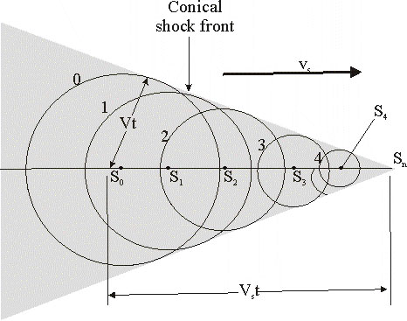
Description
Now consider what happens when the speed v_{s} of a source exceeds the wave speed v.

Slide 13
The circles represent spherical wave fronts emitted by the source at various times during its motion.
At t = 0, the source is at S₀ and at a later time t, the source is at S_{n}
At the time t, the wave front centered at S₀ reaches a radius of vt.
In this same time interval, the source travels a distance v_{s}t to S_{n}.
At the instant the source is at S_{n}, waves are just beginning to be generated at this location, and hence the wave front has zero radius at this point.
The tangent line drawn from S_{n} to the wave front centered on S₀ is tangent to all other wave fronts generated at intermediate times.

Slide 14
Thus, we see that the envelope of these wave fronts is a cone whose apex half-angle α (the “Mach angle”) is given by
The conical wave front produced when v_{s} > v (supersonic speeds) is known as a shock wave.
An interesting analogy to shock waves is the V-shaped wave fronts produced by a boat (the bow wave) when the boat’s speed exceeds the speed of the surface-water waves

Slide 15
Sonic Boom
Jet airplanes traveling at supersonic speeds produce shock waves, which are responsible for the loud “sonic boom” one hears.
The shock wave carries a great deal of energy concentrated on the surface of the cone, with correspondingly great pressure variations.
Such shock waves are unpleasant to hear and can cause damage to buildings when aircraft fly supersonically at low altitudes.
In fact, an airplane flying at supersonic speeds produces a double boom because two shock waves are formed, one from the nose of the plane and one from the tail.

Slide 16
Applications
Shock waves have applications outside of aviation.
They are used to break up kidney stones and gallstones without invasive surgery, using a technique with the impressive name extracorporeal shock-wave lithotripsy.
A shock wave produced outside the body is focused by a reflector or acoustic lens so that as much of it as possible converges on the stone.
When the resulting stresses in the stone exceed its tensile strength, it breaks into small pieces and can be eliminated.

Slide 17
Mach Number
Mach number is a dimensionless measure of relative speed.
It is defined as the speed of an object relative to a fluid medium, divided by the speed of sound in that medium.
where M is the Mach number,v is the speed of the object relative to the medium and v_{s} is the speed of sound in the medium.

Slide 18
Mach number is named after Austrian physicist and philosopher Ernst Mach.
It can be shown that the mach number is also the ratio of inertial forces (also referred to aerodynamic forces).
The square of the Mach number is Cauchy number.
M² = C, Cauchy number.

Slide 19
High speed flights can be classified in five categories
      Sonic : M = 1
      Subsonic : M<1
      Transonic : 0.8 < M < 1.2
      Supersonic : 1.2 < M<5
      Hypersonic : M > 5

Slide 20
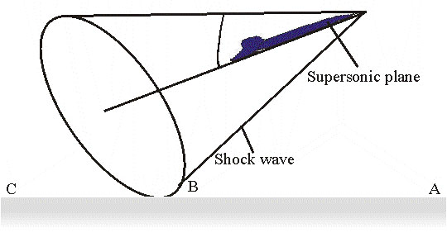
For supersonic and hypersonic flows, small disturbances are transmitted downstream within a cone as shown in Figure
The wave front is a cone with angle α called the Mach angle .

Slide 21
v
Mach number
:.
v_{s}

Slide 22
The speed of sound depends primarily on the fluid temperature around it and is given as
where T is the temperature (Kelvin), R is the gas constant of fluid and γ is the adiabatic index of the gas (that is the ratio of specific heats of a gas at constant pressure and volume).

Slide 23
For most calculations, standard air conditions are assumed and a value of γ =1.4 and R = 287 J/(kg K) are used.
The Mach number is commonly used both with objects traveling at high speed in a fluid, and with high speed fluid flows inside channels such as nozzles, diffusers or wind tunnels.

Slide 24
At a temperature of 15 degree Celsius and at sea level, Mach 1 is 340.3m/s(1,225 km/h) in the Earth’s atmosphere.
The speed represented by Mach 1 is not a constant, it is temperature dependent.
Hence in the stratosphere it remains about the same regardless of height, though the air pressure changes with height.

Slide 25
Critical Mach number
A critical mach number is the speed of an aircraft (below Mach 1)when the air flowing over some area of the airfoil has reached the speed of sound.
For instance, if the air flowing over a wing reaches Mach 1 when the wing is only moving at Mach 0.8, then the wing’s critical Mach number is 0.8.

Slide 26
Mach Tuck
For a subsonic aircraft traveling significantly below Mach 1.0, Mach tuck is an aerodynamic effect, whereby the nose of an aircraft tends to pitch downwards as the air flow around the wing reaches supersonic speeds.

Slide 27
Mach meter
A Mach meter is an aircraft instrument that shows the ratio of the speed of sound to the true airspeed, a dimensionless quantity called Mach number.
That is, Mach meter is an aircraft instrument that indicates speed in Mach numbers.

Slide 28
Worked Example 1
An aircraft is flying at speed 370m/s at an attitude where the speed of sound is 320m/s. Calculate the Mach number
Mach number =

Slide 29
Worked Example 2
A sonic boom is heard 20.5s after the Concorde passes overhead. Assuming the Mach 1.75 and speed of sound is 320 m/s, calculate the distance traveled by the flight at this time.
Distance traveled = speed of flight × time
= (560 m/s) (20.5s)
= 11500 m

Slide 30
Worked Example 3
Determine the velocity of a bullet fired in the air if the Mach angle is observed to be 30°. Given that the temperature of the air is 22°C Take γ = 1.4 and R = 287.43 J/kg.K
T = 273.15 +22 = 295.15 K
Sonic velocity =
= 344.6 m/s
For the Mach cone, Sin α =
:.Bullet velocity = (2.0) (344.6 m/s) = 689.2 m/s

Slide 31
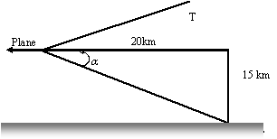
Worked Example 4
An observer on the ground hears the sonic boom of a plane 15km above when the plane has gone 20km ahead of him. Estimate the speed of flight of the plane.

Slide 32
tan α =
α = 36.87°
sin 36.87° = 0.6 = 1/M
M = 1.67
The plane must be flying at a supersonic speed corresponding to a local mach number of 1.67.

Slide 33
Exercise Problem1
An aircraft is flying horizontally at Mach 1.8 over a flat desert. A sonic boom is heard on the ground 8.1s after the aircraft has passed directly overhead. Assume the speed of sound in the air is 350 m/s. At what altitude is the aircraft flying?
Hint : Altitude = v_{s}t sinα = 283l m

Slide 34
Exercise Problem 2
A supersonic fighter plane moves with a Mach number of 1.5 in atmosphere at an altitude of 500m above the ground level. What is the time that lapses, by which the acoustic disturbance reaches an observer on the ground after it is directly overhead? Take T = 20°C, γ = 1.4 and R = 287 J/kg.K
Hint: Sonic velocity =
Time elapsed = 1.09 s

Slide 35

THANK YOU
THANK YOU

