Slide 1
MAE 3241: AERODYNAMICS AND FLIGHT MECHANICS
Overview of Shock Waves and Shock Drag
Mechanical and Aerospace Engineering Department
Florida Institute of Technology
D. R. Kirk

Slide 2
PERTINENT SECTIONS
Chapter 7: Overview of Compressible Flow Physics
  Reads very well after Chapter 2 (§2.7: Energy Equation)
  §7.5, many aerospace engineering students don’t know this 100%
Chapter 8: Normal Shock Waves
  §8.2: Control volume around a normal shock wave
  §8.3: Speed of sound
    Sound wave modeled as isentropic
    Definition of Mach number compares local velocity to local speed of sound, M=V/a
    Square of Mach number is proportional to ratio of kinetic energy to internal energy of a gas flow (measure of the directed motion of the gas compared with the random thermal motion of the molecules)
  §8.4: Energy equation
  §8.5: Discussion of when a flow may be considered incompressible
  §8.6: Flow relations across normal shock waves

Slide 3
PERTINENT SECTIONS
Chapter 9: Oblique shock and expansion waves
  §9.2: Oblique shock relations
    Tangential component of flow velocity is constant across an oblique shock
    Changes across an oblique shock wave are governed only by the component of velocity normal to the shock wave (exactly the same equations for a normal shock wave)
  §9.3: Difference between supersonic flow over a wedge (2D, infinite) and a cone (3D, finite)
  §9.4: Shock interactions and reflections
  §9.5: Detached shock waves in front of blunt bodies
  §9.6: Prandtl-Meyer expansion waves
    Occur when supersonic flow is turned away from itself
    Expansion process is isentropic
    Prandtl-Meyer expansion function (Appendix C)
  §9.7: Application t supersonic airfoils

Slide 4
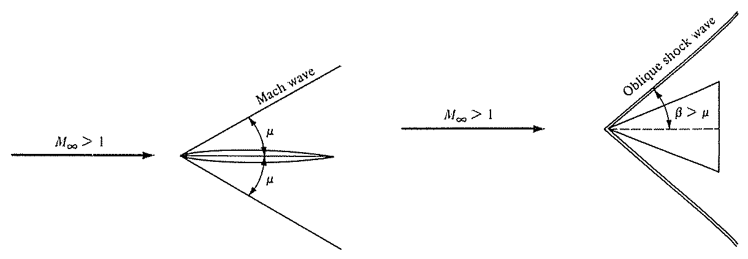
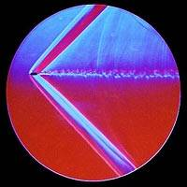
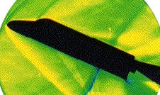
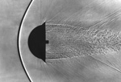
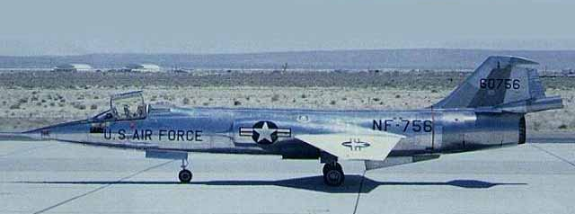
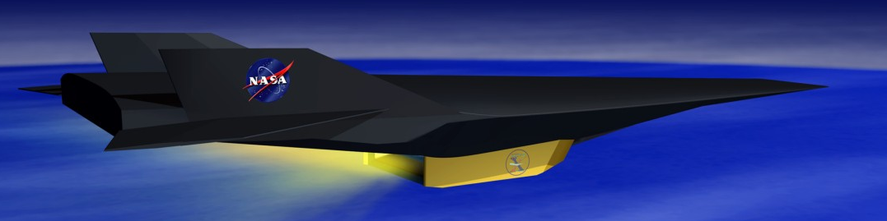
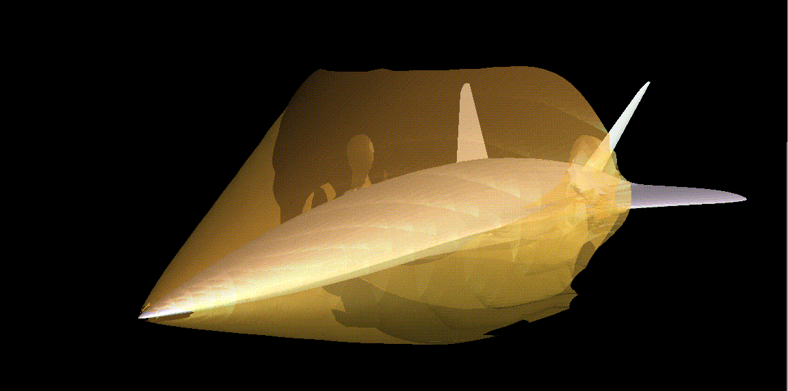
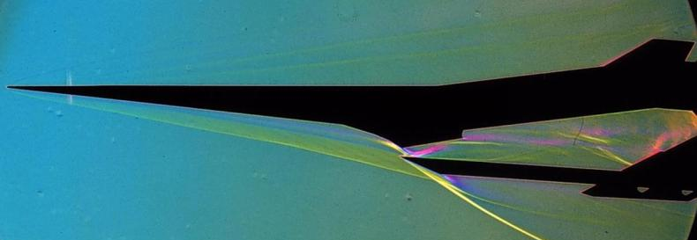
EXAMPLES OF SUPERSONIC WAVE DRAG
F-104 Starfighter

Slide 5
DYNAMIC PRESSURE FOR COMPRESSIBLE FLOWS
Dynamic pressure is defined as q = ½ρV²
For high speed flows, where Mach number is used frequently, it is convenient to express q in terms of pressure p and Mach number, M, rather than ρ and V
Derive an equation for q = q(p,M)

Slide 6
SUMMARY OF TOTAL CONDITIONS
If M > 0.3, flow is compressible (density changes are important)
Need to introduce energy equation and isentropic relations
Must be isentropic
Requires adiabatic, but does not have to be isentropic

Slide 7
NORMAL SHOCK WAVES: CHAPTER 8
Upstream: 1
M₁ > 1
V₁
p₁
ρ₁
T₁
s₁
p_{0,1}
h_{0,1}
T_{0,1}
Downstream: 2
M₂ < 1
V₂ < V₁
P₂ > p₁
ρ₂ > ρ₁
T₂ > T₁
s₂ > s₁
p_{0,2} < p_{0,1}
h_{0,2} = h_{0,1}
T_{0,2} = T_{0,1} (if calorically perfect, h₀=c_{p}T₀)
Typical shock wave thickness 1/1,000 mm

Slide 8
SUMMARY OF NORMAL SHOCK RELATIONS
Normal shock is adiabatic but nonisentropic
Equations are functions of M₁, only
Mach number behind a normal shock wave is always subsonic (M₂ < 1)
Density, static pressure, and temperature increase across a normal shock wave
Velocity and total pressure decrease across a normal shock wave
Total temperature is constant across a stationary normal shock wave

Slide 9
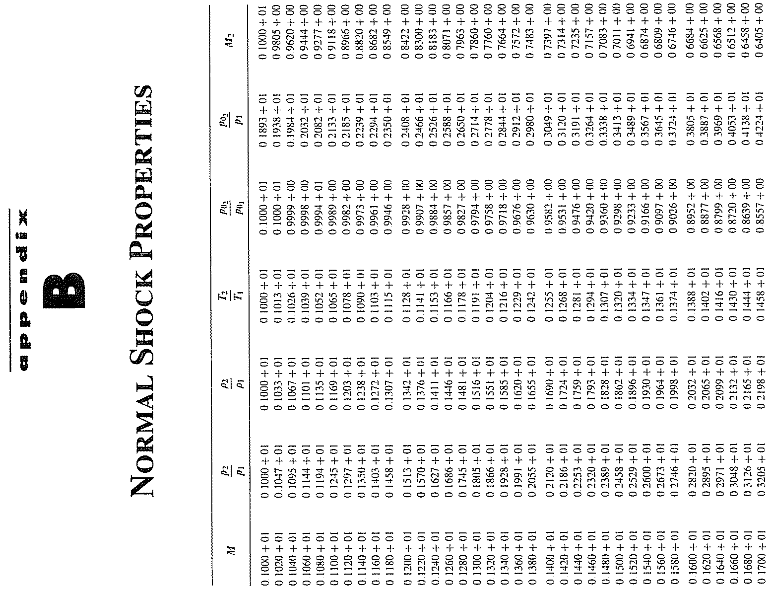
TABULATION OF NORMAL SHOCK PROPERTIES

Slide 10
SUMMARY OF NORMAL SHOCK RELATIONS

Slide 11
NORMAL SHOCK TOTAL PRESSURE LOSSES
Example: Supersonic Propulsion System
Engine thrust increases with higher incoming total pressure which enables higher pressure increase across compressor
Modern compressors desire entrance Mach numbers of around 0.5 to 0.8, so flow must be decelerated from supersonic flight speed
Process is accomplished much more efficiently (less total pressure loss) by using series of multiple oblique shocks, rather than a single normal shock wave
As M₁ ↑ p₀₂/p₀₁ ↓ very rapidly
Total pressure is indicator of how much useful work can be done by a flow
  Higher p₀ → more useful work extracted from flow
Loss of total pressure are measure of efficiency of flow process

Slide 12
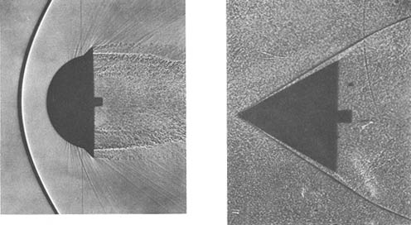
ATTACHED VS. DETACHED SHOCK WAVES

Slide 13
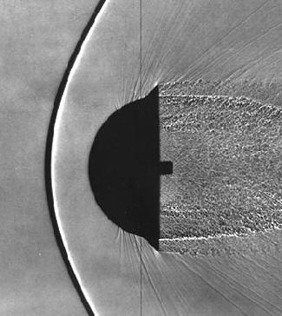
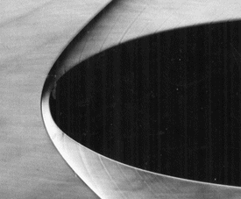
DETACHED SHOCK WAVES
Normal shock wave model still works well

Slide 14
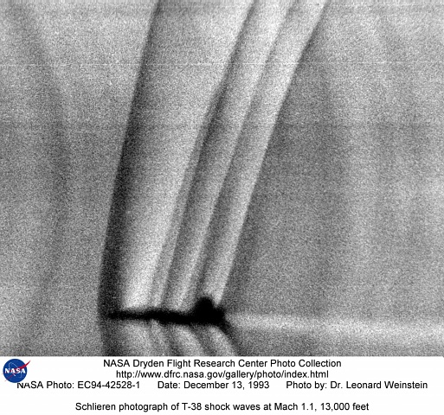
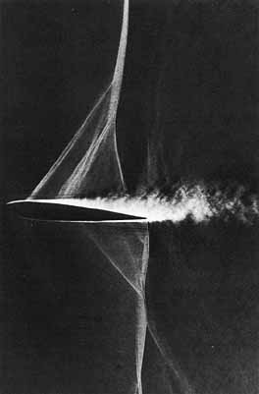
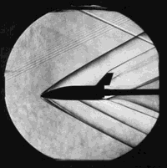
EXAMPLE OF SCHLIEREN PHOTOGRAPHS

Slide 15
OBLIQUE SHOCK WAVES: CHAPTER 9
Upstream: 1
M₁ > 1
V₁
p₁
ρ₁
T₁
s₁
p_{0,1}
h_{0,1}
T_{0,1}
Downstream: 2
M₂ < M₁ (M₂ > 1 or M₂ < 1)
V₂ < V₁
P₂ > p₁
ρ₂ > ρ₁
T₂ > T₁
s₂ > s₁
p_{0,2} < p_{0,1}
h_{0,2} = h_{0,1}
T_{0,2} = T_{0,1} (if calorically perfect, h₀=c_{p}T₀)
θ
β

Slide 16
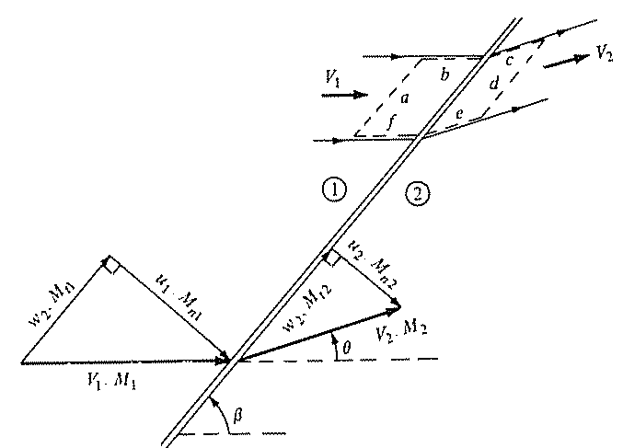
OBLIQUE SHOCK CONTROL VOLUME
Notes
Split velocity and Mach into tangential (w and M_{t}) and normal components (u and M_{n})
V·dS = 0 for surfaces b, c, e and f
  Faces b, c, e and f aligned with streamline
(pdS)_{tangential} = 0 for surfaces a and d
pdS on faces b and f equal and opposite
Tangential component of flow velocity is constant across an oblique shock (w₁ = w₂)

Slide 17
SUMMARY OF SHOCK RELATIONS
Normal Shocks
Oblique Shocks

Slide 18
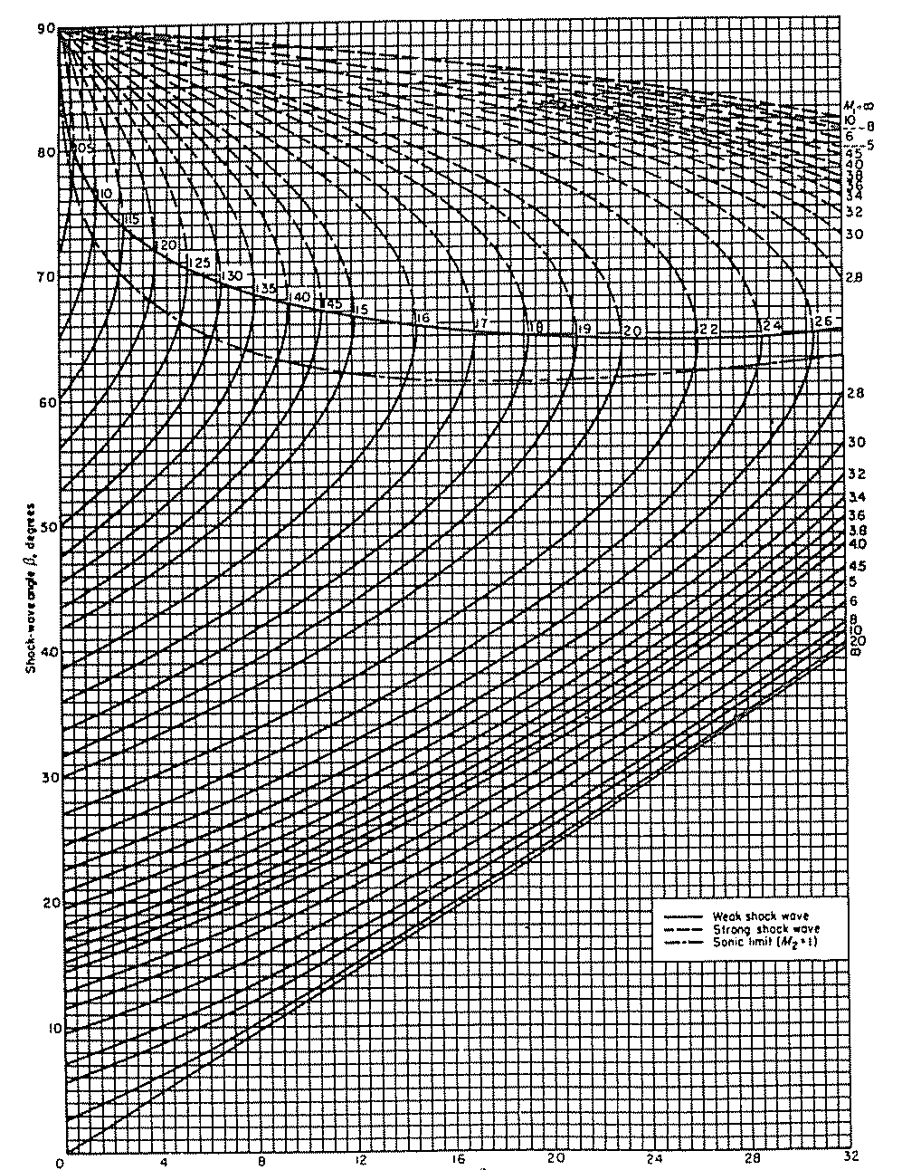
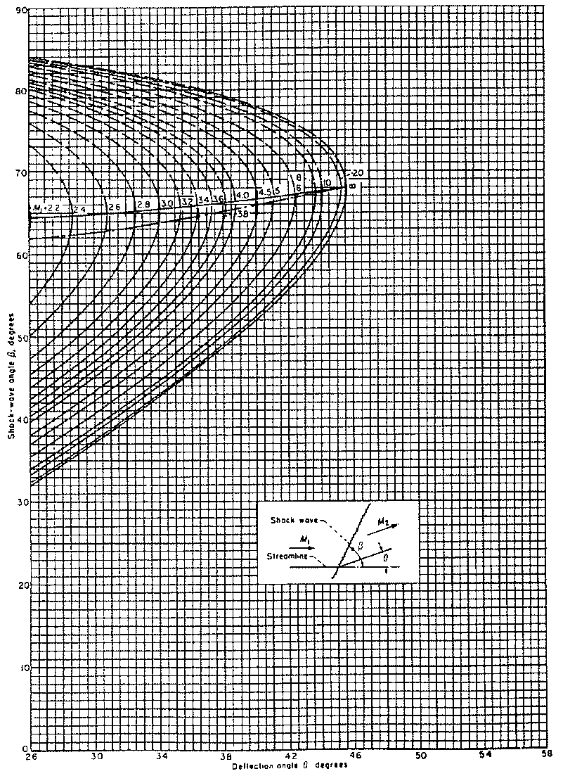
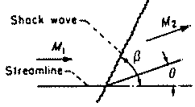
θ-β-M RELATION
Strong
M2 < 1
Weak
Shock Wave Angle, β
M2 > 1
Detached, Curved Shock
Deflection Angle, θ

Slide 19
SOME KEY POINTS
For any given upstream M₁, there is a maximum deflection angle θ_{max}
  If θ > θ_{max}, then no solution exists for a straight oblique shock, and a curved detached shock wave is formed ahead of the body
  Value of θ_{max} increases with increasing M₁
  At higher Mach numbers, the straight oblique shock solution can exist at higher deflection angles (as M₁ → ∞, θ_{max} → 45.5 for γ = 1.4)
For any given θ less than θ_{max}, there are two straight oblique shock solutions for a given upstream M₁
  Smaller value of β is called the weak shock solution
    For most cases downstream Mach number M₂ > 1
    Very near θ_{max}, downstream Mach number M₂ < 1
  Larger value of β is called the strong shock solution
    Downstream Mach number is always subsonic M₂ < 1
  In nature usually weak solution prevails and downstream Mach number > 1
If θ =0, β equals either 90° or μ

Slide 20
EXAMPLES
Incoming flow is supersonic, M₁ > 1
  If θ is less than θ_{max}, a straight oblique shock wave forms
  If θ is greater than θ_{max}, no solution exists and a detached, curved shock wave forms
Now keep θ fixed at 20°
  M₁=2.0, β=53.3°
  M₁=5, β=29.9°
  Although shock is at lower wave angle, it is stronger shock than one on left. Although β is smaller, which decreases M_{n,1}, upstream Mach number M₁ is larger, which increases M_{n,1} by an amount which more than compensates for decreased β
Keep M₁=constant, and increase deflection angle, θ
  M₁=2.0, θ=10°, β=39.2°
  M₁=2.0, θ=20°, β=53°
  Shock on right is stronger

Slide 21
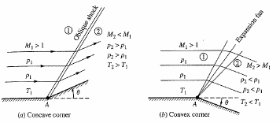
OBLIQUE SHOCKS AND EXPANSIONS
Prandtl-Meyer function, tabulated for γ=1.4 in Appendix C (any compressible flow text book)
Highly useful in supersonic airfoil calculations

Slide 22
TABULATION OF EXPANSION FUNCTION

Slide 23
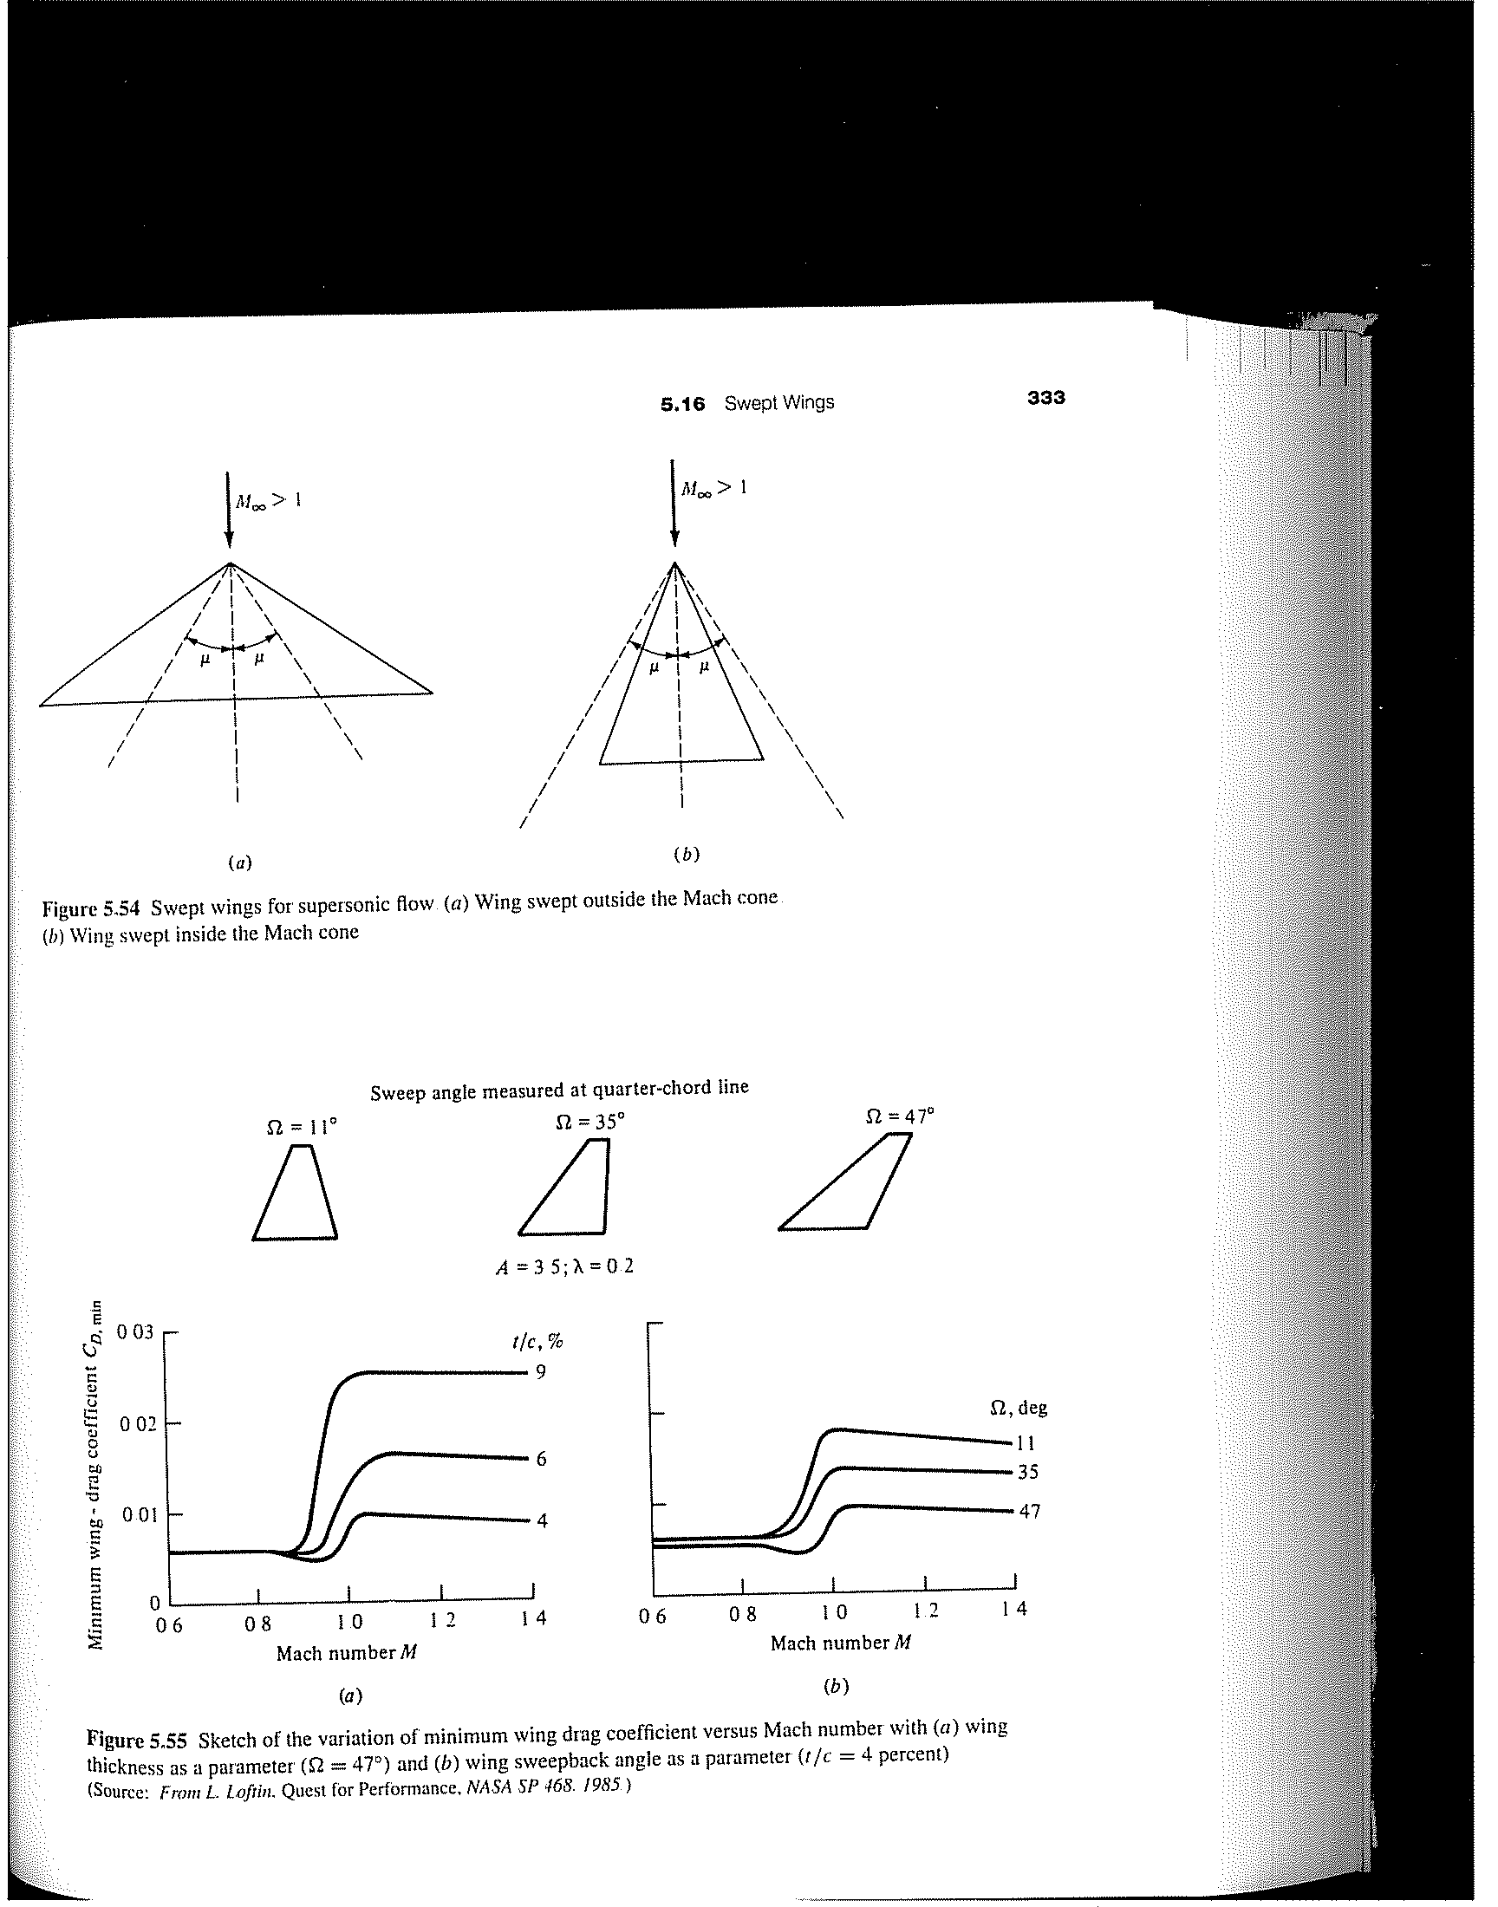
SWEPT WINGS: SUPERSONIC FLIGHT
If leading edge of swept wing is outside Mach cone, component of Mach number normal to leading edge is supersonic → Large Wave Drag
If leading edge of swept wing is inside Mach cone, component of Mach number normal to leading edge is subsonic → Reduced Wave Drag
For supersonic flight, swept wings reduce wave drag

Slide 24
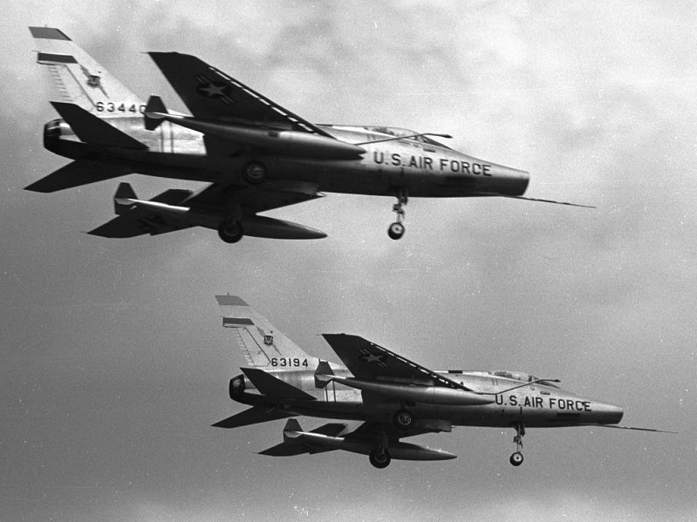
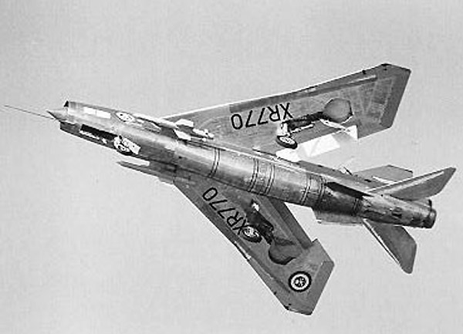
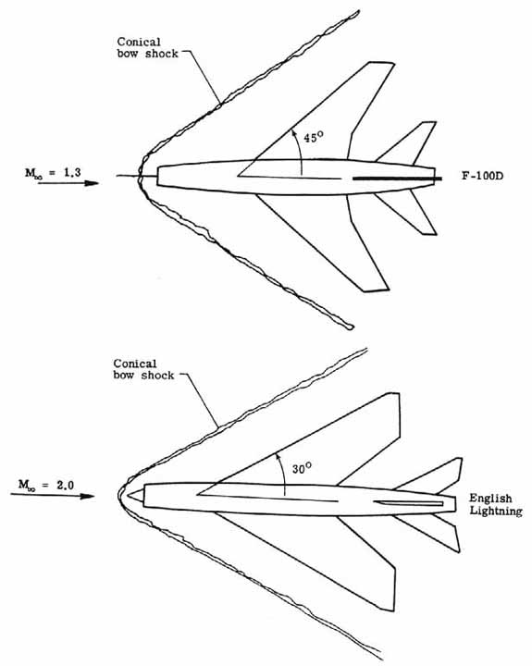
WING SWEEP COMPARISON
F-100D
English Lightning

Slide 25
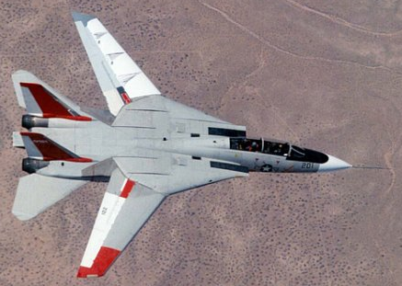
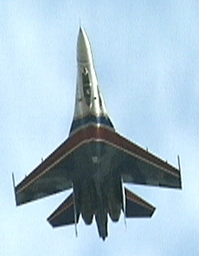
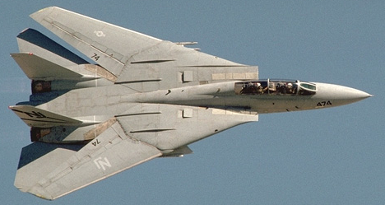
SWEPT WINGS: SUPERSONIC FLIGHT
M∞ < 1
SU-27
θ
M∞ > 1
∼ 26º
μ(M=1.2) ~ 56º
μ(M=2.2) ~ 27º

Slide 26
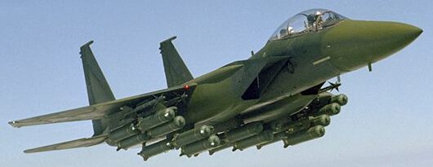

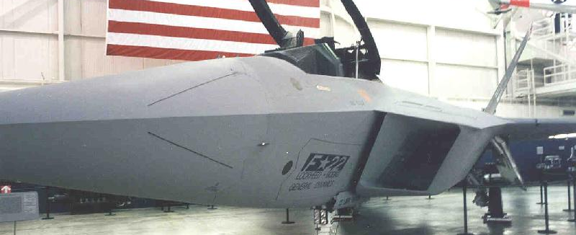
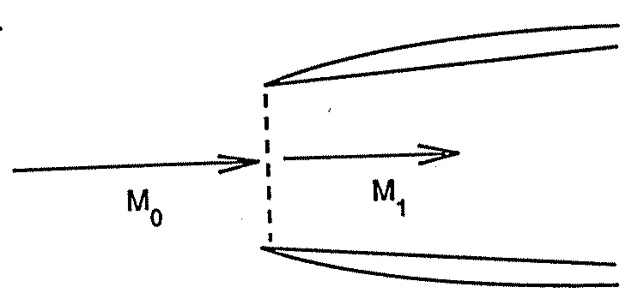

SUPERSONIC INLETS
Normal Shock Diffuser
Oblique Shock Diffuser

Slide 27

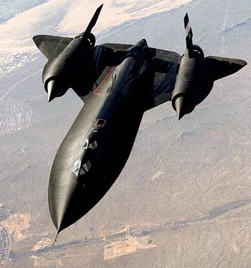
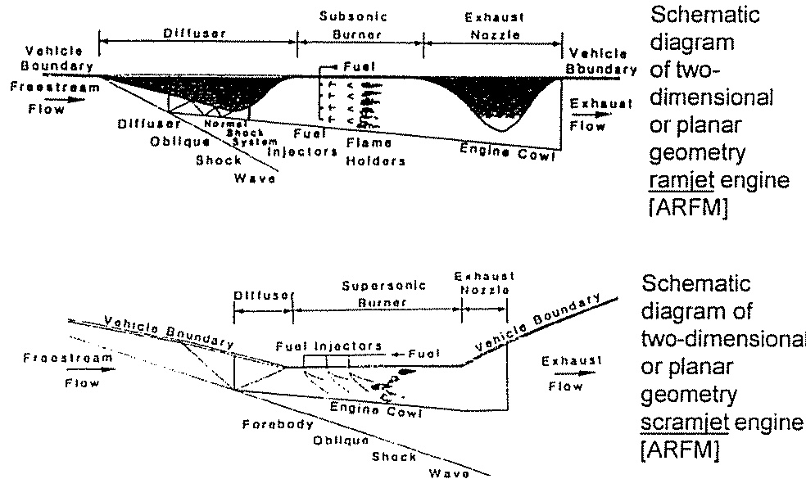
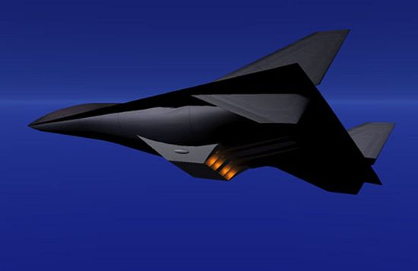
SUPERSONIC/HYPERSONIC VEHICLES

Slide 28
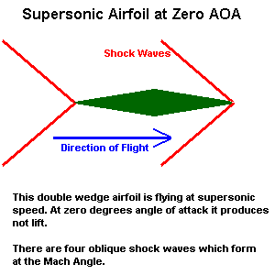
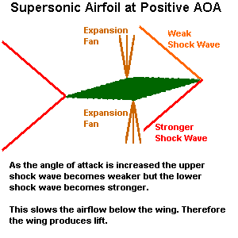

EXAMPLE OF SUPERSONIC AIRFOILS
http://odin.prohosting.com/~evgenik1/wing.htm

