Slide 1
Energy Audit

Slide 2
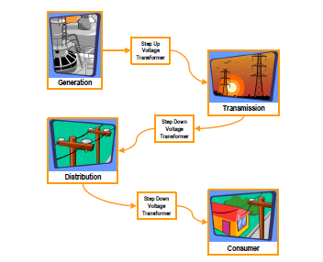

Slide 3
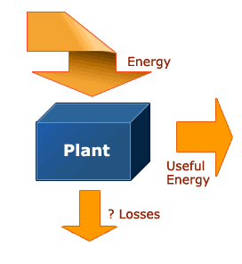

Slide 4
Energy Losses
Energy loss in any industrial process or plant is inevitable; it is a foregone conclusion. But its economic and environmental impacts are not to be taken lightly, thus explaining the growing need for industrial energy efficiency. Put simply, the level of energy efficiency a plant or process can achieve is inversely proportionate to the energy loss that occurs; the higher the loss, the lower the efficiency.

Slide 5
Where and how do most of the losses occur, how much energy is actually lost and are they controllable or recoverable? The answers to these questions remain well concealed in a black box where once energy is input, we do not know what really happens to it inside and how much the losses are. It is only when we look into the black box and extract these details that we are able to ascertain the performance of the overall or process levels and respond more effectively to the weaknesses in energy management.

Slide 6
Overall energy losses in a plant can result from losses due to designs that do not incorporate energy efficient specifications such as heat recovery option; operations that run on inefficient methods; and poor or
non-energy efficiency-conscious maintenance programme. Reducing these losses will substantially increase the plant's efficiency, but we need data to identify and quantify the losses and subsequently suggest suitable techno-economic solutions to minimize the losses. This data can be acquired through energy audits.

Slide 7
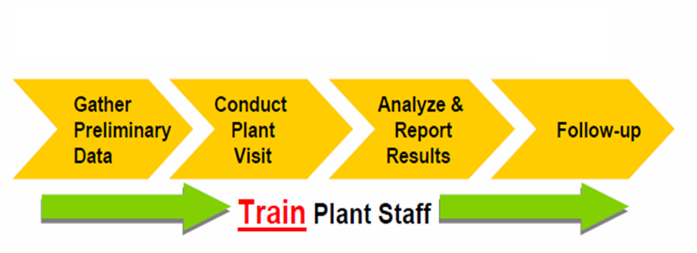
Stages of Energy Audit

Slide 8
Energy audit: Definition and Types
Energy audit is a systematic study or survey to identify how energy is being used in a building or plant, and identifies energy savings opportunities. Using proper audit methods and equipment, an energy audit provides the energy manager with essential information on how much, where and how energy is used within an organization (factory or building).

Slide 9
This will indicate the performance at the overall plant or process level. The energy manager can compare these performances against past and future levels for a proper energy management. The main part of the energy audit report is energy savings proposals comprising of technical and economic analysis of projects. Looking at the final output, an energy audit can also be defined as a systematic search for energy conservation opportunities.

Slide 10
This information can be transformed into energy savings projects. It will facilitate the energy manager to draw up an action plan listing the projects in order of priority. He will then present it to the organization's management for approval. Providing tangible data enables the management to be at a better position to appreciate and decide on energy efficiency projects. Adopting this activity as a routine or part of the organization's culture gives life to energy management, and controlling the energy use by energy audit is what we refer to as Energy Management by Facts

Slide 11
Energy audit stages
Energy audit can be categorized into two types, namely walk-through or preliminary and detail audit.
Walk-through or preliminary audit
Walk-through or preliminary audit comprises one day or half-day visit to a plant and the output is a simple report based on observation and historical data provided during the visit. The findings will be a general comment based on rule-of-thumbs, energy best practices or the manufacturer's data.

Slide 12
Preliminary Energy Survey
Quick overview of energy use patterns
Provides guidance for energy accounting
system
Provides personnel with perspectives of
processes and equipment
Identify energy – intensive processes and
equipment
Identify energy inefficiency ,if any
Set the stage for detailed energy survey

Slide 13
Detail audit
Detail audit is carried out for the energy savings proposal recommended in walk-through or preliminary audit. It will provide technical solution options and economic analysis for the factory management to decide project implementation or priority. A feasibility study will be required to determine the viability of each option.

Slide 14
Detailed Energy Survey
Detailed evaluation of energy use pattern
By processes and equipment
Measurement of energy use parameters
Review of equipment operating
characteristics
Evaluation of efficiencies
Identify DSM options and measures
Recommendation for implementation

Slide 15
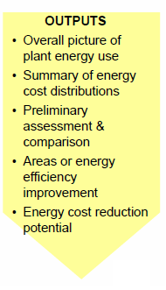
Inputs and Outputs of Energy audit

Slide 16
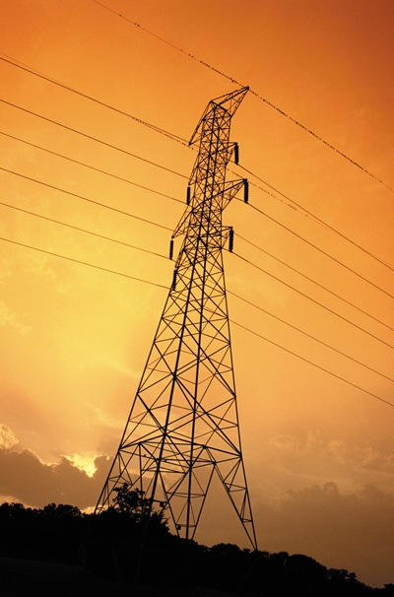
ELECTRICAL ENERGY AUDIT
Areas covered under Electrical audit are
1. Electrical System :
• Electrical Distribution system (substation & feeders study)
• PF Improvement study
• Capacitor performance
• Transformer optimization
• Cable sizing & loss reduction
• Motor loading survey
• Lighting system
• Electrical heating & melting furnaces
• Electric ovens

Slide 17
2. Mechanical System :
• Fans & Blowers
• Exhaust & ventilation System
• Pumps and pumping System
• Compressed air System
• Air Conditioning & Refrigeration System
• Cooling Tower System

Slide 18
THERMAL ENERGY AUDIT
Areas covered under Electrical audit are
Steam Generation Boilers
• Steam Audit and Conversation
• Steam Trap Survey
• Condensate Recovery System
• Insulation Survey
• Energy and Material Balance for Unit operation
• Heat Exchanger
• Waste Heat Recovery System

Slide 19
WATER AUDIT & CONSERVATION
Industry has recognized 'Water Audit' as a important tool for water resource management
Water Audit study is a qualitative and quantitative analysis of water consumption to identify means of reuse and recycling of water. This study includes segregation of effluent streams and schemes for effectively treating them to enable byproduct recovery. Water Audits encourage social responsibility by identifying wasteful use, enables estimation of the saving potential they not only promote water conservation but also deliver cost savings, but also companies to safeguard public health and property, improve external relations and reduce legal liability.

Slide 20
Benefits of energy audit
There is a lot of potential for energy savings from energy audits.. Technical solutions proposed in the energy audits show massive potential for energy savings in every sub-sector with an average of almost ten percent of the energy usage. However, this can only materialize through replication at other factories within the respective sub-sector.

Slide 21
Benefits of an industrial energy audit include:
Energy savings
Avoiding power factor penalties and environmental compliance costs
Quality improvements
Productivity improvements
Reduced maintenance
Fewer breakdowns
Better safety and protection
A process for repeatable improvements

Slide 22
Process VS. Equipment
Equipment efficiency improvement : Max. 5%
Process efficiency improvement : 15% to 30%
Conclusion
Focus on Processes

Slide 23
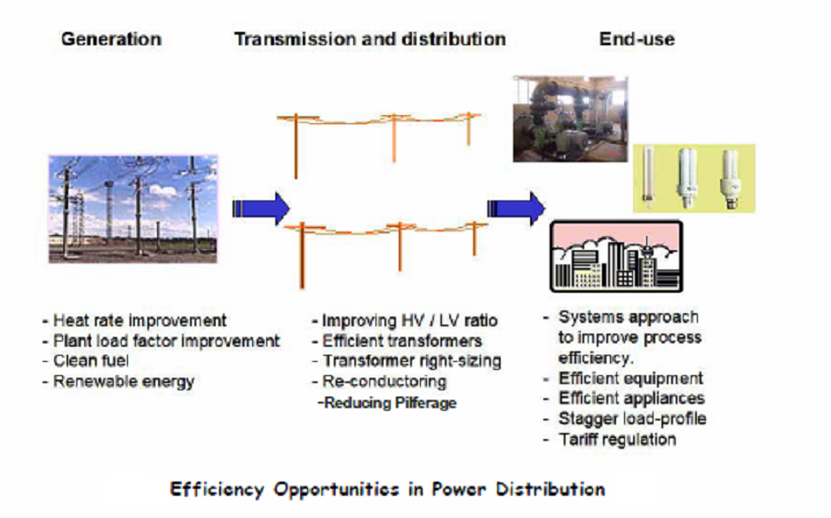

Slide 24
Energy intensive processes and equipment
Examples of processes
Electrical furnace
Rolling mills
Gas furnace
Steam generation
Feed water system
Condensate return system
Steam distribution system
Electrlyzer
Examples of equipment
Electrical motor
Pump
Fan
Heater (gas,..,electric)
Dryer (steam/electric)
Motor / generator
Compressor
Light bulb

Slide 25
Energy conservation opportunities
Electrical
Reduce demand by load management
Electrical / thermal
Reduce consumption by improving energy use efficiency
(reducing losses ,utilizing waste heat ,etc..)

Slide 26
Examples of conservation
opportunities - processes
1.Electric furnace
- Automation of energy supply control
- Substitute electricity by thermal energy
( mazout/solar/gas )
- Reduce radiation losses

Slide 27
2. Steam generation system
- Combustion efficiency improvement
- Waste heat recovery from flue gases
- Heat loss reduction from boiler surfaces
- Reduce leakage
3. Condensate return system
4. Steam distribution system
- Pipe insulation
- Steam traps
- Steam leaks

Slide 28
Examples of conservation
opportunities –equipment
Gas/air compression system
pre-cooling the gas/air
2. High efficiency motors
3. High efficiency lamps
4. High efficiency pump/fan
5. Change electric dryer and heater to oil/gas fuel
6. Replace motor/generator set with silicon
controlled rectifier (SCR)

Slide 29
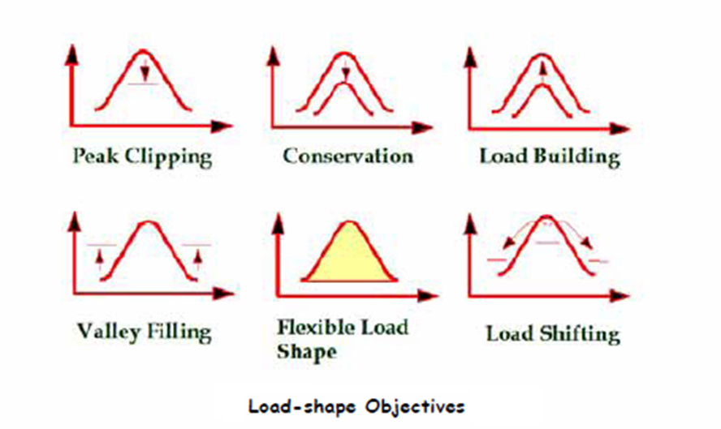
Demand Side Management (DSM)

Slide 30
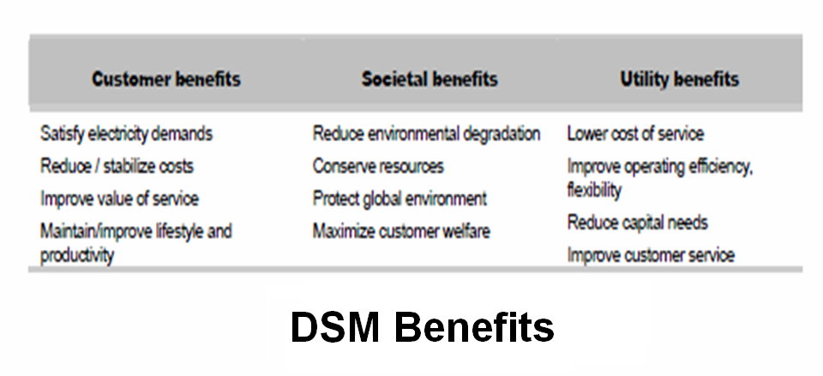

Slide 31
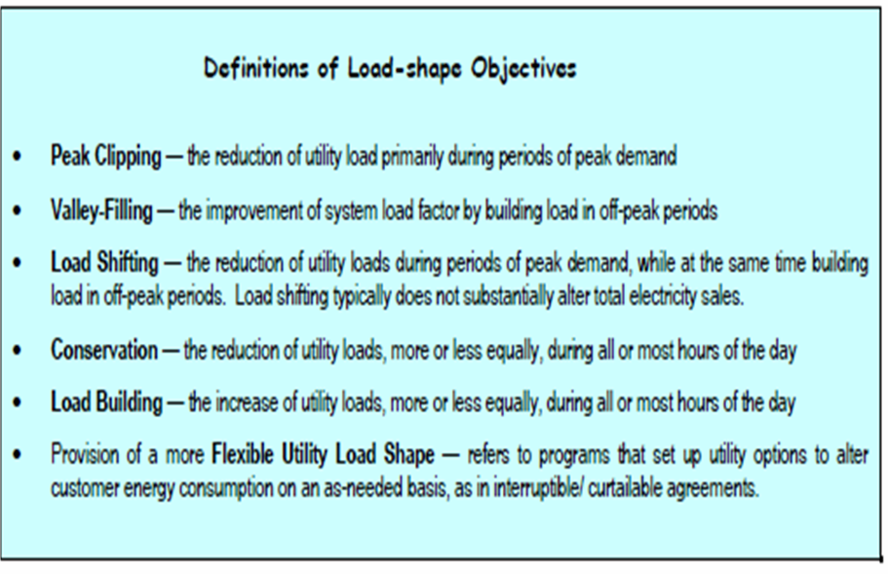

Slide 32
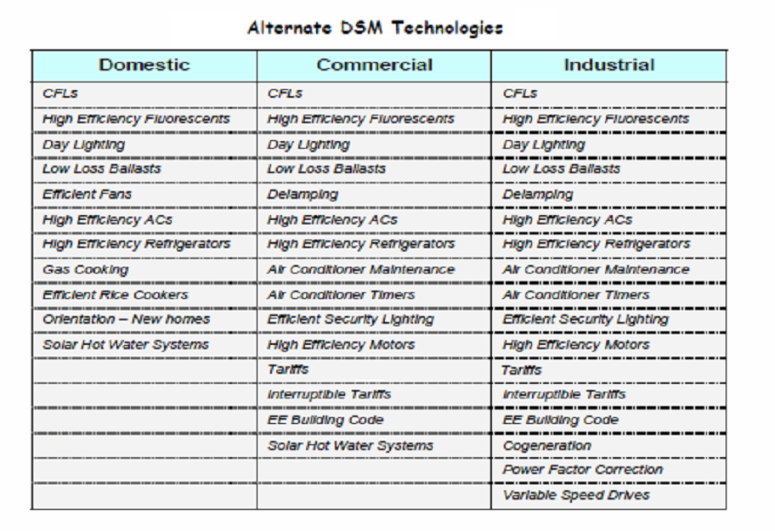

Slide 33
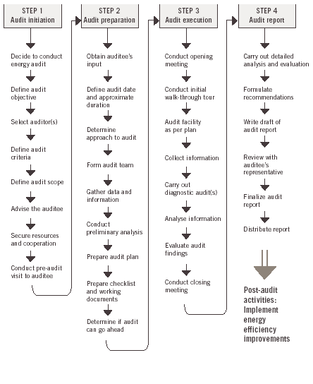
Energy Audit / step by step

Slide 34
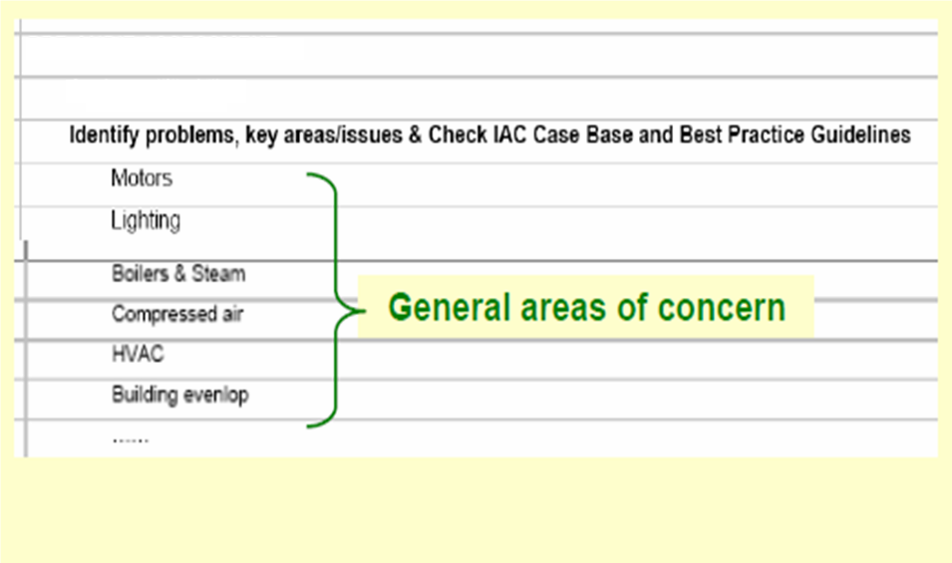
Analyze utility bills

Slide 35
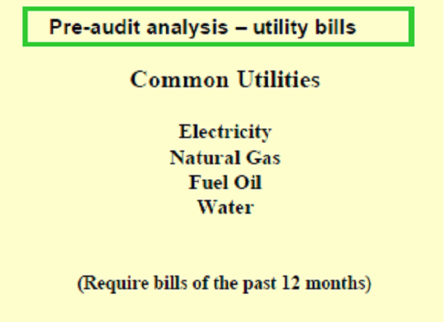

Slide 36
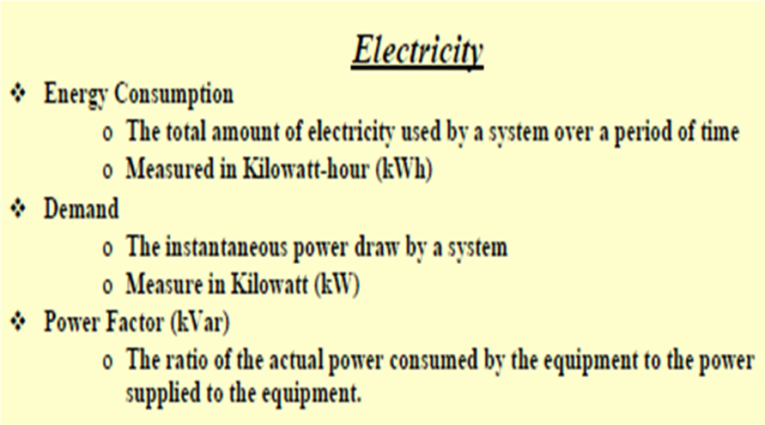

Slide 40
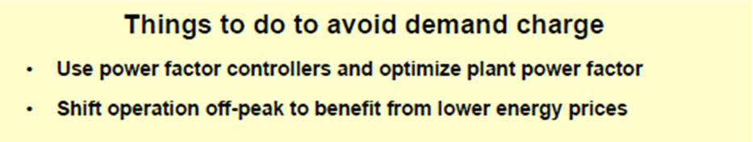

Slide 41
Case study
Basic data of the company
1- General description of company and products.
2- Electrical distribution system.
3- Energy price.
4- Energy factor and environmental pollution.
5- Electrical loads of company.

Slide 42
1- General description of company and products:
Company “ A “ lies in Kilo “ XX” Alexandria desert road. The company operates 24 hours with 3 shifts a day for 300 days/ year. The company produces dry batteries.
2- Electrical distribution system:
Electric power network of “ A “ Company is supplied by two transformers 500 KVA, 11/ 0.4 kV. Also, there is two standby generators 400 kVA per each.
Figure (1) shows the single line diagram for the electric distribution network.

Slide 43
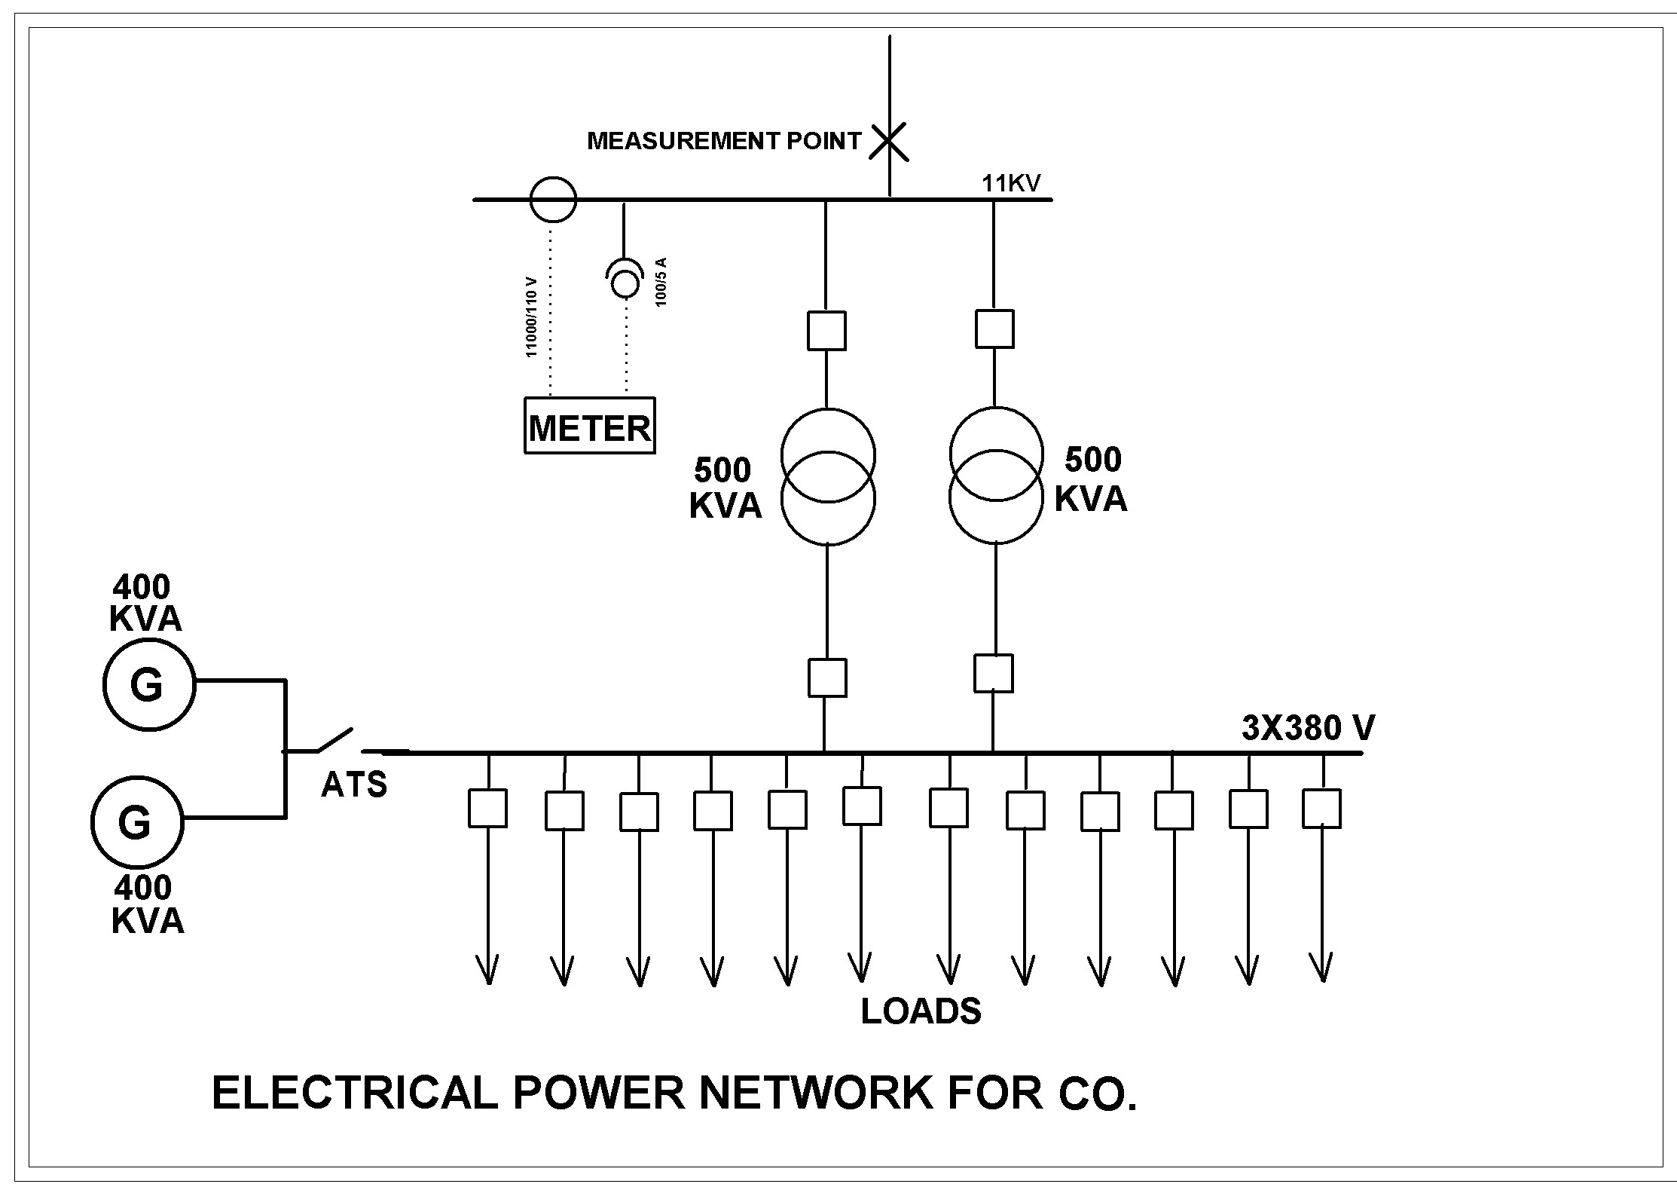

Slide 44
Table (2)
Meter No. | Contracted power | Max. demand 2007 | Power factor 2007
366 | 1350 KW | 863 kW | 0.9
Figure (2) shows the monthly development of electric consumption for company loads during 2006 and 2007.

Slide 45
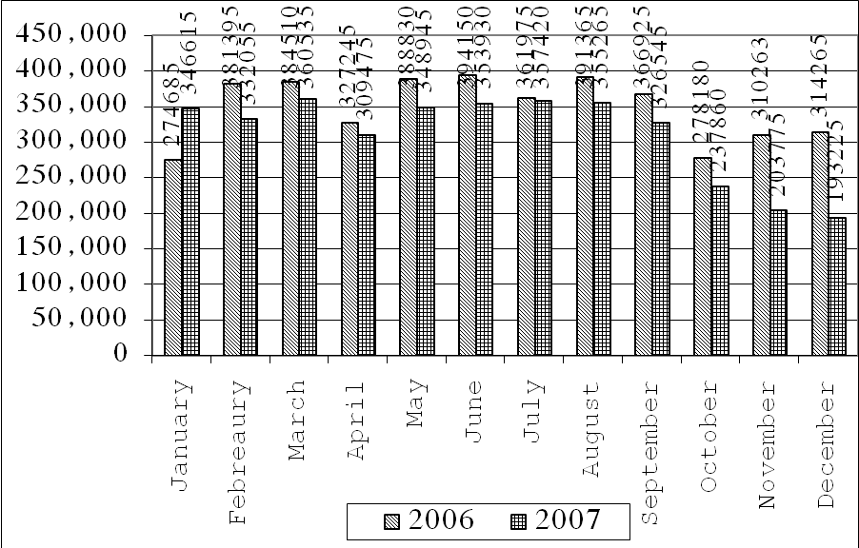

Slide 46
3- Energy price:
According to appendix (2)
4- Energy factor and environmental pollution.
0.2196 kg fuel /kWh
3.082 kg CO2/ kg fuel
0.677 kg CO2 /kWh
5- Electrical loads of company:
The following tables represent loads and its rating

Slide 47
Power (HP) |  | Description No. X rating | Item
3 | 1 X 3HP |  | motor
112.6 | 28 X 3000 W |  | Heaters
0.25 | 1 X 0.25 HP |  | Water pump
0.75 | 1 X 0.75 HP |  | Exhaust fan
5 | 2 X 1 HP + 4 X 0.75 HP |  | Cooker assistant
121.6 |  | Total power for this process
0.75 | 3 X 0.25 HP |  | Conveyor belt
7.3 | 1 X 10 Ampere + 1 X 15 Ampere |  | heater
2 | 2 X 1 HP |  | Exhaust fan
1 | 1 X 1 HP |  | Conveyor belt
11.05 |  | Total power for this process

Slide 48
lighting loads:
Location | Type | No. of lamps X rating | Total power (kW)
ABC 1 | 120 cm. fluorescent lamp | 40 X 304 | 12.16
ABC 2 | 120 cm. fluorescent lamp | 40 X 84 | 3.36

Slide 49
Power Factor

Slide 50
Equipment and appliances requiring reactive energy
All AC equipment and appliances that include electromagnetic devices, or depend on magnetically-coupled windings, require some degree of reactive current to create magnetic flux.
The most common items in this class are transformers and reactors, motors and discharge lamps (with magnetic ballasts) The proportion of reactive power (kvar) with respect to active power (kW) when an item of equipment is fully loaded varies according to the item concerned being:
* 65-75% for asynchronous motors
* 5-10% for transformers

Slide 51
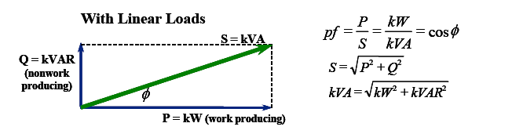

Slide 53
Values of cos ϕ and tan ϕ for commonly-used equipment

Slide 54
Range of PF % | Equipment
40-80 | Non Power factor corrected fluorescent &HID lighting fixture ballasts
50-70 | Arc welders
20-50 | Solenoids
60-90 | Induction heating equipment
30-95 | Small “ dry-pack” transformers
55-90 | Induction motors

Slide 55
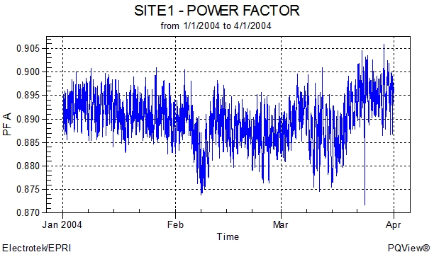

Slide 56
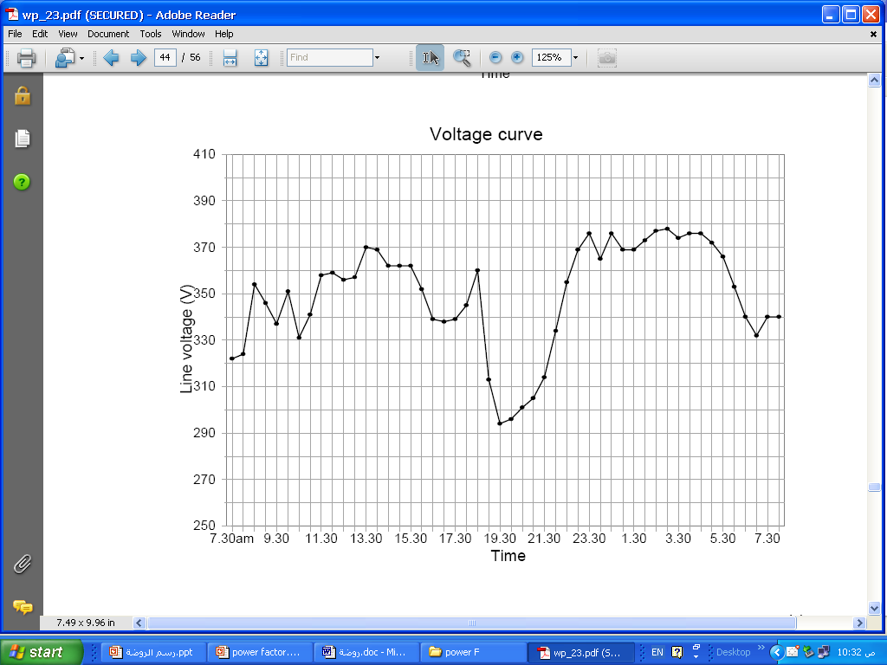
Example (1)
1-
380 V
380 V± 5% =361 :399 V

Slide 57
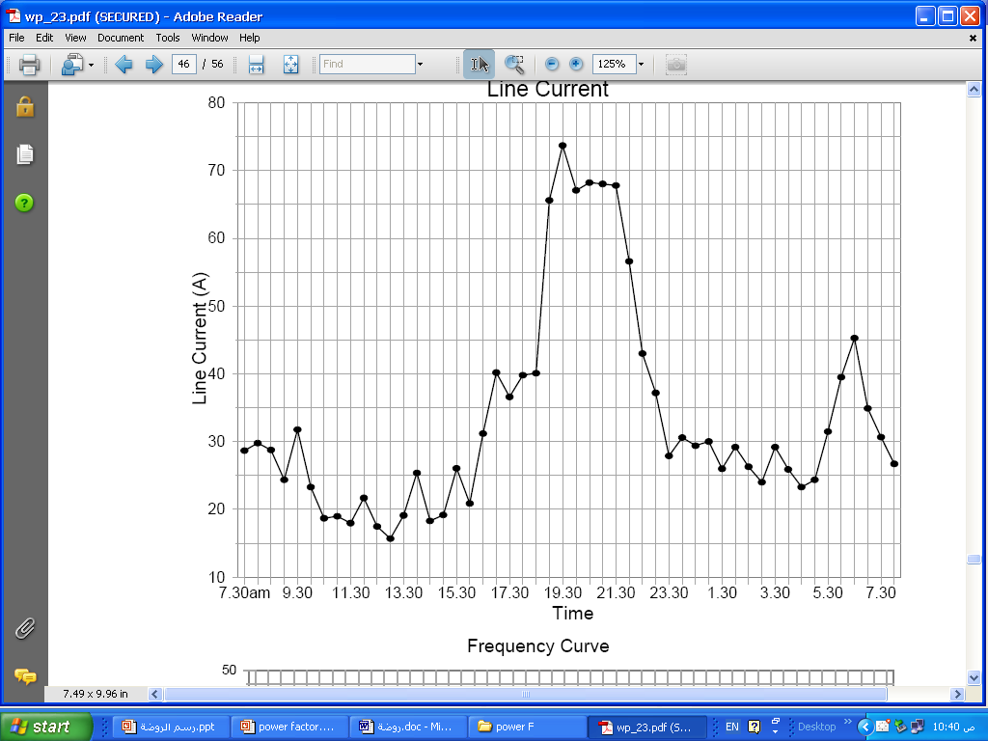
2- Line Current

Slide 58
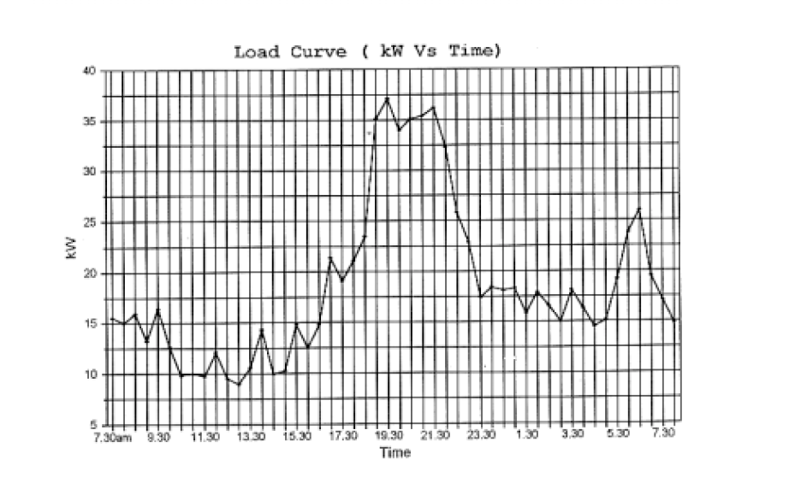
3-

Slide 59
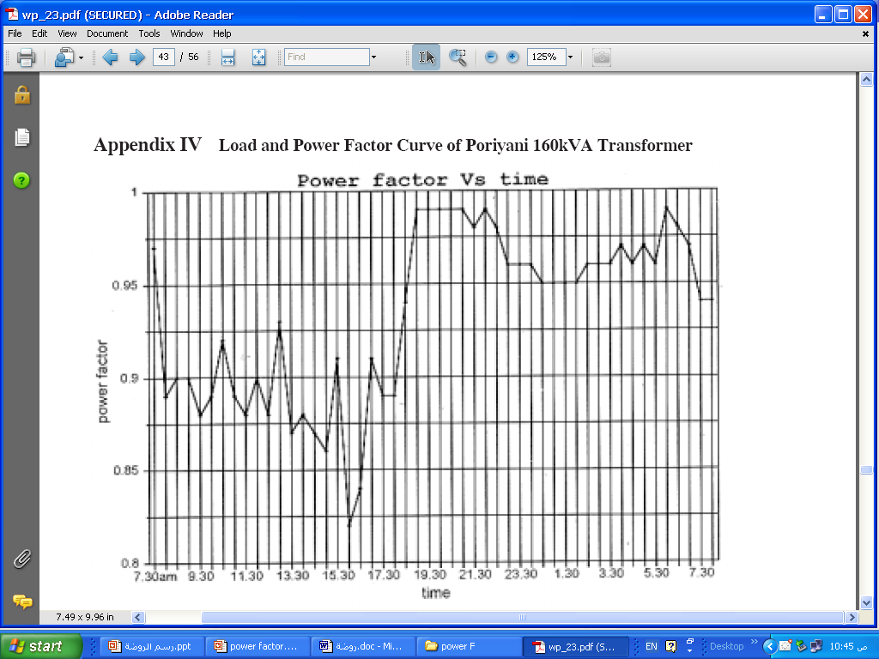
4-

Slide 60
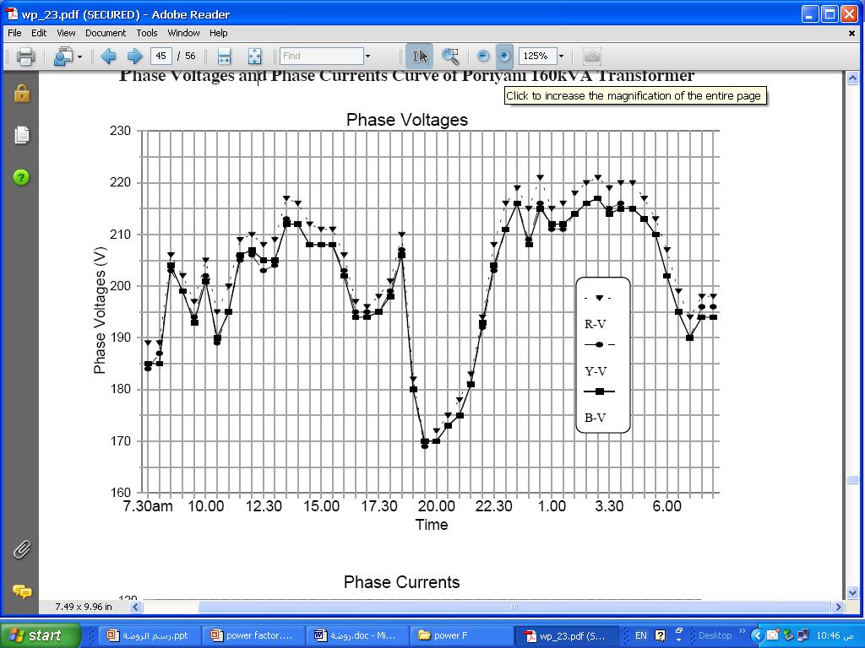
5-
220 V± 5% =209 :231 V

Slide 61
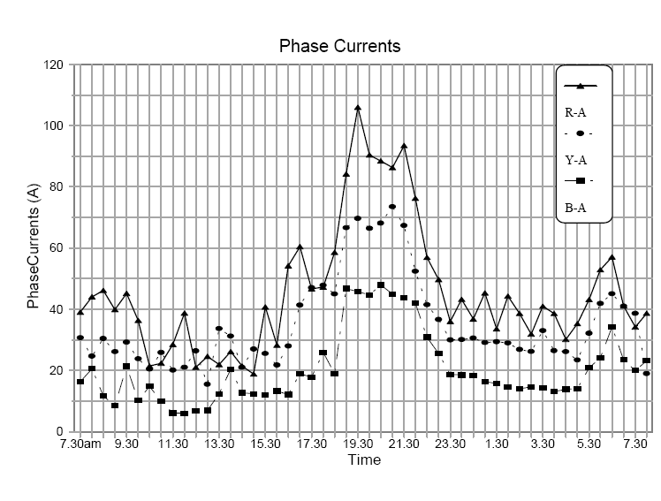
6-

Slide 62
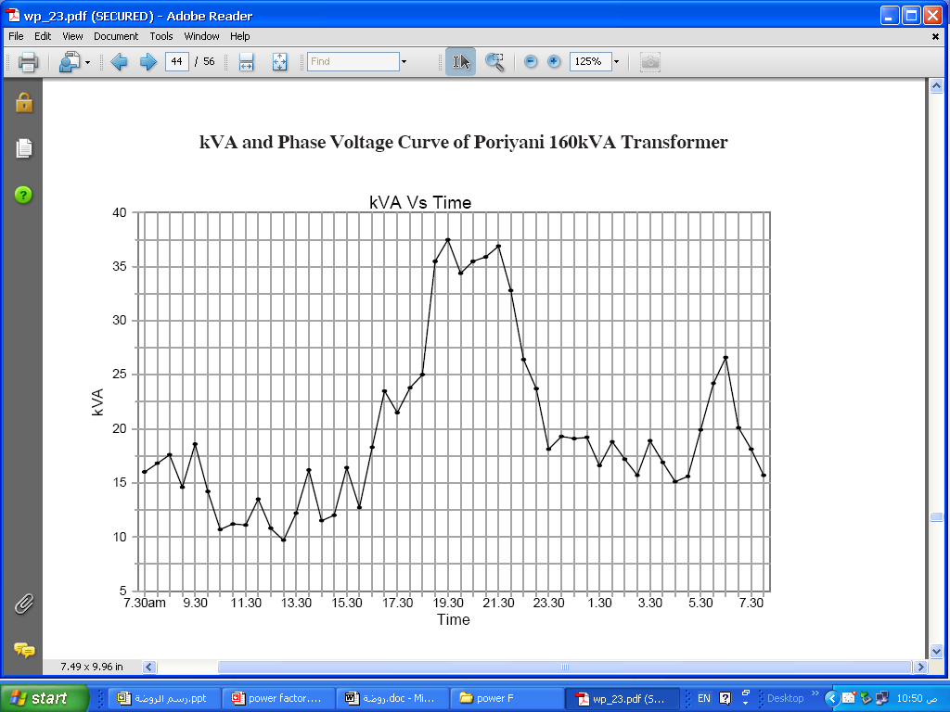
7-

Slide 63
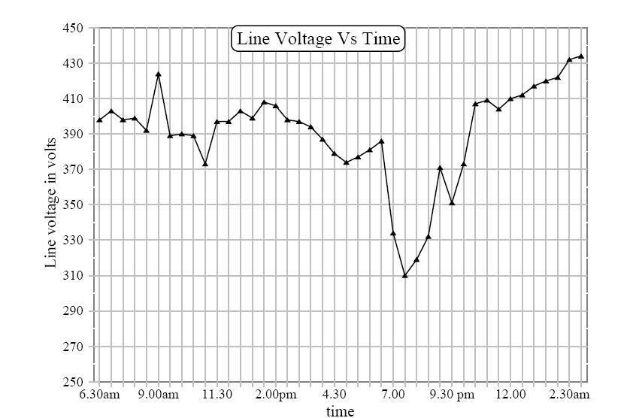
Example (2)
1-

Slide 64
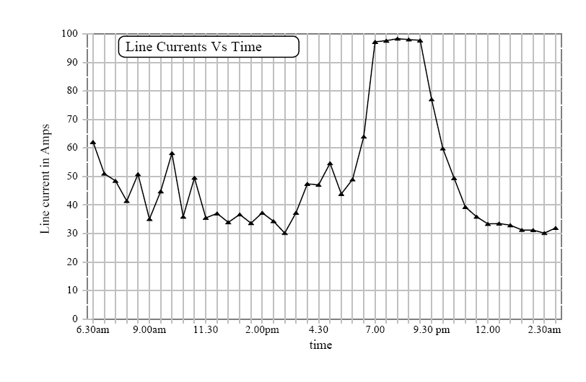
2-

Slide 65
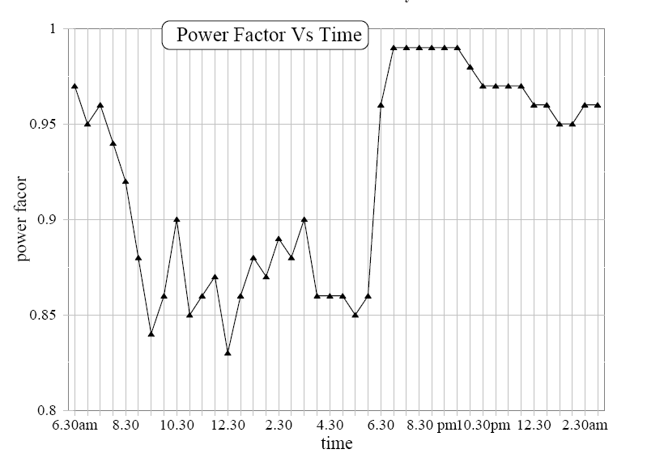
3-
0.9

Slide 66
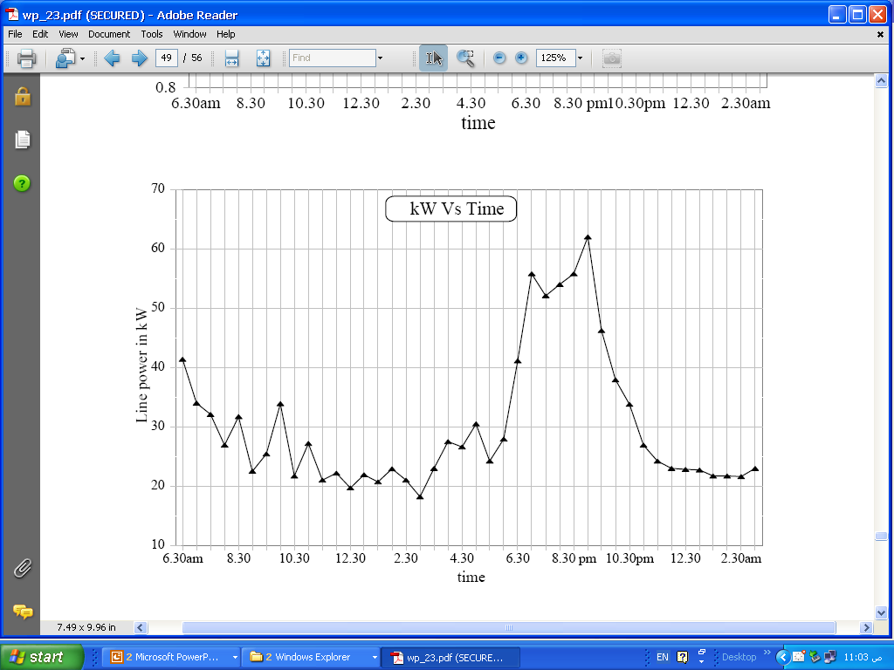
4-

Slide 67
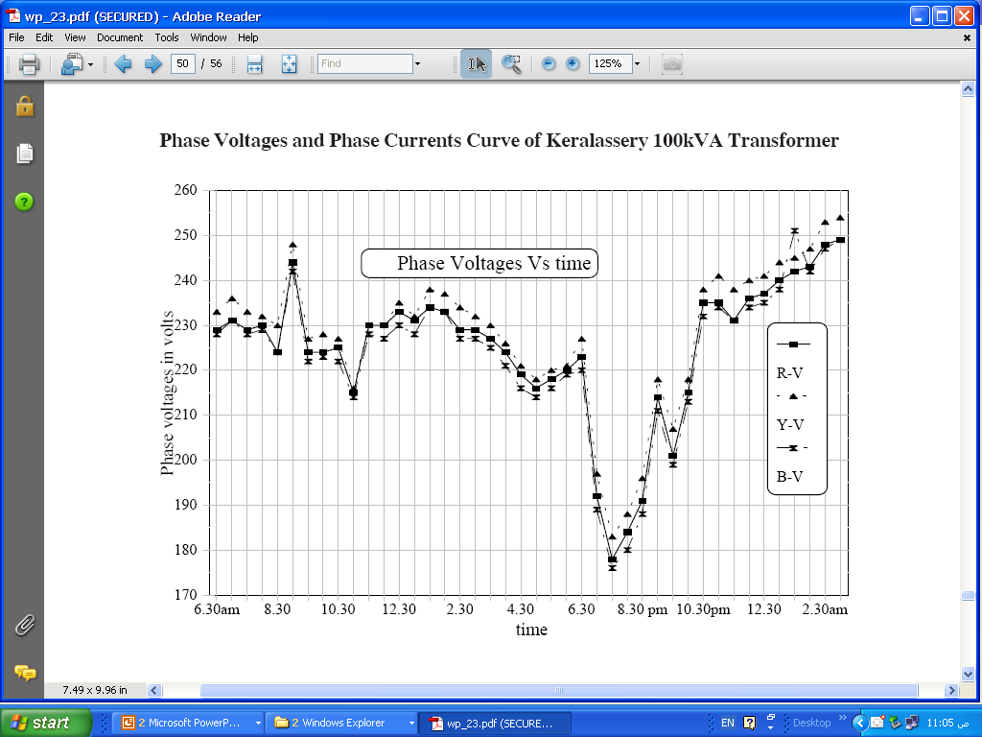
5-

Slide 68
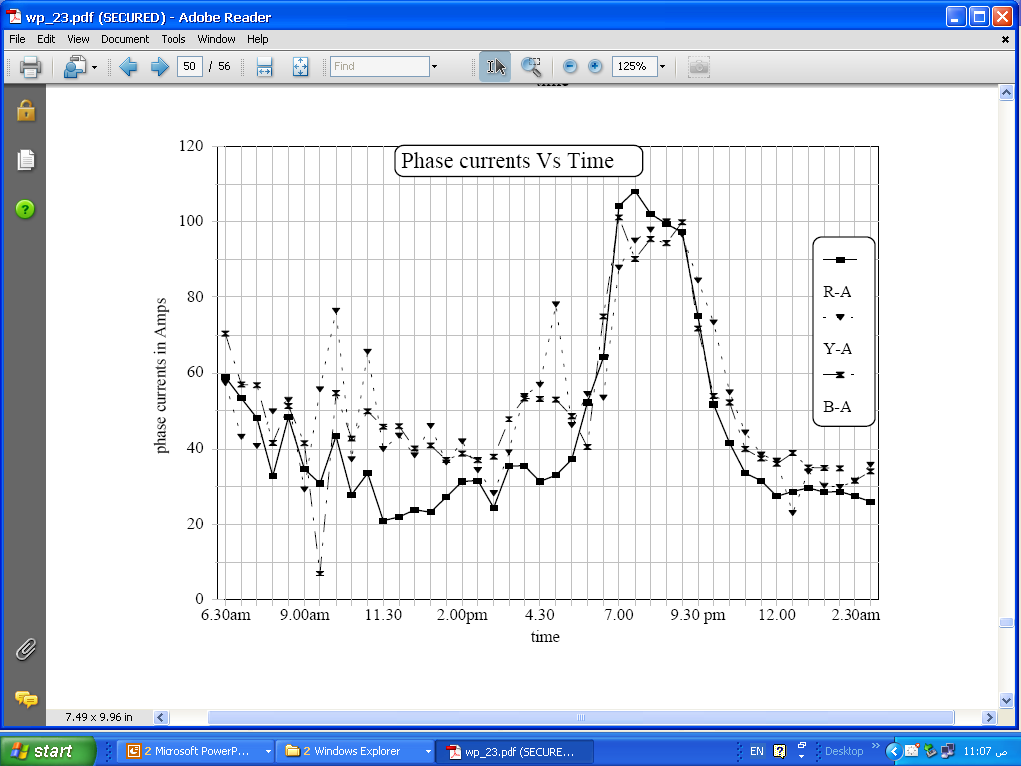
6-

Slide 69
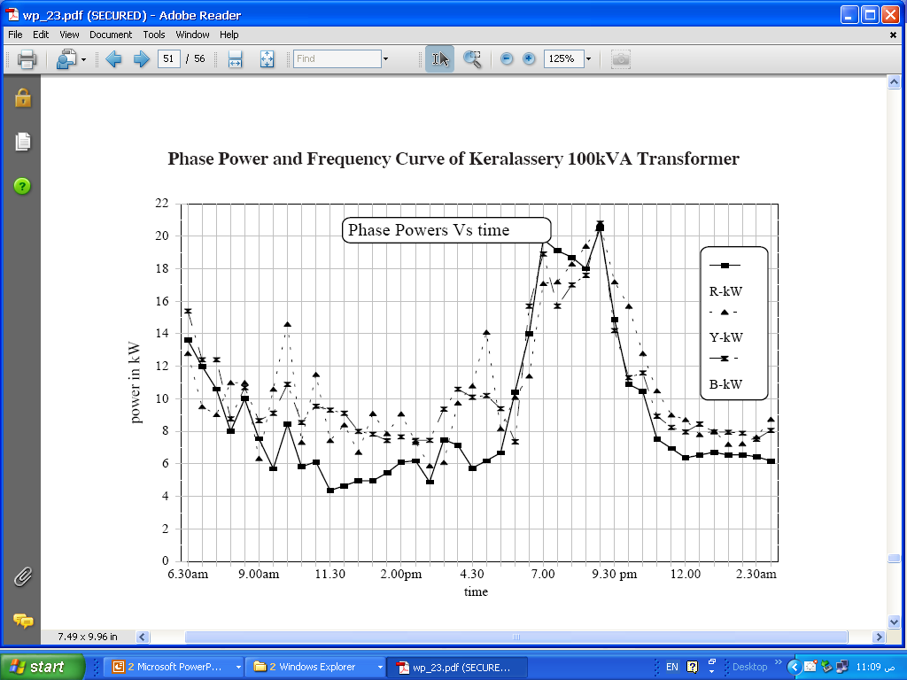
7-

Slide 70
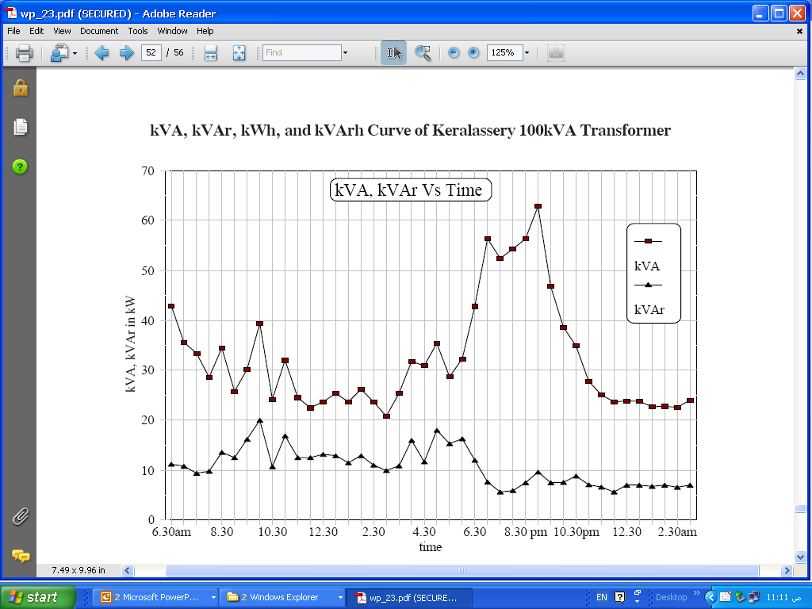
8-

Slide 71
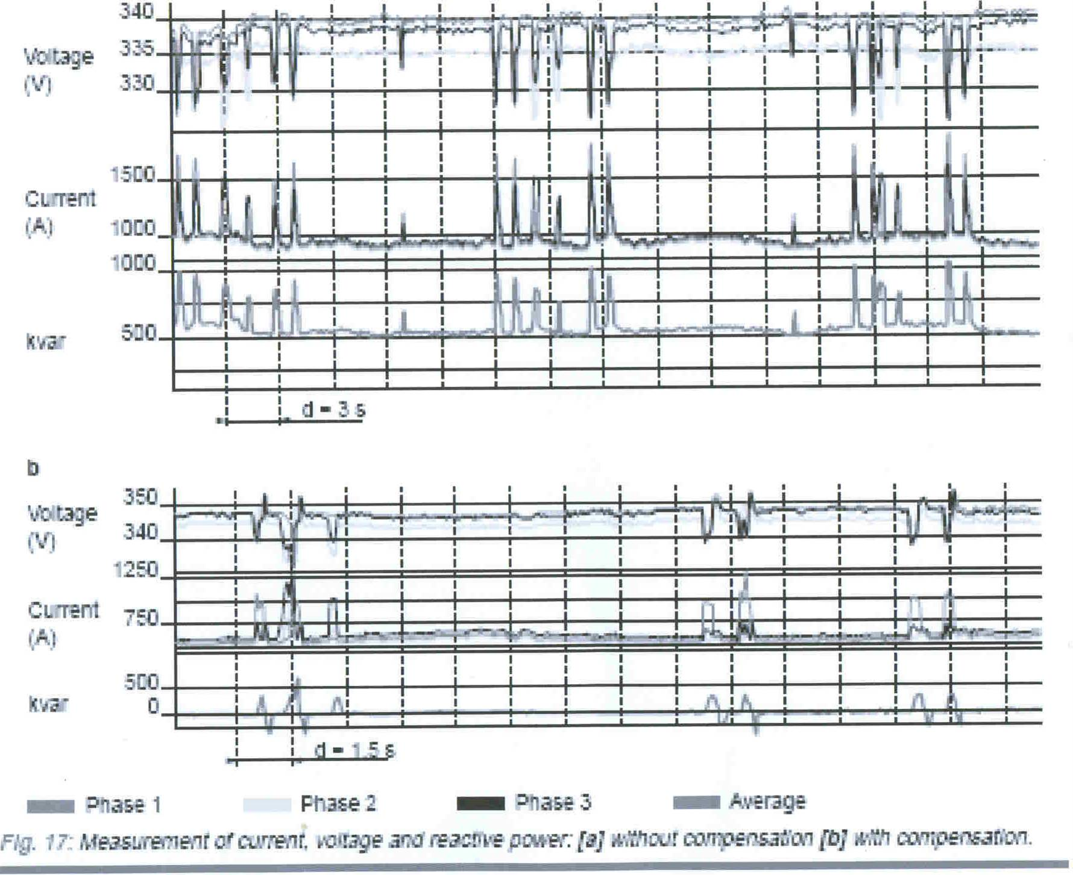

Slide 72
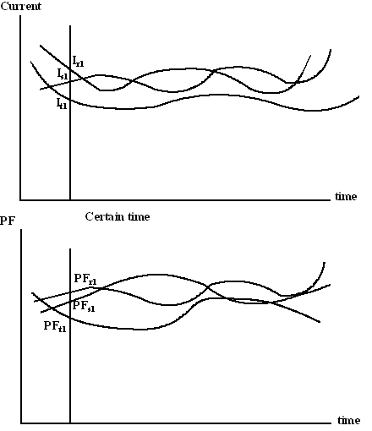

Slide 73
For 3-phase balanced current
For 3-phase unbalanced current, PF at certain time is

Slide 74
معامل القدرة و عقد توريد الطاقة
عقد توريد كهرباءعلى الجهد المنخفض حتى 500 كيلو وات
البند الخامس:
أولا: الكهرباء الموردة بموجب هذا العقد يتم حساب قيمتها بناء على ما يلى:
1- سعر الطاقة الكهربائية: لكل كيلووات ساعة طبقا لتعريفة الطاقة الكهربائية السارية
2- معامل القدرة: للمنتفعين بقدرة 10 كيلو وات فأكثر
أسعار الطاقة الكهربائية موضوعة على أساس معامل قدرة متوسط 0.9 فى حالة انخفاض هذا المعامل فى السنة المالية عن 0.9 يزاد سعر الطاقة بمقدار 0.5% لكل 0.01 من أنخفاض المعامل حتى 0.7

Slide 75
و فى حالة انخفاض المعامل عن 0.7 يزاد سعر الطاقة بمقدار 1% لكل 0.01 من أنخفاض المعامل عن 0.7 يلتزم المنتفع فى هذه الحالة بتركيب أجهزة تحسين معامل القدرة خلال تسعة شهور من تاريخ إخطاره بكتاب مسجل بعلم الوصول.
و فى حالة عدم تركيب الأجهزة خلال تلك المدة يكون للشركة الحق فى قطع التغذية عن المنتفع إلى أن يقوم بتحسين معامل القدرة إلى ما لا يقل عن 0.7 و يظل العقد ساريا حتى يتم تحسين المعامل .
و فى حالة زيادة المعامل عن 0.92 يخفض سعر الطاقة بمقدار 0.5% لكل 0.01 من أرتفاع المعامل عن 0.92 و بحد أقصى 0.95

Slide 76
عقد توريد كهرباءعلى الجهد المتوسط بقدرةأكبر من 500 كيلو وات
البند الخامس:
-
-
- معامل القدرة:
أسعار الطاقة الكهربائية موضوعة على أساس معامل قدرة متوسط 0.9 و فى حالة انخفاض هذا المعامل فى السنة المالية عن 0.9 يزاد سعر الطاقة بمقدار 0.5% لكل 0.01 من أنخفاض المعامل حتى 0.7

Slide 77
و فى حالة انخفاض المعامل عن 0.7 يزاد سعر الطاقة بمقدار 1% لكل 0.01 من أنخفاض المعامل عن 0.7 يلتزم المنتفع فى هذه الحالة بتركيب أجهزة تحسين معامل القدرة خلال تسعة شهور من تاريخ إخطاره بكتاب مسجل بعلم الوصول.
و فى حالة عدم تركيب الأجهزة خلال تلك المدة يكون للشركة الحق فى قطع التغذية عن المنتفع إلى أن يقوم بتحسين معامل القدرة إلى ما لا يقل عن 0.7 و يظل العقد ساريا حتى يتم تحسين المعامل .
و فى حالة زيادة المعامل عن 0.92 يخفض سعر الطاقة بمقدار 0.5% لكل 0.01 من أرتفاع المعامل عن 0.92 و بحد أقصى 0.95

Slide 78
مثال
متوسط معامل القدرة المقاس = 0.46
الاستهلاك السنوى = Kwh63933
احسب مقابل انخفاض معامل القدرة
الحل:
أ ) انخفاض معامل القدرة من 0.9 وحتى 0.7 أي 0.2
تزيد قيمة الطاقة 0.005 لكل 0.01 من انخفاض المعامل للقيمة 0.2
ب) انخفاض معامل القدرة من 0.7 وحتى 0.46 أي 0.24
تزيد قيمة الطاقة 0.01 لكل 0.01 من انخفاض المعامل للقيمة 0.24

Slide 79
متوسط معامل القدرة المقاس = 0.46
أ ) انخفاض معامل القدرة من 0.9 وحتى 0.7 أي 0.2
تزيد قيمة الطاقة 0.005 لكل 0.01 من انخفاض المعامل
للقيمة 0.2
ب) انخفاض معامل القدرة من 0.7 وحتى 0.46 أي 0.24
تزيد قيمة الطاقة 0.01 لكل 0.01 من انخفاض المعامل
للقيمة 0.24

Slide 80
أي أن:
تزيد قيمة الطاقة بالنسبة :
(20×0.005) + (24×0.01) = 0.34 = 34%
قيمة الطاقة المقابلة لانخفاض معامل القدرة من 0.9 إلى 0.46
= نسبة الزيادة المفروضة × الطاقة المستهلكة خلال العام × سعر الطاقة الكهربائية
= 0.34 × (63933 ك.و.س/السنة) × (0.231 جنيه/ك.و.س)
=جنية 5021

Slide 81

Power Factor Improvement
Capacitors

Slide 82
What we will learn:
Most Industrial loads require both Real power and Reactive power to produce useful work
You pay for BOTH types of power
Capacitors can supply the REACTIVE power thus the utility doesn’t need to
Capacitors save you money!

Slide 83
Why Apply PFC’s?
Power Factor Correction Saves Money!
  » Reduces Power Bills
  » Reduces I²R losses in conductors
  » Reduces loading on transformers
  » Improves voltage drop

Slide 84
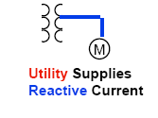
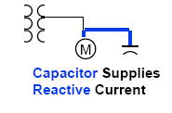
Why do we Install Capacitors?
Capacitors supply, for free, the reactive energy required by inductive loads.
  » You only have to pay for the capacitor !
  » Since the utility doesn’t supply it (kVAR), you don’t pay for it!

Slide 85
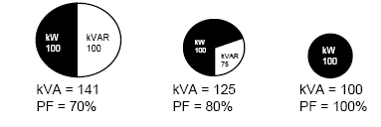
Other Benefits:
Released system capacity:
  » The effect of PF on current drawn is shown below:
  Decreasing size of conductors required
  to carry the same 100kW load at P.F.
  ranging from 70% to 100%

Slide 86

Other Benefits:
Reduced Power Losses:
» As current flows through conductors, the conductors
heat. This heating is power loss
» Power loss is proportional to current squared (P_{Loss}=I²R)
» Current is proportional to P.F.:
» Conductor loss can account for as much as 2-5% of
total load
Capacitors can reduce losses by 1-2% of the total load

Slide 87
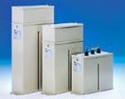
Low Voltage Capacitor Unit –Low Voltage Capacitor
Cubicle-type automatic capacitor banks are modular in structure.

Slide 88
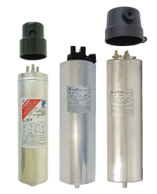
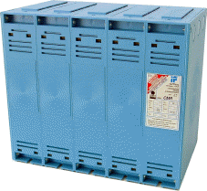


Series CMR
Series RCF
Series MFA
Series MFHC

Slide 89
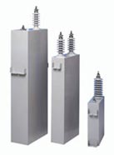
High Voltage Capacitor Unit –High Voltage Capacitor Units
There are two types of fuses used for capacitors; internal and external.

Slide 90
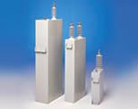
High Voltage Capacitor – High Voltage Capacitors
High Voltage Capacitors One-Phase Units have all-film dielectric and are impregnated with dielectric liquid which is environmentally safe.

Slide 91
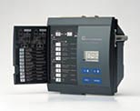
Power Factor Controller – Power Factor Controllers
Power Factor controllers 6 step or 12 step models are manufactured for the control of the automatic capacitor banks.

Slide 92
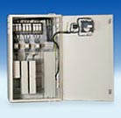
Power Factor Correction Capacitor PFC
Automatic capacitor banks are used for central power factor correction at main and group distribution boards.

Slide 93
Different Locations of capacitor banks

Slide 94
Determining capacitor
requirements

Slide 96
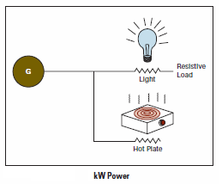

Slide 97
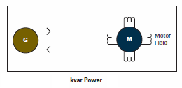
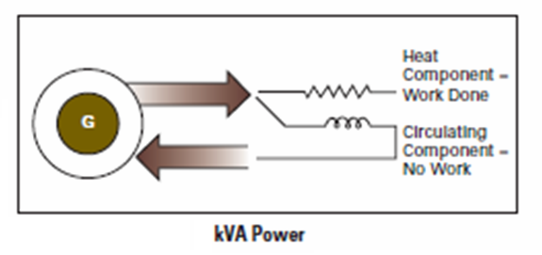

Slide 98
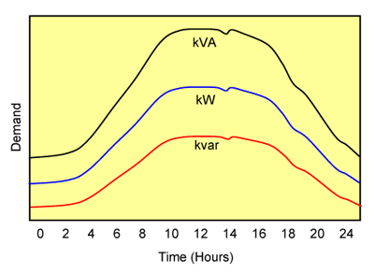

Slide 99


Slide 100
Examples:
A plant with a metered demand of 600 KW is operating at a 75% power factor. What capacitor KVAR is required to correct the present power factor to 95%?
Solution
From Table 1, Multiplier to improve PF from 75% to 95% is 0.553
Capacitor KVAR = KW × Table 1 Multiplier
Capacitor KVAR = 600 × 0.553 = 331.8 say 330

Slide 101
2. A plant load of 425 KW has a total power requirement of 670 KVA. What size capacitor is required to improve the factor to 90%?
Solution
Present PF = KW/KVA = 425/670 = 63.4% say 63%
From Table 1, Multiplier to improve PF from 63% to 90% is 0.748
Capacitor KVAR = KW × Table 1 Multiplier =
425 × 0.748 = 317.9 say 320 KVAR

Slide 102
3. A plant operating from a 480 volt system has a metered demand of 258 KW. The line current read by a clip-on ammeter is 420 amperes. What amount of capacitors are required to correct the present power factor to 90%?
Solution
KVA = 1.73 × KV × I = 1.73 × 0.480 × 420 = 349 KVA
Present PF = KW/KVA = 258/349 = 73.9% say 74%
From Table 1, Multiplier to improve PF from 74% to 90% is 0.425
Capacitor KVAR = KW × Table 1 Multiplier = 258 × 0.425 = 109.6 say 110 KVAR

Slide 103
4. Assume an uncorrected 460 KVA demand, 380 V, 3-phase, at 0.87 power factor (normally good).
Determine KVAR
required to correct
to 0.97 power factor..
460 KVA₁
412 KVA₂
400 kw

Slide 104
Solution:
KVA × PF = KW
460 × 0.87 = 400 KW actual demand
at PF = 0.97
KVA corrected = 400/0.97 = 412 KVA
From Table of multipliers, to raise the PF from 0.87 to 0.97
Required Capacitor
Multiplier = 0.316
KW × multiplier = KVAR required
KVAR required = 400 × 0.316 = 126 KVA
= 140 KVAR (use)

Slide 105

Transformer serving the loads

Slide 109


Slide 110
As the triangle relationships demonstrate, KVA decreases as power factor increase.
At 70% power factor , it required 142 KVA to produce 100 KW. At 95% power factor, it requires only 105 KVA to produce 100 KW. Another way to look at it is that at 70% power factor, it takes 35% more current to do the same work.

Slide 111


Slide 112

Required Apparent Power before and after Adding Capacitors

Slide 113


