Slide 1
Module -4
Two dimensional electronic system,
Two dimensional behaviour,
MOSFET structures,
Heterojunctions Quantum wells,
Modulation doped quantum wells,
Multiple quantum wells
The concept of super lattices Kronig - Penney model of super lattice.

Slide 2
Introduction
Study : nanostructures or devices formed by one or several heterojunctions
These devices can be constructed from basic structures - heterojunctions, MOS structures.
provide electrons with a potential well for electrons of nano metric size at the junction.

Slide 3
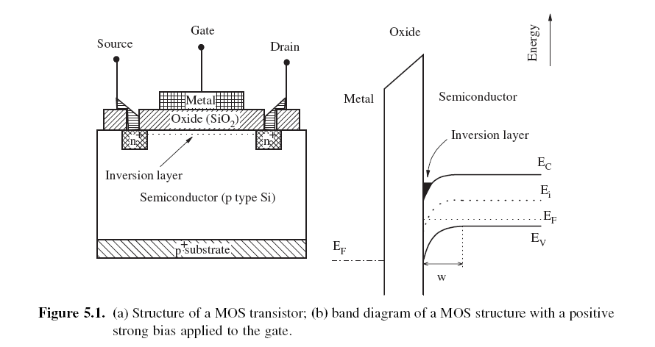
MOSFET

Slide 4
MOSFET
main contributor to present technology in general, and microelectronics in particular
basic unit of ULSI
MOSFET-based electronic devices constitute close to 90% of the semiconductor device market.

Slide 5
MOSFET
positive potential at gate, the electrons from n+ and p-silicon accumulate at the Si–SiO2 interface. These electrons form inversion layer or channel
Form triangular-shaped potential well in nanoscale.
Shape is due to space charge (a collection of particles with a net electric charge occupying a region, either in free space or in a device) of ionized acceptors in the p-type silicon, whose corresponding holes are repelled by the electric field across the dielectric oxide produced by the positive gate potential.

Slide 6
MOSFET
Amount of electrons in the inversion layer depends on the magnitude of the electric field across the insulator. The name “FET” is due to the control effect of the electric field applied to the gate.
MOSFET technology is popular due to:
- excellent properties of the Si–SiO2 interface
- possibilities of reducing the size of the MOSFET below 100 nm in modern IC.

Slide 7
Conditions to have Quantum Effects at Si–SiO2 interface
(a) the SiO2 insulator should have neither high concentration of impurities nor of trapped charge
(b) the smoothness of the Si–SiO2 interface should be controlled at the atomic size level, since a rough surface on top of the inversion channel would greatly decrease the electron mobility in the inversion layer.

Slide 8
Behaviour of electrons in the potential well,
The electron inversion layer can be considered a 2D system of electrons immersed in a triangular-shaped quantum well, located in the semiconductor, close to the interface with the oxide.
In the MOS structure, although the electrons are confined along the perpendicular direction, they are practically free to move in the plane of the interface.
the quantized values for the energy of confinement is=

Slide 9
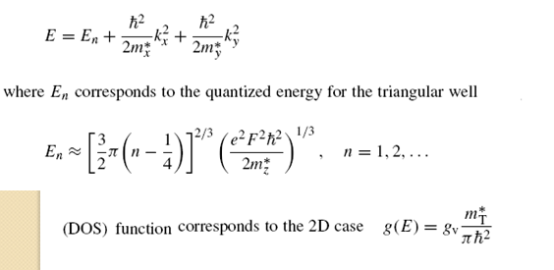

Slide 10
Where,
Equation for E represents a parabola in reciprocal space
gv - conduction band valley degeneracy
Degeneracy - having more than one quantum states with the same sharply-defined energy. Eg: there can be a state where an electron is rotating one way around the nucleus and another state of the same energy where it rotates the opposite way.
If N degenerate states exists; energy level is said to be N fold degenerate

Slide 11
gv - conduction band valley degeneracy
Degeneracy arises from the fact that constant energy surfaces (loci of all k-points having same energy in CB) of the silicon conduction band are formed by six ellipsoids in the <001> direction of momentum space
constant energy surface is an ellipsoid - a surface that may be obtained from a sphere by deforming it by means of directional scaling.

Slide 12
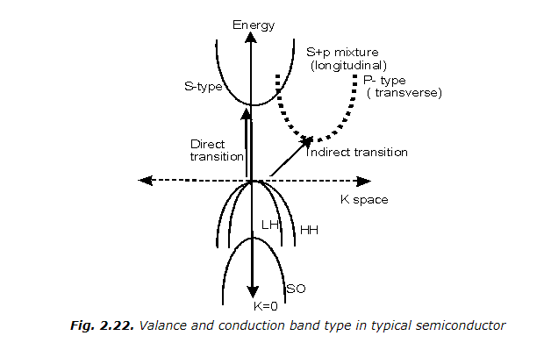
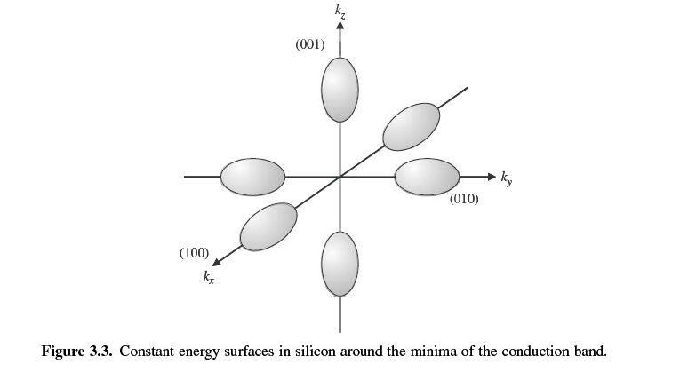
gv - conduction band valley degeneracy

Slide 13
The long axis of the ellipsoid corresponds to the longitudinal effective mass m∗_{L} = 0.91m0 and the two equal short axes to the transversal effective mass m∗_{T} = 0.19m0
Therefore, there are two conduction band minima corresponding to the heavy effective mass and four to the light one.
neglecting coupling of the electrons in the various conduction band minima, two different subband values for the Si <001> exist.

Slide 14
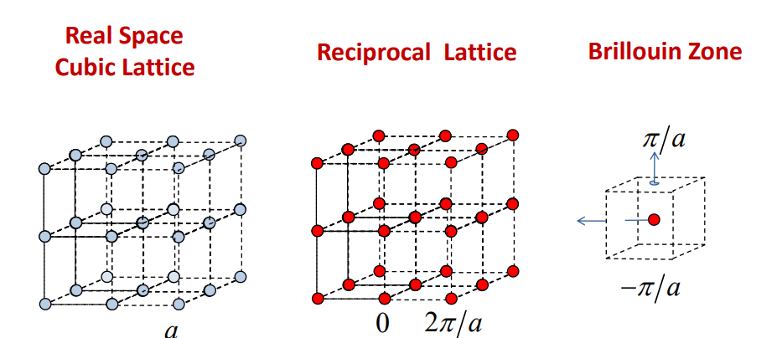

Slide 15
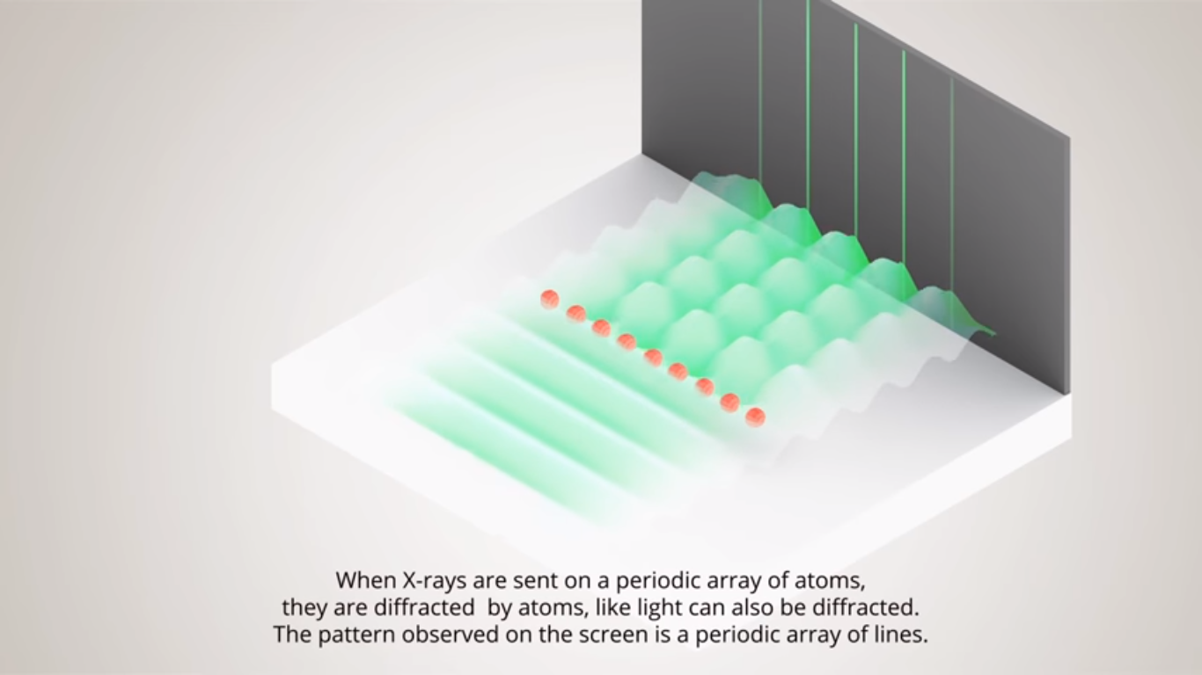

Slide 16
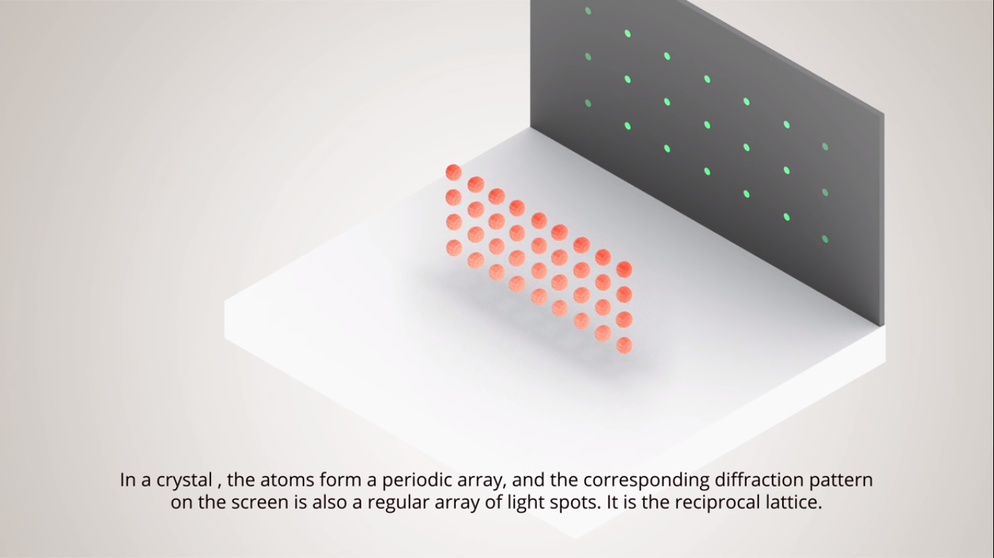

Slide 17

BZ- Primitive cell (min. volume cell) in reciprocal space
Ellipsoid =
Momentum space – set of all momentum vector a physical system can have
In SCs- bands are parabolic but Constant energy surface are ellipsoid
The band gap is called "direct" if the crystal momentum of electrons and holes is the same in both the conduction band and the valence band;
Valley – CB minima

Slide 18
Energies of electrons in valleys perpendicular / parallel to the interfaces.
Case 1: Electrons in valleys perpendicular to the interfaces.
The effective mass which enters Eq. for
En = . &
gv = 2.
This results in sub bands of lower energy
Case 1I: Electrons in valleys parallel to the interfaces.
En = and
gv = 4.

Slide 19
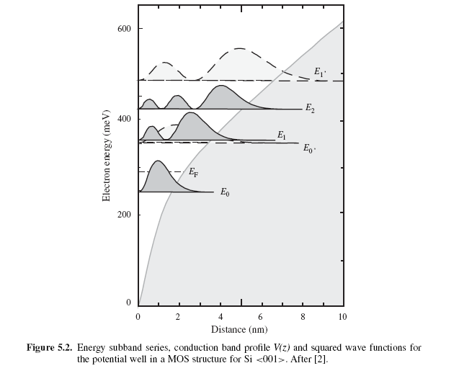
Results obtained for the energies of a Si-MOSFET with the insulating oxide grown over a <001> silicon surface
self-consistent numerical solution of Schrödinger and Poisson equations using the parameters

Slide 21
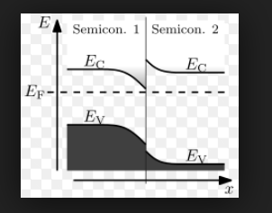
Hetreojunctions
interfaces between two semiconductors of different gaps
most versatile building blocks of electronic devices, especially those based on III-V compounds.

Slide 22
Al_{x}Ga_{1−x}As – GaAs heterojunction
Most popular - n-type Al_{x}Ga_{1−x}As and almost intrinsic or lightly doped p-type GaAs.
an inversion layer of electrons is formed in the GaAs close to the GaAs–AlGaAs interface.
physics of this electronic system is having principle similar to MOS structure
Devices based on AlGaAs structures can be used to much higher frequencies than silicon devices due to the high mobility of electrons in GaAs.
Since oxides and insulators deposited over GaAs do not present an interface of sufficient quality, the most important device applications are based on a Schottky structure of the type metal–AlGaAs–GaAs

Slide 23
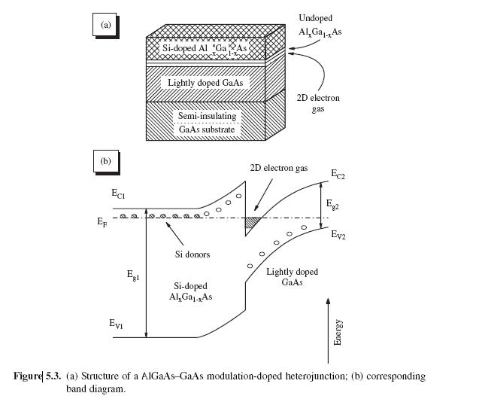

Slide 24
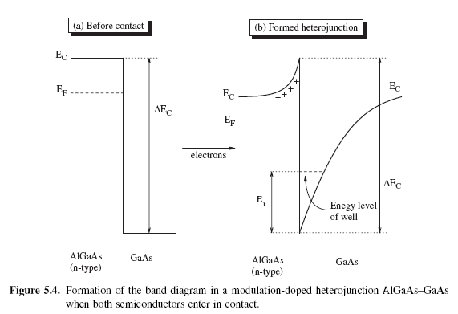
Formation of electron well of nanometric size - modulation-doped heterojunction / modulation doping.

Slide 25
Case 1. Before contact
Fermi level, of n-type AlGaAs is close to the conduction band, and for lightly p-doped GaAs is close to the middle of the gap
bands are flat because the materials are electrically neutral and have uniform doping.
barrier between them in the conduction band, ΔEc, can
be approximately found following Anderson’s rule.

Slide 26
Anderson’s Rule
Electron affinity of a semiconductor is defined as the energy required for an electron located at the bottom Ec of the conduction band, to get out of the solid.
Vacuum level refers to the energy of a free stationary electron that is outside of any material (it is in a perfect vacuum). It may be taken as infinitely far away from a solid.
As the vacuum level is a property of the electron and free space, it is often used as the level of alignment for the energy levels of two different materials.
χ = Evac – Ec.

Slide 27
Anderson’s rule
Anderson’s rule - when we join two materials, the vacuum levels should line up.
If χA and χB are the electron affinities of the AlGaAs and GaAs, respectively, we should have
ΔEc ≡ χA − χB,
According to this rule, one gets a value of Ec of 0.35 eV for a doping x in AlxGa1−xAs around 0.3.

Slide 28
Case II – Heterojunction formed
electrons from the donors of the n-material will cross the interface reaching the undoped GaAs.
Therefore, as in the p–n junction, an internal electric field will be created and directed from the non-neutralized donors in the AlGaAs to the additional electronic charges in the GaAs.
This field is the one that causes the band bending

Slide 30
At equilibrium, the two Fermi levels line up, the bands are bent like in the case of the p–n junction, with the only difference that the barrier ΔEc is created.
Moving away from the interface, the bottom Ec of the conduction bands is flat and at the same distance from the Fermi level E_{F}.
A quantum well for the electrons has been formed which is limited by a potential well of height ΔEc in the left and a potential energy curve at the right, within the GaAs.

Slide 31
The quantum well for the electrons is triangle shaped at the as in the case of the MOS structure.
Therefore, if z direction is perpendicular to the interface, the electrons forming the 2D inversion layer are free to move along the (x, y) plane, but their energy for the motion along z is quantized as in a potential well.

Slide 32
The charge carriers are located in a region (mainly in the GaAs), spatially separated from the AlGaAs semiconductor which originates the free electrons.
The electrons in the well should have very high mobility for their motion along the (x, y) plane, since they move within the GaAs which is free of dopant impurities and it is well known that impurity scattering is one of the main factors which limit carrier mobility, especially at low temperatures.
Evidently, the electron motilities' is higher than the MOS structure

Slide 33
These factors allow us to describe the main properties of AlGaAs–GaAs heterojunctions.
Numerically solving Poisson’s equation for the potential and Schrödinger’s equation for the electron wave functions is needed
Assumed that potential well is perfectly triangular in shape.
Detailed calculations also allow calculation of average width of the well (40–80 Å),
Electron concentration per unit area, ns ≈ 10¹²cm⁻²,
energy ε₁ of the first level ≈ 0.04 eV.

Slide 34
To construct FET based on AlGaAs–GaAs heterojunctions, source and drain contacts have to be deposited as for the MOSFET.
By applying differences of potential to the gate, the number of carriers in the channel, and therefore its conductance, can be controlled as in the case of the MOSFET
These transistors are called modulation-doped field effect transistor (MODFET), from modulation doping, or high electron mobility transistor (HEMT).

Slide 35
SiGe strained heterostructures
Large lattice constant difference between Si and Ge (4%.)i.e. the layers grow strained over the substrate
that a critical thickness should not be surpassed else the structure breaks off.
Height of the barriers which appear at the interface is small as Eg of Si and Ge is small
Applications: high frequency transistors, IR photo detectors, bi polar Si transistors

Slide 36
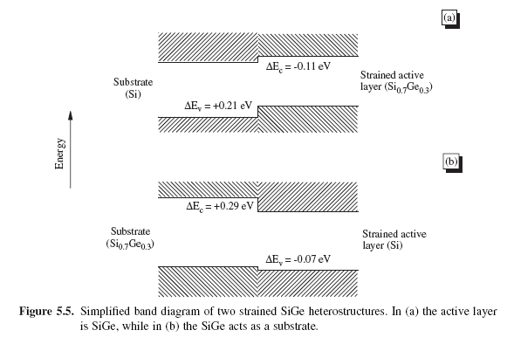
Si-Ge and Si heterojunctions

Slide 37
Si- strained active layer Si0.7Ge0.3
the conduction band offset is rather small, in contrast to the valence band offset.
forming a 2D hole gas in the SiGe alloy, with electron mobilities around 2m²V⁻¹s⁻¹
i.e.half the value found for electrons in a typical MOSFET
the discontinuity in the conduction band is fairly large
Form a 2D electron gas, with free motion in the plane of the interface.
The silicon effective mass corresponding to this motion is the low transversal one ( ≈ 0.19m0),
Leads to high mobility of around 20m²V⁻¹s⁻¹, several times higher than that of the MOSFET.

Slide 38
Narrow-band gap material for the base region, improves the efficiency of the Si emitter region in bipolar Transistor.
Advantage was from the reduced values of the SiGe band gap alloys, wrt to Si.
The strain that appears in the heterojunction also contributes to the decrease of the bandgap.
The large bandgap offset allows the fabrication of a highly doped, low resistivity, base material, which allows the performance of Si transistors to much higher frequencies.

Slide 39
Modulation-doped quantum well
It is desirable to have approximately symmetric and square-shaped wells in multiple quantum wells.
A symmetric well is formed by facing two AlGaAs – GaAs hetero junctions opposing each other
The wide gap semiconductor material Al_{x}Ga_{1−x}As is located at the ends and the GaAs in the middle.
The distance between the two interfaces is made sufficiently small. Then the resulting well for electrons and holes would be almost square with a barrier on each side of the same height.

Slide 40
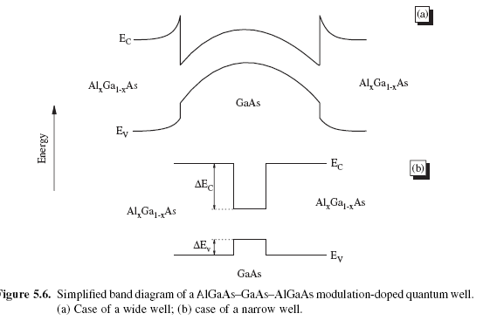

Slide 41
Volume of material inside the well is free of ionized donors (located in the AlGaAs material).
So, electrons inside the well, which originated at AlGaAs donor-material, can move into the GaAs region or channel with very high mobility.
As in the case of the modulation-doped
heterojunctions, MODFET high-frequency transistors can be fabricated if appropriate
source and drain contacts are deposited.

Slide 42
Quantum well structures with either high or low mobility for electrons can be fabricated by introducing a controlled amount of impurities.
A double quantum well structure with high and low mobilities constitutes the base of the velocity-modulation transistors.
In these transistors, the switching from one state to the other is controlled by an electric field
transverse to the layers which redistributes the amount of charged electrons and therefore the current in either wells.
Velocity-modulation transistors can be operated at very high frequencies.

Slide 43
It is difficult to find accurate equations for the wave functions and energy levels of electrons and holes in the wells,.
As the potential at the bottom, instead of being flat, is influenced by the variations at the interfaces and the problem has to be solved by numerical methods

Slide 44
To describe the general behaviour, perturbation theory is used and we consider the potential variations as a perturbation.
The perturbation potential should be symmetric, and thus an even function of z, ie only states with the same parity can be mixed,.
For instance, if we assume that only three levels exist in the well, the first state can only be coupled with the third.
Evidently, the occupation of levels depends on the electron concentration in the well, and for low concentrations usually the first level is the only one occupied.

Slide 45
Multiple quantum wells (MQW)
The signal provided by a single quantum well is usually too small to be used in the solid state devices. Therefore, it is often necessary to use an array of quantum wells, especially in optoelectronic devices, such as photodetectors.
These structures are called multiple quantum wells (MQW) and are formed by several single quantum wells.
If the wells for electrons and holes are located in the same space location, the MQW is called Type I while the name Type II is used when the corresponding wells are located alternatively

Slide 46
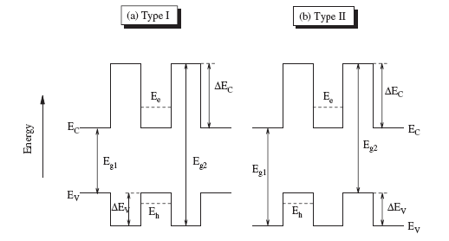

Slide 47
In a MQW system it is assumed that there is no interaction between neighbouring quantum wells, because the barriers separating the wells are thick enough, usually more than about 10 nm.
If the energy barriers between consecutive wells are thin enough, the wells will be coupled to each other by tunnelling effects.
The discrete energy levels of the quantum wells are then transformed into energy bands.
Then, the system of MQWs is called a superlattice and the energy spectrum shows very interesting new features.

Slide 48
In optoelectronics,
MQWs are frequently used and are made of about 50 single wells.
The periodicity (thickness of the well plus barrier) is about 20 nm, then the total thickness of the array approaches 1μm. the limit in thickness;
Else radiation would be strongly absorbed before reaching the inner quantum wells.
Spectrum of the total optical signal does not necessarily coincide with that of a single quantum well since the thickness of each well is not exactly the same for all (Eg: the percentage variation in the width of a quantum well when the thickness varies by just one monolayer).
So, the breadth of the MQW energy levels can be used as an index of its uniformity in thickness.

Slide 49
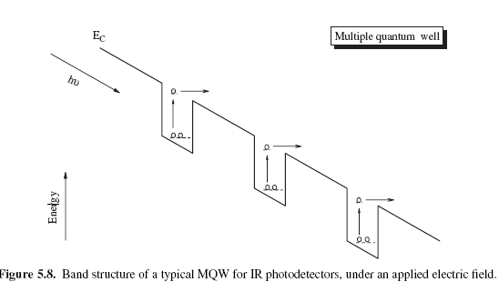
Band Structure of MQW for IR photodetectors

Slide 50
Band Structure of MQW for IR photodetectors
Usually work at wavelengths in the 10μm range.
to detect this long wavelength radiation using bulk semiconductors, a gap of only about 0.1 eV is reqd.
Options: use intersubband detection in quantum wells.
By : (i) adjust the well height ΔEc (by changing the value of x in Al_{x}Ga_{1−x}As / GaAs),
(ii) the values of energy levels through the thickness of the well material.

Slide 51
Band Structure of MQW for IR photodetectors
the levels are calculated so that the second level is only a little below the bottom edge of the conduction band of the wide gap material (Al_{x}Ga_{1−x}As).
Also, the semiconductor doping is chosen so that the n = 1 level is full and the n = 2 empty.
Taking these considerations, when a photon of energy ω, equal to E2 − E1 impinges, electrons will be liberated and drift along the z-axis by the action of a weak applied electric field.

Slide 52
Superlattice
Proposed by Leo Esaki
consists of a periodic set of MQW where the thickness of the energy barriers separating the individual wells is sufficiently small.
As barriers become thinner, the electron wave functions corresponding to the wells overlap due to the tunnelling effect.
the discrete energy levels of the wells broaden and produce energy bands,
Most singular aspect - accurate control over the small thicknesses (d = breadth of the well (a) + the thickness of the barrier (b)) to be achieved by MBE.

Slide 53
Origin of the band structure of superlattice
Consider the overlapping between the electron states for a simple two-well system.
wave functions of what is known as the double coupled quantum well system.
Solution is by using Perturbation theory

Slide 54
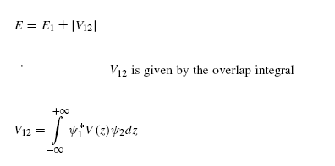
each original level, say E1, of the isolated wells splits into two, with energies
The two resulting levels are separated in energy by 2|V12|,
where the magnitude of V12 is an indication of how much one well can influence the energy states of the neighbouring one

Slide 55
