Slide 1
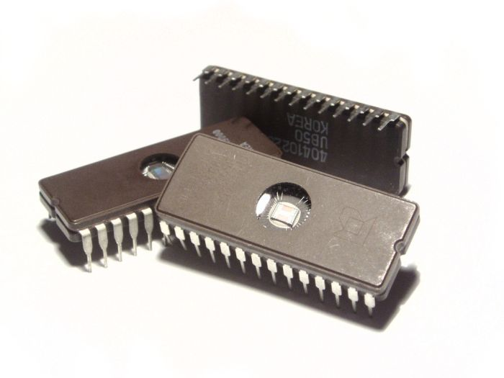
INTEGRATED CIRCUITS

Slide 2
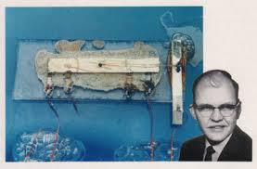
INTEGRATED CIRCUITS
In electronics, an integrated circuit (also known as IC, microcircuit, microchip, silicon chip, or chip) is a miniaturized electronic circuit (consisting mainly of semiconductor devices, as well as passive components) that has been manufactured in the surface of a thin substrate of semiconductor material. Integrated circuits are used in almost all electronic equipment in use today and have revolutionized the world of electronics.
The first integrated circuit was developed in the 1950s by Jack Kilby of Texas Instruments and Robert Noyce of Fairchild Semiconductor.

Slide 3
ADVANTAGES OF IC’S
SMALL SIZE
LOW COST
IMPROVED PERFORMANCE
HIGH RELIABILITY AND RUGGEDNESS
LOW POWER CONSUMPTION
EASY TROUBLESHOOTING
INCREASED OPERATING SPEED
LESS WEIGHT,VOLUME
EASY REPLACEMENT

Slide 4
DISADVANTAGES OF IC’S
AS IC IS SMALL IN SIZE ITS UNABLE TO DISSIPATE LARGE AMOUNT OF POWER. INCREASE IN CURRENT MAY PRODUCE ENOUGH HEAT WHICH MAY DESTROY THE DEVICE.

Slide 5
CLASSIFICATION OF IC’S
On the basis of fabrication techniques used
On the basis of the chip size
On the basis of applications

Slide 6
ON BASIS OF FABRICATION
Monolithic IC’s
Hybrid or Multi-chip ICs.

Slide 7
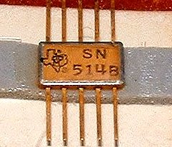
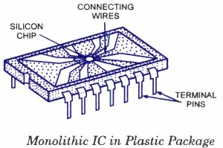
MONOLITHIC IC’S
Monolithic circuit is built into a single stone or single crystal i.e. in monolithic ICs, all circuit components, and their interconnections are formed into or on the top of a single chip of silicon. Monolithic ICs are by far the most common type of ICs used in practice, because of mass production , lower cost and higher reliability.

Slide 8
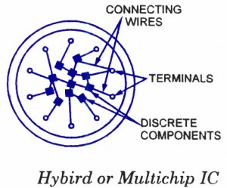
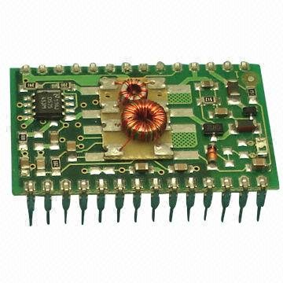

HYBRID IC’S
The circuit is fabricated by interconnecting a number of individual chips.
Hybrids ICs are widely used for high power audio amplifier applications .
Have better performance than monolithic ICs
Process is too expensive for mass production

Slide 9
ON BASIS OF CHIP SIZE
SSI (small-scale integration)
MSI (medium-scale integration)
LSI (large-scale integration)
VLSI (very large-scale integration)
ULSI (ultra large-scale integration)

Slide 10
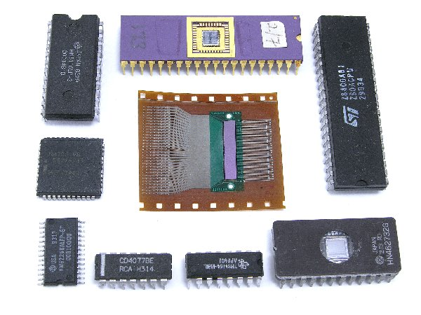
SSI AND MSI
Small scale integration (SSI) has 3 to 30 gates/chip orUp to 100 electronic components per chip
Medium scale integration (MSI) has 30 to 300 gates/chip or 100 to 3,000 electronic components per chip

Slide 11
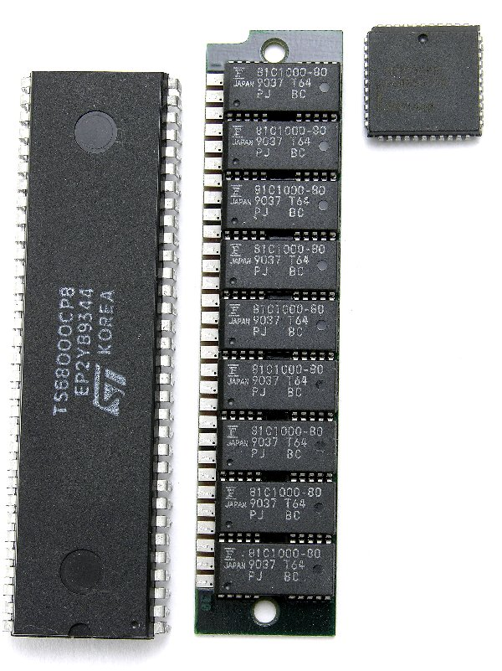
LSI AND VLSI
Large scale integration (LSI)-300 to 3,000 gates/chip or 3,000 to 100,000 electronic components per chip
Very large scale integration (VLSI)-more than 3,000 gates/chip or 100,000 to 1,000,000 electronic components per chip

Slide 12
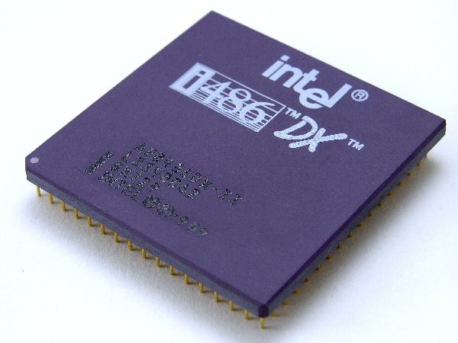
ULSI
Ultra Large-Scale Integration (ULSI)- More than 1 million electronic components per chip The Intel 486 and Pentium microprocessors, for example, use ULSI technology.

Slide 13
ON BASIS OF APPLICATIONS
LINEAR INTEGRATED CIRCUITS
DIGITAL INTEGRATED CIRCUITS

Slide 14
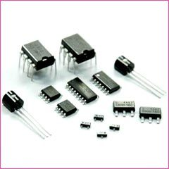
LINEAR INTEGRATED CIRCUITS
When the input and output relationship of a circuit is linear, linear ICs are used. Input and output can take place on a continuous range of values.
Example operational amplifiers, power amplifiers, microwave amplifiers multipliers etc.

Slide 15
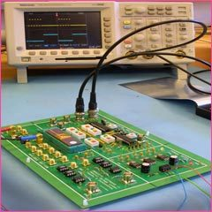
DIGITAL INTEGRATED CIRCUITS
When the circuit is either in on-state or off-state and not in between the two, the circuit is called the digital circuit. ICs used in such circuits are called the digital ICs. They find wide applications in computers and logic circuits.
Example logic gates, flip flops, counters, microprocessors, memory chips etc.

Slide 16
Monolithic IC process
Wafer preparation
Oxidation
Diffusion/ion implantation
Chemical vapour deposition
Metallization
Lithography
packaging

Slide 17
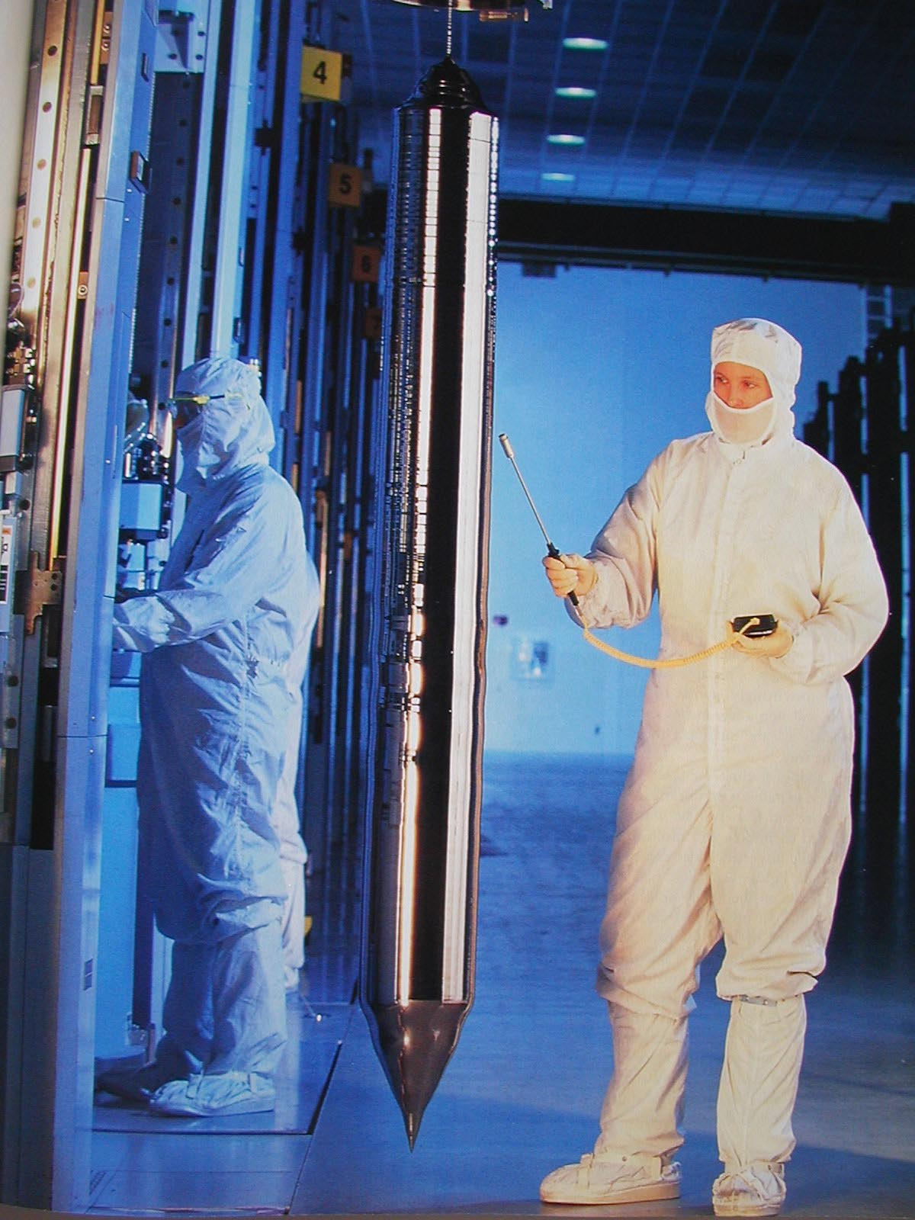
Wafer preparation
10 – 30 cm diameter
1- 2 m length

Slide 18

400-600 µm thick

Slide 19
Oxidation
Oxygen introduced either as high purity gas or as water vapour

Slide 20
Diffusion/ion implantation
Techniques in which dopants are introduced
Diffusion-dopant impurities are added in a high temperature furnace(1000-1200ºc)-the impurity will move from higher concentration to lower concn.
Ion implantation- produce dopants in ion form-accelerates by electric field-used where accurate control of dopant is required

Slide 21
Chemical vapour deposition
Process by which gases or vapours are chemically reacted resulting in the formation of a solid on a substrate
Used to create dielectrics and poly Si(low temp)
Advtg of CVD compared to oxidation-oxide deposits at a faster rate at a lower temp
Special case of CVD is- epitaxy- single crystalline Si is grown over the wafer(high temp)

Slide 22
Metallization
Interconnects various components of IC
Deposition of aluminium metal over the areas where interconnection is required

Slide 23
Lithography
Defines surface geometry of components
Selective removal of SiO₂ to form opening(windows) through which dopants may be diffused to produce various ckt components
Lithography types- photolithography,fine line lithography(x-ray lithography,electron beam lithography,ion beam lithography)

Slide 24
Packaging
Chip- rectangular shape 1 and 10 mm on each edge-tested electrically while still in wafer form
Bad chips-marked for final identification
Chips-seperated each other by dicing
Good chips mounted in packages
Fine gold wires –used to interconnect pins of packages to bonding pads of die
Package –sealed under vaccum or in an inert atmosphere

Slide 25
https://www.youtube.com/watch?v=qm67wbB5GmI
https://www.youtube.com/watch?v=aWVywhzuHnQ

Slide 26
Lithography
Etching out oxide layer to create a path to diffusion
Different masks with window patterns are used
Photolithography and fine line lithography

Slide 27
Photolithography – process steps
Photoresist application
Prebake
Alignment and exposure
Development
Postbake
Oxide etching
Photoresist stripping

Slide 28
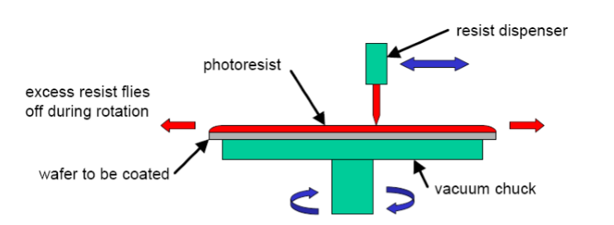
Photo resist application

Slide 29
Photoresist application(spinning)
Photoresist-applied to centre of oxidized Si wafer
Rotational velocity-3000 to 7000 rpm – 30 to 60 sec
Kodak thin film resist
PHOTORESIST
SiO₂
Si wafer

Slide 30
Prebake
Oven-80º c – 30 to 60 min
Photoresist-semisolid fim

Slide 31
Alignment &exposure
Mask aligner – aligns mask with wafer
Photomask-glass plate(125mm sq & 2 mm thick)-photographic emulsion pattern on one side
After proper alignment, wafer is brought into direct contact with photomask
UV rays- exposure - 3 to 10 sec

Slide 32
uv rays
glass photomask
Opaque pattern
Si wafer

Slide 33
Development
2 types of photoresist- negative photoresist
- positive photoresist
Negative type- areas – exposed to UV rays- polimerized-make resist tougher &insoluble in developer solution
Si wafer

Slide 34
Positive photoresist-areas exposed to UV Light- depolimerization-exposed areas of photoresist- readily soluble in developer solution

Slide 35
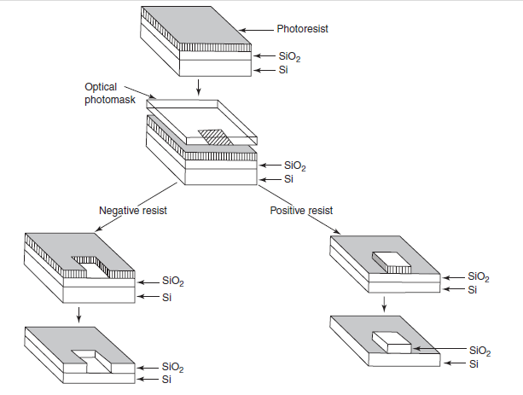
Photolithography processes using negative and positive photoresist:

Slide 36
Post bake
Oven-150º c – 30 to 60 min
Toughens further remaining resist- more resistant to HF used for etching oxide layer

Slide 37
Oxide etching
Etching of oxide layer- wafer gets ready for impurity diffusion
Sprayed with HF solution
Diluted solution- 10:1(H₂O: HF)
- 10:1(NH₄F: HF)
HF Solution- will not attack photoresist layer or underlying Si

Slide 38
10:1(NH₄F: HF) – etching rate-1000º A/min at 25º c
Si wafer

Slide 39
Photoresist stripping
H₂ SO₄ -H₂O₂ with abrasion process
Wash & dry
Negative photoresist- difficult to remove
Positive photo resist- easily removable- acetone
Si wafer

Slide 40
Photo mask fabrication
IC fabrication – batch processing
No: of IC’s /chip – depends on – chip size & diameter of wafer
Mask layout- CAD
No: of masks- each mask- opaque areas- windows are created

Slide 41
Fineline lithography
Electron beam lithography
X-ray lithography
Ion beam lithography

Slide 42
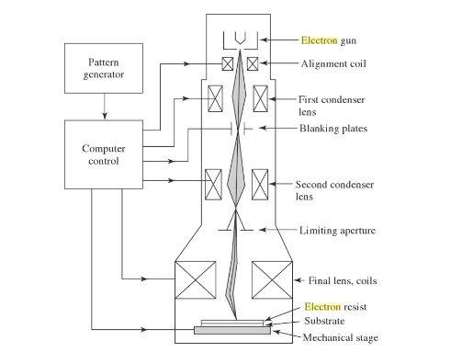
Electron beam lithography

Slide 43
Advtg of EBL
Micron or submicron geometries in a highly automated and precise environment
Depth of focus greater than photolithography
Direct patterning without a mask

Slide 44
Disadvantage
Low throughput- 10 wafer/hr
Limited by electron scattering-collisions-energy losses & path changes

Slide 45
Chemical vapour deposition(CVD)
Formation of nonvolatile solid film on a substrate by the reaction of vapour phase chemicals(reactants) that contain the required constituents
Used to deposite dielectrics and polySi

Slide 46
Metallization
CVD
PVD – Evaporation
- sputtering

Slide 47
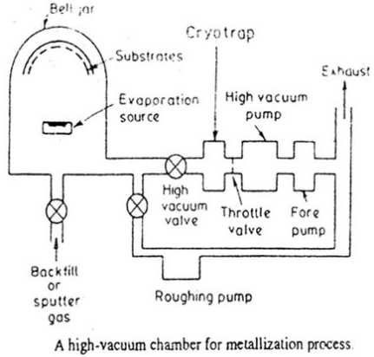

Slide 48
Al for metallization
Film thickness 1µm & conductor widths of 2 to 25µm.
Advtgs of Al:
1.Good conductivity
2.Easy to deposite thin film by vaccum evaporation
3.Forms good mechanical bond with Si and forms low resistance ohmic contact
4.Applied and patterned with single deposition and etching process

Slide 49
Metallization patterning
Aluminium etchant- phosphoric acid+nitric acid+acetic acid
Lift off process

Slide 50
https://www.youtube.com/watch?v=qm67wbB5GmI
https://www.youtube.com/watch?v=aWVywhzuHnQ

Slide 51
ETCHING FOR DESIGN:
Etching selectively removes layers of SiO2, metals, and poly-silicon, according to the desired patterns delineated by the resist. The two major methods of etching are wet chemical etching or dry etching.
The windows are created by the photolithographic process and subsequent etching process in the desired pattern implemented by the masking process .

Slide 52
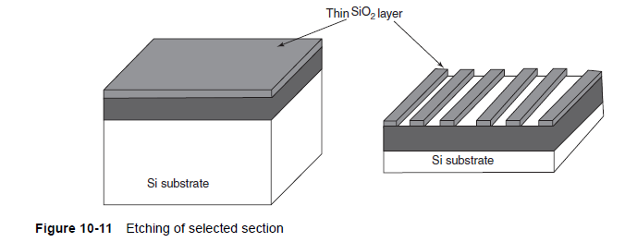
Different Types of Etching:
1. Wet Chemical Etching:
Wet etching is accomplished by partial submersion of the wafer in an acid bath having some definite concentration. Etching solutions are housed in a temperature-controlled baths.

Slide 53
Different Types of Etching:
2. Dry Chemical Etching:
Dry processing effectively etches desired layers through the use of gases, using either, a chemically reactive gas, or through physical bombardment of argon atoms. Dry etching is commonly used due to its ability to better control the etching process and decrease contamination levels.
3. Chemical Plasma Etching:
Plasma etching systems have been developed that can effectively etch silicon, silicon dioxide, silicon nitride, aluminium, gold, glass, etc. The barrel or cylindrical, and the parallel plate or planar are the two kinds of plasma etching reactor systems are generally used. The typical reactor consists of a vacuum reactor chamber

Slide 54
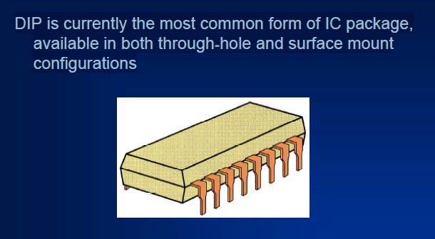

Slide 55
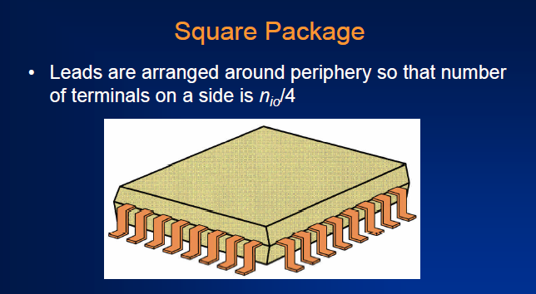

Slide 56
PACKAGING PROTECTION:
The last step of this process is packaging.
Packaging is done according to the dimension of the product type, and the requirements of the manufacturer. The wafer is certified then the wafer is broken into small individual dies.
Small wires are bonded to connect pads to the external connection pins. The most common packaging is dual input packaging or DIP, mostly used in digital IC.
Pin grid array (PGA) and leadless chip carrier (LCC) packages are used in modern VLSI design. After testing and packaging, the product is sent to the market for sale.

