Slide 1
PLA DESIGN

Slide 2
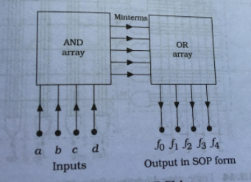

Slide 3
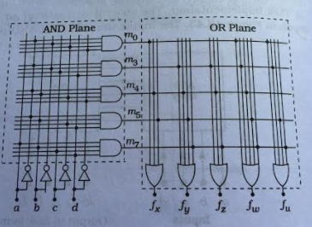

Slide 4


Slide 5
Pseudo NMOS Logic
Dynamic logic

Slide 6
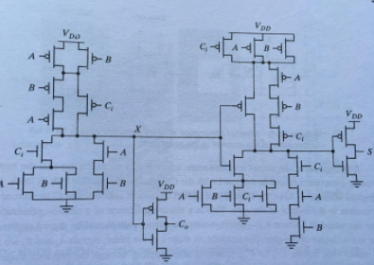
Static adder

Slide 7
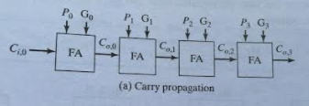
Carry bypass/carry skip adder

Slide 8
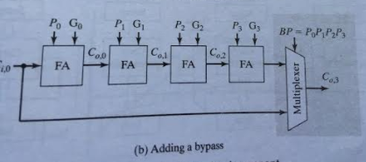

Slide 9
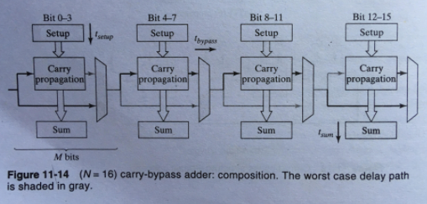


Slide 10


Slide 11
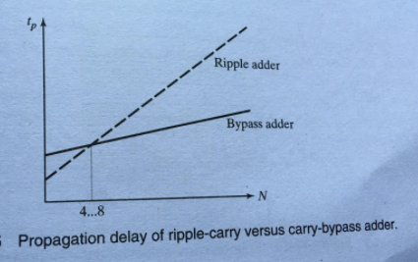

Slide 12
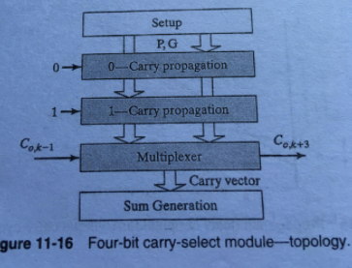
Carry select adder

Slide 13
