Slide 1
VLSI
MODULE 1

Slide 2
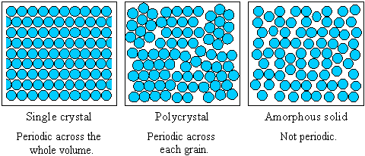
Single crystals have infinite periodicity, polycrystals have local periodicity, and amorphous solids (and liquids) have no long-range order.

Slide 3
Basic IC Fabrication steps
Si wafer preparation
Diffusion of impurities
Ion Implantation
Oxidation
Lithography
Chemical Vapour Deposition
Metallisation
Packaging

Slide 4
Si wafer preparation
Steps :-
Generation of MGS from raw material
Conversion of MGS to EGS
Conversion of EGS to single crystal Si
Metallurgical-grade silicon (MGS)
Electronic-grade silicon (EGS)

Slide 5
1) Generation of MGS from raw material
Quartzite (pure form of sand ,(SiO₂)) & Carbon is taken in an arc furnace and heated at high temperature to produce MGS
MGS is drawn off &
solidifies at purity of 98%
The impurities present
in MGS are Fe, Al and C

Slide 7
2) MGS to EGS Conversion

Slide 8
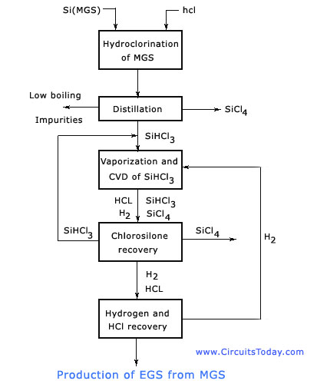
SiHCl₃, SiCl₄
Si (EGS)
HCl

Slide 9
MGS to EGS Conversion
MGS is grounded to powdered form and is treated with anhydrous Hydrogen Chloride (HCl) in a fluidized bed reactor at 300° C to form trichlorosilane (SiHCl₃).
SiHCl₃ fractionally distilled and reduced by H₂ to obtain pure form.
EGS is pure form of Si but it is polycrystalline.
+ Impurity Chlorides

Slide 10
Defects in EGS :
In real crystals, due to thermal agitation, atoms can be misplaced from their location which leads to following defects :
1)Point Defect: Includes vacancy, interstitial, misplaced atoms
Vacancy is created when an atom is removed from crystal lattice site (Shottky Defect).
Interstitial : A non-Si atom is placed in one of many interstitial voids of crystal structure.
Misplaced atoms : Si atoms leaves its regular site in a crystal & takes up an interstitial position in the vicinity of a newly formed vacancy.

Slide 11
2) Edge Dislocation defect : An extra plane of atoms is introduced in between orginal plane of atoms.
3)Area Defect : Occurs when area discontinuity is large & crystals of different orientation are kept together. 2 types
Twinning : occurs when one portion of crystal lattice takes up the orientation wrt other.
Grain Boundary : It’s the region with large concentration of broken or unsatisfied bonds.
4) Volume defects : occur due to precipitates of impurity or dopant atoms

Slide 12
Conversion of EGS to single crystal Si
2 methods
Flat Zone (FZ)Method
Czochralski (CZ)
Apparatus Puller (bulky)
Puller has 4 main parts : Furnace
Crystal Pulling Mechanism
Ambient Control
Control System

Slide 13
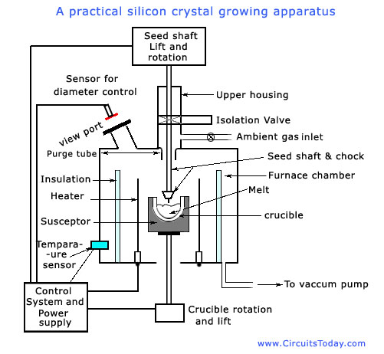

Slide 14
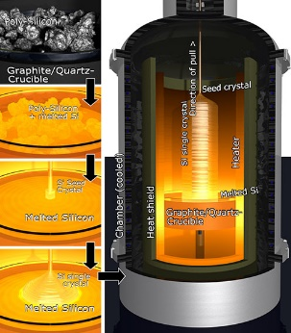

Slide 15
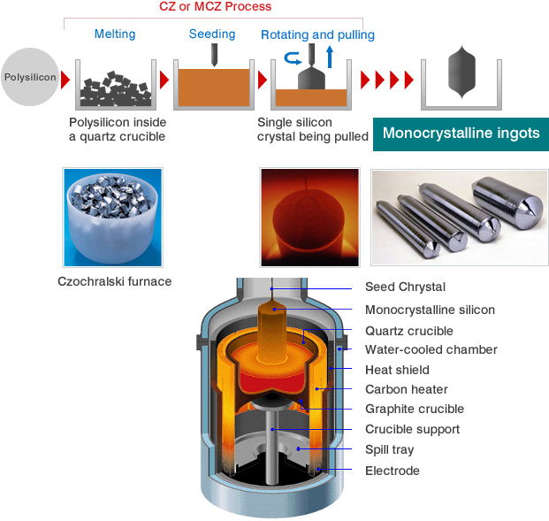

Slide 16
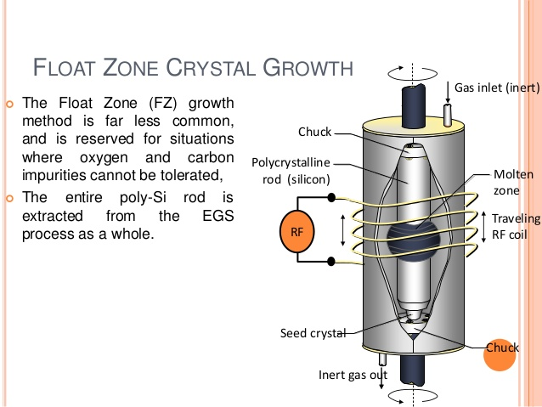

Slide 18
CRYSTAL SHAPING
Single crystal si obtained after CZ and FZ process is called ingot.
Hard and brittle- for shaping a series of mechanical process are done.
material used for cutting and shaping is diamond.

Slide 19
Ingot trimming and slicing
Seed and Tang ends of ingot are trimmed
Grinded the variation in diameter across the ingot length to have uniform diameter.
Small portion of curvature is made flat for different orientation
Sliced using large diameter stainless saw blade with diamond edge
Wafer Polishing and cleaning
Slicing- surface and edge may get damaged
One side of wafer is given smooth polished finish
Other side is given a lapping operation to obtain acceptable degree of flatness and parallelism
Thoroughly cleaned and dried using chemicals.
Gettering

Slide 20
Diffusion of impurities
To get p/n type
Si wafer--high temperature (1000-1200°c)--dopants are introduced-diffused on to wafer.
2 types :
Substitutional Diffusion
Interstitial diffusion

Slide 21
Interstitial diffusion
Impurity atom move to Interstitial voids in the lattice.
Impurity atom in void can move to neighbour void easily.
So diffusion rate is high.
Eg:- Cu,Ni etc…

Slide 22
Substitutional Diffusion
At high temp Si move from their lattice site , leaving vacancies where impurity atoms can move
Si atom is replaced by impurity atom
Impurity atom need to overcome energy barrier due to breaking of covalent bonds to move into a vacancy
Eg : B,P

Slide 23
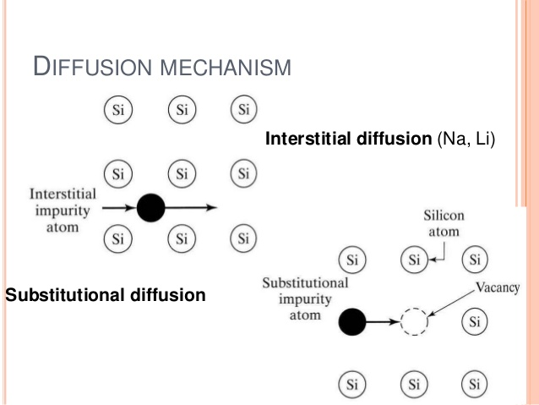

Slide 24
FACTORS AFFECTING DIFUSION RATE
Temperature
mechanism of diffusion.
Physical properties
Properties of lattice.
Concentration ingredient of impurity.
Semi-conductor geometry.

Slide 25
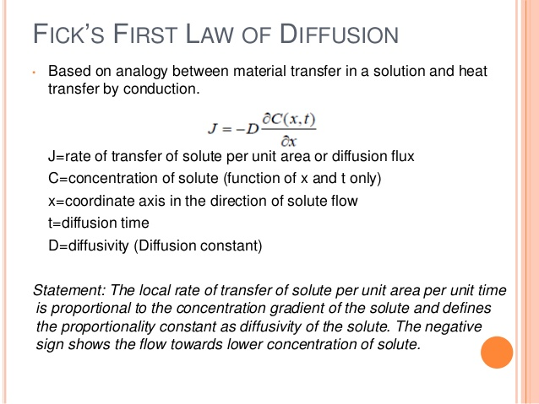

Slide 26
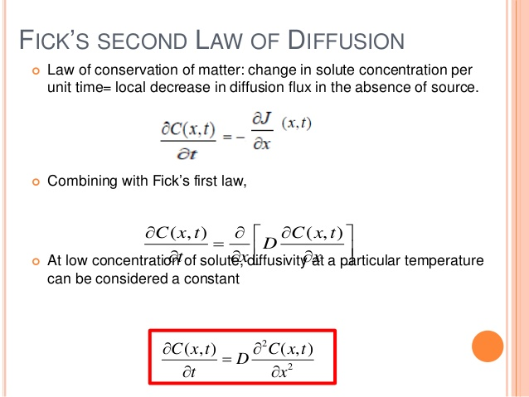

Slide 27
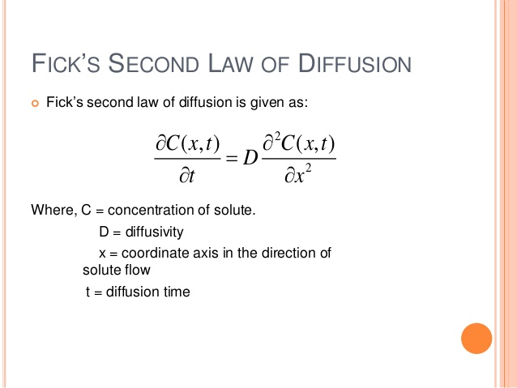

Slide 28
OXIDATION

Slide 29
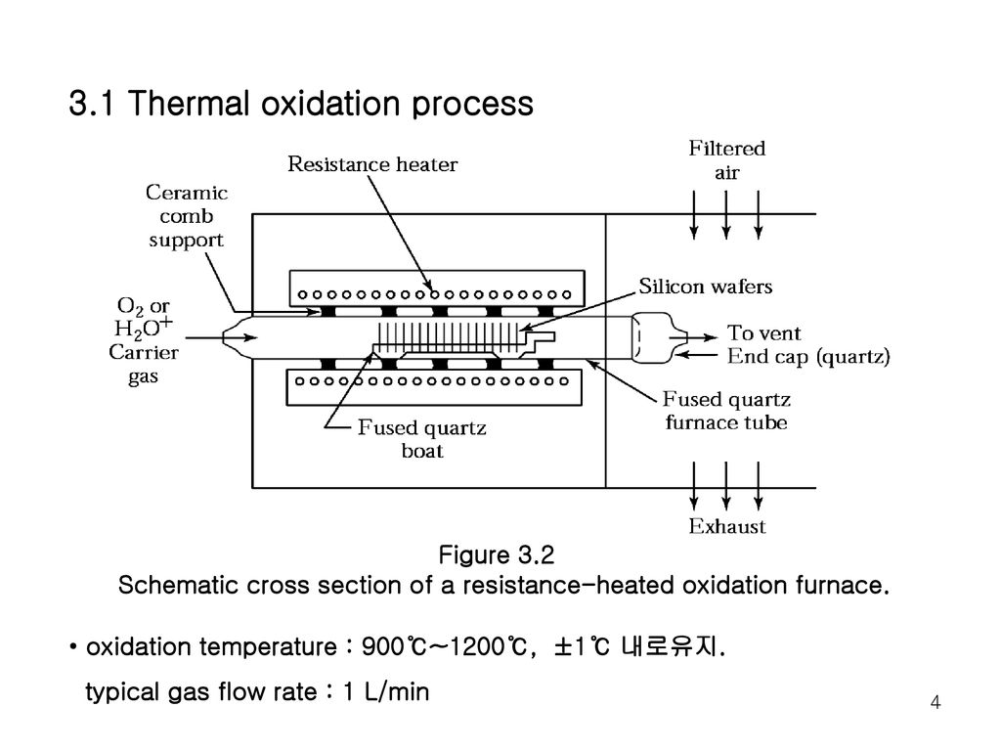

Slide 30
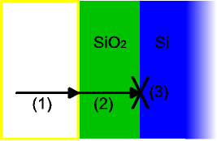
Deal–Grove model
Deal–Grove model mathematically describes the growth of an oxide layer on the surface of a material
Model assumes that oxidation reaction occurs at the interface between the oxide layer and the substrate material
Here the oxidizing species :
Transported from the bulk of the gas phase to the gas-oxide interface with flux F1.
Transported across the existing oxide toward the silicon with flux F2.
React at the Si-SiO2 interface with the silicon with flux F3.

