Slide 1
Module 6

Slide 2
Real Time OS
A system is called a real-time system, when we need quantitative expression of time (i.e. real-time) to describe the behavior of the system

Slide 3
Hard real time system
  Meeting deadline is a must
  Otherwise it will cause unacceptable damage or fatal error to the system
  Eg: Flight engines, Electronic engines
Soft real time system
  Deadlines are specified, but not mandatory
  Completion of task even after deadline is acceptable
  Eg: Airline reservation system, Multimedia systems

Slide 4
Characteristics of RTOS
Determinism
  Extent to which a system performs operations at fixed, predetermined times or within predetermined time intervals
  Process requests for services are dictated by external events and timings

Slide 5
Responsiveness
  Concerned with how long after acknowledgement, it takes an OS to service the interrupt
    If the execution of an ISR requires a process switch, then the delay will be longer than if the ISR can be executed within the context of current process
    Also dependent on hardware platform
    Nested interrupts can delay the service

Slide 6
User control
  User should have control over task priority
  Should be able to distinguish between hard and soft tasks and to specify relative priorities within each class
Reliability
  A failure of a real time system can lead to huge loss

Slide 7
Fail soft operation
  Ability of a system to fail in such a way to preserve as much capability and data as possible
  File and data consistency should be maintained even with system shutdown

Slide 8
RTOS for control systems
Chemical plant control
    Temperature, pressure, chemical concentration control in chemical reaction chamber
    Parameters are sampled periodically
    Based on the values sampled at any time, the automation system decides on the corrective actions necessary at that instant

Slide 9
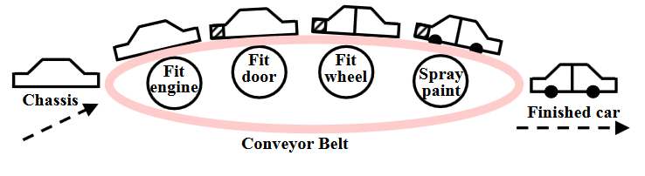
Automated car assembly plant

Slide 10
Computer system of an aircraft
Internet and multimedia applications
  Video conferencing
  Multimedia telecast
Consumer Electronics
Defense applications
  Missile guidance system
Medical applications

Slide 11
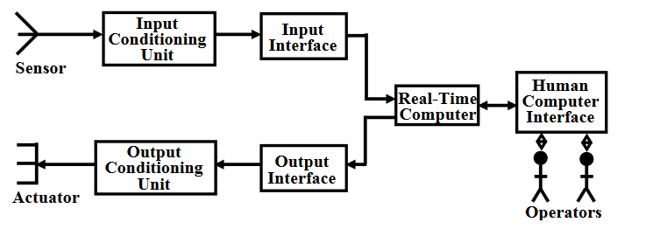
Model of real time control system

Slide 12
Signal conditioning units
  Voltage amplification
  Voltage level shifting
  Frequency range shifting and filtering

Slide 13
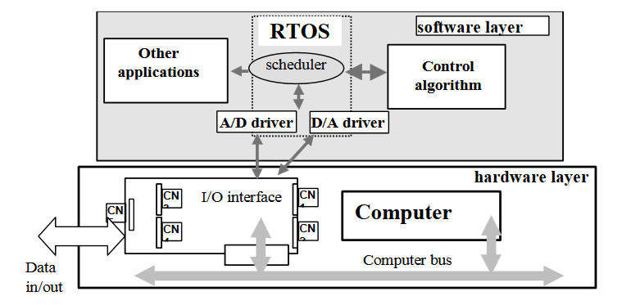
Hardware and software layer of a computer controlled system

Slide 14
VxWorks
Proprietary software developed by WindRiver systems
Supports Intel, ARM architecture
Supports most POSIX-RT functionalities
IDE – Tornado
Applications
    Aerospace
    Defense
    Medical devices
    Robotics
    Consumer electronics
    Automotives
    Space missions etc.

Slide 15
Features of VxWorks
High-Performance Real-time Kernel Facilities
    Kernel – Wind
    Preemptive priority scheduling
    Intertask synchronization and communication facilities
    Interrupt handling, Watchdog timers, Memory management

Slide 16
POSIX (Portable OS Interface) Compatibility
  POSIX standard for real time applications (1003.1b)
The main requirements of the POSIX-RT
  Execution scheduling: Must provide support for real-time (static) priorities.
  Performance requirements on system calls: It specifies the worst case execution times required for most real-time operating services.
  Priority levels: The number of priority levels supported should be at least 32.
  Timers: Periodic and one shot timers (also called watch dog timer) should be supported.
  Multithreading support

Slide 17
Real-time files:
  Real-time file system should be supported.
  A real-time file system can pre-allocate storage for files and should be able to store file blocks contiguously on the disk.
  This enables to have predictable delay in file access in virtual memory system.
Memory locking: Memory locking should be supported.
mlockall() - to lock all pages of a process
mlock() - to lock a range of pages
mlockpage() - to lock only the current page
munlockall(), munlock(), and munlockpage().

Slide 18
I/O System
    Supports fast and flexible ANSI C compatible I/O system including UNIX standard buffered I/O and POSIX standard asynchronous I/O
  7 basic I/O routines
    creat() - creates a file
    remove() – remove a file
    open() – open a file
    close() – close a file
    read() – read from a file
    write() – write to a file
    ioctl() – I/O control function

Slide 19
Also supports ANSI C compatible routines
    fopen()
    fclose()
    fread()
    fwrite()
    getc()
    putc()

Slide 20
Local File Systems
    Supports fast file system for real time applications
    Compatible with MS DOS
C++ Development Support
Shared-Memory Objects
    Provides facilities for sharing semaphores, message queues, and memory region between tasks on different processors

Slide 21
Virtual Memory
Utility libraries
  Vxworks supports a large set of utility routines
    Interrupt handling
    Watchdog timers
    Message logging
    String formatting and scanning
    Memory allocation
    Linear and ring buffer manipulations etc.

Slide 22
Performance evaluation tools
  Utilities to show CPU utilization percentage by task
Target agent
  Remote debugging of applications
Vxworks Simulator (VxSim) and Logic analyzer (WindView)
  VxSim simulates a target for use as a prototyping and testing environment
  WindView provides advanced debugging tools for the simulator environment

Slide 23
Board support packages (BSP)
  Available for a variety of boards
  Provides routines for hardware initialization, interrupt setup, timers, memory mapping etc.
Network facilities

Slide 24
Multitasking
  Allows a real time application to be constructed as a set of independent tasks, each with its own thread of execution and set of system resources
  Intertask communication: co-ordination, synchronization and communication between these tasks

Slide 25
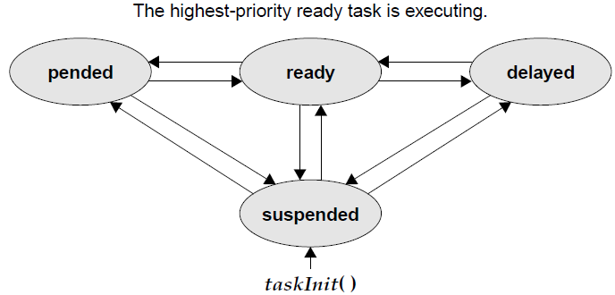
Task state transition

Slide 26
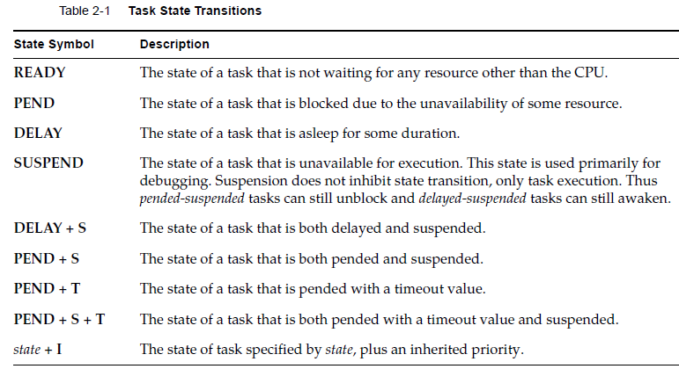

Slide 27
Intertask communication
Supports a rich set of intertask communication mechanism
    Shared memory: for simple sharing of data
    Semaphore: for basic mutual exclusion and synchronization
    Message queues and pipes: for intertask message passing within a CPU
    Sockets and remote procedure calls: for network transparent intertask communication
    Signals: for exception handling

Slide 28
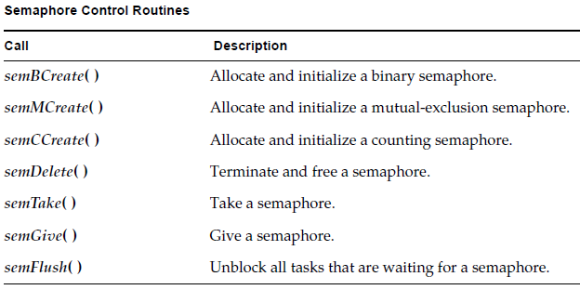

Slide 29
µC/OS II
MicroC/OS (µC/OS)
Commercially released by Micrium Inc., written by Jean J. Lacrosse
Applications
    Avionics
    Medical equipment and devices
    Industrial controls
    Consumer Electronics
    Automotive

Slide 30
Multitask real time kernel
Priority-based preemptive real-time kernel for microprocessors
Written mostly in programming language C
Can run upto 64 tasks at the same time

Slide 31
Supports all types of processors from 8-bit to 64-bit, ported to more than 100 microprocessors and microcontrollers
Extensible with many additional modules (TCP/IP stack, USB host and client, FAT file system etc.)

Slide 32
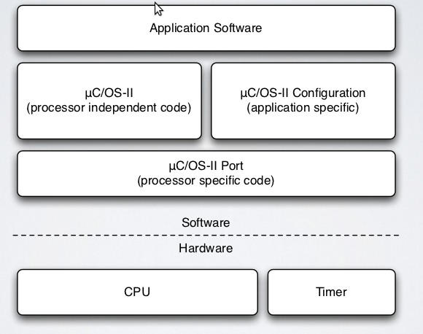
µC/OS-II software architecture

Slide 33
Processor independent code:
    Common code which is available in the form of source code.
    Independent of the hardware or processor.
Processor specific code:
    According to the specification of the processor.
    Partially C code, partially assembly.

Slide 34
Functions of µC/OS-II
Task management
Time management
Intertask communication and synchronization
Fixed size memory management
Interrupt system management

Slide 35
Task management
5 states
  Dormant
  Ready
  Running
  Waiting
  ISR

Slide 36
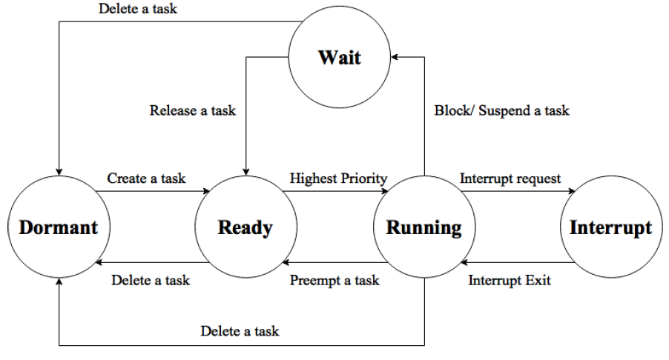
Task states

Slide 37
Dormant task
  State of a task before creating it
Ready task
  Functions to create a task:
    OSTaskCreate()
    OSTaskCreateExt()
  Task state changes from dormant to ready

Slide 38
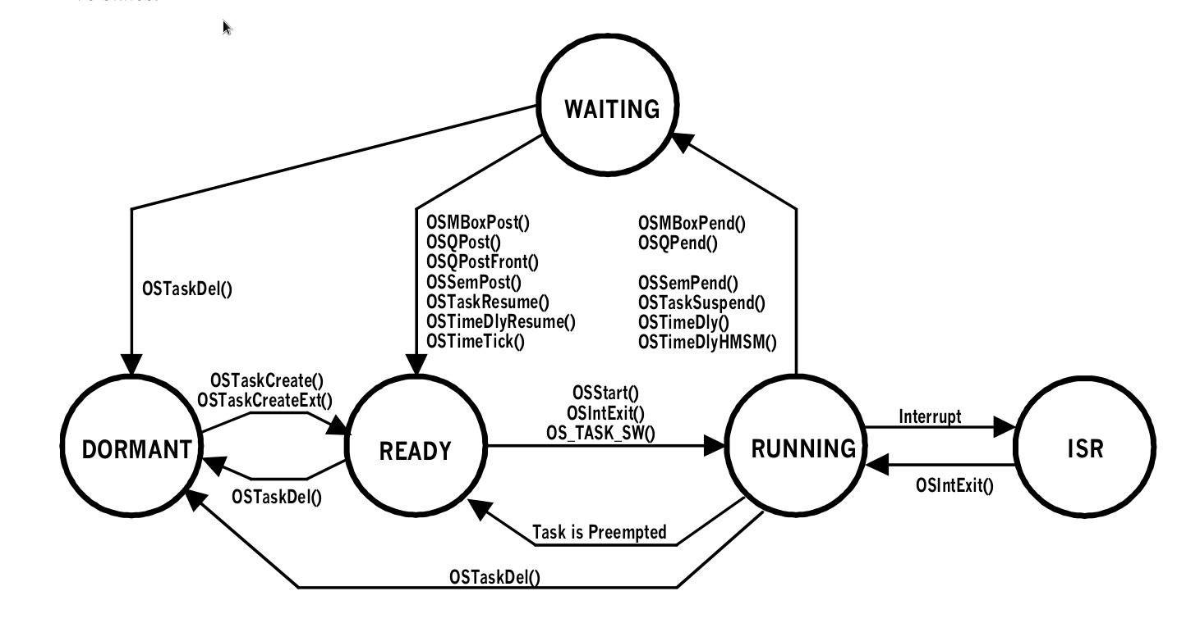

Slide 39
Task Control Block
To keep track of status of each task
Contains task name, state priority, stack pointer and program counter

Slide 40
Time management
Supports a number of services that handle time issues
  OSTimeDly()
  OSTimeTick()

Slide 41
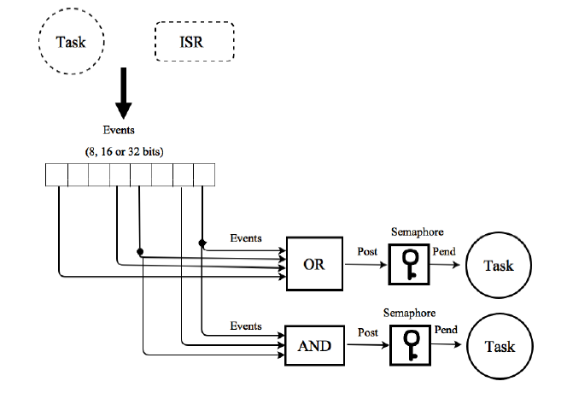
Intertask communication and synchronization
Uses event flags and semaphores
Mail boxes and queues are available

Slide 42
Fixed size memory management
Each task should have its own stack to store the key registers when being preempted
  Can use malloc and free functions in C
May lead to memory fragmentation issues
Uses fixed sized memory blocks made of contiguous memory area

Slide 43
Interrupts and ISR
Interrupts can be nested upto 255 levels
    OSIntEnter() – serve an ISR
    OSIntExit() – exit from an ISR
When executing critical region interrupts can be disabled
  Macros for enabling and disabling interrupts
    OS_Enter_Critical
    OS_Exit_Critical

Slide 44
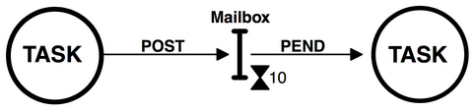
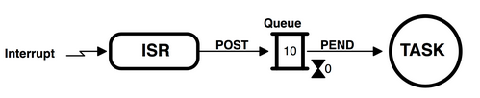
Mail box and queue

Slide 46
Multiprocessors
Load sharing is possible with multiple CPUs
Homogeneous system – processors are identical
Asymmetric multiprocessing
Symmetric multiprocessing (SMP)

Slide 47
Asymmetric multiprocessing
Master processor - Scheduling decisions, I/O processing, other system activities are handled
Other processors execute only user code
Simple - only one processor access the system data structure, reducing the need for data sharing

Slide 48
Symmetric multiprocessing (SMP)
Each processor is self scheduling
All processes may be in a common ready queue
Or each processor can have its own private queue of ready processes
Eg: Windows XP, Windows 2000, Solaris, Linux

Slide 49
Processor affinity
Moving processes between different processors for execution is expensive
Contents of cache memory must be invalidated for the processor being migrated from; and the cache for the processor being migrated to must be repopulated
Hence most SMP systems avoid migration of processes

Slide 50
Soft affinity
  OS has a policy of attempting to keep a process running on the same processor
  No guarantee – it is possible for a process to migrate between processors
Hard affinity
  Migration is not at all possible

Slide 51
Load balancing
To keep the workload evenly distributed all processors in an SMP system
Required only on systems where each processor has its own private queue of ready processes
Two approaches
  Push migration
  Pull migration

Slide 52
Push migration
  A specific task periodically checks the load on each processor
  Distributes the load by moving (or pushing) processes from overloaded to idle or less busy processors

Slide 53
Pull migration
  An idle processor pulls a waiting task from a busy processor
Load balancing works against the principle of processor affinity
  If not carefully managed, the savings gained by balancing the system can be lost in rebuilding caches

Slide 54
Symmetric multi threading (SMT) / Hyper threading
Provides multiple logical CPUs on a physical CPU
Each logical CPU has own architectural state, i.e. registers, pipelines, mode bits, and interrupt states
Logical CPUs share memory, bus, and cache

Slide 55
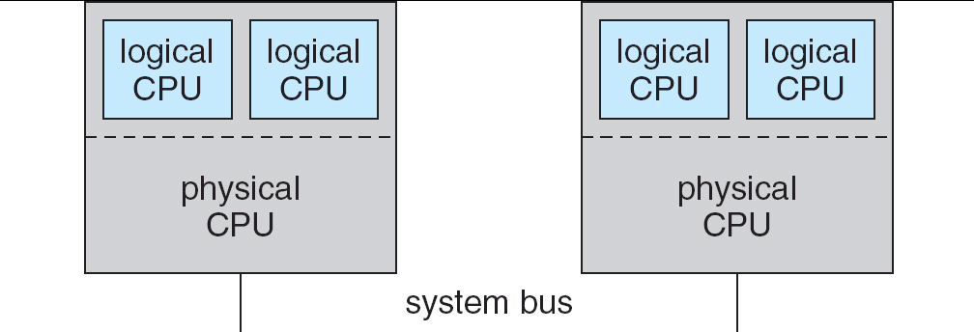

Slide 56
Multiprocessor scheduling
Multithreaded process – scheduling is complex
User level threads
    Kernel knows nothing about threads
    Scheduling happens on a per process basis
Kernel level threads
    Kernel is aware of the threads
    Thread level scheduling is possible

Slide 57
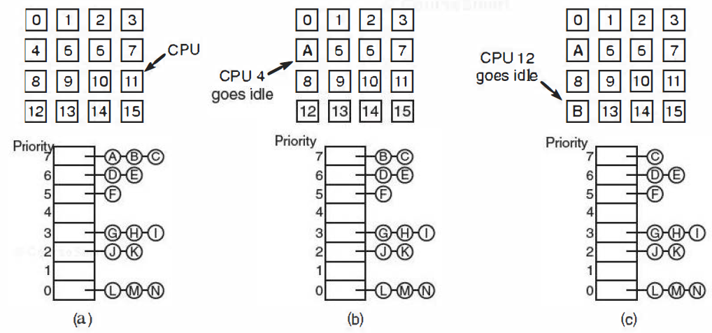
Time sharing
Scheduling of independent threads
Processor affinity scheduling can be done to save time

Slide 58
Space sharing
Scheduling of related threads
    A single process can have multiple threads that work together
    It is better to run all the threads at once
Assumption: Entire group of threads are created at once
Scheduler checks to see if there are as many CPUs free as the number of threads
If available, all threads will be executed simultaneously
If not available, none of the threads are executed until enough CPUs are available

Slide 59
