Slide 1
Module 5
I/O management and Disk scheduling

Slide 2
I/O devices
Human readable
    Printer, Display, etc.
Machine readable
    USB, disk drives, CD drive, sensors etc.
Communication
    Modems, digital line drivers etc.

Slide 3
Differences within each class
    Data rate
    Application
    Complexity of control
    Unit of transfer
    Data representation
    Error conditions

Slide 4
Organization of the I/O function
Programmed I/O
Interrupt driven I/O
Direct memory access (DMA)

Slide 5
Programmed I/O
    Processor issues an I/O command on behalf of a process
    Process then busy waits for the operation to be completed
    Wastage of CPU time

Slide 6
Interrupt driven I/O
    Processor issues an I/O command on behalf of a process
    Non-blocking : continue to execute that process
    Blocking : current process is blocked, schedule another process. Once I/O is completed interrupt is generated and the blocked process can be resumed.

Slide 7
Direct memory access (DMA)
    DMA module controls the exchange of data between main memory and I/O module
    Processor issues request to DMA module for transfer blocks of data without the involvement of processor
    Interrupt is generated only after entire block has been transferred

Slide 8
Evolution of I/O functions
Processor directly controls a peripheral device. Eg: microprocessor controlled devices
A controller or I/O module is added: Processor uses programmed I/O without interrupts. Processor relieved from the details of external device interfaces
Same configuration as in step 3, but interrupts are employed
DMA introduced – I/O is given direct control of memory via DMA
I/O processors and instruction set tailored for I/O were introduced. CPU instructs I/O processor to execute an I/O program in main memory
Memory is incorporated for I/O module – behaves like a computer. I/O devices are controlled with minimal processor involvement.

Slide 9
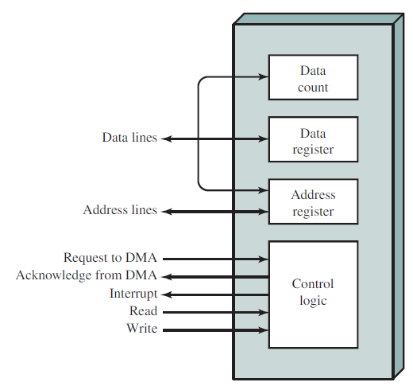
DMA block diagram

Slide 10
CPU tells DMA controller:
  Read/Write
  Device address
  Starting address of memory block for data
  Amount of data to be transferred
CPU carries on with other work
DMA controller deals with transfer
DMA controller sends interrupt when finished

Slide 11
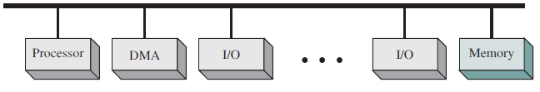
DMA configurations
Single bus, detached DMA
  All modules use same system bus
  Detached DMA controller
  Each transfer uses two bus cycles
    Transfer request and data transfer
  CPU is suspended twice

Slide 12
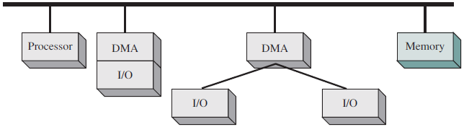
Single Bus, Integrated DMA controller
  Controller may support more than one device
  Each transfer uses bus once
    DMA to memory
  CPU is suspended once

Slide 13
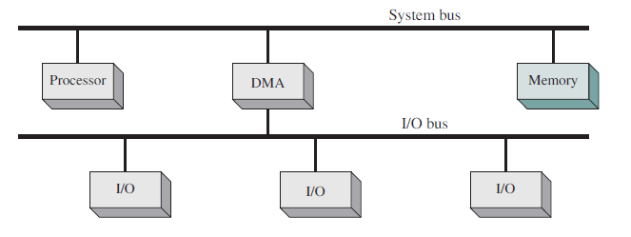
I/O bus configuration
  Reduces the number of interfaces
  Easily expandable configuration

Slide 14
Operating system design issues of I/O
Design objectives
  Efficiency
  Generality

Slide 15
Efficiency
  I/O devices are slower than main memory and the processor
  Often create bottleneck
  When a process is waiting for I/O to be completed, other process can be executed

Slide 16
Generality
  Handling of all I/O devices in a uniform manner
  Hierarchical and Modular design
  Hides all the inner details of I/O device from user program
  User may see only general functions such as read, write, close, lock etc.

Slide 17
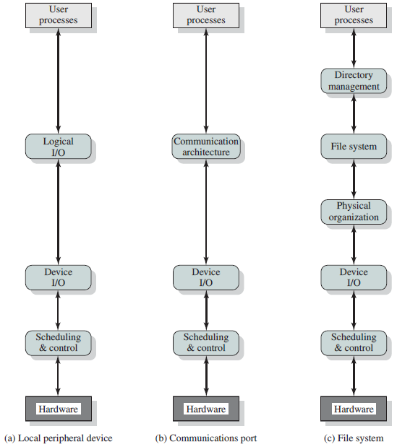
Model of I/O organization

Slide 18
Logical I/O
    Deals with the device as a logical resource
    Not concerned with the actual control of device
    Manages general functions like open, read, write etc. on behalf of process
Device I/O
    Requested operations and data are converted into appropriate sequences of I/O instructions, channel commands, and controller orders
    Buffering technique – for improving efficiency

Slide 19
Scheduling and control
    Queueing and scheduling of I/O operation occurs at this layer
    Interrupts are handled
    I/O status is collected and reported

Slide 20
Directory management
    Symbolic filenames are converted to identifiers that reference the file directly or indirectly through a file descriptor or index table
File system
    Deals with logical structure of files
    Operations – open, read, write, close etc.
    Access rights are managed
Physical organization
    Virtual memory address to physical address conversion
    Sectors and tracks of secondary disc is considered

Slide 21
I/O buffering
Increase the efficiency of I/O device
Block oriented device
  Stores information in blocks of fixed size
  Transfers are made one block at a time
  Eg: Disks, USB
Stream oriented device
  Transfers information as stream of bytes
  Eg: Keyboard, mouse, printer etc.

Slide 22
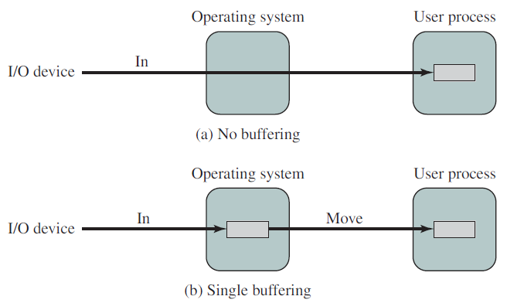
Single buffer

Slide 23
Execution time per block
Without buffering
  T + C
With buffering
max[C, T] + M
    T – time required to input one block
    C – computation time that intervenes between input requests
    M - time required to move the data from the system buffer to user memory

Slide 24
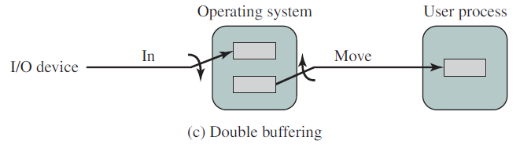
Double buffering
Execution time
  max[C, T]

Slide 25
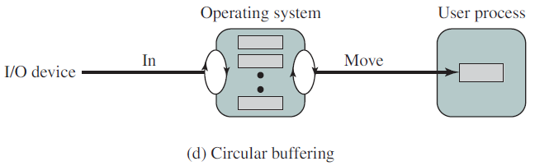
Circular buffering

Slide 26
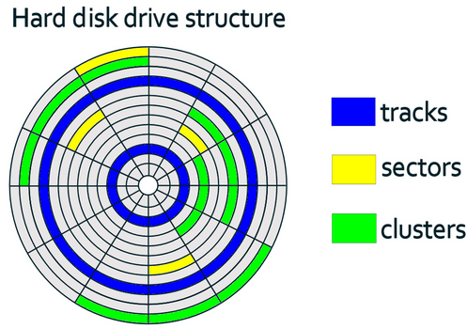
Disk scheduling
Disks are slower than main memory

Slide 27
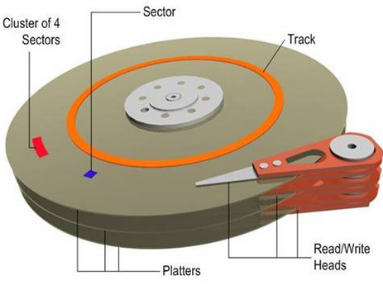

Slide 28
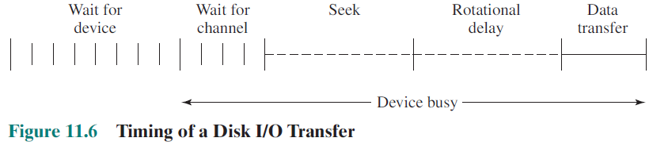
Disk scheduling

Slide 29
Read/Write head must be positioned at the desired track and at the beginning of the desired sector on that track
Seek time: Time it takes to position the head at the desired track
Rotational delay: Time it takes for the beginning of the sector to reach the head
Access time: Seek time + Rotational delay
    Time it takes to get into position to read or write
Transfer time: Data transfer

Slide 30

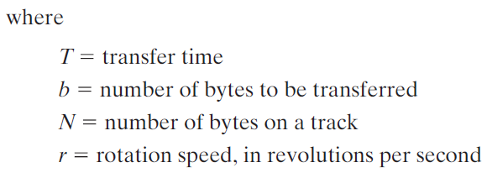
Data transfer time

Slide 31



Total average access time
- average rotational delay

Slide 32
Timing comparison example
Consider a disk with following parameters
    Average seek time: 4 ms
    Rotation speed: 7500 rpm
    512 byte sector
    500 sectors per track
Find the time required to read 1.28Mb data

Slide 33
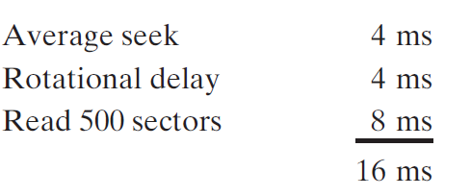
Time to read first track
For remaining tracks there is no seek time

Slide 34
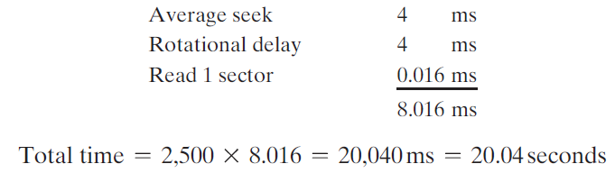
If sectors are distributed randomly over the disk

Slide 35
Disk scheduling policies
Random access of tracks – poor performance
FIFO
Priority
SSTF
SCAN
CSCAN
N step SCAN and FSCAN

Slide 36
FIFO
Processes items from the queue in sequential order
Simple, fair algorithm
Requests are granted in the order of reception

Slide 37
Example
Consider a disk with 200 tracks
Assume disk head is initially located at track 100
Tracks requested by processes – 55, 58, 39, 18, 90, 160, 150, 38, 184

Slide 38
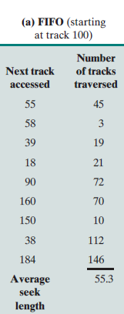
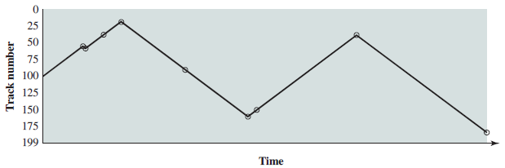
FIFO

Slide 39
Priority
With a system based on priority, the control of the disk scheduling is outside the control of disk management software
Short batch jobs and interactive jobs are given higher than longer jobs
Not intended to optimize disk utilization
To meet objectives within OS

Slide 40
Shortest Service Time First
Selects the disk I/O request that requires least movement of the disk arm from its current position
Better performance than FIFO

Slide 41
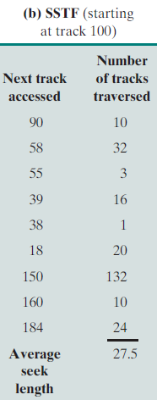
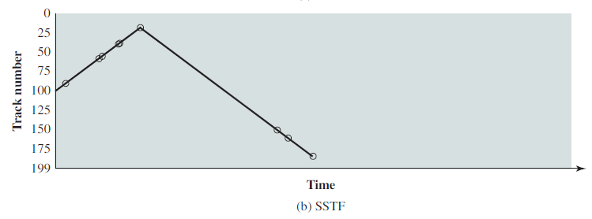

Slide 42
SCAN
Arm is moved in one direction satisfying all outstanding requests in that direction
Service direction is reversed after that
Expected service interval for sectors at the periphery 2t
  t – time for a scan from inner track to outer track

Slide 43
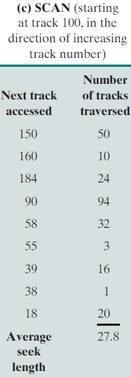
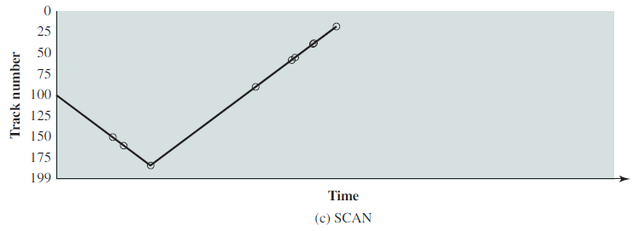

Slide 44
CSCAN
Restricts scanning to one direction only
When the last track has been visited in one direction, the arm is returned to the opposite end of the disk and the scan begins again
Expected service interval for sectors at the periphery t + s_{max}
  t – time for a scan from inner track to outer track
  s_{max} – maximum seek time

Slide 45
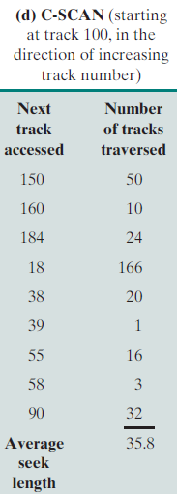
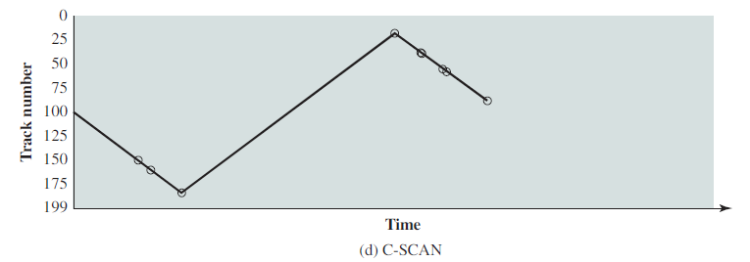

Slide 46
N step SCAN
Segments the disk request queue into sub queues of length N
Sub queues are processed one at a time, using SCAN
While a queue is being processed, new requests must be added to some other queue
If fewer than N requests are available at the end of a scan, all of them are processed in next scan

Slide 47
FSCAN
Uses two subqueues
When the scan begins, all of the requests are in one of the queues, with the other empty
During a scan, all new requests are put into the other queue

Slide 48
Disk Caches
Cache memory
    Smaller and faster than main memory
    Placed in between main memory and the processor
    Reduces the average memory access time by exploiting the principle of locality
      If a memory segment is accessed, it is highly likely that the same might be referenced again

Slide 49
Disk caches
    Buffer in main memory for disk sectors
    Contains a copy of some of the sectors on the disk
    When an I/O request is made for a particular sector, a check is made to determine if the sector is in cache
    If available, the request is satisfied via the cache
    If not, the requested sector is read into the disk cache from the disk
    Locality of reference or principle of locality is applicable here also

Slide 50
Design considerations
Replacement strategies
    Least Recently Used (LRU) algorithm – Replace the block that has been in the cache longest with no reference to it
    Least Frequently Used (LFU) – Replace the block that has experienced the fewest references
      Problem with blocks that are referenced infrequently overall, but when they are referenced, there are short intervals of repeated references

Slide 51
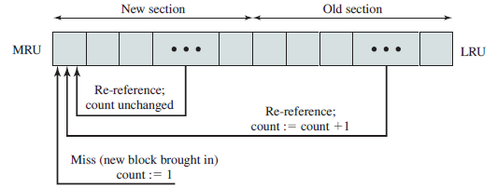
Frequency based replacement

