Slide 1
Module 4

Slide 2
Main memory division
    For OS
    For program currently being executed
Multiprogramming
    Program area further subdivided to accommodate multiple processes
Memory management – by OS

Slide 3
Memory management requirements
Relocation
Protection
Sharing
Logical organization
Physical organization

Slide 4
Relocation
Process of adjusting program addresses to match the actual physical addresses where the program resides when it executed
Why is relocation needed?
    Active processes need to be swapped in and out of main memory in order to maximize processor utilization
    When it is swapped back in it would be loaded to a different memory location

Slide 5
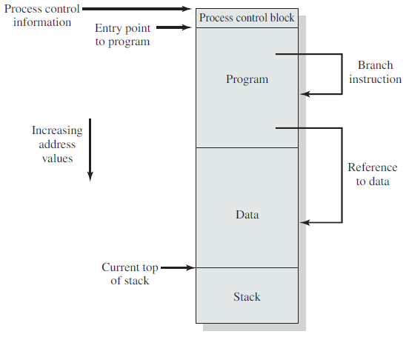
Consequently it must be possible to adjust addresses whenever a program is loaded

Slide 6
Protection
Each process should be protected against unwanted interference by other processes
Location of a program in main memory is unpredictable
Memory references generated by a process must be checked at run time
Mechanisms that support relocation also support protection

Slide 7
Sharing
If a number of processes are executing same program
    Allow each process access to the same copy of the program rather than have their own separate copy
    Controlled access to shared areas of memory can be allowed without compromising protection

Slide 8
Logical organization
Main and Secondary memory - organized as a linear address space consisting of a sequence of bytes or words
Programs are written as modules
    Modules can be written and compiled independently
    Different degrees of protection given to modules (read-only, execute-only)
    Modules can be shared among processes

Slide 9
Physical organization
Main memory available for a program plus its data may be insufficient.
Principle of overlaying
  Various modules can be assigned the same region of memory
  A main program responsible for switching the modules in and out as needed

Slide 10
Memory partitioning
Fixed partitioning
Dynamic partitioning

Slide 11
Fixed partitioning
Main memory is divided into a number of static partitions
A process may be loaded into a partition of equal or greater size
Simple to implement
Little OS overhead

Slide 12
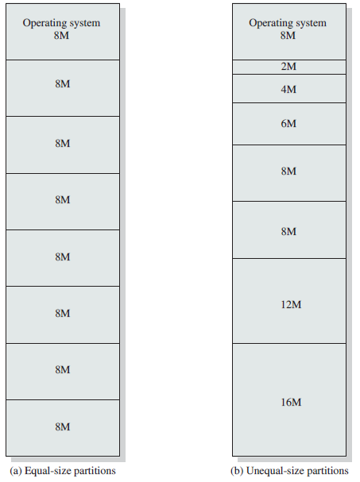
Fixed partitioning
64MB memory partition

Slide 13
Placement algorithm
If all the partitions are occupied with processes, then one process must be swapped out to make room for a new process

Slide 14
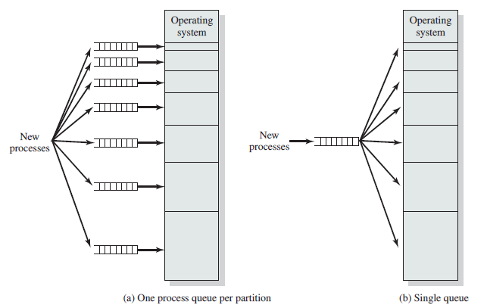
Placement algorithm
Memory partitions of unequal size

Slide 15
Drawbacks of fixed size partitioning
Inefficient memory utilization
  If a program size is less than 2MB, loaded into 8MB segment – wastage of resource – internal fragmentation
  Program size greater than partition size
    Redesign the program so that, only a portion of the program be in memory at a time

Slide 16
Dynamic partitioning
Partitions are created dynamically
Each process is loaded into a partition of exactly the same size as that of the process
More efficient use of main memory

Slide 17
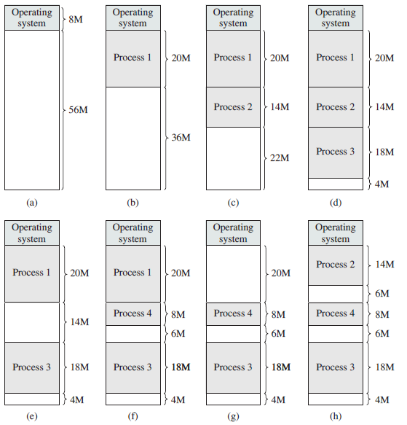
Dynamic partitioning

Slide 18
Large number of small vacant slots are developed as time progresses
Memory becomes more fragmented
Memory utilization declines
External fragmentation

Slide 19
Overcoming external fragmentation
Compaction
    OS shifts the processes so that they are contiguous
    All the free slots come together
    Memory utilization improves
Difficulties with compaction
    Time consuming process
    Need huge CPU usage
    There should not be problems with memory references

Slide 20
Placement algorithm
When a process is loaded or swapped into main memory with more than one free block of sufficient size – OS should decide which block to allocate
Placement algorithms
    Best fit
    First fit
    Next fit

Slide 21
Best fit
    Chooses the block that is closest in size to the request
First fit
    Scan the memory from the beginning
    Choose the first available block that is large enough
Next fit
    Begins to scan memory from the location of the last placement
    Choose the next available block that is large enough

Slide 22
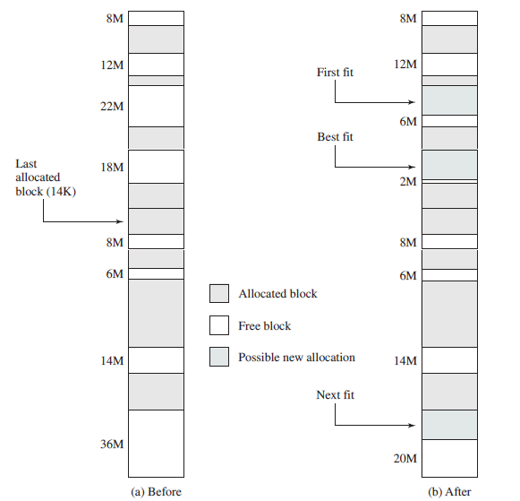

Slide 23
Paging
Main memory is divided into many small equal size frames
Each process is divided into frame size pages

Slide 24
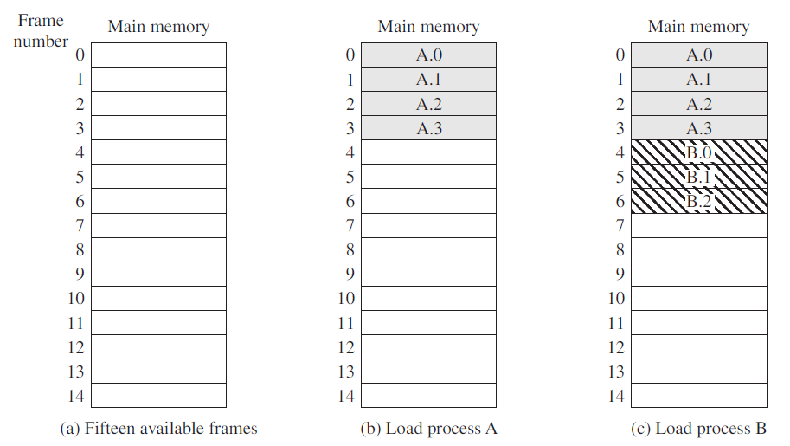

Slide 25
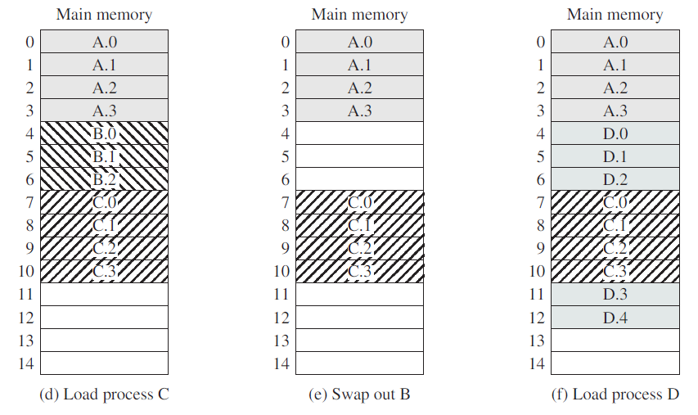

Slide 26
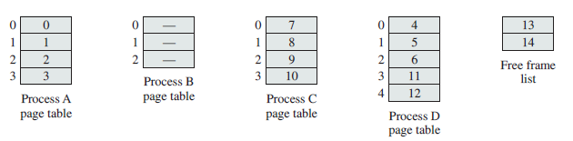
Page table
OS maintains page tables
Contains one entry for each page of the process
Each entry contains the number of the frame in main memory

Slide 27
Example
16bit addresses, Page size is 1K = 1024Bytes
Logical address: consists of page number and an offset within a page
Translated to physical address

Slide 28
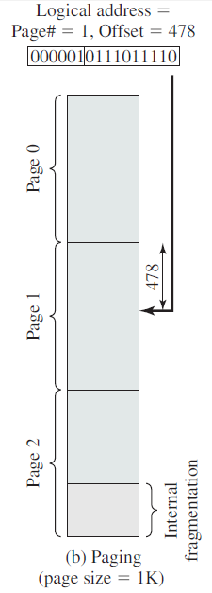

Slide 29
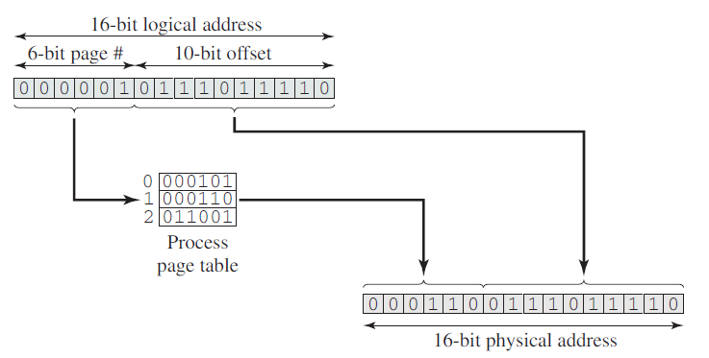
Formation of physical address

Slide 30
Segmentation
Subdivision of user program and its associated data
Each segment can be of different length
Logical address – segment number and offset
Similar to dynamic partitioning
  With segmentation a program may occupy more than one partition, and need not be contiguous

Slide 31
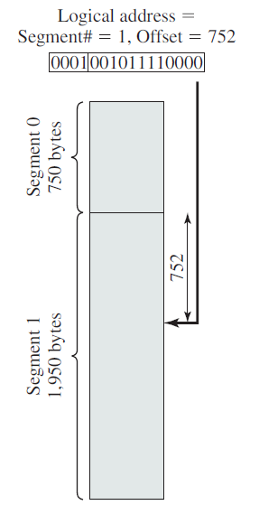
Example
Maximum segment size
4096Bytes

Slide 32
Segment table entry
Starting address in main memory of the corresponding segment
Length of the segment, to assure that invalid addresses are not used

Slide 33
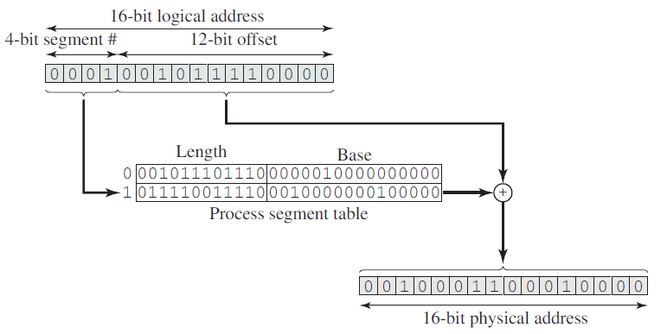
Formation of physical address

Slide 34
Paging: All the pages of a process must be in main memory for a process to run
    Internal fragmentation can occur
    No external fragmentation
Segmentation: All the segments of a process must be in main memory for a process to run
    No internal fragmentation
    External fragmentation can occur
Swapping: Take one process out of main memory and bring another from disc

Slide 35
Virtual memory
A storage allocation scheme in which secondary memory can be addressed as though it’s a part of main memory
If there is a reference to an instruction or data which is not available in main memory, page fault is generated
Swapping: OS brings the desired piece/page and take some out of memory

Slide 36
Requirement for paging
  Hardware support for paging and/or segmentation
  Software support for moving pages and/or segments between main memory and secondary memory

Slide 37
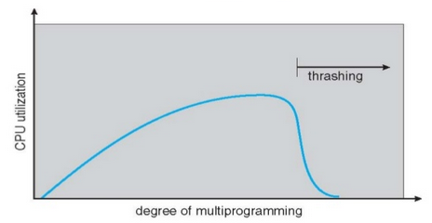
Thrashing
Swapping out a page of a process just before that page is needed
Processor spends most of its time swapping pages rather than executing user instructions

Slide 38
Thrashing
Too much of swapping process in and out of memory – reduces CPU utilization
System spends most of its time swapping pieces rather than executing instructions
Based on recent history of execution OS can make intelligent guess on which pages are required in near future

Slide 39
Principle of locality
States that program and data references within a process tend to cluster
Hence it can be assumed that only a few pieces of a process will be needed over a short period of time

Slide 40
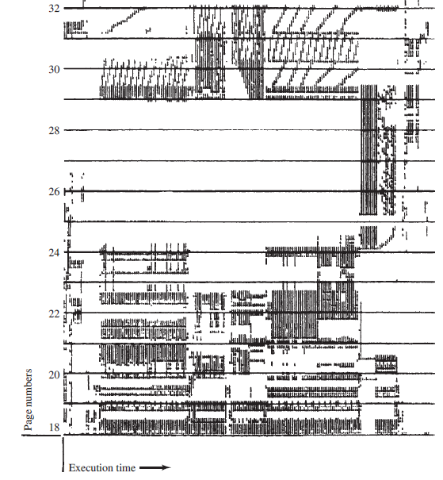

Slide 41
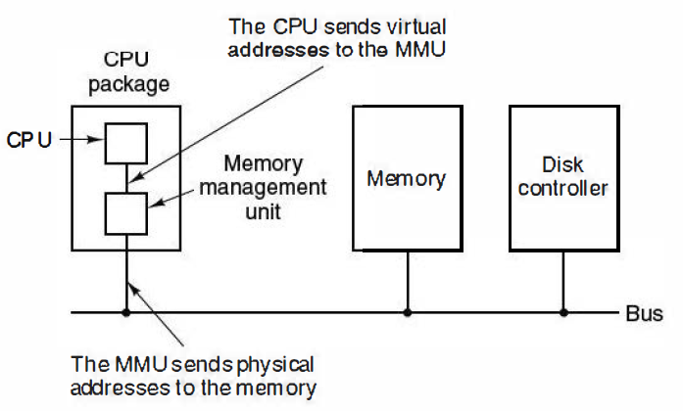
Virtual address to Physical address

Slide 42
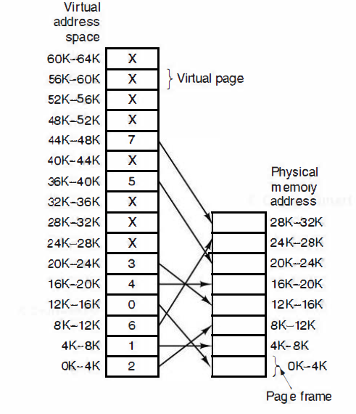

Slide 43
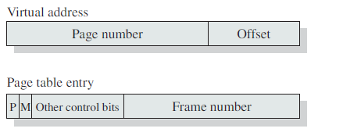

Address translation: Paging with virtual memory
P – indicates whether the page is in memory or not
M – indicates whether the contents have been altered since the page was last loaded into memory

Slide 44
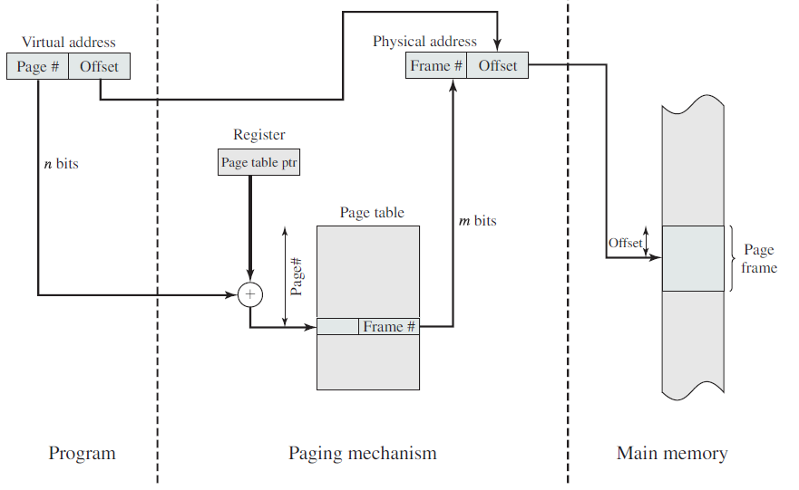
Address translation

Slide 45
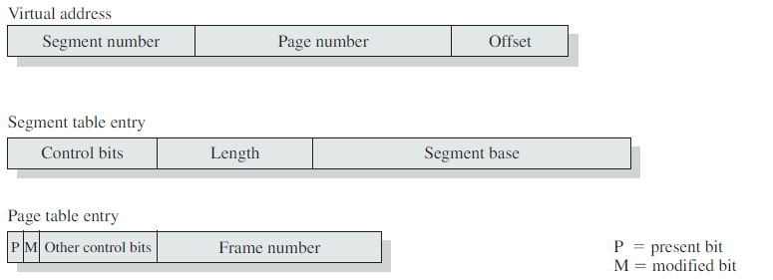
Combined segmentation and paging

Slide 46
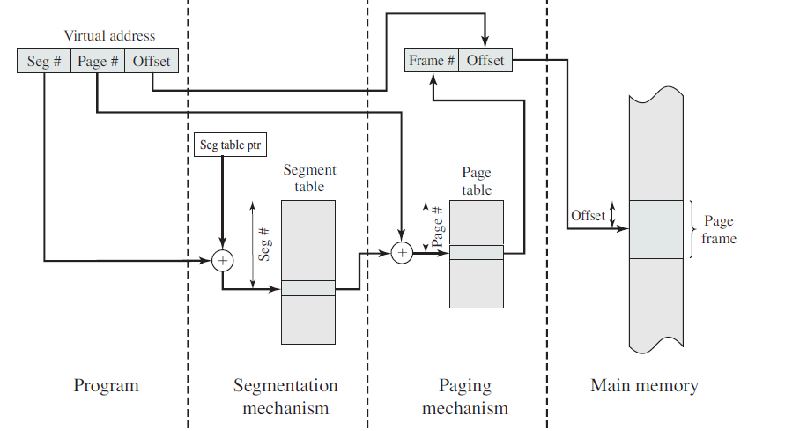

Slide 47
Page fetch policy
Demand paging
  A page is brought into main memory only when a reference is made to a location on that page
Prepaging
  Pages other than the one demanded by a page fault are brought in

Slide 48
Replacement policy
Algorithms
  Optimal
  Least Recently Used (LRU)
  First in First out (FIFO)
  Clock

Slide 49
Optimal
Replaces that page for which the time to the next reference is the longest
Results in fewest number of page faults
Difficult to implement – knowledge of the future events is required

Slide 50













Slide 51
Least Recently Used (LRU)
Replaces the page in memory that has not been referenced for the longest time
This page is least likely to be referenced in the near future
Difficult to implement
Tag each page with the time of its last reference - significant overhead

Slide 52










Slide 53
FIFO
Simplest replacement algorithm
Pages are removed in round robin style
Replaced page will be the one that has been in memory for the longest period
But if that page is still in use, it will be repeatedly paged in and out by FIFO

Slide 54










Slide 55
Clock
Requires an additional bit (Use or Reference bit) with each frame
  When a page is first loaded into a frame in memory, use bit is set to 1
  When the page is subsequently referred, its use bit is set to 1

Slide 56
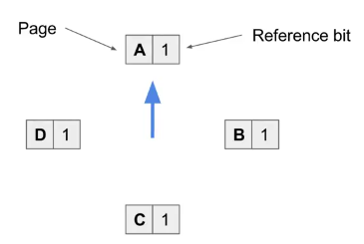
Example
Access Page E

Slide 57
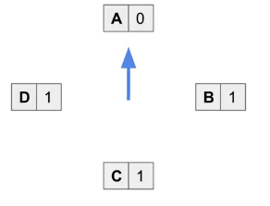

Slide 58
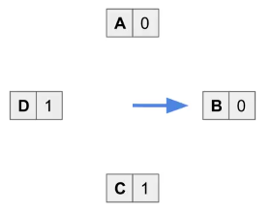

Slide 59
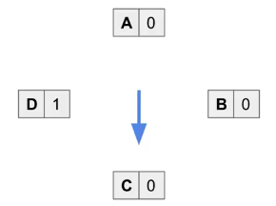

Slide 60
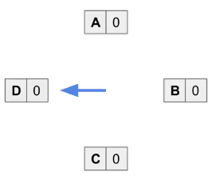

Slide 61
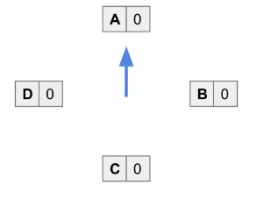

Slide 62
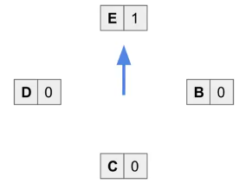
Access page C

Slide 63
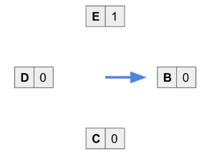

Slide 64
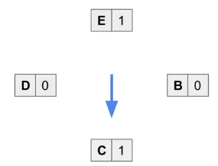
Access page E

Slide 65
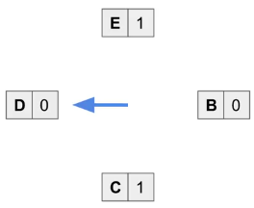

Slide 66
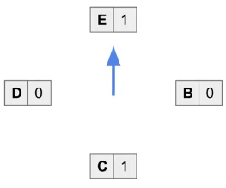
Access page Z

Slide 67
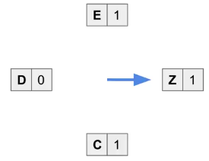

Slide 68
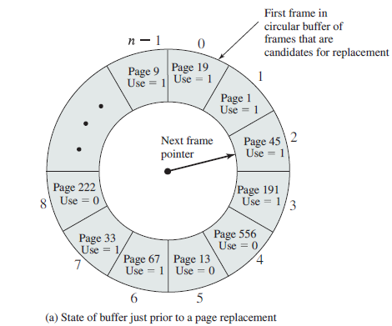
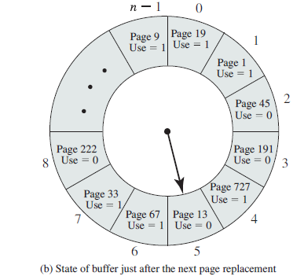
Example 2

Slide 69
Working set model
Working set information of a process at time t is defined as collection of memory pages referenced by the process during the time interval (t - τ, t)
w(t, Δ)
Δ is the working set parameter

Slide 70
