Slide 1
Module 3

Slide 2
Interprocess communication (IPC)
Independent process – cannot affect or be affected by other processes
Cooperating process – exchange data and information
Communication between processes in a well structured manner
    Shared memory
    Message passing

Slide 3
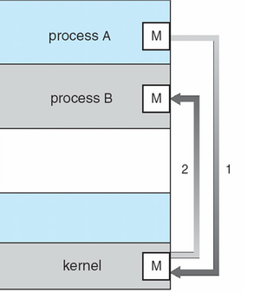
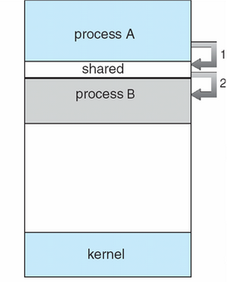
message passing shared memory

Slide 4
Message passing
For exchanging smaller amounts of data
No conflicts
Easier to implement
Implemented using system calls
  Hence kernel intervention is required
Slower than shared memory

Slide 5
Shared memory
Process can share a common main memory segment or a common file
Much faster communication mode
Kernel calls are required only to establish shared memory regions
Access does not require assistance from the kernel

Slide 6
Interprocess communication
Consider 3 issues
    How to pass information from one process to another
    There should not be interference due to two or more processes
      Eg: Two process trying to book same seat in an online reservation system
    Proper sequencing when dependencies are present
      Eg: Process A generates data, Process B prints data
      B has to wait until A generates data

Slide 7
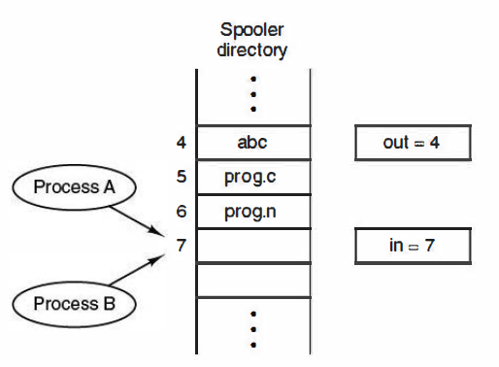
Race conditions
Problems?
  Print spooler
in is local variable containing pointer to next free slot
out is local variable pointing to next file to be printed

Slide 8
Race condition – Two or more processes are reading or writing some shared data and the final result depends on who runs precisely and when

Slide 9
How to avoid races?
Critical resource - shared memory location or shared printer
Critical regions – portion of program that uses the shared resources
Solution: Mutual exclusion
Mutual exclusion – only one process at a time can use a shared variable/file
Ensure that two processes can’t be in the critical region at the same time

Slide 10
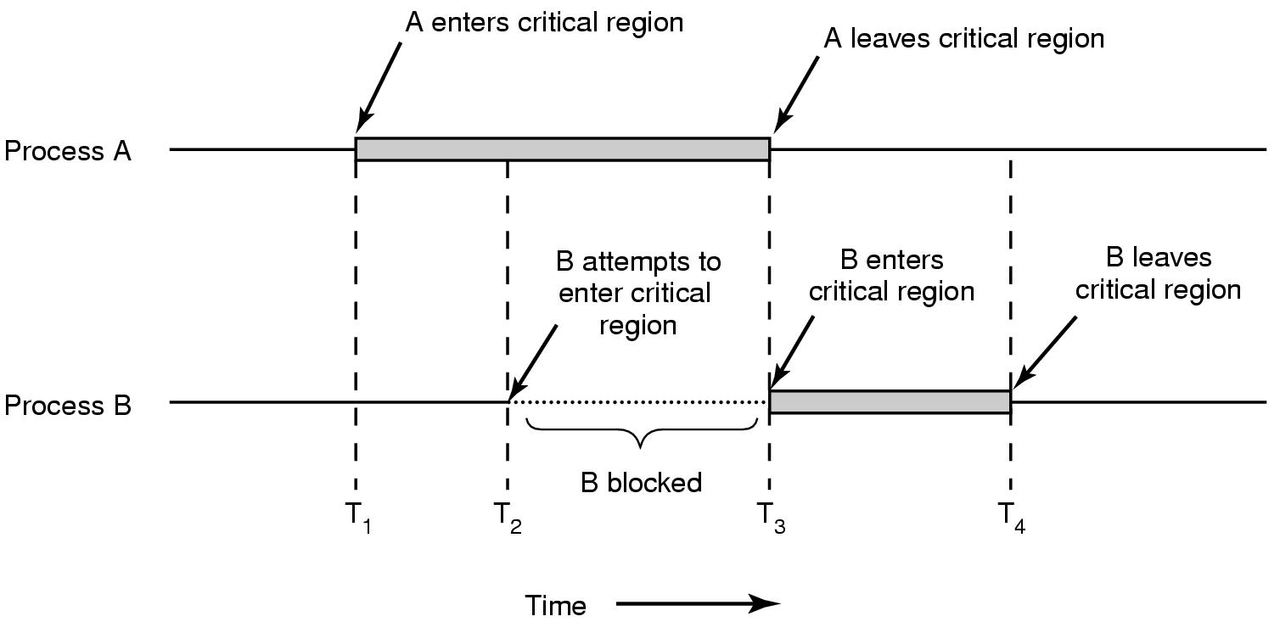
Mutual exclusion using critical regions

Slide 11
Conditions to avoid races/Requirements for mutual exclusion
1. No two process may be simultaneously inside their critical region
2. No process running outside its critical region can block other processes
3. No process should have to wait forever to enter its critical region i.e. no deadlock or starvation
4. When no process is in a critical section, any process that requests entry to its critical section must be permitted to enter without delay
5. A process remains inside critical region for a finite time only
6. No assumptions may be made about speeds or number of CPU’s

Slide 12
Various proposals to achieve mutual exclusion
    Disabling interrupts
    Lock variables
    Strict alternation
    Peterson's solution
    The TSL instruction

Slide 13
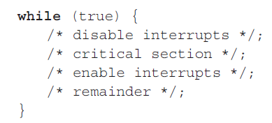
Disabling interrupts
Process disables interrupts, enters critical region
Enables interrupts when it leaves critical region
Problems
    User process might never enable interrupts- system crash
    Won’t work on multi-core chips - disabling interrupts affects only the CPU that executed the disable instruction

Slide 14
Lock variables
A software solution
All process shares a lock variable
When a process wants to enter critical region, it first check lock variable
    When lock is 0, process turns it to 1 and enters critical region
    When exiting critical region, turn lock to 0
Problem
    Race conditions can occur – both process can enter critical region at the same time

Slide 15
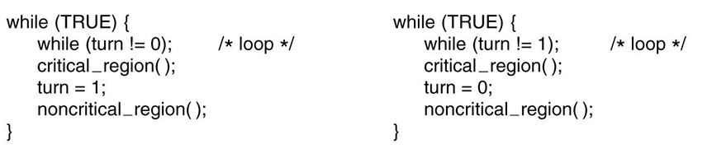
Strict alternation
Uses an integer variable – turn
Keeps track of whose turn it is to enter critical region
Process 0 Process 1

Slide 16
Busy waiting – continuously checking a variable until some value appears
    Usually not acceptable, since it’s a wastage of CPU
A lock that uses busy waiting is known as spin lock
Problems
    Taking turns is not a good solution when one of the processes is much slower than the other one
      Violation of condition 3

Slide 17
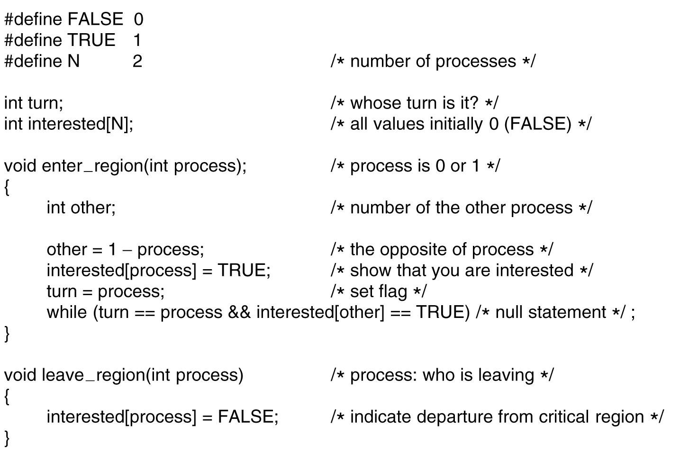
Peterson’s solution

Slide 18
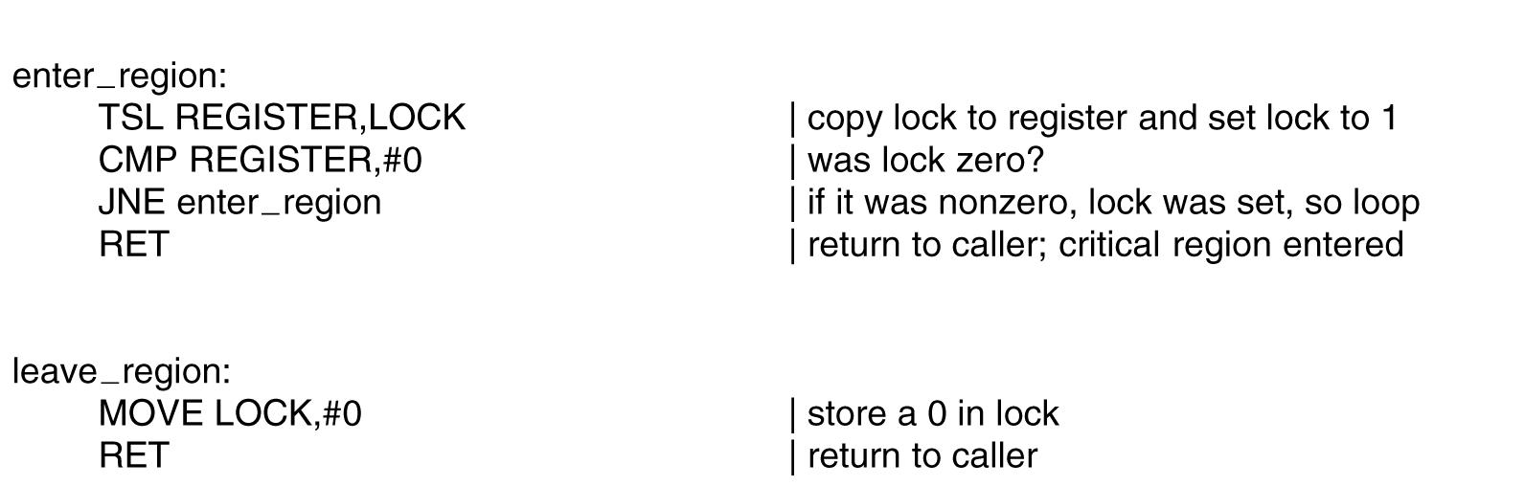
Hardware solution using TSL instruction
Using TSL (Test and Set Lock) instruction or TSL is atomic
Memory bus is locked until it is finished executing – other CPUs cannot access during this time

Slide 19
TSL instruction
    Reads the contents of a memory location
    Store it in a register
    Store a non-zero value at the address
Operation is guaranteed to be indivisible

Slide 20
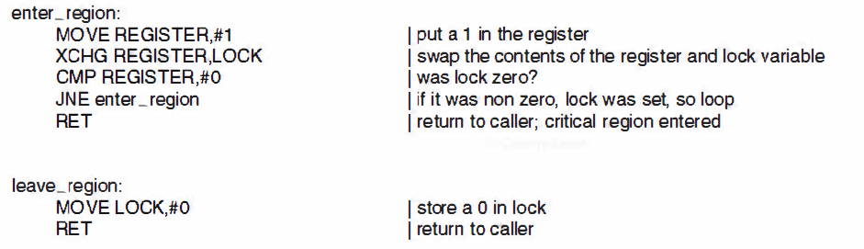
Hardware solution using XCHG instruction
All Intel x86 CPUs use XCHG instruction for synchronization

Slide 21
Producer Consumer problem
Also known as bounded buffer problem
One of the classical problems in IPC
Two processes shares a common fixed size buffer
Producer – puts information/data into buffer
Consumer – consumes the data from buffer
What to do when buffer is full or empty?

Slide 22
Buffer full – producer goes to sleep, awakened when consumer has removed one or more items
Buffer empty – consumer goes to sleep, awakened when producer puts something into buffer

Slide 23
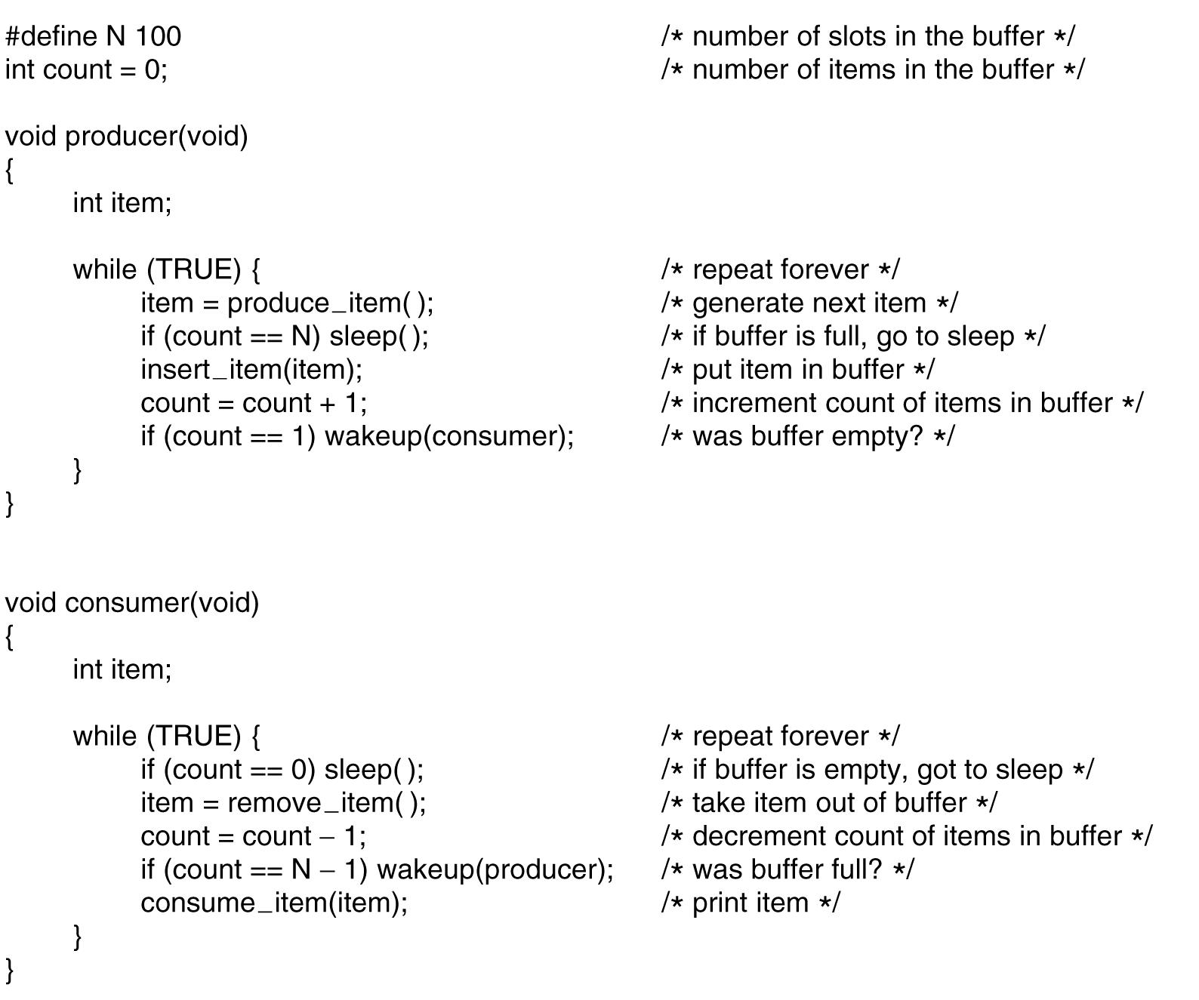

Slide 24
Race condition in producer consumer problem
Let buffer be empty
Scheduler picks consumer
Consumer reads count = 0
Scheduler picks producer
Producer inserts data into buffer, count incremented, wakeup call for consumer
Consumer is not yet logically asleep, wakeup call is missed
Scheduler picks consumer
Consumer goes into sleep mode
Scheduler picks producer
Producer inserts data into buffer, count incremented
When buffer is full producer also goes into sleep mode

Slide 25
Semaphore
A variable type (usually integer) used for synchronization among processes
Only three operations – initialization , increment and decrement
Ensures that synchronization is maintained
Decrement operation
    Down operation on a semaphore checks to see if the value is greater than 0
    If so, the semaphore is decremented and continues
    If the value is zero, the process is put to sleep or process is blocked
Increment operation
    Process is unblocked if value is greater than zero

Slide 26
Checking the value, changing it, and possibly going to sleep/blocked mode are all done as a single, indivisible atomic action
Once a semaphore operation has started, no other process can access the semaphore until the operation has completed or blocked – atomicity
Essential for solving synchronization problems and avoiding race conditions

Slide 27
Solving producer consumer problem using semaphore
up and down are implemented in an indivisible manner
    Either interrupts are disabled when there is a semaphore operation
    In case of multi core CPU, each semaphore should be protected by TSL instructions
Uses 3 semaphores
    full – Counts the number of slots that are full
    Ensures that producer stops running when buffer is full
    empty – Counts the number of slots that are empty
    Ensures that consumer stops running when buffer is empty
    mutex – Make sure producer and consumer does not access the buffer at same time – mutual exclusion

Slide 28
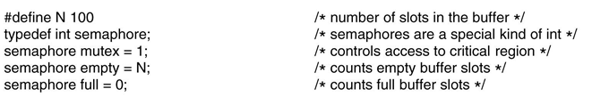
Mutex
    Binary semaphores
    Take only two values 0 and 1
    Used by two or more processes to ensure that only one of them can enter the critical region at a time
    Mutual exclusion is guaranteed by Mutex

Slide 29
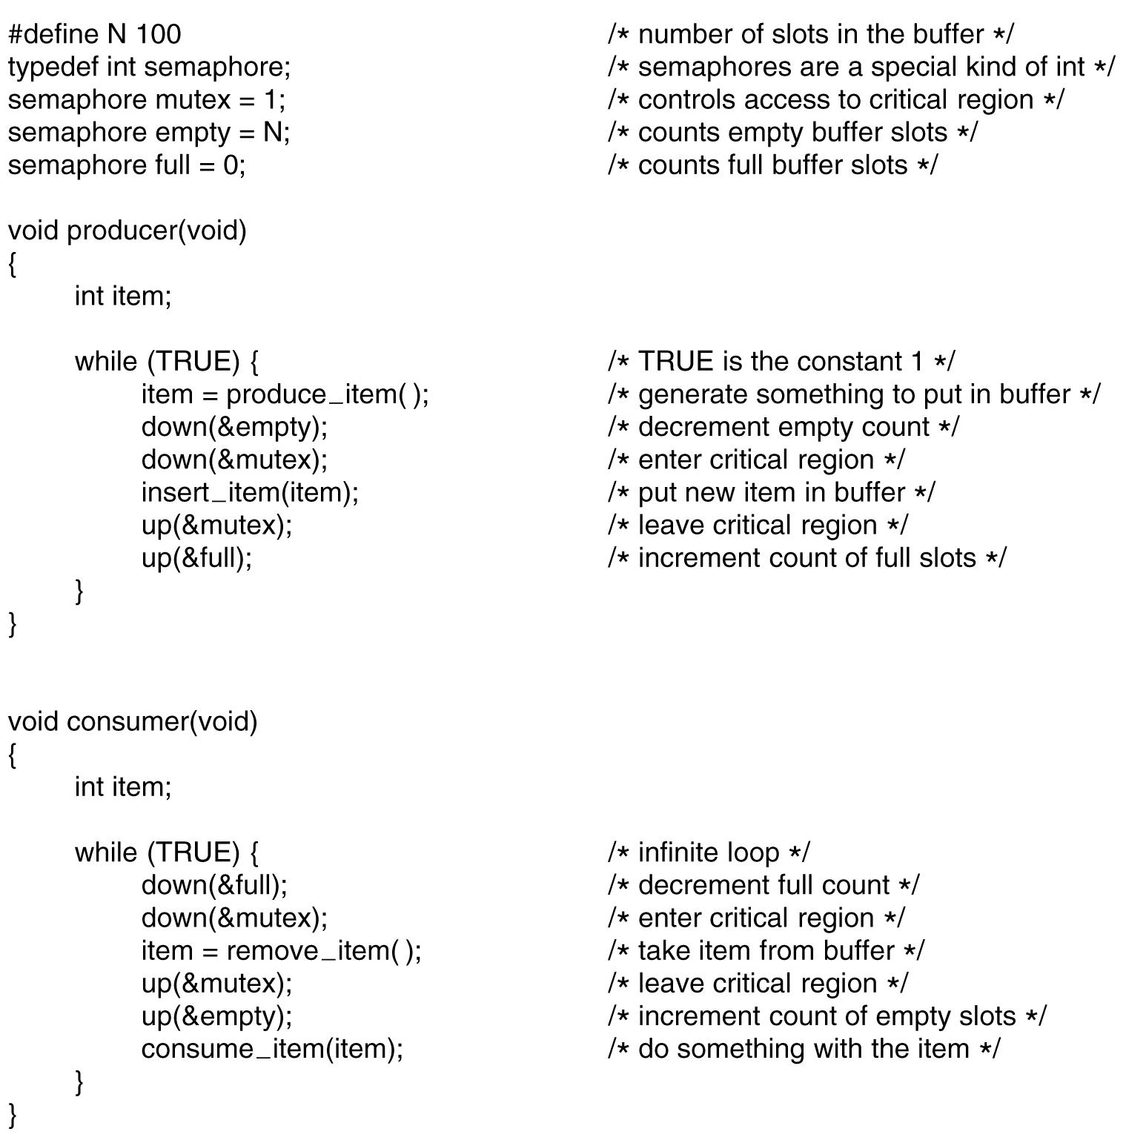

Slide 30
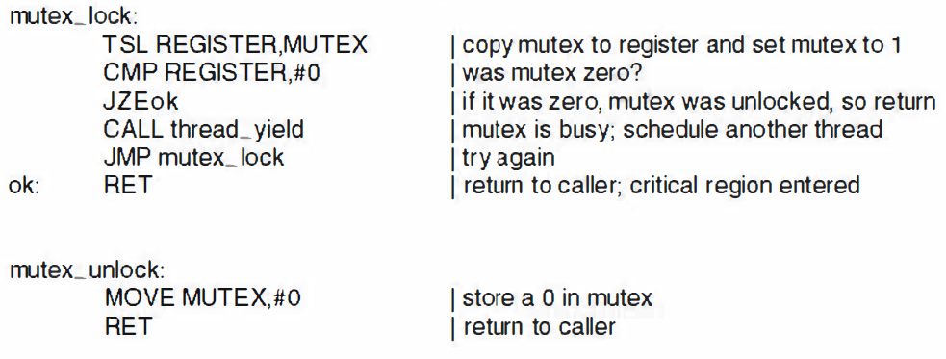
Mutex
Mutex lock for handling user threads

Slide 31
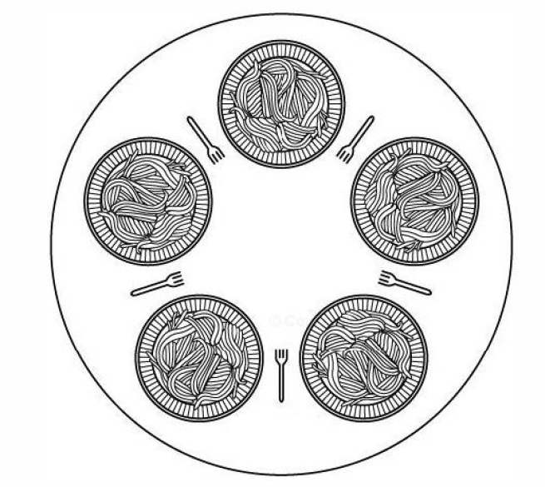
Dining Philosophers problem

Slide 32
Actions
    Thinking – No forks are required
    Eating – Both forks are required
For eating process one has to take left fork and right fork, one at a time, in either order
If successful in acquiring two forks, he/she eats for a while, then puts down the fork and continue thinking

Slide 33
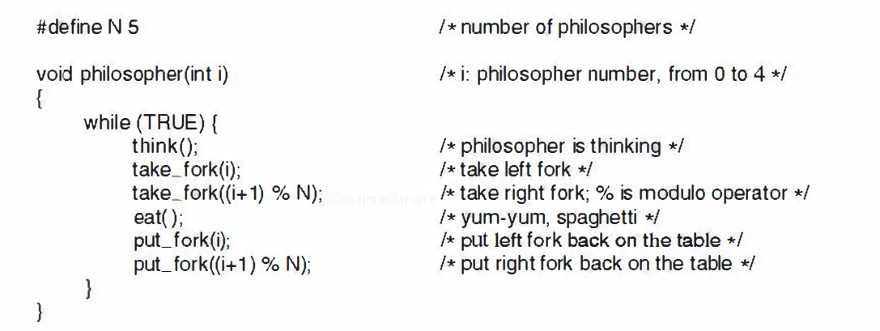
Will this logic work?

Slide 34
All philosophers acquire left fork
    None can take their right fork – Deadlock
All waits for equal amount of time again try to acquire forks at same time - Can lead to starvation

Slide 35
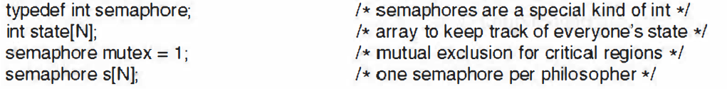
Two semaphores
    mutex – mutual exclusion for critical region (acquiring forks or putting it down)
    s[N] – one semaphore per philosopher

Slide 36
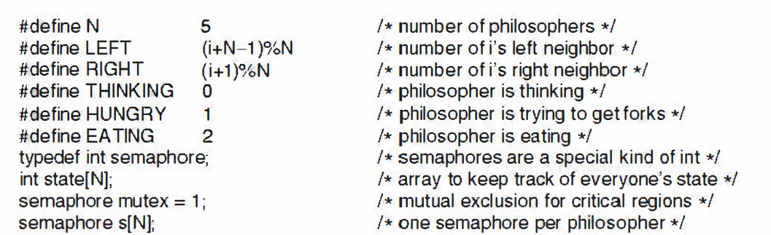

Slide 37
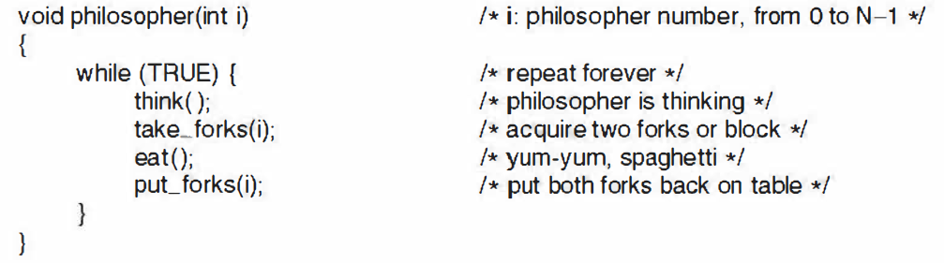

Slide 38
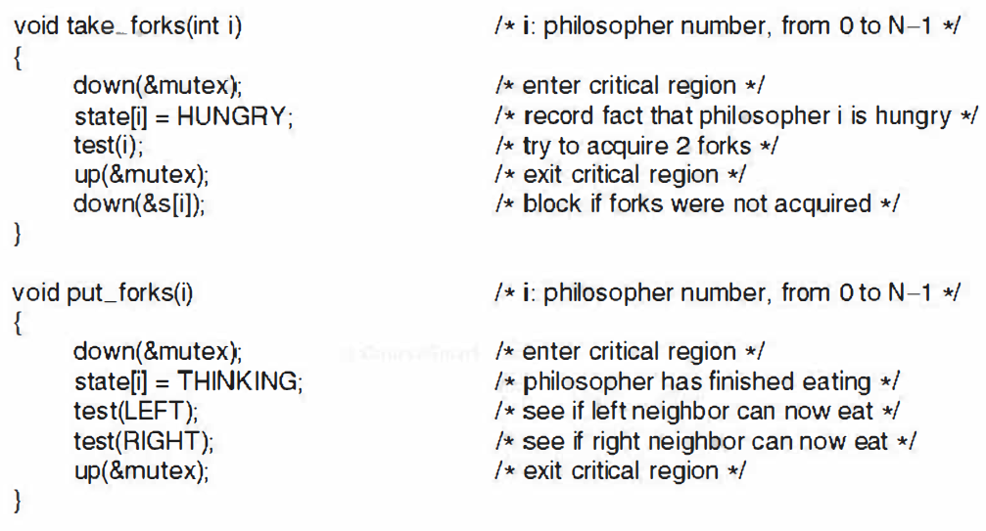
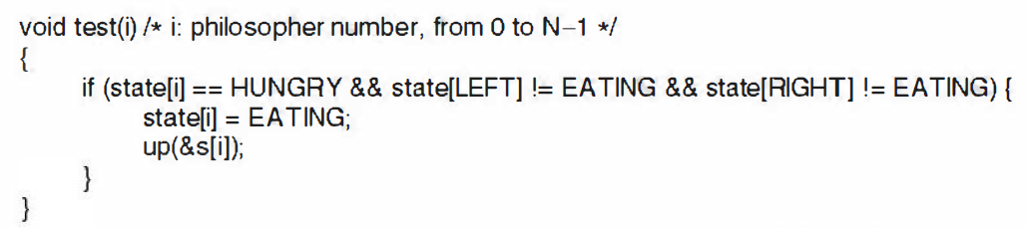

Slide 39
Readers Writers problem
Any number of readers may simultaneously read a file, database, etc.
Only one writer at a time may write to the file
If a writer is writing to the file, no reader may read from it

Slide 40
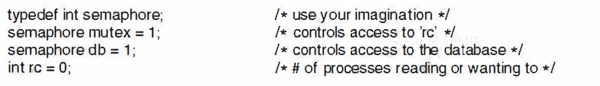
Two semaphores
    mutex – controls the readers count
    db – controls the access to database

Slide 41
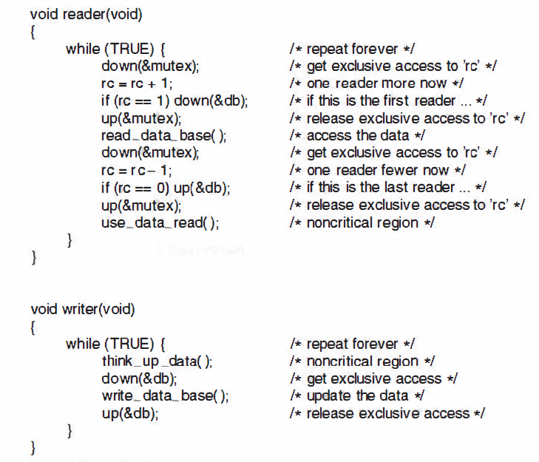

Slide 42

Message passing techniques
Uses two primitives
send – A process sends information in the form of a message to another process designated by a destination
receive – A process receives a message from a given source by executing receive primitive

Slide 43
Design issues in message passing
Synchronization
Addressing

Slide 44
Design issues
Synchronization – mutual exclusion between co-operating process
  Blocking send, blocking receive
    Both the sender and receiver are blocked until the message is delivered
    This combination allows tight synchronization between processes
  Nonblocking send, blocking receive
    Sender may continue on, the receiver is blocked until the requested message arrives
    Most useful combination
    Allows a process to send one or more messages to a variety of destinations as quickly as possible
  Nonblocking send, blocking receive
    Neither party is required to wait

Slide 45
Addressing
  Direct addressing
    send – includes a specific identifier of destination process
    receive – two options
      process designate a sending process by knowing ahead of time from which process a message is expected
      If it is not known, for eg: printer-server process, it accepts print requests from any other process

Slide 46
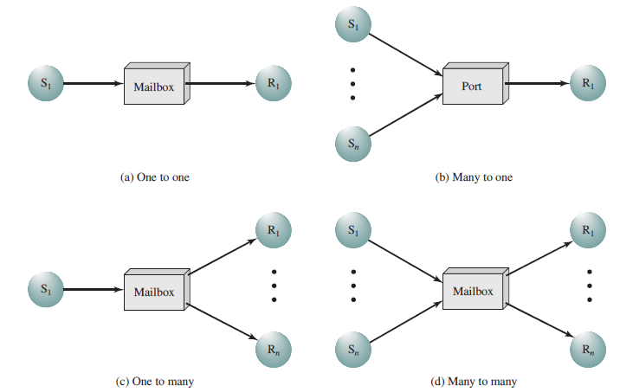
  Indirect addressing
    Messages are not sent directly from sender to receiver
    Shared queue is maintained – mailboxes

Slide 47
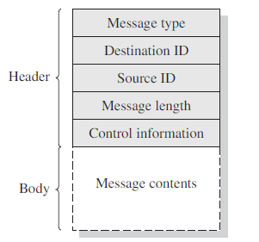
Message format

Slide 48
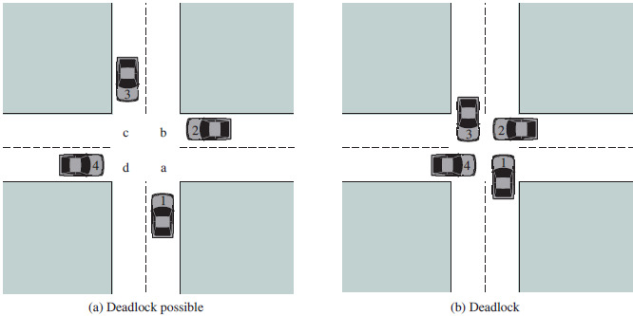
Deadlocks
Permanent blocking of a set of processes that either compete for system resources or communicate with each other

Slide 49
A set of processes is deadlocked when each process in the set is blocked awaiting for freeing up requested resources
Dead lock is permanent

Slide 50
Conditions for deadlock
1. Mutual exclusion: Only one process may use a resource at a time. No process may access a resource that has been allocated to another process
2. Hold and wait: Process currently holding resources that were granted earlier can request new resources

Slide 51
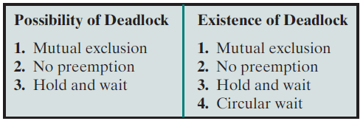
3. No preemption: No resource can be forcibly removed from a process holding it. They must be explicitly released by the process holding it
4. Circular wait: There must be circular list of two or more processes, each of which is waiting for a resource held by the next member of the chain

Slide 52
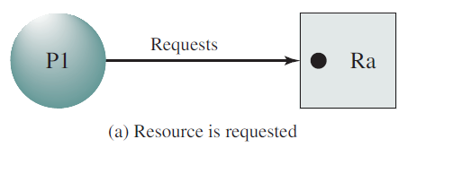
Deadlock modeling - Resource allocation graph
Resource that has been requested by a process, but not yet granted

Slide 53
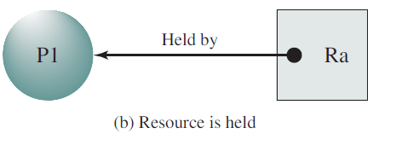
Request has been granted

Slide 54
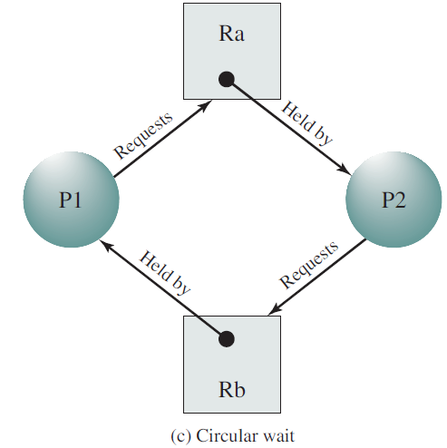
Deadlock

Slide 55
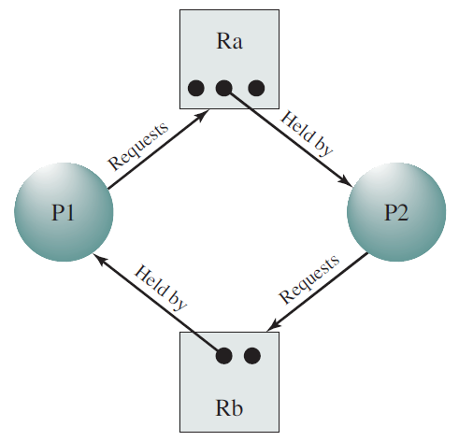
Multiple units of resources are available – no deadlock

Slide 56
Handling deadlocks
Detection and recovery
Dynamic avoidance by careful allocation of resources
Prevention – by adopting a policy that avoids one of the conditions

Slide 57
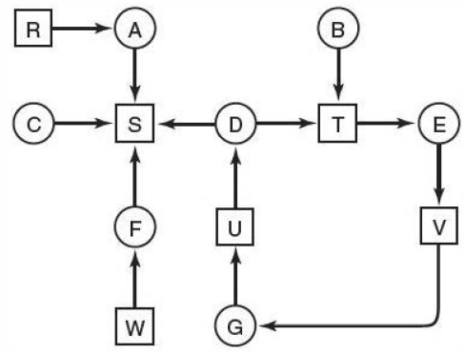
Deadlock detection and recovery
Deadlock detection with one resource of each type

Slide 58
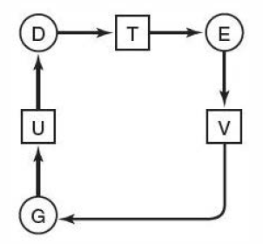
Deadlock exists – if it contains one or more cycles

Slide 59
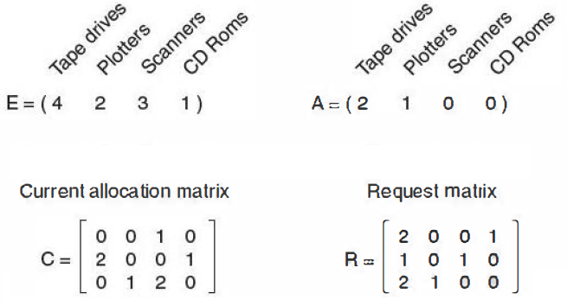
Deadlock detection with multiple resource of each type
Example
E – Resources in existence A – Available resources
C – Current allocation matrix R – Request matrix

Slide 60
Deadlock detection algorithm
Look for a process whose resource request can be satisfied
    3rd process can be satisfied – process 3 runs and returns its resources
    A = (2 2 2 0)
    Now 2nd process can be executed
    A = (4 2 2 1)
    1st process can be executed – No deadlock

Slide 61

If R = $\left[\begin{matrix}2 & 0 & 0 1 \\ 2 & 1 & 0 2 \\ 2 & 1 & 0 0\end{matrix}\right]$
Leads to deadlock

Slide 62
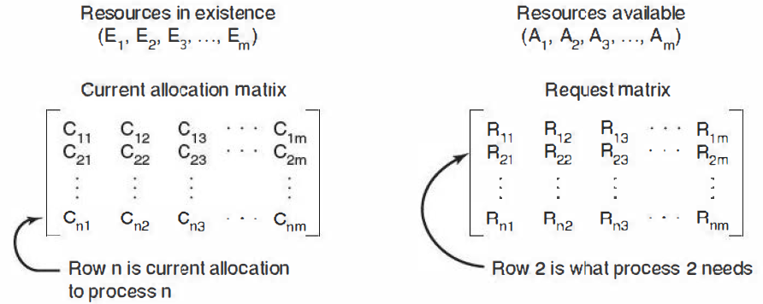

Generalization
C_{ij} – no. of instances of resource j currently allotted to P_{i}
R_{ij} – no. of instances of resource j that P_{i} wants

Slide 63
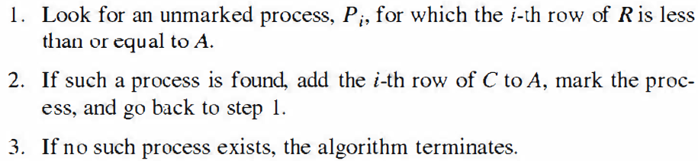
Deadlock detection algorithm
Each process is initially unmarked (not executed)
Process that are executed are marked as complete
If all the processes are marked as complete – no deadlock
Unmarked process - deadlocked

Slide 64
Recovery from deadlock
Abort all deadlocked processes
Backup each deadlocked process to some previously defined checkpoint and restart all the process
Successively abort deadlocked processes until deadlock no longer exists
Successively preempt resources until deadlock no longer exists

Slide 65
Selection criteria for (3) and (4)
    Least amount of processor time consumed so far
    Least amount of output produced so far
    Most estimated time remaining
    Least total resources allocated so far
    Lowest priority

Slide 66
Deadlock avoidance
While granting a resource to a process, system should decide whether granting a resource is safe or not
Make allocations when it is safe

Slide 67
Resource trajectories or Joint progress diagram

Slide 68
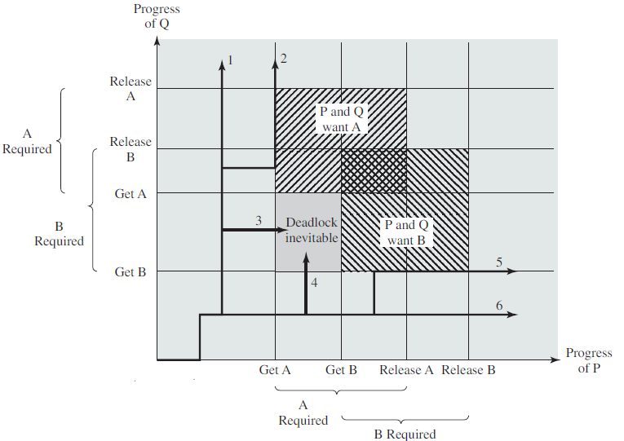
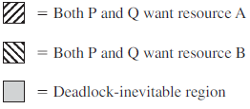


Slide 69
1, 2, 5, 6 – No deadlocks
3, 4 – Deadlock

Slide 70
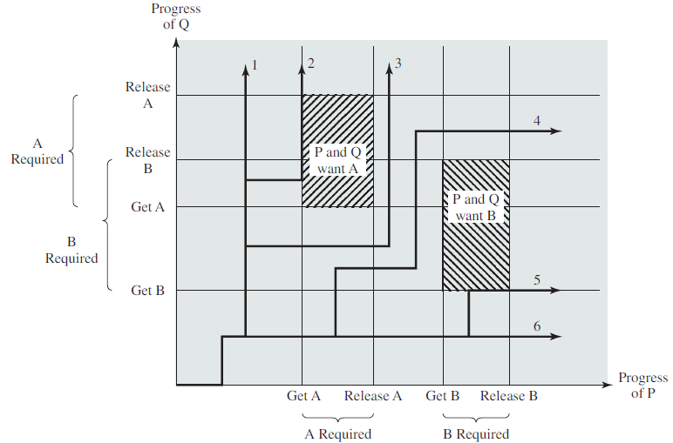

Slide 71
Deadlock avoidance
Safe state
    There is at least one sequence of resource allocations to processes that does not result in deadlock
    All of the processes can be run to completion
Unsafe state
    Can lead to dead lock

Slide 72
Banker’s algorithm for a single resource
Similar to the way a small banker might deal with a group of customers
Algorithm checks to see if granting the request leads to an unsafe state
If it does, the request is denied and is postponed

Slide 73
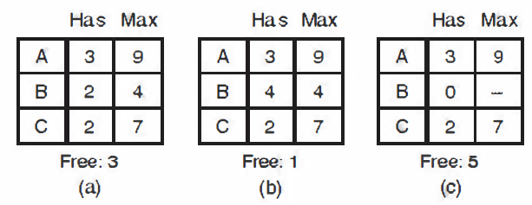
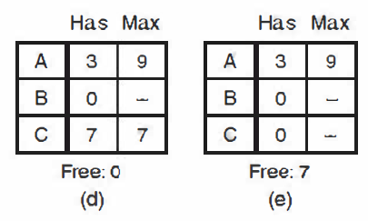
Safe state
10 instances of same resource exist

Slide 74
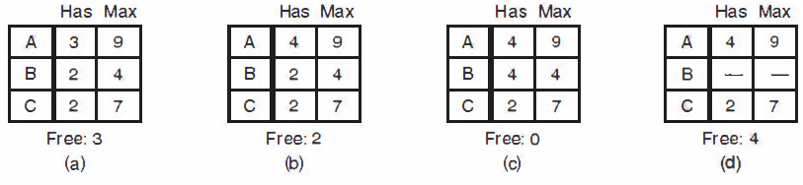
Unsafe state

Slide 75
Unsafe state is not a deadlocked state
Safe state – system can guarantee that all process will finish
Unsafe state – no such guarantee can be given

Slide 76
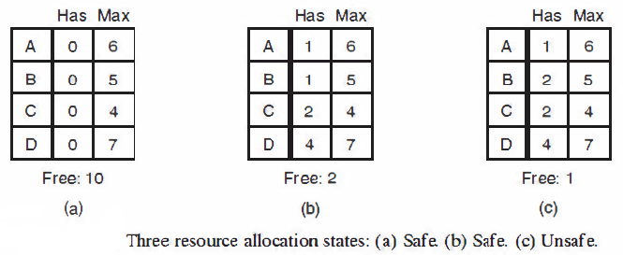

Slide 77
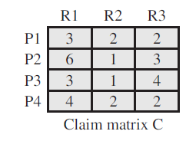
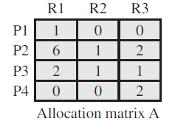

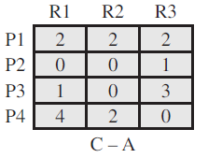
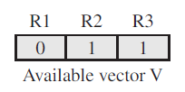
Banker’s algorithm for multiple resources
Initial state

Slide 78
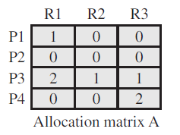
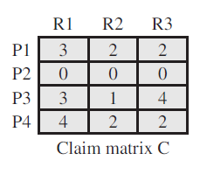

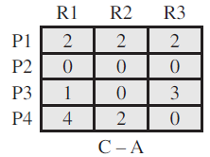

P2 runs to completion

Slide 79





P1 runs to completion

Slide 80





P3 runs to completion

Slide 81

Deadlock prevention
Indirect method
    Prevent the occurrence of one of the three necessary conditions
Direct method
    Prevent the occurrence of a circular wait

Slide 82
Mutual exclusion
Cannot be avoided
Spooling can reduce deadlocks to some extend

Slide 83
Hold and wait condition
All process requests all their resources before starting execution
If everything is available, the process will be allocated whatever it needs and can run to completion
If one or more resources are busy, nothing will be allocated and the process would just wait

Slide 84
A process may not know in advance all of the resources that it will require
Resources allocated to a process may remain unused for a considerable period, during that time they are denied to other processes
A process may be held up for a long time waiting for all of its resource requests to be filled

Slide 85
No preemption
If a process holding certain resources is denied a further request, that process must release its original resources
If necessary, request them again together with the additional resources

Slide 86
Circular wait
Prevented by defining a linear ordering of resource type
If a process has been allocated resources of type R, then it may subsequently request only those resources of types following R in the ordering
Difficulty in determining the order

Slide 87

If i > j, A is not allowed to request j
If i < j, B is not allowed to request i

Slide 88
Integrated deadlock strategies
Different strategies in different situations
Group resources into a number of different resource classes
Use the linear ordering strategy for the prevention of circular wait to prevent deadlocks between resource classes
Within a resource class, use the algorithm that is most appropriate for that class

Slide 89
Types of resource classes
Swappable space
    Blocks of memory on secondary storage for use in swapping processes
Process resources
    Assignable devices such as printers, scanners, files etc.
Main memory
    Assignable to processes in pages or segments
Internal resources
    I/O channels

Slide 90
Strategy for each class
Swappable space
    All resources are allocated at one time
    Maximum storage requirements are usually known
Process resources
    Resource ordering
Main memory
    Prevention by preemption
    Preempted process is swapped to secondary memory
Internal resources
    Resource ordering can be used

