Slide 1
Module 2

Slide 2
Outline
Process
Process scheduling
Threads
Thread scheduling

Slide 3
Process Model
A program in execution
An instance of executing program
All executable softwares including OS – organized into a number of sequential processes
Includes Program Counter, Registers and Variables
CPU switches between processes - multiprogramming

Slide 4
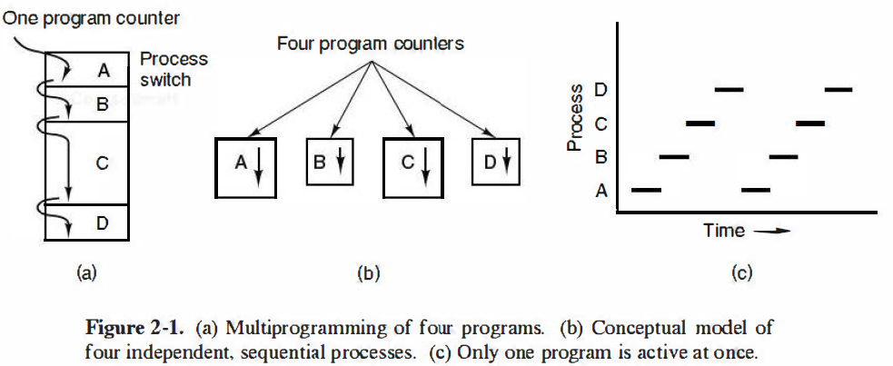
Only one program counter, but 4 logical program counters

Slide 5
Process creation events
System initialization
Execution of a process – creation system call by a running process
A user request to create a new process
Initialization of a batch job

Slide 6
Process creation events
System initialization
    Created when booting up the system
    Foreground processes – interact with users
    Back ground processes – Not associated with particular users, but instead have some specific functions
    Daemons – process that stay in the background

Slide 7
Execution of a process – creation system call by a running process
    Parent process – a process that created one or more child process
    Child process
System call for creating a child process
    UNIX – fork()
    Windows – CreateProcess

Slide 8
A user request to create a new process
    Command line
    Double click on an icon in GUI

Slide 9
Initialization of a batch job
    Found in mainframes
    Eg: Sales reporting/Inventory management at the end of a day
    OS starts the process required for this, when it has enough resources to execute it

Slide 10
Process Termination
Normal exit (voluntary)
Error exit (voluntary)
Fatal error (involuntary)
Killed by another process (involuntary)

Slide 11
Normal exit (voluntary)
Process have completed their work or time limit has exceeded
Eg: A compiler has finished compiling a C program
Eg: Close button in GUI – removes any temporary file and exit the application

Slide 12
Error exit (voluntary)
Eg: Trying to compile a non existing C program

Slide 13
Fatal error (involuntary)
Due to program bugs or other hardware failure
Eg: Executing invalid instructions, referencing nonexistent memory, divide by zero error, I/O failure etc.

Slide 14
Killed by another process (involuntary)
A process executes a system call telling the OS to kill some other process
Killer process must have necessary authorization to perform this operation
Parent termination – When a parent terminates, OS may automatically terminate all of the offspring of that parent
Parent request – A parent process typically has the authority to terminate its offspring
UNIX – kill
Windows – TerminateProcess

Slide 15
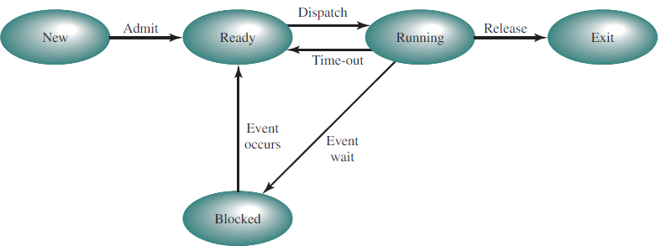
Process states

Slide 16
New – The process is being created
Running – Instructions are being executed
Blocked – The process is waiting for some event to occur (such as an I/O completion or reception of a signal)
Ready – The process is waiting for the scheduler to pick it

Slide 17
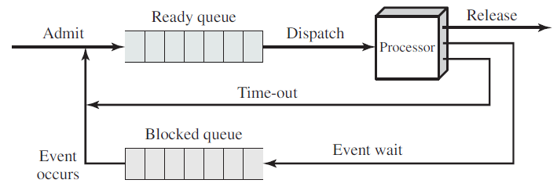
Queueing model
In the absence of any priority scheme, FIFO can be used
Single blocked queue

Slide 18
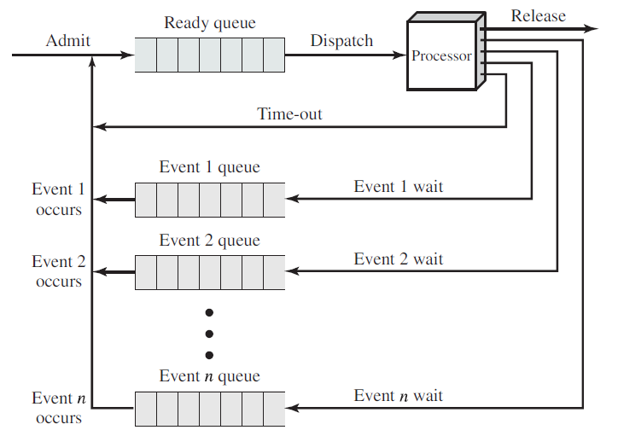
Multiple blocked queue

Slide 19
Process Control Block or Process Table
One entry per process
All the information about each process is stored in the PCB - maintained by OS
    process identifier
    process state
    program counter
    stack pointer
    memory pointers
    status of open files
    I/O status information
    accounting and scheduling information etc.

Slide 20
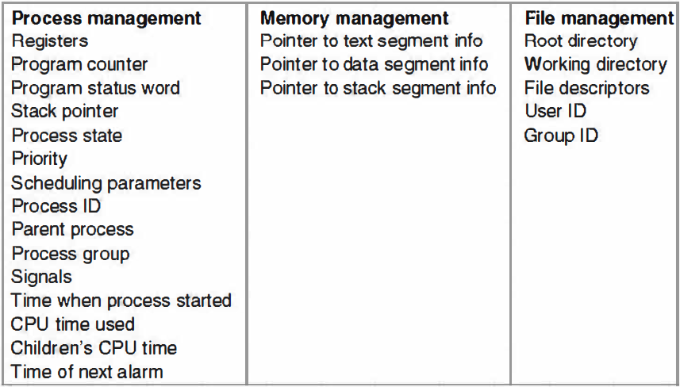
Some of the fields of PCB

Slide 21
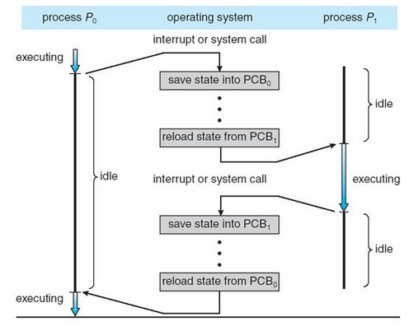
CPU switch from process to process
Context switch

Slide 22
Scheduling
Scheduler – Selects the next process to be executed among multiple processes
Scheduling algorithm
Efficient use of CPU
Process switching is expensive

Slide 23
Process behavior
All processes have alternate bursts of CPU cycle and I/O cycle
    CPU bound process – Long CPU bursts, infrequent I/O waits
    I/O bound process – short CPU bursts, frequent I/O waits

Slide 24
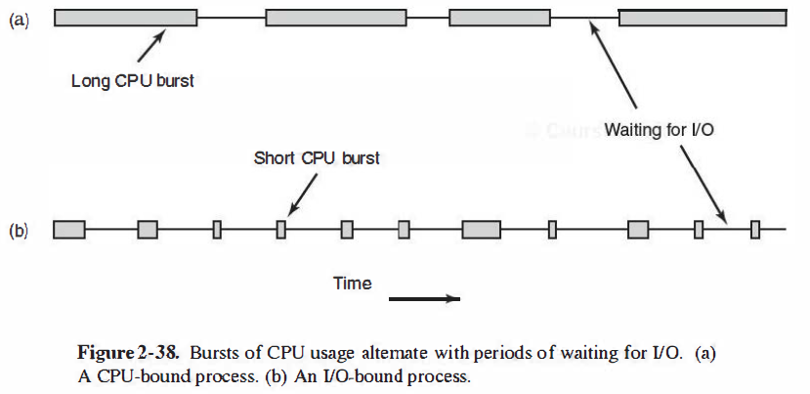

Slide 25
Types of processor scheduling
Long term scheduling
Medium term scheduling
Short term scheduling

Slide 26
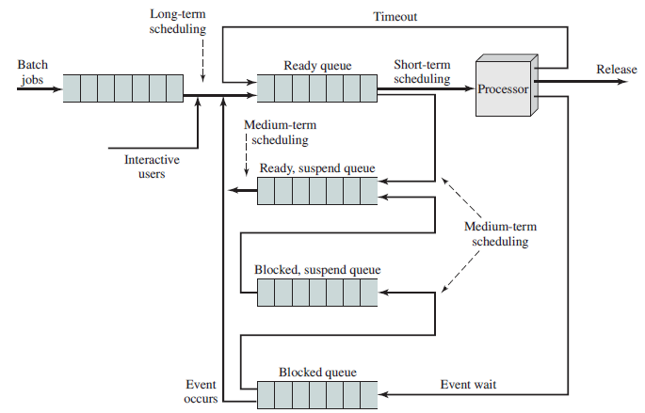
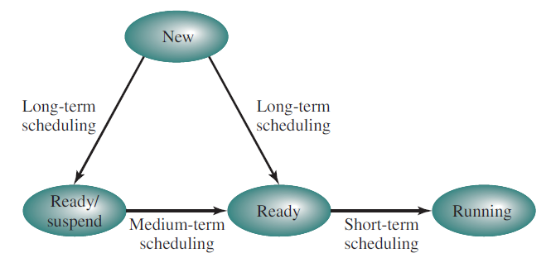
Process state transition Queueing diagram for scheduling

Slide 27
Long term scheduling
Performed when a new process is created
Decision whether to add a new process to the set of processes that are currently active

Slide 28
Medium term scheduling
The decision to add to the number of processes that are partially or fully in main memory
When part of the main memory gets free, OS looks at the list of suspend/ready processes, decides which one is to be swapped in
Memory is a constraint here
Decision depends on priority, memory and other resources required, etc.

Slide 29
Short term scheduling
The decision as to which available process will be executed by the processor

Slide 30
When to schedule?
1. When a new process is created – whether to run parent process or child process
2. When a process is terminated – some other process must be selected from the set of ready processes

Slide 31
When to schedule?
3. When a process blocks on I/O – select another process to be executed
4. When an I/O interrupt occurs – A process that was blocked waiting for I/O may now be ready to run – scheduler can decide whether to pick this process or some other ready process

Slide 32
Types of scheduling algorithms
Non-preemptive scheduling
    A process is selected to run and is continued till it blocks for I/O or waiting for another process
    Or it is continued until the process releases voluntarily
    Even if a process runs for hours, it will not be forcibly suspended
    After a clock interrupt processing has been completed, the process that was running before the interrupt is resumed

Slide 33
Types of scheduling algorithms
Preemptive scheduling
    A process is executed for a fixed time
    If it is still running at the end of the time interval, it is suspended and the scheduler picks another process to run

Slide 34
Scheduling algorithm – categories
Batch systems
Interactive systems
Real time systems

Slide 35
Batch systems
For periodic tasks – pay roll management, inventory, claims processing etc.
No interactive user is waiting
Hence preemptive or non-preemptive scheduling with long time periods for each process is acceptable
Hence process switching is reduced – improvement in performance

Slide 36
Interactive systems
Interactive users are present
Preemption is necessary
Otherwise some users may have to wait indefinitely

Slide 37
Real time systems
Timings are critical
Processes may not run for long time periods

Slide 38
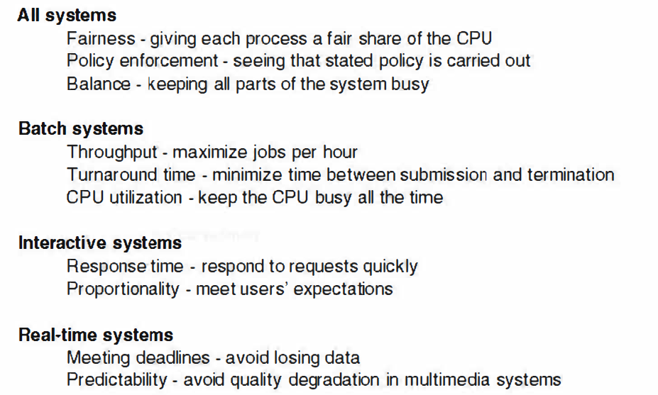
Scheduling algorithm goals/criteria

Slide 39
Scheduling algorithms in Batch systems
First Come First Served (FCFS)
Shortest Job First (SJF)

Slide 40
First Come First Served
Simplest algorithm
Non-preemptive algorithm
As new jobs come in, they are put onto the end of the queue
When the running process block for I/O, the first process on the queue is run next
When the blocked process is ready, it is put on the end of the queue

Slide 41
Example
Find the average waiting time and average turn around time.
Process | Burst Time (mSec)
P1 | 24
P2 | 3
P3 | 3

Slide 42
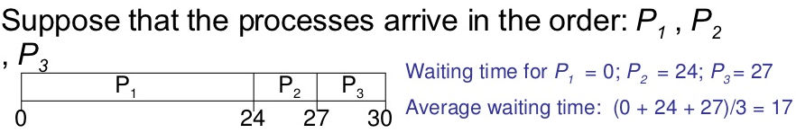
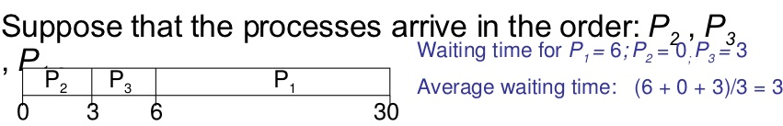
msec
Average turn around time: (24 + 27 + 30)/3 = 27msec
msec
Average turn around time: (3 + 6 + 30)/3 = 13 msec

Slide 43
FCFS advantages
    Simplest algorithm
    Easier to understand and implement
FCFS disadvantages
    Average waiting time is not minimal. Depend on the execution order
    Lower CPU utilization because of convoy effect
    Not suitable for time shared systems

Slide 44
Shortest Job First (SJF)
CPU is assigned to the process having the smallest CPU burst
If two process have the same CPU burst, FCFS scheduling is used

Slide 45
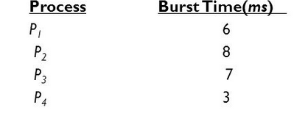

Slide 46
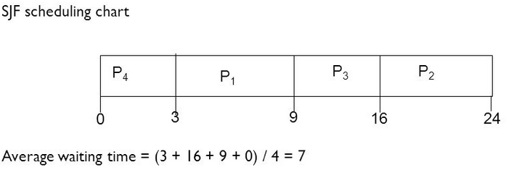

Slide 47
Advantages of SJF
    Algorithm is optimal – minimum average waiting time
Disadvantage of SJF
    Exact CPU burst time may not be available
    Approximation is made from the previous CPU burst

Slide 48
Scheduling in interactive systems
Priority scheduling
Round Robin scheduling

Slide 49
Priority scheduling
Each process is assigned a priority
CPU is allocated to the process with highest priority
Equal priority process are allocated in FCFS order

Slide 50
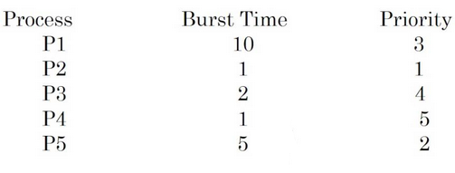
Example
All times are in msec

Slide 51
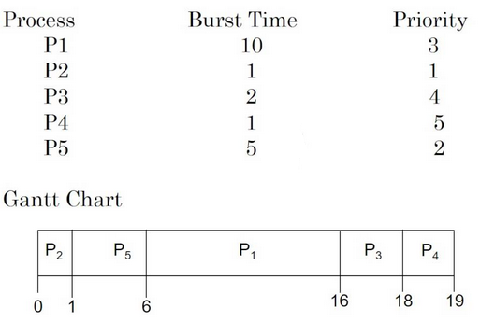
Example
Average waiting time = 8.2msec

Slide 52
Assigning priorities – dynamically (internally) or statically (externally)
Internally (dynamically) defined priorities – set by OS to achieve certain system goals
    Time limits
    Memory requirements
    Number of open files
    Ratio of average I/O burst to average CPU burst time – An I/O bound process should be given higher priority than CPU bound process

Slide 53
Statically (Externally) defined priorities – priorities are set outside OS
    Importance of work
    Type and amount of funds allocated
    Department sponsoring the work
    Political factors etc.

Slide 54
Priority scheduling – Preemptive or Non-preemptive
Preemptive – will preempt the CPU if the priority of the newly arrived process is higher than the priority of currently running process
Non preemptive – New process will be added at the head of the ready queue

Slide 55
Indefinite blocking or starvation – Low priority process may have to wait indefinitely
Prevention of starvation
  Scheduler may decrease priority of the currently running process at each clock interrupt
    If the priority drops below that of the next highest process, a process switch occurs

Slide 56
2. Each process may be given a maximum time quantum for execution (preemption)
When the time period is utilized completely next highest priority process is executed
3. Gradually increasing the priority of process that wait for long time

Slide 57
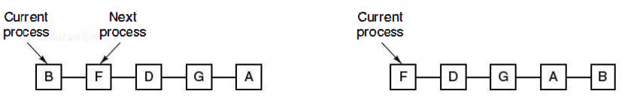
Round Robin scheduling
Similar to FCFS, but preemption is added to switch between processes
A small unit of time for execution – time quantum is defined

Slide 58
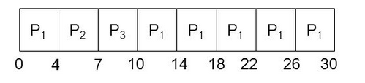
Example
Assume a time quantum of 4msec
Process | Burst Time (mSec)
P1 | 24
P2 | 3
P3 | 3

Slide 59
Waiting time for process P1 = 0 + (10-4) = 6msec
Waiting time for process P2 = 4msec
Waiting time for process P3 = 7msec
Hence average waiting time = 17/3 = 5.66msec

Slide 60
Draw the Gantt chart and find average waiting time. Assume time quantum as 2msec.
Process | Burst Time (mSec)
P1 | 10
P2 | 5
P3 | 2

Slide 61

Process | Burst Time (mSec)
P1 | 10
P2 | 5
P3 | 2

Slide 62
Waiting time for process P1 =
0 + (6-2) + (10-8) + (13-12) = 7msec
Waiting time for process P2 =
2 + (8-4) + (12-10) = 8msec
Waiting time for process P3 = 4msec
Hence average waiting time = 19/3 = 6.33msec

Slide 63
Process | Arrival time (mSec) | Burst Time (mSec)
P0 | 0 | 5
P1 | 1 | 3
P2 | 2 | 8
P3 | 3 | 6

Slide 64
Time quantum for process execution – 4msec
Process switching – 1msec
20% of CPU time is used for administrative overhead

Slide 65
Time quantum for process execution – 100msec
Process switching – 1msec
Only 1% of CPU time is used for administrative overhead
Consider 50 processes in queue
50th process may have to wait 5 sec for execution

Slide 66
Too short quantum
    Large number of process switches
    Lowers CPU efficiency
Too long quantum
    Poor response to short interactive requests
A quantum of around 20-50msec is often a reasonable compromise

Slide 67
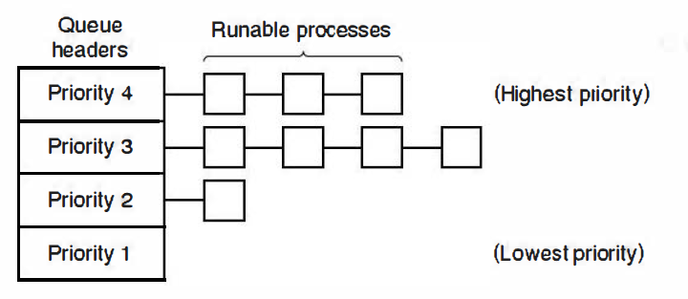
Multilevel Queue scheduling
Processes are classified into different groups

Slide 68
Example
Foreground process (interactive process) – high priority
Background process (Batch process) – low priority

Slide 69
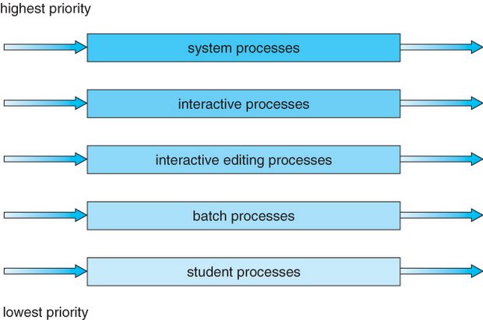

Slide 70
Processes are permanently assigned to each queue
Each queue can have its own scheduling algorithm
There must be scheduling among the queues – usually fixed priority preemptive scheduling

Slide 71
Disadvantage
    Processes are permanently assigned to a queue
    Do not change the queue
    Hence inflexible

Slide 72
Multilevel feedback queue scheduling
Allows a process to move between queues
Processes are classified based on CPU bursts
If a process use CPU for too long, it will be moved to a low priority queue
A process that waits too long in a lower priority queue may be moved to a higher priority queue
A process in lower priority queue can only execute only when higher priority queues are empty.
A process running in the lower priority queue is interrupted by a process arriving in the higher priority queue.

Slide 73
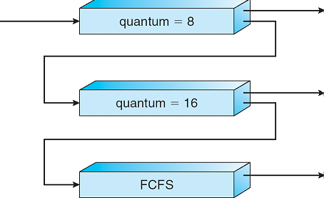

Slide 74
Multilevel-feedback-queue scheduler is defined by the following parameters:
    Number of queues
    Scheduling algorithms for each queue
    Method used to determine when to upgrade a process
    Method used to determine when to demote a process
    Method used to determine which queue a process will enter when that process needs service

Slide 75
Concept of Threads
Light weight process – Thread
Main motive for thread
    Support multiple activities in a single application at the same time
    Since light weight – easier to create and destroy than process
    Performance enhancement

Slide 76
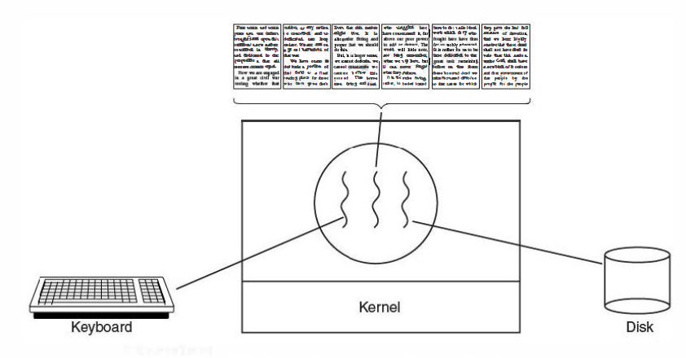
Examples
Word processor can have different threads for
    Display graphics
    Accepting keystrokes from user
    Spelling and grammar check
    Auto save etc.

Slide 77
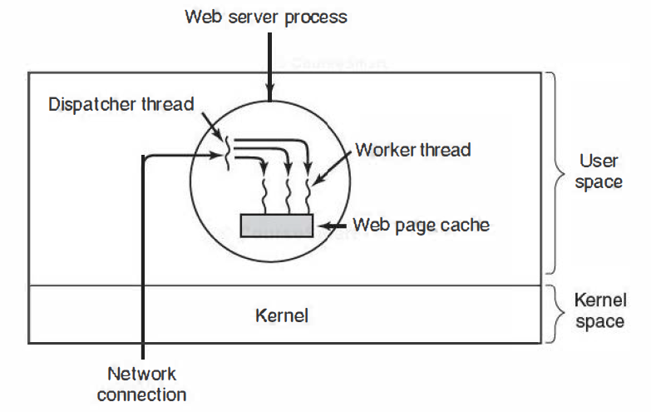
Examples
Multithreaded web server

Slide 78
Process
    Different address space in memory
    Single thread of control
Thread
    Multiple threads of control
    Same address space
    Quasi-parallel execution in the same address space

Slide 79
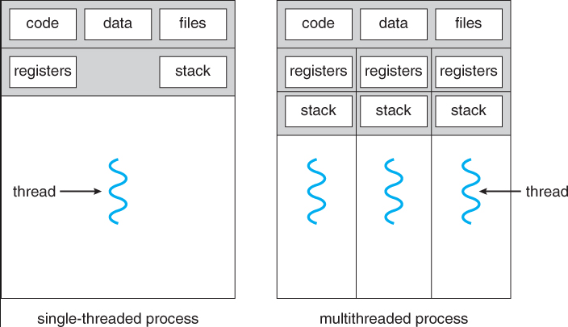

Slide 80
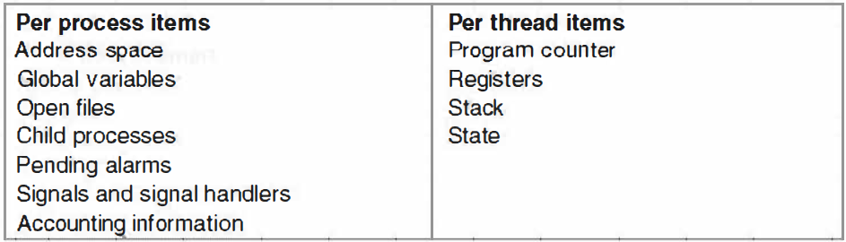

Slide 81
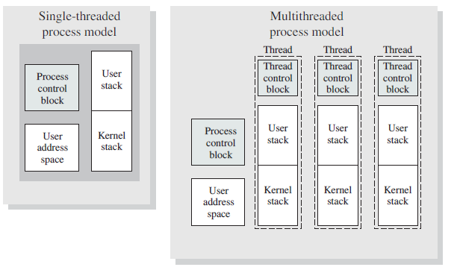
Single and Multithreaded process model

Slide 82
Benefits of threads
Very less time to create a thread in an existing process than to create a new process
Less time to terminate a thread
Less time to switch between threads within the same process than to switch between processes
Communication between threads of same process does not need involvement of kernel whereas inter process communication requires involvement of kernel

Slide 83
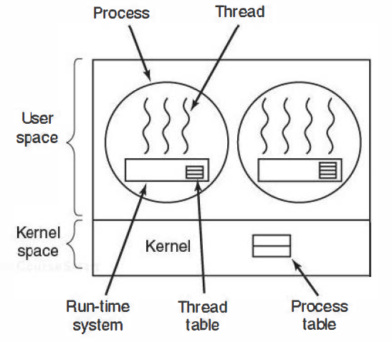
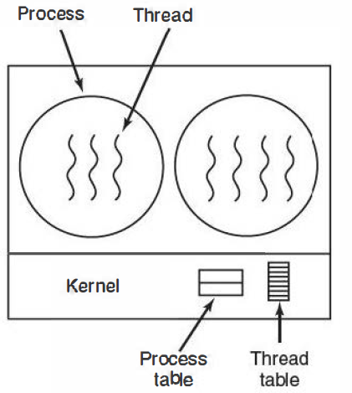
Implementing threads in user space and kernel space

Slide 84
Thread scheduling
In multi threaded process
    Process level scheduling
    Thread level scheduling
Depends on
    User level threads
    Kernel level threads

Slide 85
User level thread scheduling
Kernel is not aware of the existence of threads
Kernel will do scheduling in process level
Threads run on top of a run time system, which is a collection of procedures that manages threads
Each process may have a thread scheduler, which decides the thread to be executed
    Round robin, Priority scheduling etc.

Slide 86
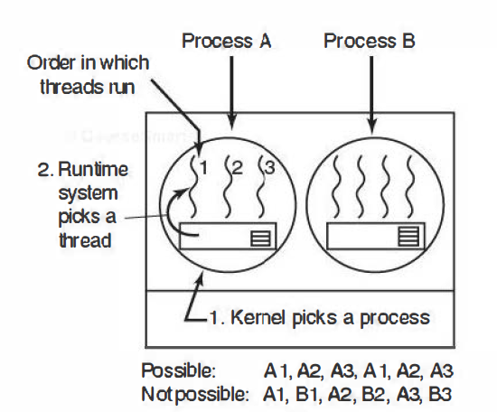

Slide 87
Kernel level thread scheduling
Kernel picks a particular process to run
It does not have to take into account which process the thread belongs to
The thread is given a quantum, and is forcibly suspended if it exceeds the quantum

Slide 88
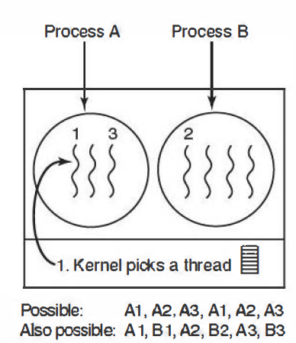

Slide 89
Comparison
User level thread switching
    Much simpler process than kernel level thread switching
    Does not require kernel mode privileges
    Can be done with minimum machine instructions
    Scheduling can be application specific
    If a thread blocks for I/O operation, it will suspend the entire process
    User level threads can employ application specific thread scheduler – can tune an application much better than kernel
Kernel level thread switching
    Much complex process
    Requires full context switching
    If a thread blocks for I/O operation, it will not suspend the entire process

Slide 90
Consider kernel switching
  Current process is A1
  Next thread to be executed can be A2 or B2
  Two threads A2 and B2 have same priority
Which thread will be selected by the kernel? Why?

