Slide 1
Module 1

Slide 2
Introduction to OS
Components of a Modern computer
    One or more processors
    Main memory (RAM)
    Disks (ROM)
    Printers
    Keyboards
    Monitors
    Network interfaces etc.

Slide 3
Managing these devices by individual user is an extremely difficult task.
This task is given to a software module known as Operating System (OS).
It provides a simple and user friendly interface to users.

Slide 4
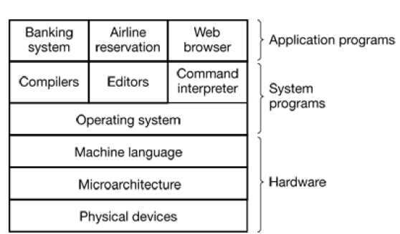

Slide 5
Physical devices
    Integrated circuit chips
    Wires/Bus
    Power supplies
    Cathode ray tubes etc.

Slide 6
Microarchitecture level
    Physical devices (logic gates, registers, lookup tables, multiplexers, counters etc.) are grouped together to form functional units
    Implementation of ALU, FPU or even larger units
    In each clock cycle instructions and data are fetched, decoded and computations are done, results are stored in registers

Slide 7
Machine language
    Moving data around the machine
    Arithmetic operation
    Loading values into special device registers
OS – hides all these complexities from the user (Application programmer)

Slide 8
Modes of operation
Kernel mode (Supervisor mode)
    Operating system
    Complete access to all hardware
    Can execute any instruction, the machine is capable of executing
    Need special privilege to enter into this mode
User mode
    Rest of the software runs in user mode
    Only a subset of machine instructions is available

Slide 9
User mode programs/software – user preference
    Web browser – Mozilla, Firefox, Internet explorer
Kernel mode programs – very limited access
    Clock interrupt handler – cannot be modified by user

Slide 10
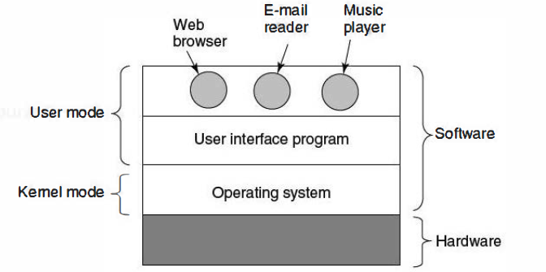

Slide 11
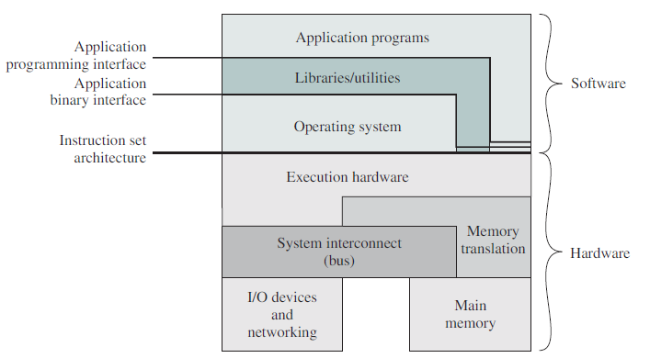

Slide 12
Functions of OS
As an extended machine / User interface
As a resource manager

Slide 13
OS: Functions
As an extended machine
    Architecture – instruction set, memory organization, I/O, bus structure – handling these at machine language level is quite difficult.
    OS should provide simple, high level abstraction to deal with.
    Operating systems turn ugly hardware into beautiful abstractions.

Slide 14
Example
#BEGIN 0000H // Program counter will be loaded with 0000H
LDA 2000H // A<-18H
MOV B,A // B<-18H
LDA 2001H // A<-29H
ADD B // A<-A+B; A<-41H
STA 2003H // 2003<-41H
HLT // Stop the Program

Slide 15
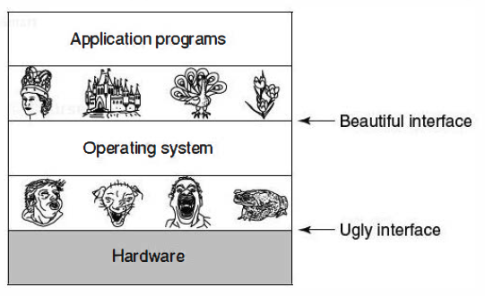

Slide 16
These codes are hardware dependent.
Need to deal with memory, movements of data etc.
OS can provide some level of abstraction to this.
c = a + b; (High level language)

Slide 17
As an extended machine
Create good, simple and high level abstractions
Manage the abstract objects thus created
Eg: Abstraction of disk – it contains a collection of files which can be read, written or finally closed.
No worry about the type of modulation or current state of motor

Slide 18
Thus OS hides all complexities like timers, interrupts, memory management and other low level features from the user
OS presents an extended machine or virtual machine that is easier to program than the underlying hardware

Slide 19
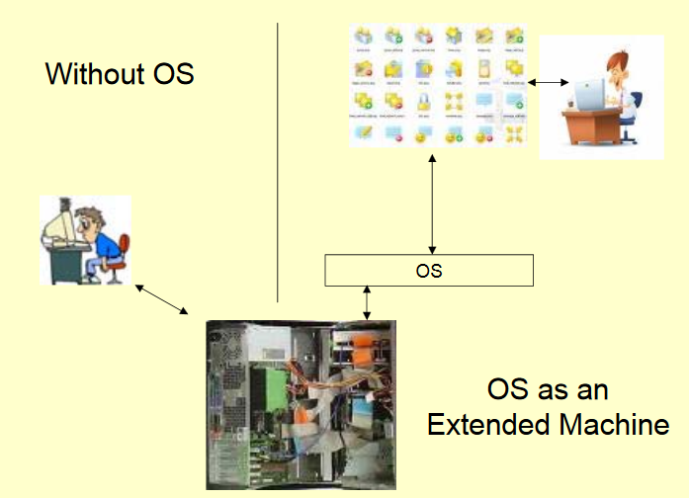

Slide 20
Summary: As an extended machine
Program development
Program execution
Access to I/O devices
Controlled access to files
System access
Error detection and response
Accounting
Application Programming Interface (API)
Application Binary Interface (ABI)

Slide 21
As a resource manager
OS provides an orderly and controlled allocation of the processors, memories, I/O devices etc. among various programs/users
Eg. Buffering of printer data
Allocation of CPU to different process

Slide 22
Resource management
    Sharing in time
    Sharing in space

Slide 23
Sharing in time
    How long for one user/process?
    Who goes next?

Slide 24
Sharing in space
    Main memory divided into segments to hold multiple programs at the same time
    Fairness of space allocation
    Protection of individual data

Slide 25
History of OS

Slide 26
First Generation (1945-55) Vacuum tubes
Machines based on vacuum tubes
No concept of OS as such
Programming
    Absolute machine language
    Wiring up the electrical circuits by connecting thousands of cables to plugboard to control the machine’s basic functions
    Very primitive
    Very slow even for simplest calculations

Slide 27


Slide 28
2nd Generation (1955-65) Transistors and Batch systems
Transistors replaced vacuum tubes
Smaller, faster, cheaper, and energy efficient than 1st generation systems
Programming
    Started with machine/assembly language
    Mean while high level languages like FORTRAN, COBOL were developed
    Programs were written on paper
    Punch it on cards
    Write it on to magnetic tapes

Slide 29
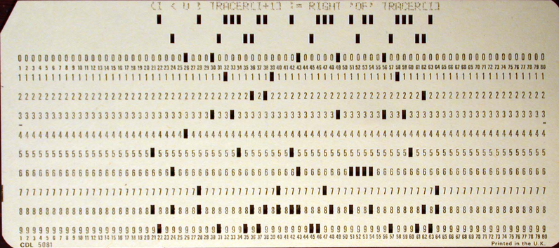
Punch Card

Slide 30
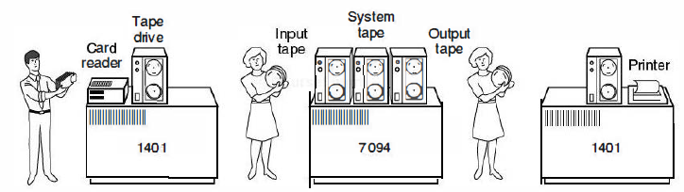
IBM 1401 – for reading cards, copying tapes, printing output
IBM 7094 – for numerical computations

Slide 31
2nd generation - used for scientific and engineering calculations like solving partial differential equations
Typical OS – FMS(Fortran Monitoring System), IBSYS

Slide 32
3rd Generation (1965-80) ICs and multiprogramming
Maintaining two completely different product lines (i.e. 7094 and 1401) was quite expensive
IBM introduced ‘system/360’
Designed to handle both scientific and numerical computing
Thus a single family of machines could satisfy the needs of all customers
Made of ICs rather than individual transistors

Slide 33
Introduced OS/360
It was supposed to satisfy different categories of users/systems – i.e. card reading to heavy computations
It had to work in commercial as well as in scientific environments
It had to be efficient for all these different users
But couldn’t meet all these conflicting requirements

Slide 34
Despite its enormous size and problems OS/360 satisfied most of its customers
Introduced many new concepts which was not available in 2nd generation systems

Slide 35
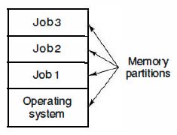
Multiprogramming
CPU utilization was less in 7094
CPU was sitting idle during tape reading or during I/O operation
Many jobs are placed in main memory at once
One job doing I/O operation, another one using CPU

Slide 36
SPOOLING
Simultaneous Peripheral Operation On Line
Jobs are kept in queue/buffer
When one job is finished, OS will take the next job
1401s were no longer needed
Eg: printer spooling

Slide 37
Time sharing
Each user is provided a time slot
Effective usage of CPU
Provides fast interactive service to users
Batch jobs are executed in background
1st general purpose time sharing system – CTSS (Compatible Time Sharing System developed by MIT)

Slide 38
4th Generation (1980-present) Personal computers
Large Scale Integration (LSI)
    Disk Operating System (DOS)
    MS DOS
    Windows 95
    Windows 98
    Windows NT
    Windows Me
    Windows XP ……

Slide 39
Types of OS

Slide 40
Batch OS
Performs batch processing
Executing routine jobs without any interactive user
Execution of a series of jobs without manual intervention
Improves processor utilization
Jobs are batched by the type of language or requirement

Slide 41
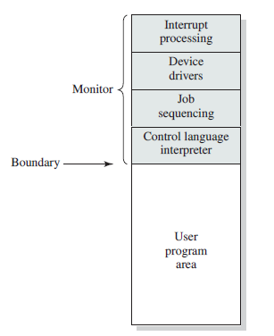
Memory layout for batch systems
Batch systems use a software known as monitor/supervisor

Slide 42
Batch processing examples
    Claim processing in insurance company
    Daily sales reporting
Benefits of batch processing
    Can be scheduled when resources are less busy

Slide 43
Multi programming OS
To maximize the CPU utilization
Processes waiting for I/O should not block other processes which in turn wastes CPU time
I/O devices are slow when compared with processor
Many programs loaded into main memory
An old concept

Slide 44
Idea is to keep the CPU busy as long as there are processes ready to execute
Running program keeps executing until it voluntarily gives the CPU back or when it blocks for I/O

Slide 45
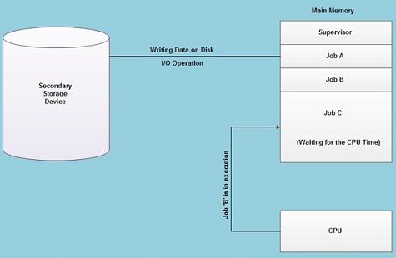

Slide 46
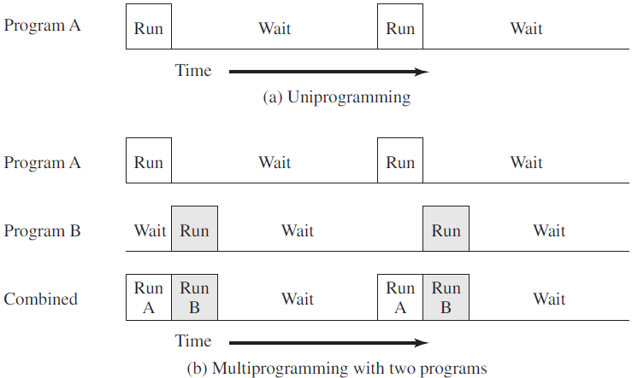

Slide 47
Multitasking
Concept of modern operating system
Multiple programs, process, task, thread running at the same time
    At any point in time the CPU is executing one task only while other tasks waiting their turn
    The illusion of parallelism is achieved when the CPU is reassigned to another task (context switch)

Slide 48
Task does not use CPU until it finishes like in the older multiprogramming model
Instead each task will get a fair share of the CPU time
Minimizes the average response time

Slide 49
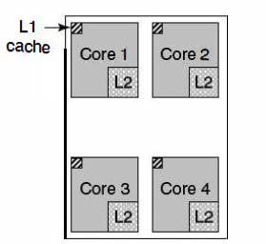
Multiprocessing
Refers actually to the CPU units rather than running processes
More than one processor is available

Slide 50
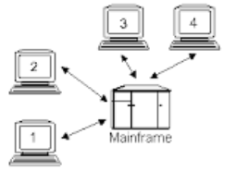

Multi user

Slide 51
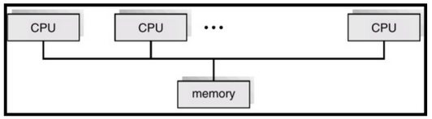
Parallel
Used to improve the computing performance
Tightly coupled system
More than one CPU in close communication
A set of processors sharing a common/shared memory
Advantages
    Improved throughput
    Economical
    Increased reliability

Slide 52
Complex task – split into smaller task, executed parallel to obtain results faster
Most high performance computing systems (supercomputers) have parallel architectures
Applications
    Weather forecasting
    Climate modeling
    Research on nuclear technology
    Astrophysics, Genetic engineering etc..

Slide 53
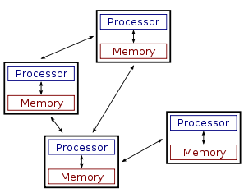
Distributed
Collection of independent, physically (and geographically) separated computers
Do not share physical memory or a clock
Communication between individual systems using local and wide area networks

Slide 54
Information is exchanged by passing messages between the processors
Examples
  Peer to Peer networks
    Individual system act as both suppliers and consumers of resources
    Decentralized and distributed network
    In contrast to the typical client-server model
    File sharing, content delivery, media streaming etc.

Slide 55
Distributed OS
    Makes this architecture seamless and transparent to the user
    Shields the user from the complexities of the architecture and make it appear to behave like a timeshared centralized environment.
Advantages
    Performance
    Cost effectiveness
    Fault tolerance

Slide 56
Real time OS
Time is a key parameter
Two types
    Hard real time system
    Soft real time system
Hard system
    An action must occur absolutely at a certain moment or within a certain range
    Eg: Nuclear systems, Some medical equipments, Operations in a car assembly line

Slide 57
Soft systems
    Missing an occasional deadline is acceptable
    Eg: Digital audio, multimedia systems
Examples of RTOS
    Vx works
    QNX

Slide 58
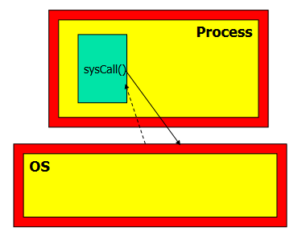
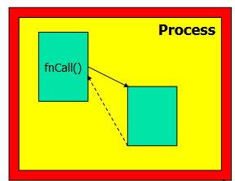
System Calls
System call Vs Function call
Function call System call

Slide 59
System Calls
Interface between OS and user programs – defined by a set of System Calls
Eg: In user mode, a program needs a system service – reading data from a file
Execute TRAP instruction or system call instruction to transfer control to OS
OS figures out the requirement of the calling process by inspecting parameters

Slide 60
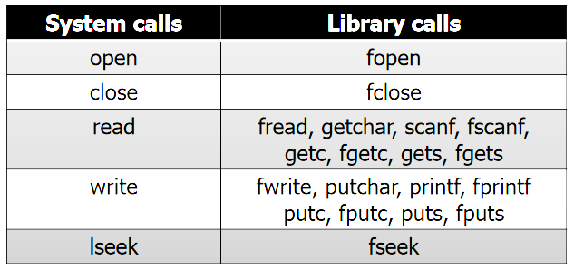

Slide 61
Example
System call from a c program with a library call fgetc()

Slide 62
count = read(fd, buffer, nbytes);
fd -> specifys the file
buffer -> points to a buffer
nbytes -> no. of bytes to read

Slide 63
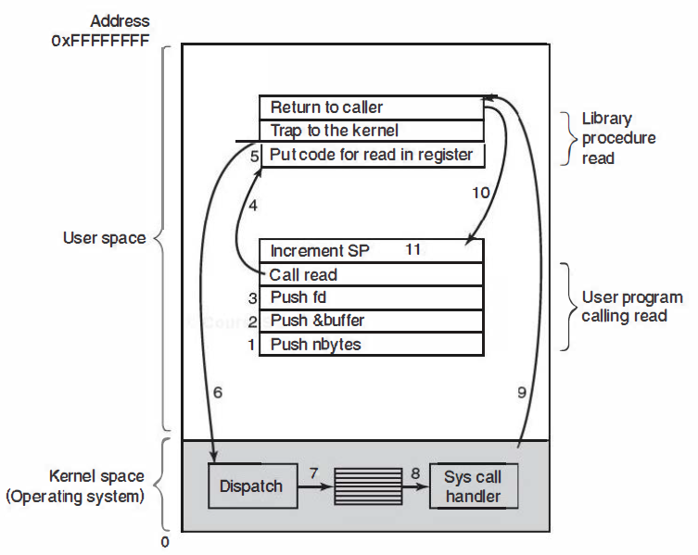

Slide 64
Operating System Structure

Slide 65
Various designs
Monolithic systems
Microkernel
Layered systems
Virtual machines
Exokernels
Client-server model

Slide 66
Monolithic systems
Most common organization
The entire OS runs as a single program in kernel mode
“The Big Mess” system – no organized structure
Characterized by a collection of procedures that can call any other procedure
Does not allow information hiding – every procedure is visible to every other procedure
Crash in any of these procedures will bring down the entire OS

Slide 67
Services provided by the OS are requested by executing TRAP instruction
Trap results in a switch to kernel mode
Examples
    DOS, Windows 95, 98, XP
    Solaris
    FreeBSD, OpenBSD

Slide 68
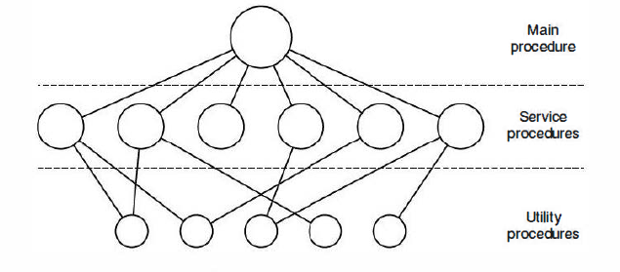
Basic structure
    Main program that invokes requested service procedures
    Set of service procedures to carry out system calls
    Set of utility procedures to help the service procedures. Eg: Fetching data from user programs

Slide 69
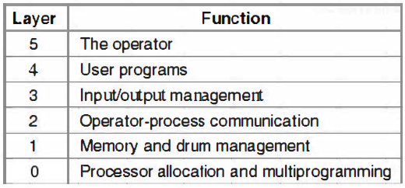
Layered systems
Organization as a hierarchy of layers
Layers of THE system built at (Technische Hogeschool Eindhoven, Netherlands)

Slide 70
Layer 0: Provides basic multiprogramming of CPU
    Allocation of processor, switching between different processes
    Above layer 0, it don’t have to worry about the fact that multiple processes were running on a single processor
Layer 1: Memory management
    Allocates space for current active process in main memory
    Also manages secondary memory
    Above layer 1, process don’t have to worry about whether they were in main memory or secondary

Slide 71
Layer 2: Inter process communication and user layer
Layer 3: I/O management, buffering of data
Layer 4: User programs are found
Layer 5: System operator process

Slide 72
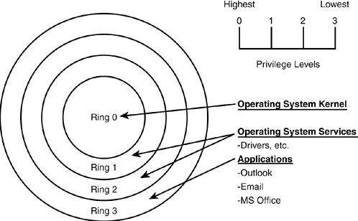
MULTICS architecture
  Inner core is more privileged than outer core

Slide 73
Advantages of layered approach
    Simplicity of construction
    Ease of debugging and system verification
    Each layer is implemented with only those operations provided by the lower layers
    A layer does not need to know how these operations are implemented; it needs to know only what operations the bottom layers can do

Slide 74
Disadvantages of layered approach
    Decreased efficiency
    Eg: For I/O operation
    system call to I/O layer – call to memory management layer – call to CPU scheduling layer – access of hardware
    Functionality of each layer has to be defined – careful planning is required

Slide 75
Examples of layered OS
    Earlier versions of Windows NT
    OS/2

Slide 76
Microkernels
Reduces kernel size
As little as possible in kernel mode
Reduces fatal system crashes
Achieves high reliability
OS split into small, well defined modules
Microkernel – runs in kernel mode, every thing else in user mode
Communication takes place between user modules using message passing

Slide 77
Examples of Microkernel OS
    Symbian
    QNX (RTOS)
    MINIX3
    Pike OS
    Initial release of Windows NT (Layered microkernel OS)

Slide 78
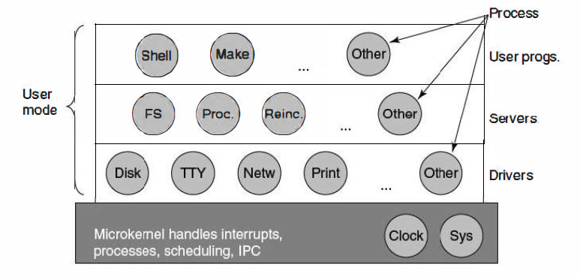
Simplified architecture of MINIX system
Sys – Kernel call handler
FS – File server
Reinc. – Reincarnation server

Slide 79
Advantages
    Easier to extend a microkernel
    New services can be added to user space, and hence does not require modification of kernel
    Easier to port from one hardware design to another
    More security and reliability
Disadvantages
    Performance overhead of user space to kernel space communication

Slide 80
Virtual machines
Software implementation of a physical machine
VM abstracts the hardware of a single computer into several different execution environments
An illusion is created such that each execution environment will feel that it is running its own private computer
Each VM can run on any OS that will run directly on the bare hardware

Slide 81
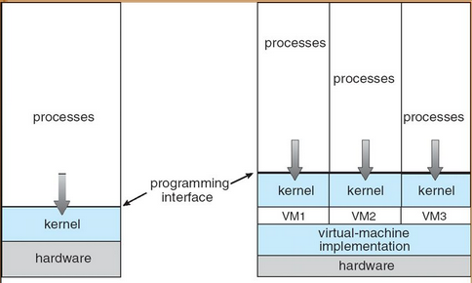
CPU scheduling and virtual memory techniques – illusion of own processor and own memory
Non-virtual machine Virtual machine

Slide 82
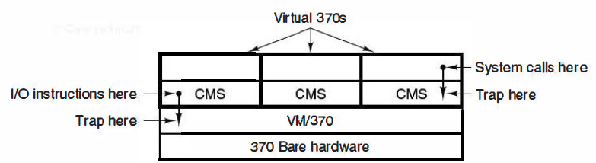
Structure of VM/370
Introduced by IBM
Each machine can have distinct OS like
    OS/360
    Batch OS
    Conversational Monitor System (CMS) – for single interactive user

Slide 83
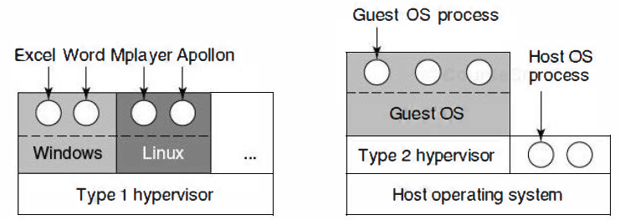
Virtual Machine Monitor - software program that enables the creation, management and governance of virtual machines
Hypervisor – same functionality as of virtual machine monitor

Slide 84
Type 2 hypervisor – uses a host OS and its file systems to create processes, store files etc.
Type 1 – no host OS

Slide 85
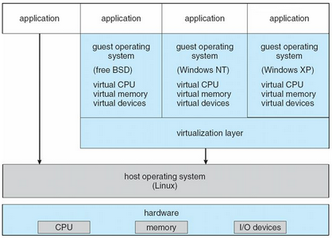
Vmware architecture
Popular commercial application that abstracts Intel 80X86 hardware into isolated virtual machines

Slide 86
Popular Hypervisors
    VMware
    Xen (Cambridge University)
    VirtualBox (by Oracle)
    Hyper-V (by Microsoft)

Slide 87
Exokernel
Developed by a team at MIT
Each user is given a subset of resources
Exokernel – program running in kernel mode
    Allocates resources to virtual machine/user
    Make sure no machine is accessing somebody else’s resources
    Each user level can run its own OS, except that each one is restricted to using only the resources it has been allocated
    Kernel protects hardware resources (CPU, memory, disk, network etc.)
    Application programs manages resources

Slide 88
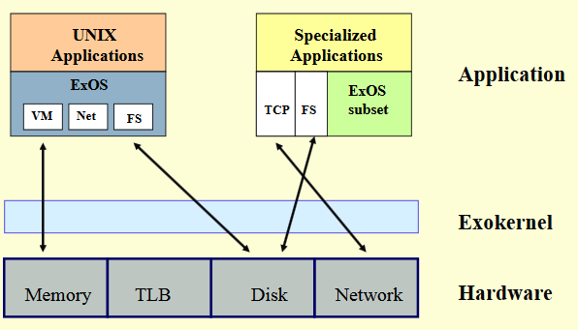
ExOS library - provides a user level implementation of an UNIX OS
Library Procedure

Slide 89
Eg: Instead of having a File System in OS, users can have a file system as a library procedure
These library procedures can be linked with any program that needs to use files
Two components
    Exokernel
      Securely multiplex all available hardware
      Protects hardware resources
    Library operating system (LibOS)
      Memory management, Process scheduling, I/O, File system management etc.

Slide 90
Exokernel advantages
Offers flexibility to application design – improvement in application performance

Slide 91
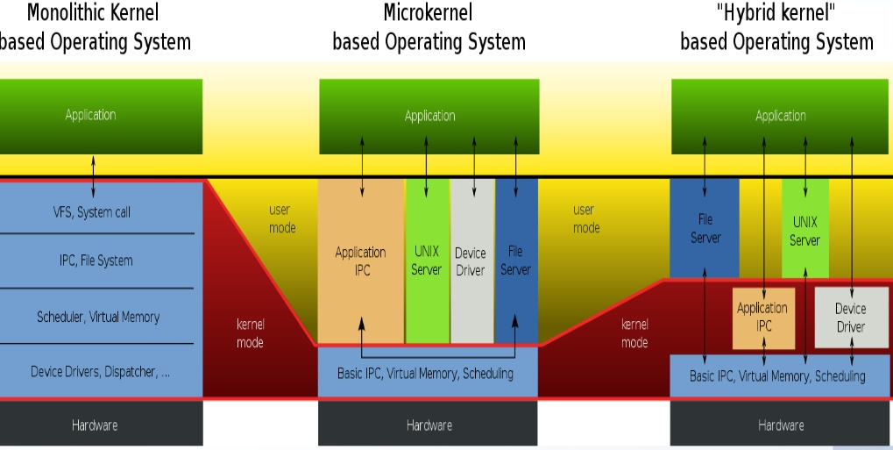
Hybrid kernel
Combination of monolithic and microkernel

Slide 92
Eg: Microsoft Windows NT, 2000
Advantages
    Performance benefits of monolithic kernel
      Function calls (Monolithic) is faster than Inter Process Communication (Microkernel)
    Stability of microkernel

