Slide 1
Operator Overloading & Inheritance

Slide 2
Operator overloading
Operator overloading is an important concept in C++. It is a type of polymorphism in which anoperator is overloaded to give user defined meaning to it. Overloaded operator is used to perform operation on user-defined data type. Operator overloading allows you to redefine the way operator works for user-defined types only (objects, structures). It cannot be used for built-in types (int, float, char etc.). ... You do not need to create an operator function. Operator overloading cannot change the precedence and associatively of operators.

Slide 3
Syntax
return_type operator operator_symbol (argument_list)
{
//body of function
}
Eg. complex operator+(complex obj)
void operator ++()

Slide 4
Operator overloading[Contd….]
To extend the meaning of an operator, an operator function is defined with a keyword operator followed by the operator symbol
Operator overloading in C++ can be achieved in following ways
  Operator overloading using member function
  Operator overloading using non-member function
  Operator overloading using friend function

Slide 5
Following are the operators that cannot be overloaded
pointer to member access operator ( .* )
scope resolution operator ( :: )
member access operator ( . )
condition operator ( ?: )
size operator ( sizeof )
run-time type information operator ( typeid )

Slide 6
Unary Operator Overloading
As the name suggests, Unary operators operate on single operand or data.
Following are the examples of Unary operators:
  Unary minus ( – ) operator
  Logical not ( ! ) operator
  Decrement ( — ) and Increment ( ++ ) operator

Slide 7
Binary Operator Overloading
As the name suggests, those operators which operate on two operands or data are called binary operators.

Slide 8
Overloading Binary Operators Using Friends
Friend functions may be used in place of member functions for overloading a binary operator, the only difference being that a friend function requires two arguments to be explicitly passed to it, while a member function requires only one

Slide 9
Manipulation of strings using operators
C++ allows us the facility of manipulate strings using the concept of operator overloading.
For example we can overload + operator to concate two strings. We can overload == operator to compare two strings

Slide 10
Inheritance: Extending Classes
Inheritance is one of the core feature of an object-oriented programming language. It allows software developers to derive a new class from the existing class. The derived class inherits the features of the base class (existing class).

Slide 11
Syntax:
class subclass_name : access_mode base_class_name
{
//body of subclass
};
access_mode is the mode in which you want to inherit this sub class for example: public, private etc

Slide 12
Different forms of inheritance
Single Inheritance
Multiple Inheritance
Hierarchical Inheritance
Multilevel Inheritance
Hybrid Inheritance

Slide 13
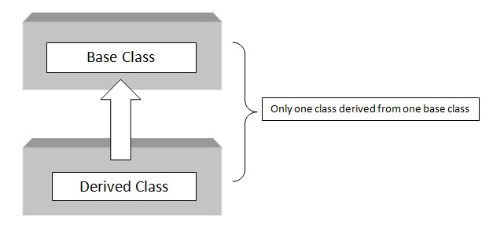
Single Inheritance

Slide 14
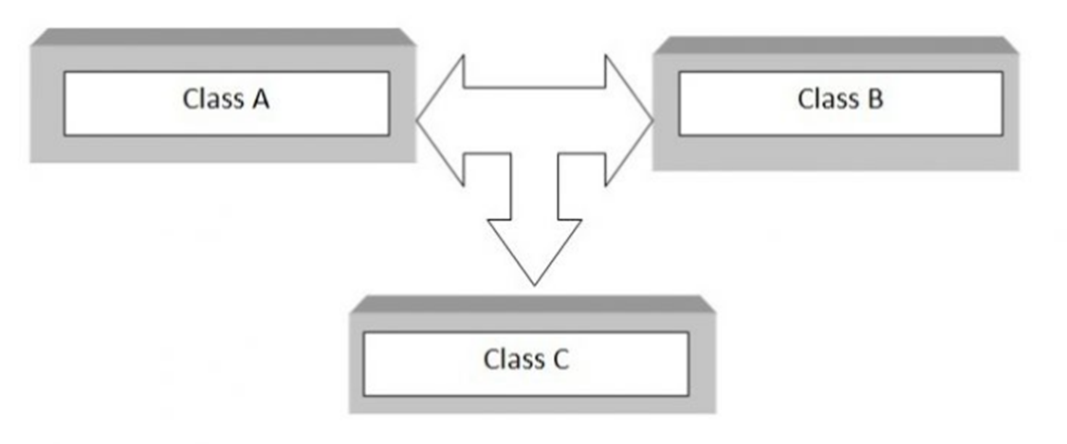
Multiple Inheritance

Slide 15
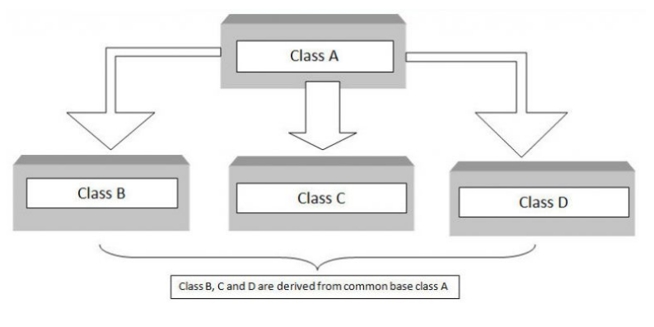
Hierarchical Inheritance

Slide 16
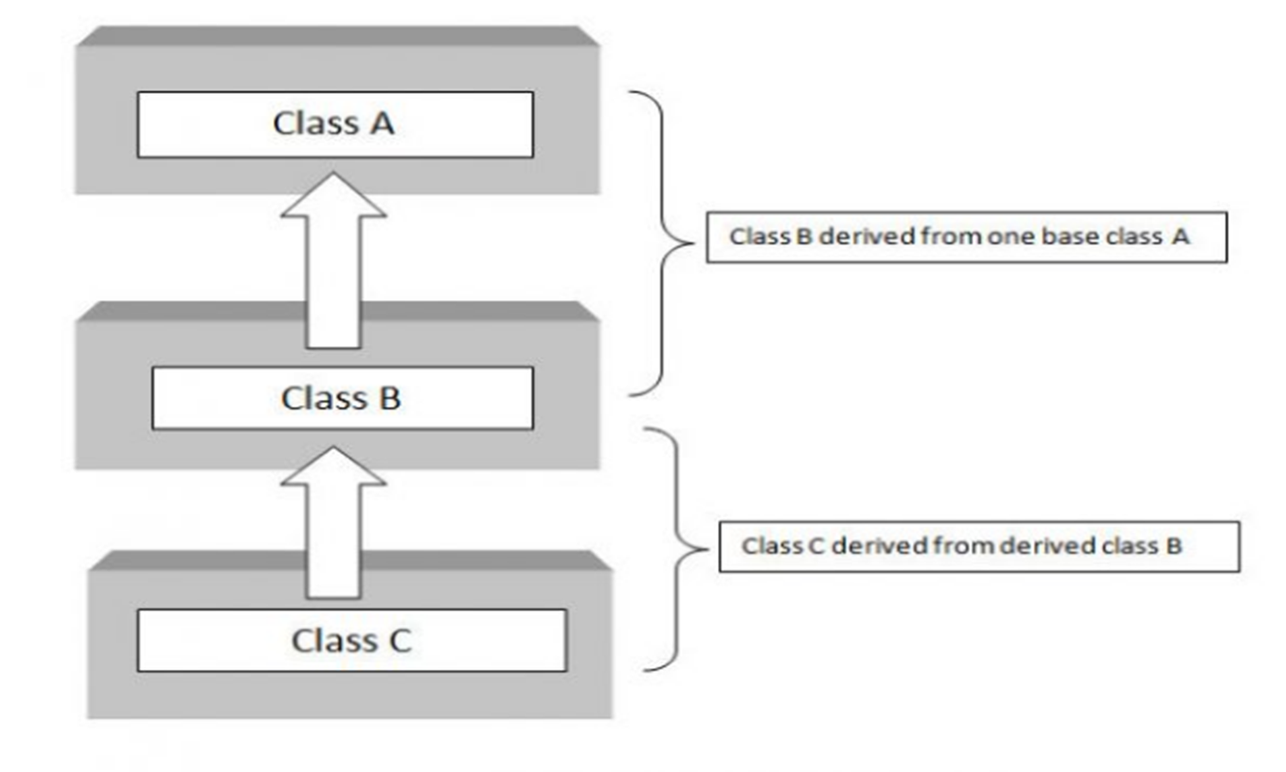
Multilevel Inheritance

Slide 17
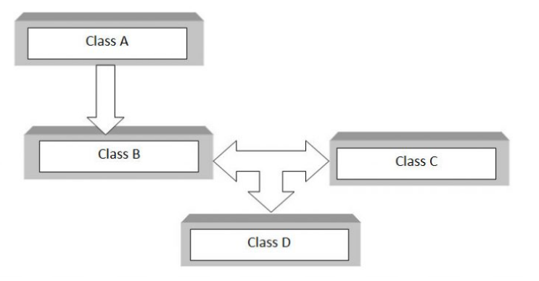
Hybrid Inheritance

Slide 18
Accessibility in Public Inheritance
Accessibility | private variables | protected variables | public variables
Accessible from own class? | yes | yes | yes
Accessible from derived class? | no | yes | yes
Accessible from 2nd derived class? | no | yes | yes

Slide 19
Accessibility in Protected Inheritance
Accessibility | private variables | protected variables | public variables
Accessible from own class? | yes | yes | yes
Accessible from derived class? | no | yes | yes (inherited as protected variables)
Accessible from 2nd derived class? | no | yes | yes

Slide 20
Accessibility in Private Inheritance
ccessibility | private variables | protected variables | public variables
Accessible from own class? | yes | yes | yes
Accessible from derived class? | no | yes (inherited as private variables) | yes (inherited as private variables)
Accessible from 2nd derived class? | no | no | no

Slide 21
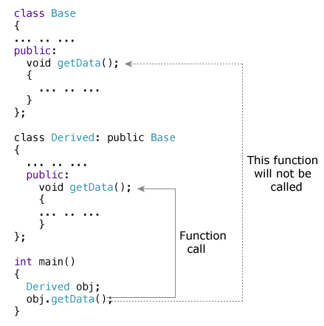
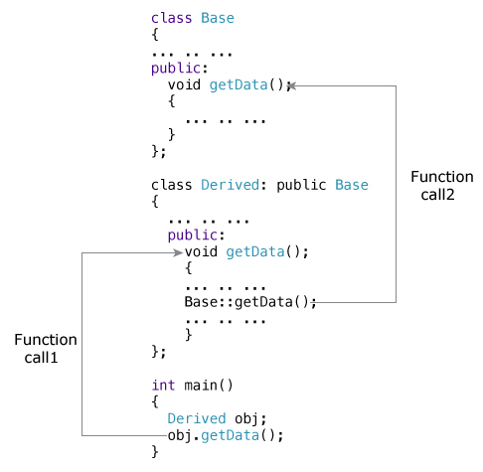
Function Overriding

Slide 22
friend Class
When a class is made a friend class, all the member functions of that class becomes friend functions.
In this program, all member functions of class B will be friend functions of class A. Thus, any member function of class B can access the private and protected data of class A. But, member functions of class A cannot access the data of class B.

Slide 23
Contd…
class B; // forward declaration
class A
{
// class B is a friend class of class A
friend class B;
... .. ...
}
class B
{
... .. ...
}

Slide 24
Virtual Base Classes
Virtual base classes (C++ only) Suppose you have two derived classes B and C that have a common base class A , and you also have another class D that inherits from B and C . You can declare the base class A as virtual to ensure that B and C share the same subobject of A .

Slide 25
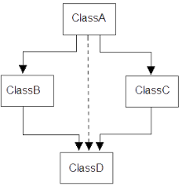
Virtual Base Classes

Slide 26
Abstract Class
In C++, pure virtual function are used to specify the pure interfaces of abstract classes. An abstract class in C++ must have at least one pure virtual function. We cannot create objects of abstract classes. A pure virtual function (or abstract function) in C++ is a virtual function for which we don't have implementation, we only declare it. A pure virtual function is declared by assigning 0 in declaration.

Slide 27
Constructors in Derived Class
Base class constructors are always called in the derived class constructors. Whenever you create derived class object, first the base class default constructor is executed and then the derived class's constructor finishes execution. When a derived class object is created using constructors, it is created in the following order: Virtual base classes are initialized, in the order they appear in the base list.

Slide 28
Nesting of Classes
A nested class is declared within the scope of another class. The name of a nested class is local to its enclosing class. You can define member functions and static data members of a nested class in namespace scope

