Slide 1
Object Pointers

Slide 2
Polymorphism
Polymorphism means more than one function with same name, with different working. In dynamic polymorphism memory will be allocated at run-time. Both function overloading and operator overloading are an examples of static polymorphism. Virtual function is an example of dynamic polymorphism.

Slide 3
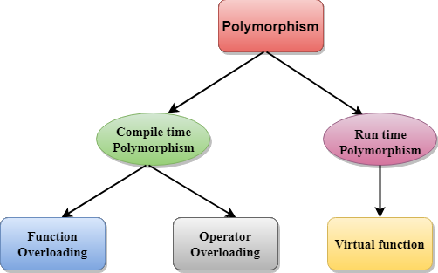
Polymorphism

Slide 4
Pointers to Objects
A variable that holds an address value is called a pointer variable or simply pointer.
Pointer can point to objects as well as to simple data types and arrays.
Sometimes we don’t know, at the time that we write the program , how many objects we want to create. when this is the case we can use new to creat objects while the program is running. new returns a pointer to an unnamed objects.

Slide 5
this pointer
Every object in C++ has access to its own address through an important pointer called this pointer. The this pointer is an implicit parameter to all member functions. Friend functions do not have a this pointer, because friends are not members of a class.

Slide 6
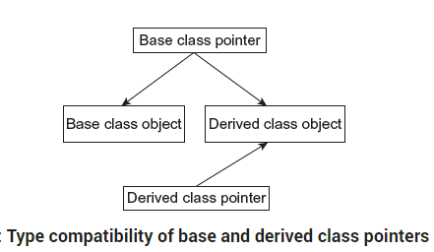
Pointer to derived classes

Slide 7
Virtual Functions
A virtual function is a member function that is declared within a base class and redefined by a derived class. To create virtual function, precede the function’s declaration in the base class with the keyword virtual. When a class containing virtual function is inherited, the derived class redefines the virtual function to suit its own needs.
Base class pointer can point to derived class object. In this case, using base class pointer if we call some function which is in both classes, then base class function is invoked. But if we want to invoke derived class function using base class pointer, it can be achieved by defining the function as virtual in base class, this is how virtual functions support runtime polymorphism

Slide 8
Rules for virtual Functions
They Must be declared in public section of class.
Virtual functions cannot be static and also cannot be a friend function of another class.
Virtual functions should be accessed using pointer or reference of base class type to achieve run time polymorphism.
The prototype of virtual functions should be same in base as well as derived class.
They are always defined in base class and overridden in derived class. It is not mandatory for derived class to override (or re-define the virtual function), in that case base class version of function is used.
A class may have virtual destructor but it cannot have a virtual constructor.

Slide 9
Pure virtual functions
A pure virtual function or pure virtual method is a virtual function that is required to be implemented by a derived class if the derived class is not abstract. Classes containing pure virtual methods are termed "abstract" and they cannot be instantiated directly

Slide 10
Virtual Constructor & Destructors

