Slide 1
Principles of Object Oriented Programming

Slide 2
Software Crisis
The following issues need to be addressed to face this crisis
  How to represent real-life entities of problems in system design?
  How to design systems with open interfaces?
  How to ensure reusability and extensibility of modules?
  How to develop modules that are tolerant to any changes in future?
  How to improve software productivity & decrease s/w cost?
  Hoe to improve the quality of s/w?
  How to manage time schedules?
  How to industrialize the s/w development process?

Slide 3
Quality issues considered for evaluation
Correctness
Maintainability
Reusability
Openness and interoperability
Portability
Security
Integrity
User friendliness

Slide 4
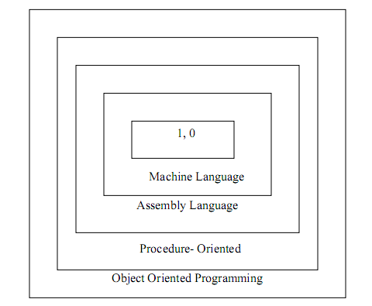
Software Evolution

Slide 5
Conventional Programming, using High level languages such as
COBOL
FORTAN
C
Commonly known as POP(Procedure Oriented Programming)

Slide 6
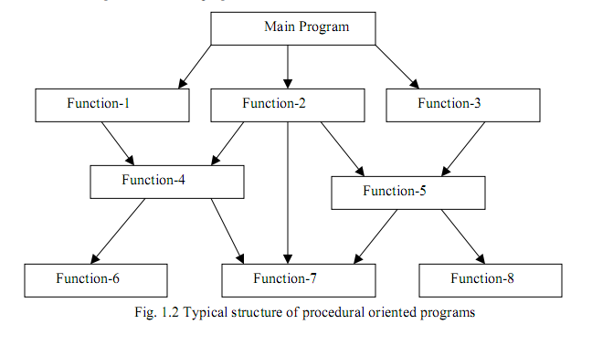
Procedure Oriented Programming

Slide 7
Relationship of data and functions in POP
Global Data
Global Data
Function – 1
Local Data
Function – 2
Local Data
Function – 2
Local Data

Slide 8
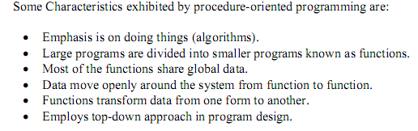

Slide 9
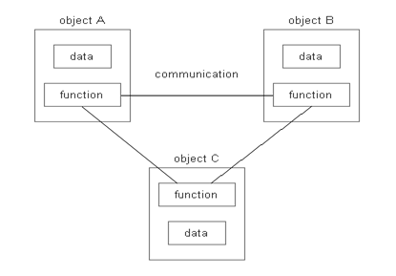
Organization of function and data in OOP

Slide 10
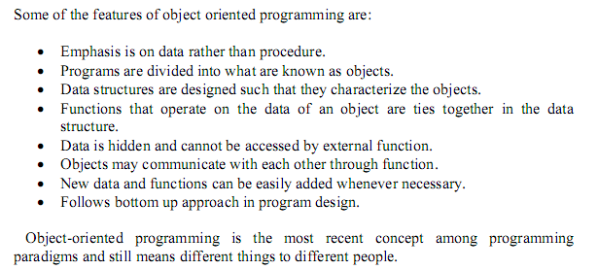

Slide 11
Basic Components of Object Oriented Programming
Objects
Classes
Data Abstraction & Encapsulation
Inheritance
Polymorphism
Dynamic Binding
Message Passing

Slide 12
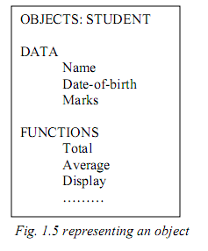
Objects
STUDENT
Total
Average
Display

Slide 13
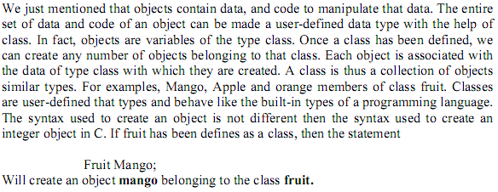
Classes

Slide 14
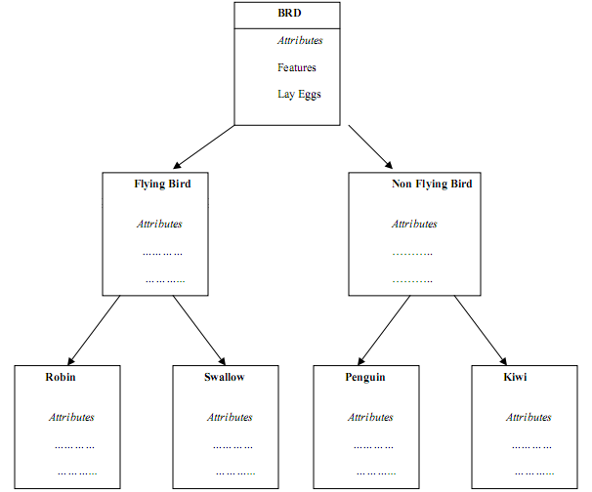
Inheritance

Slide 15
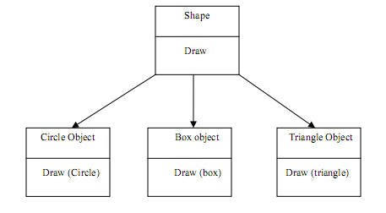
Polymorphism

Slide 16
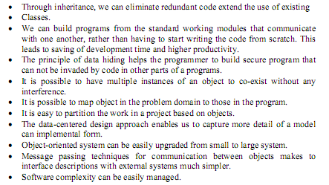
Benefits of Object Oriented Programming

Slide 17
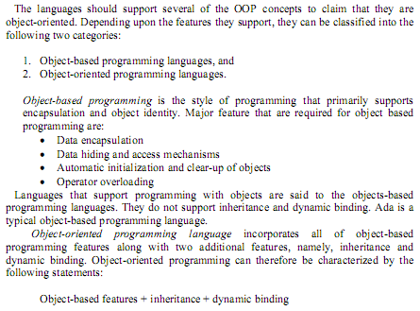

Slide 18
Applications of OOP
Real time system
simulation & modelling
Object oriented databases
Hypertext, hypermedia & expertext
AI & expert systems
Neural systems and parallel programming
Decession support and office automation systems
CIM/CAM/CAD systems

Slide 19
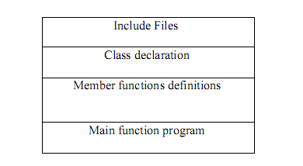
Structure of a C++ Program

Slide 20
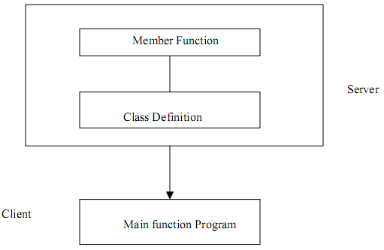
Client Server model

