Slide 1
Module 6

Slide 2
Spread Spectrum
Modulate the signal so as to increase significantly the bandwidth of the signal to be transmitted.
‘Spread the spectrum’
Spread spectrum is characterized by
    Wide bandwidth
    Low power

Slide 3
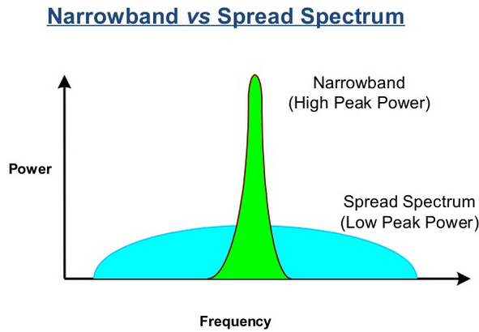

Slide 4
Types of spread spectrum
    Frequency hopping spread spectrum (FHSS)
    Direct sequence spread spectrum (DSSS)
    Code division multiple access (CDMA)

Slide 5
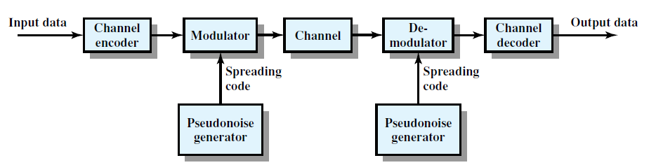
Basic principle

Slide 6
Input is fed into a channel encoder – produces an analog signal with a relatively narrow bandwidth around some center frequency.
Signal is further modulated using a sequence of digits known as a spreading code or spreading sequence.
Spreading code is generated by a pseudo-noise (PN), or pseudorandom number generator

Slide 7
These process will significantly increase the bandwidth (spread the spectrum) of the signal to be transmitted.
On the receiving end, the same digit sequence is used to demodulate the spread spectrum signal.

Slide 8
Spread spectrum – Advantages, Applications
The earliest applications of spread spectrum were military, where it was used for its immunity to jamming.
Better immunity to noise and multipath distortions

Slide 9
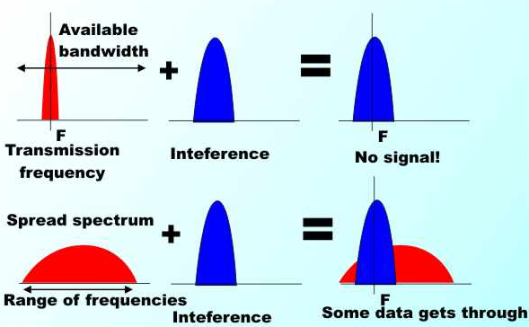

Slide 10
Spread spectrum – Advantages, Applications
Used for hiding and encrypting signals.
Only a recipient who knows the spreading code can recover the encoded information.
Several users can independently use the same higher bandwidth with very little interference.
This property is used in cellular telephony applications – CDMA.

Slide 11
Frequency Hopping Spread Spectrum
Signal is broadcast over a random series of radio frequencies, hopping from frequency to frequency at fixed intervals.
A receiver, hopping between frequencies in synchronization with the transmitter, picks up the message.

Slide 12
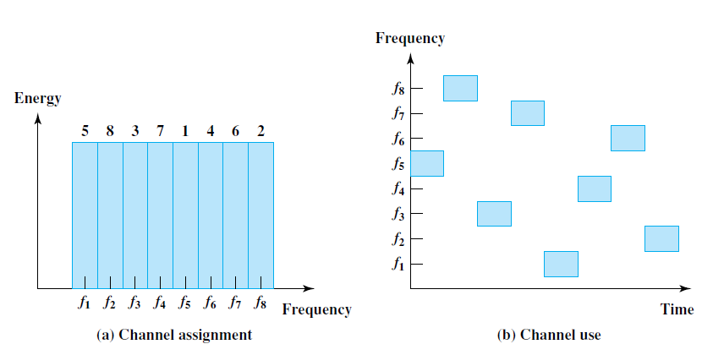
FHSS – Basic principle

Slide 13
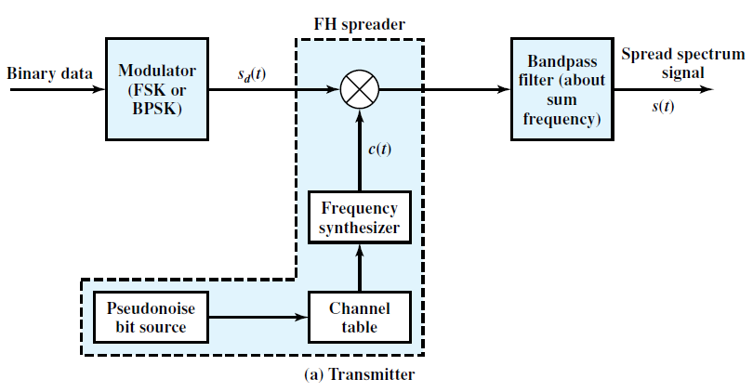
FHSS Transmitter

Slide 14
Pseudo-noise (PN), or pseudorandom number, source serves as an index into a table of frequencies.
Spreading code - Each k bits of the PN source specifies one of the carrier frequencies.
Typically, there are 2^{k} carrier frequencies forming 2^{k} channels.

Slide 15
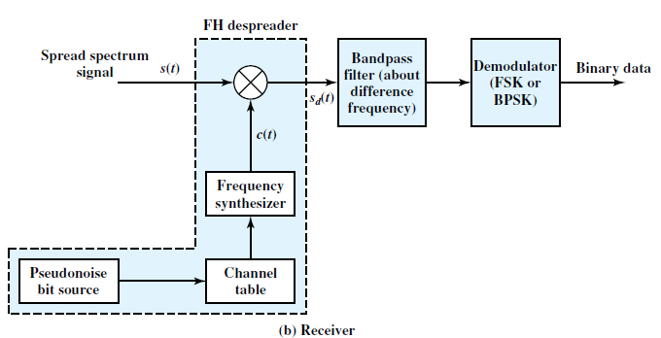
FHSS Receiver
spread spectrum signal is demodulated using the same PN sequence

Slide 16
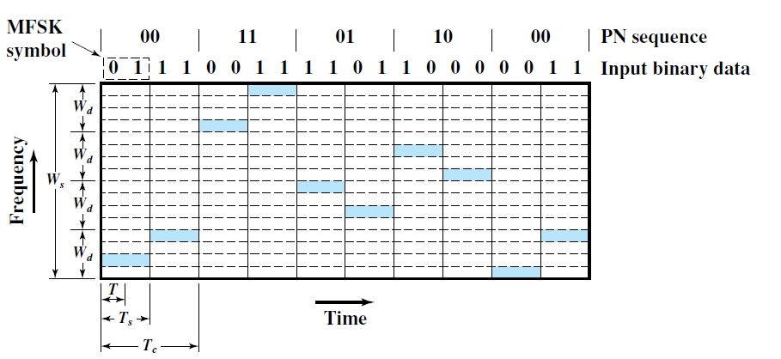
Slow Frequency Hop Spread Spectrum
FHSS using MFSK

Slide 17
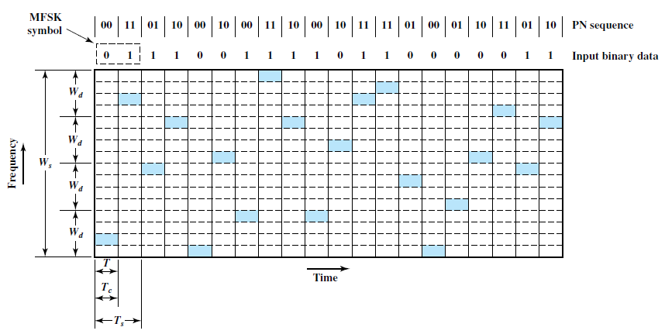
Fast Frequency Hop Spread Spectrum

Slide 18

1/Ts – Symbol rate
1/Tc – Frequency hop rate

Slide 19
Direct Sequence Spread Spectrum (DSSS)
Each data bit is represented by multiple bits in the transmitted signal, using a spreading code.
Frequency spread is directly proportional to the number of bits in the code.
Eg: 10 bit spreading code spreads the signal across a frequency band that is 10 times greater than a 1-bit spreading code

Slide 20
Digital information is combined with spreading code using an exclusive-Or (XOR) operation.

Slide 21
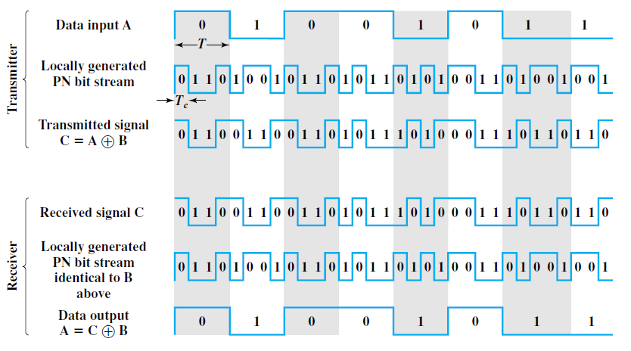

Slide 22

DSSS using BPSK
BPSK signal
A: amplitude of the signal
fc: carrier frequency
d(t): +1 for binary 1
-1 for binary 0

Slide 23

DSSS sequence
c(t) – PN sequence
Decoded sequence at receiver

Slide 24
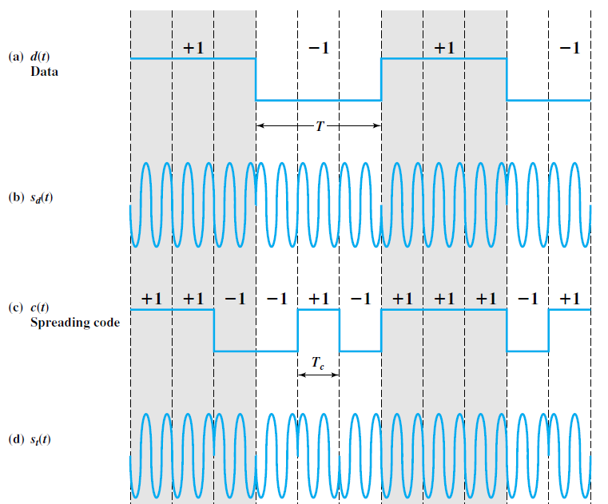

Slide 25
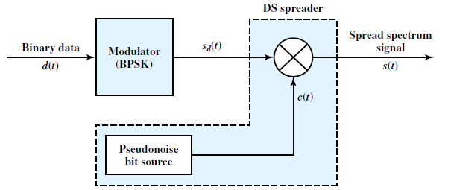
DSSS Transmitter

Slide 26
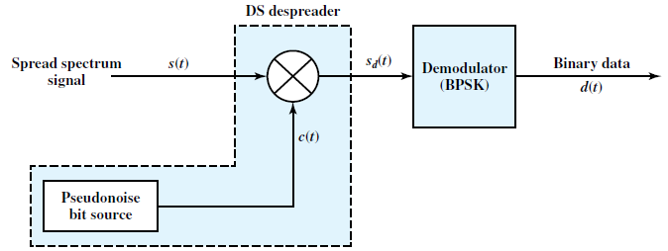
DSSS Receiver

Slide 27
Code Division Multiple Access (CDMA)
CDMA is a multiplexing technique used with spread spectrum
Each user has got a unique code
Consider 3 users A, B, C with unique codes
C_{A} = < 1, -1, -1, 1, -1, 1 >
C_{B} = < 1, 1, -1, -1, 1, 1 >
C_{C} = < 1, 1, -1, 1, 1, -1>

Slide 28
For transmitting binary 1, user transmits its code as such.
For transmitting binary 0, compliment of the code is transmitted.

Slide 29
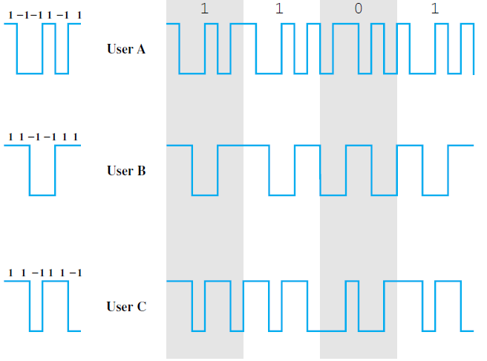

Slide 30
Decoding of received message
If a user with unique code c = < c1, c2, c3, c4, c5, c6 > generates a chip pattern d = < d1, d2, d3, d4, d5, d6 >
Decoding function S_{u}(d) is calculated by the user who wish to decode the data

Slide 31
Let user A wants to communicate binary 1 with any other user.
C_{A} = < 1, -1, -1, 1, -1, 1 >
Transmitted sequence = 1, -1, -1, 1, -1, 1
S_{u}(d) = (1 x 1) + (-1 x -1) + (-1 x -1) + (1 x 1) + (-1 x -1) + (1 x 1) = 6
= 6 * 1

Slide 32
Let user A wants to communicate binary 0 with any other user.
C_{A} = < 1, -1, -1, 1, -1, 1 >
Transmitted sequence = -1, 1, 1, -1, 1, -1
S_{u}(d) = (-1 x 1) + (1 x -1) + (1 x -1) + (-1 x 1) + (1 x -1) + (-1 x 1) = -6
= 6 * -1

Slide 33
User codes should be orthogonal
Properties
  Inner product of two equal sequence should be N where N is the number of elements in the sequence.
    Inner product - A code is multiplied by itself, element by element and add the results.

Slide 34
C_{A} = < 1, -1, -1, 1, -1, 1 >
Inner product with itself
= (1, -1, -1, 1, -1, 1 ) . (1, -1, -1, 1, -1, 1 )
= (1 x 1) + (-1 x -1) + (-1 x -1) + (1 x 1) + (-1 x -1) + (1 x 1) = 6

Slide 35
Properties
  2. Inner product of two different sequence should be 0.
C_{A} = < 1, -1, -1, 1, -1, 1 >
C_{B} = < 1, 1, -1, -1, 1, 1 >
C_{C} = < 1, 1, -1, 1, 1, -1>
Inner product of A and B = 0
Inner product of B and C = 2
Inner product of A and C = 0

Slide 36
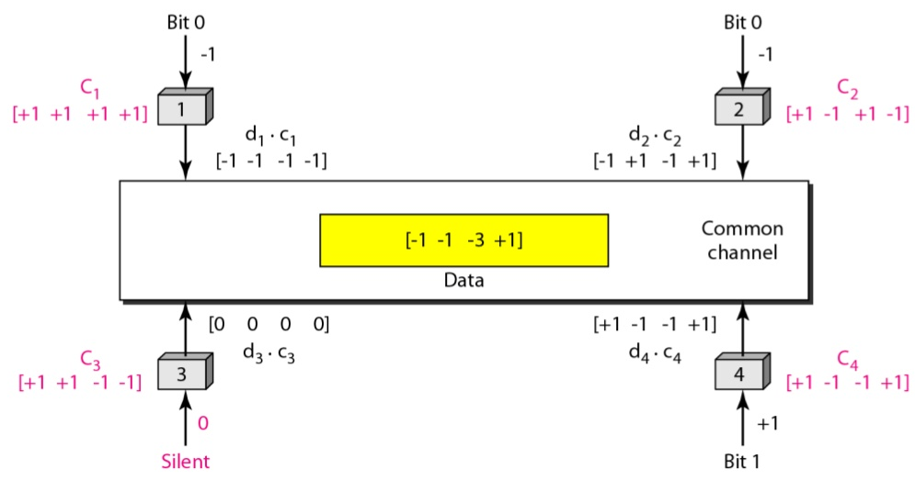
Sharing channel in CDMA

Slide 37
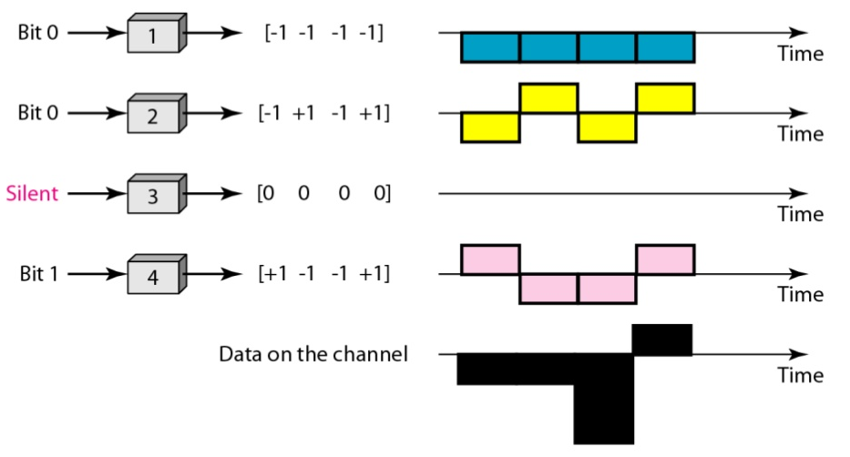
Digital signal created by four stations in CDMA

Slide 38
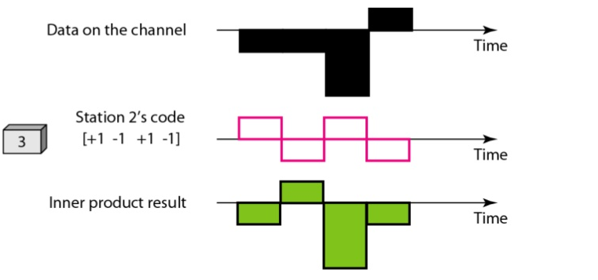
Decoding
Let station 3 is listening to station 2
Inner product = -4 = 4 * -1
Hence transmitted data is binary 0

Slide 39
Switched Communication Networks
Data transmitted from source to destination through a network of intermediate switching nodes.
Switching nodes
    Not concerned with the content of the data.
    Provides a switching facility that will move the data from node to node until they reach their destination.
End devices – stations.

Slide 40
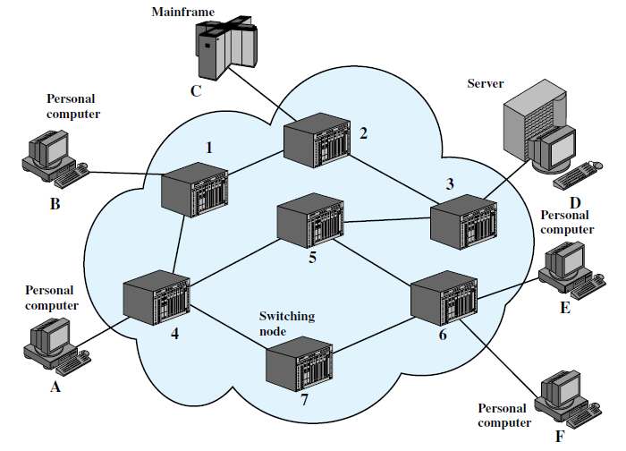

Slide 41
Switching
    Circuit switching
    Packet switching

Slide 42
Circuit switching networks
There is a dedicated communication path between two stations.
Path - connected sequence of links between network nodes.
3 phases
    Circuit establishment
    Data transfer
    Circuit disconnect

Slide 43
Circuit establishment
Before transmission an end-to-end (station-to-station) circuit must be established.
Link selection between nodes – based on
    Routing information
    Measures of availability
    Cost etc.
Eg: A – 4 – 5 – 6 – E – path established for communication between stations A and E.

Slide 44
Data Transfer
Once a dedicated path is established, data can be transferred.
Can be analog or digital depending on the link.
Full duplex communication is possible.

Slide 45
Circuit disconnect
Connection is terminated, usually by the action of one of the two stations.
Signals must be propagated to nodes to de-allocate the dedicated resources.

Slide 46
Features
Inefficient – Channel capacity is dedicated for the duration of a connection, even if no data are being transferred.
Performance – Delay prior to signal transfer for connection establishment.

Slide 47
Once the circuit is established, network is effectively transparent to the users.
Information is transmitted at a fixed data rate with no delay other than the propagation delay through the transmission links.
The delay at each node is negligible.

Slide 48
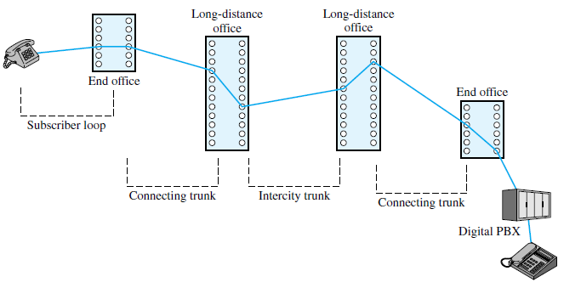
Eg: Public telephone network

Slide 49
Packet Switching
Introduced to overcome the drawbacks of circuit switching
    Network resources are reserved for a particular call.
    Suitable for voice communication; not for data.
    Data connection (e.g., personal computer user logged on to a database server), much of the time the line is idle. Hence circuit switching is inefficient.
    Terminal stations that are connected must transmit and receive at the same data rate. This limits the utility of the network in interconnecting a variety of host computers and workstations.

Slide 50
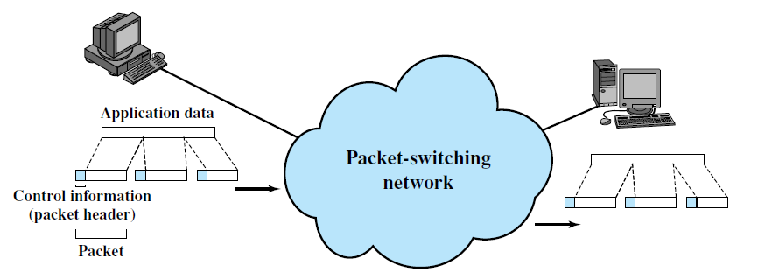
Principle

Slide 51
Data are transmitted in short packets.
If a source has a longer message to send, the message is broken up into a series of packets.
Each packet contains a portion (or all for a short message) of the user’s data plus some control information.
Control information – information required for routing the packet through the network and deliver it to the intended destination.

Slide 52
Advantages over circuit switching
Improved line efficiency
    Resources are allocated only when there are packets to be transferred
    A single node-to-node link can be dynamically shared by many packets over time.
    The packets are queued up and transmitted as rapidly as possible over the link.
Data-rate conversion
    Two stations of different data rates can exchange packets.

Slide 53
Advantages over circuit switching
Data packets are accepted even if network traffic is high.
    Delivery delay increases.
Priorities can be used
    If a node has a number of packets queued for transmission, it can transmit the higher-priority packets first.
    These packets will therefore experience less delay than lower-priority packets.

Slide 54
Switching Techniques
Two types
    Datagram approach
    Virtual circuit approach

Slide 55
Datagram approach
Each packet is treated independently, with no reference to packets that have gone before.
There is no connection set up or tear down phase

Slide 56
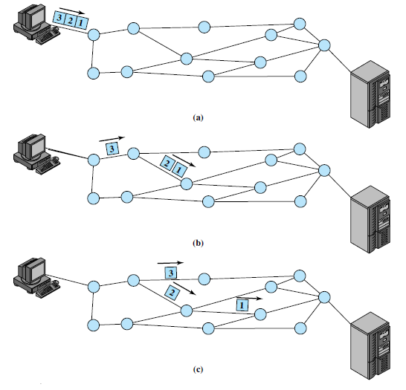
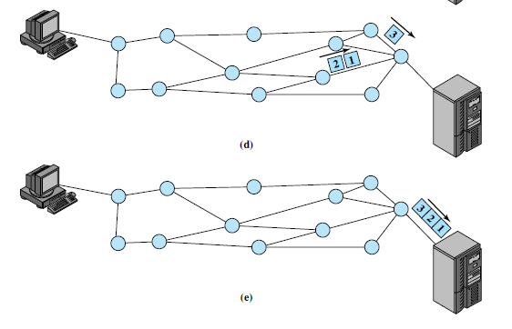

Slide 57
Node is selected dynamically by considering neighboring nodes on traffic, line failures, etc.
Packets may not follow the same route. They may arrive out of sequence at the exit point.
Either exit node or destination rearranges the packets.

Slide 58
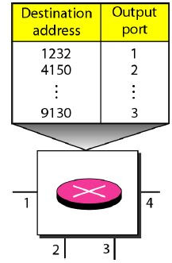
Routing table
Each switch has a routing table, which is based on the destination address
They are dynamic and are updated periodically

Slide 59
Destination address
Every packet carries a header which contains the destination address of the packet
When a switch receives a packet, the destination address is examined
Routing table is consulted to find the corresponding port through which the packets should be forwarded

Slide 60
Virtual circuit approach
A preplanned route is established before any packets are sent.
Once the route is established, all the packets between a pair of communicating parties follow this same route through the network.

Slide 61
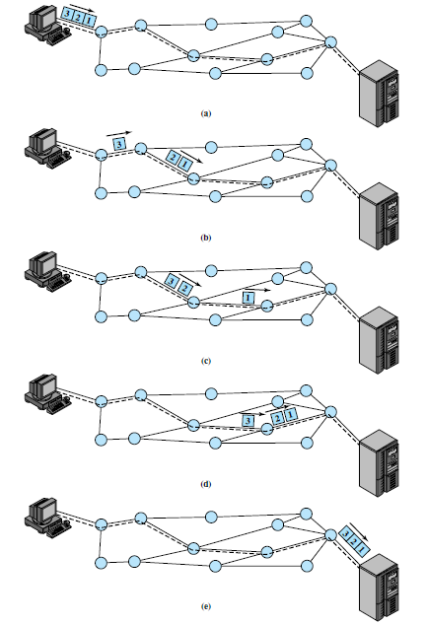

Slide 62
Because the route is fixed for the duration of the logical connection, it is somewhat similar to a circuit in a circuit-switching network.
Hence referred to as a virtual circuit.
This does not mean that this is a dedicated path, as in circuit switching.
At any time, each station can have more than one virtual circuit to any other station and can have virtual circuits to more than one station

Slide 63
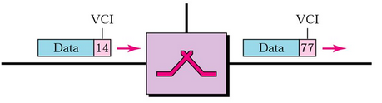
Virtual Circuit Identifier
Each switch can use its own set of unique VCIs

Slide 64
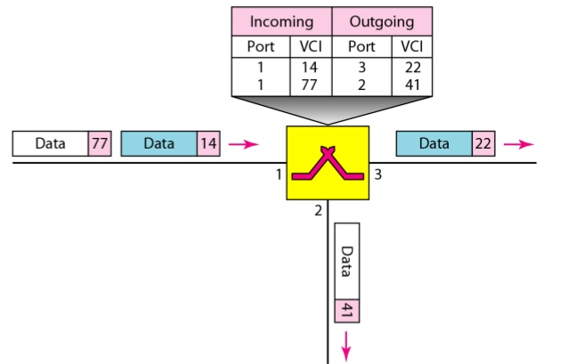

Slide 65
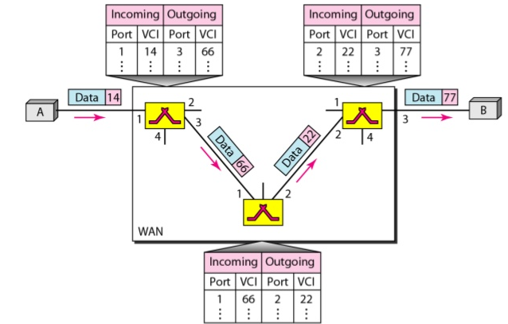
Source to destination data transfer

Slide 66
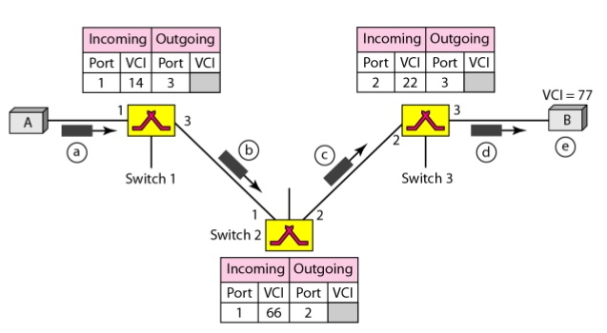
Set up request

Slide 67
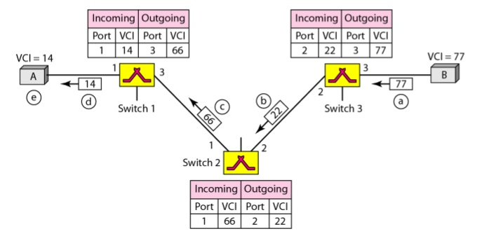
Set up acknowledgement

Slide 68
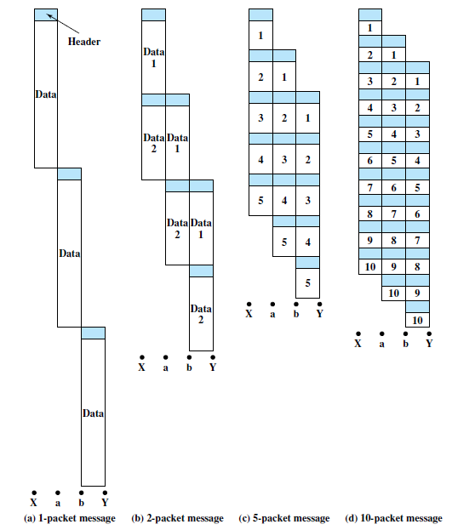
Effect of packet size on transmission time
77 Octet time
129 Octet time
92 Octet time

Slide 69
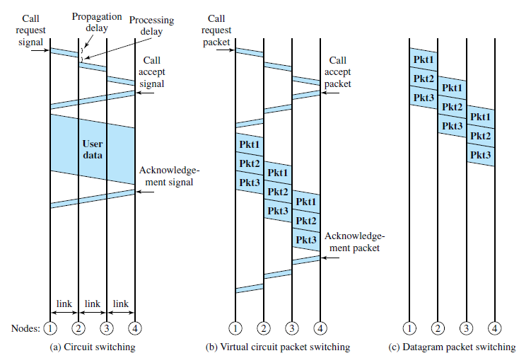
Comparison

Slide 70
3 Types of delays
Propagation delay: Time taken by a signal to propagate from one node to the next.
Processing delay: Time taken by a node to perform the necessary processing as it switches data.

Slide 71
SONET/SDH
Synchronous Optical Network
Optical transmission interface originally proposed by Bell Core and standardized by ANSI.
A compatible version, referred to as Synchronous Digital Hierarchy (SDH), has been published by ITU-T

Slide 72
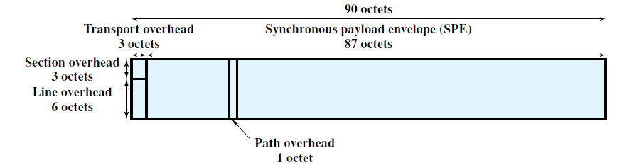
Frame format

Slide 73
Consists of 810 octets and is transmitted once every 125us for an overall data rate of 51.84 Mbps.
The frame can logically be viewed as a matrix of 9 rows of 90 octets each, with transmission being one row at a time, from left to right and top to bottom.

Slide 74
The first three columns (3 octets x 9 rows = 27octets) of the frame are devoted to overhead octets.
9 octets – section related overhead
18 octets - line overhead

Slide 75
The remainder of the frame is payload.
The payload includes a column of path overhead, which is not necessarily in the first available column position.
Line overhead contains a pointer that indicates where the path overhead starts.

