Slide 1
Module 5

Slide 2
Data Transmission
Parallel Transmission
Serial Transmission
    Asynchronous
    Synchronous

Slide 3
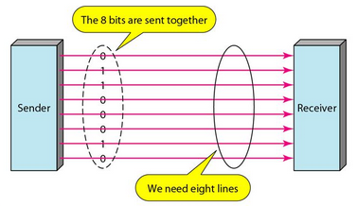
Parallel Transmission
Fast transmission of data
    Transfer speed increases by a factor of n times over serial transmission
More number of data lines are required – expensive
Transmission limited to short distances only

Slide 4
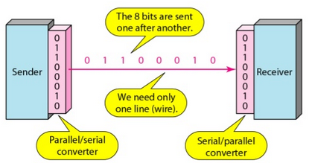
Serial Transmission

Slide 5
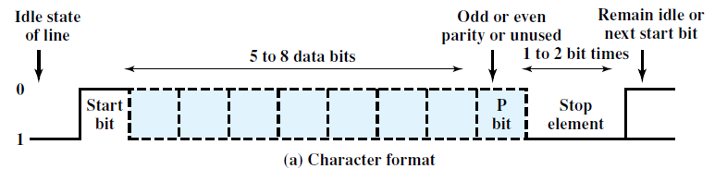
Asynchronous Transmission
Long stream of bits are not sent to avoid synchronization issues
Instead a character (5 to 8 bits wide) is sent at a time
Synchronization is maintained within each character
Re-synchronization occurs for every character transmitted

Slide 6
Start bit
Stop bit – Same as idle state
Parity bit – Odd parity or Even Parity – For error control

Slide 7
Each character begins with a start bit that alerts the receiver that a character is arriving.
Each character of data is treated independently.
Receiver samples each bit in the character and then looks for the beginning of the next character.
Not suitable for sending large blocks of data.
    Will lead to lack of synchronization

Slide 8
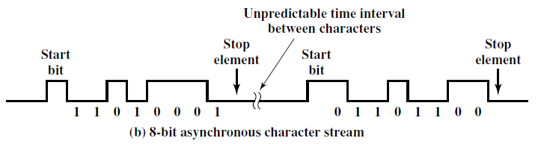

Slide 9
Asynchronous transmission is simple and cheap.
But requires an overhead of two to three bits per character.
Large frame overhead
    8 data bits, No parity bit, Start bit, Stop bit
    2 out of 10 bits carry no information
    Overhead is 20%

Slide 10
Overhead could be reduced by transmitting more information bits.
But it can lead to timing issues.
For greater efficiency – synchronous transmission

Slide 11
Synchronous transmission
A block of bits (frames) is transmitted in a steady stream without start and stop codes.
Frames – can contain multiple bytes
Transmitter and receiver should be synchronized.

Slide 12
Synchronization options
Separate clock line between transmitter and receiver.
Suitable only for short distances.
For long distance transmission clocks could be affected by noise.
Eventually, will lead to timing error.

Slide 13
Embed the clocking information in the data signal.
Digital signals - Manchester or differential Manchester encoding.

Slide 14
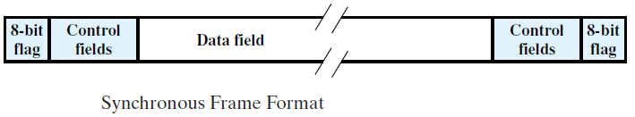
Bit patterns are added to identify the start and end of a data block
    Preamble bit pattern
    Postamble bit pattern

Slide 15
Less frame overhead than asynchronous transmission
    1000 characters each 8 bit wide
    48 bits – postamble, preamble and control bits
    48 out of 8048 bits will not carry information
    0.6% overhead

Slide 16

Types of Errors
Single bit error – Only one bit is affected by noise
Least likely to occur

Slide 17
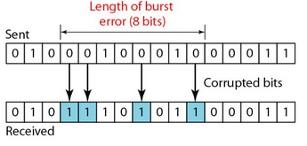
Burst error – Group of bits are affected
More common
Burst error are greater at higher data rates
Cluster of bits in which a number of errors occur, not all the bits in the cluster are in error

Slide 18
Error detection Vs. Error correction
Correction – more complex process than detection
Need to know the exact number of bits that are corrupted and their exact location in the message
Complexity increases as the number of errors and message size are very large

Slide 19
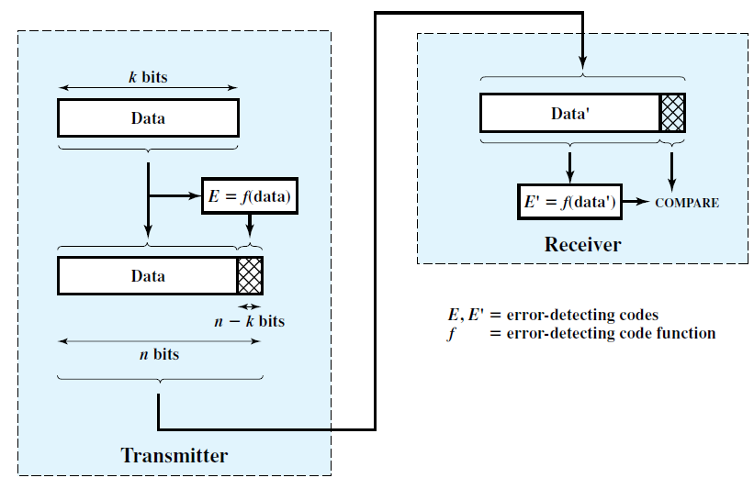
Error detection process

Slide 20
Parity check
Simplest error-detecting scheme
A parity bit is appended to the end of a block of data
Even parity - even number of 1s
Odd parity - odd number of 1s
If two (or any even number) of bits are inverted due to error, an undetected error occurs.

Slide 21
Odd Parity
Parity bit
 | 1 | 1 | 1 | 0 | 0 | 0 | 1

Slide 22
Odd Parity
Parity bit
1 | 1 | 1 | 1 | 0 | 0 | 0 | 1

Slide 23
Odd Parity – Let received sequence be
Parity bit
Odd parity is violated – Single error detected
1 | 1 | 1 | 1 | 0 | 1 | 0 | 1

Slide 24
Even Parity
Parity bit
 | 1 | 1 | 1 | 0 | 0 | 0 | 1

Slide 25
Even Parity
Parity bit
0 | 1 | 1 | 1 | 0 | 0 | 0 | 1

Slide 26
Even Parity
Parity bit
Even Parity not violated – Double or even number of errors cannot be detected
0 | 1 | 1 | 0 | 0 | 1 | 0 | 1

Slide 27
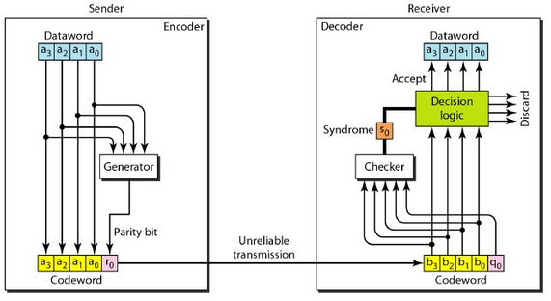
Error detection process with parity bit

Slide 28
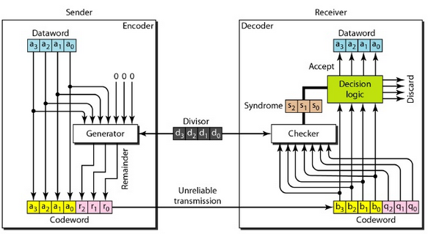
CRC

Slide 29
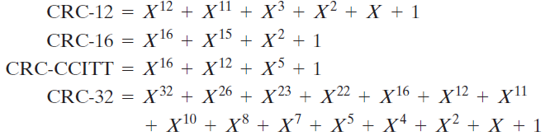
Standard CRC polynomials
CRC-12 -> transmission of streams of 6-bit characters and generates a 12-bit FCS
CRC-16 & CRC-CCITT -> 8-bit characters
CRC-32 -> point-to-point synchronous transmission standards and IEEE 802 LAN standards

Slide 30
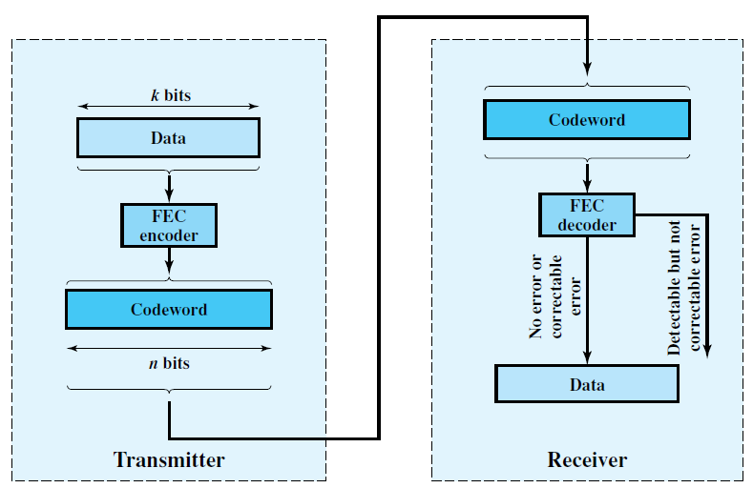
Forward Error Correction (FEC)

Slide 31
Forward Error Correction (FEC)
(n, k) block error correcting code
Redundant bits are added for error detection and correction – will not carry any information
n bit code word
k data bits
k data bits
(n-k) check bits
k data bits
n bit code word

Slide 32
Redundancy of the code = (n – k)/k
Code rate = k/n
Code rate is a measure of how much additional bandwidth is required to carry data at the same data rate as without the code.
Code rate of 1/2 requires double the transmission capacity of an un-coded system to maintain the same data rate.

Slide 33
Four possible outcomes
    No transmission errors - decoder produces the original data block as output.
    Transmission errors - decoder detects and correct those errors.
    For certain error patterns - decoder can detect but not correct the errors. In this case, the decoder simply reports an uncorrectable error.
    For certain error patterns - decoder does not detect the errors

Slide 34
Block code principles
Hamming distance – no. of bits in which two codes disagree
Eg. V₁ = 0 1 1 0 1 1
V₂ = 1 1 0 0 0 1
_{d (V1, V2) = 3}

Slide 35

Minimum distance – minimum Hamming distance between all possible code words
Data Block | Code word
0 0 | 0 0 0 0 0 | W1
0 1 | 0 0 1 1 1 | W2
1 0 | 1 1 0 0 1 | W3
1 1 | 1 1 1 1 0 | W4

Slide 36
d(0 0 0 0 0, 0 0 1 1 1) = 3
d(0 0 0 0 0, 1 1 0 0 1) = 3
d(0 0 0 0 0, 1 1 1 1 0) = 4
d(0 0 1 1 1, 1 1 0 0 1) = 4
d(0 0 1 1 1, 1 1 1 1 0) = 3
d(1 1 0 0 1, 1 1 1 1 0) = 3
Hence d_{min} = 3

Slide 37


Maximum number of guaranteed correctable errors per code word
Maximum number of errors that can be detected

Slide 38
Hamming Weight – No. of non-zero elements in a codeword
0 0 1 1 1 Hamming weight = 3

