Slide 1
Module 4

Slide 2
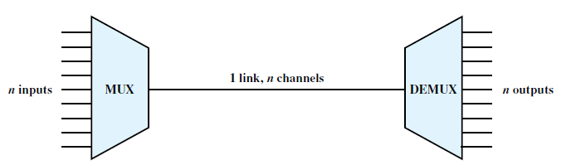
Multiplexing
Better utilization of channel capacity
Efficiency increases
Sharing of channel capacity

Slide 3
Applications
Long-haul communications
    High-capacity fiber
    Coaxial
    Microwave links
These links can carry large numbers of voice and data transmissions simultaneously using multiplexing

Slide 4
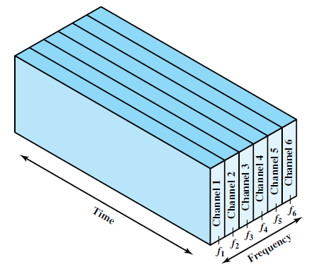
Frequency Division Multiplexing

Slide 5
Possible when the useful bandwidth of the transmission medium exceeds the required bandwidth of signals to be transmitted.
A number of signals can be carried simultaneously if each signal is modulated onto a different carrier frequency.

Slide 6
Carrier frequencies are sufficiently separated so that the bandwidths of the signals do not significantly overlap.
Guard bands – to avoid interference between adjacent channels.

Slide 7
The composite signal transmitted across the medium is analog.
Digital input - input signals must be passed through modems to be converted to analog.
In either case, each input analog signal must then be modulated to move it to the appropriate frequency band.

Slide 8
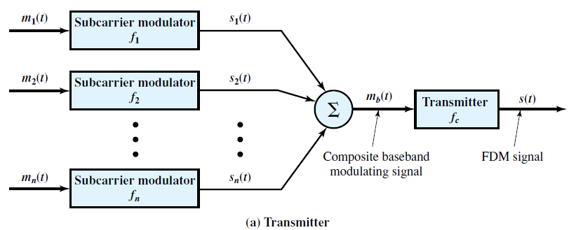
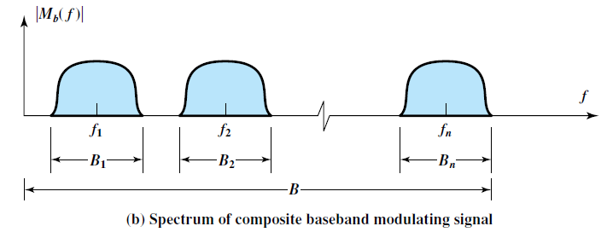
FDM transmitter

Slide 9
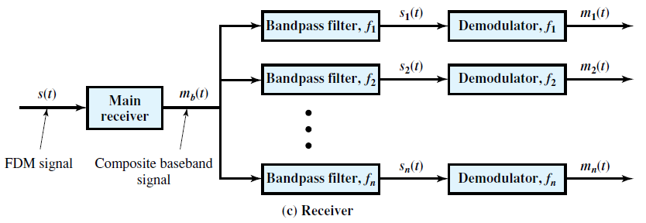
FDM receiver

Slide 10
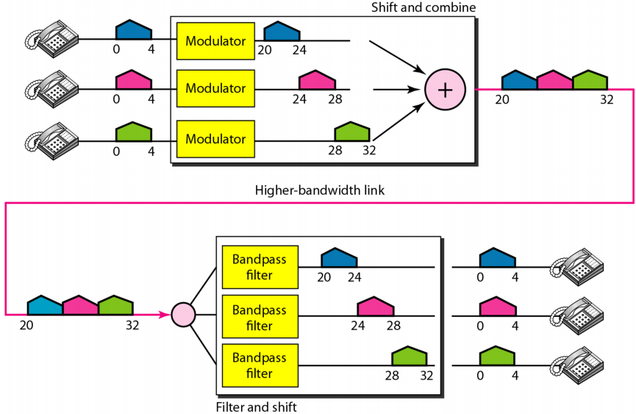

Slide 11
Wavelength Division multiplexing
Multiple beams of light at different frequencies are transmitted on the same fiber.
This is a form of FDM.
Commonly called wavelength division multiplexing (WDM).
Improves efficiency of optical fiber communication.

Slide 12
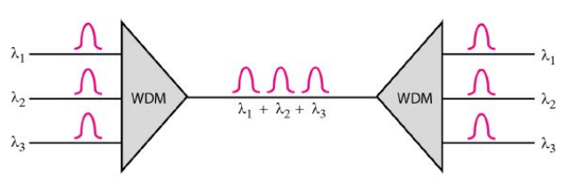
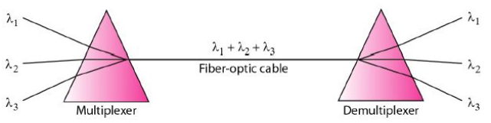
WDM scheme

Slide 13
Synchronous time division multiplexing
Possible when the achievable data rate of the medium exceeds the data rate of digital signals to be transmitted.
Multiple digital signals (or analog signals carrying digital data) can be carried on a single transmission path by interleaving portions of each signal in time.

Slide 14
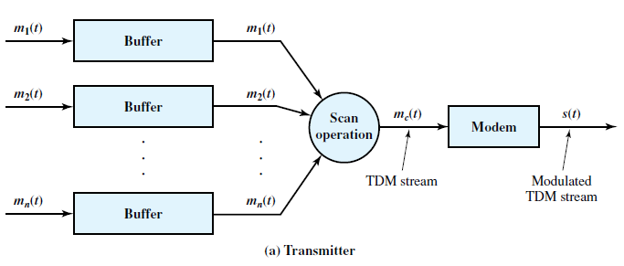
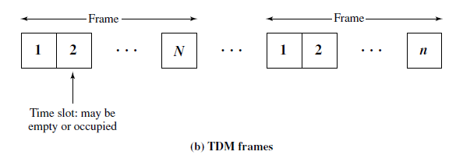

Slide 15
Incoming data from each source – buffered
    Buffer is typically one bit or one character in length
The buffers are scanned sequentially to form a composite digital data stream m_{c}(t)
The scan operation is sufficiently rapid so that each buffer is emptied before more data can arrive
Data rate of m_{c}(t) must at least equal the sum of the data rates of the m_{i}(t)

Slide 16
Data - organized into frames
Each frame contains a cycle of time slots.
    In each frame, one or more slots are dedicated to each data source.
Sequence of slots dedicated to one source - channel
Slot length equals the transmitter buffer length, typically a bit or a byte (character).

Slide 17
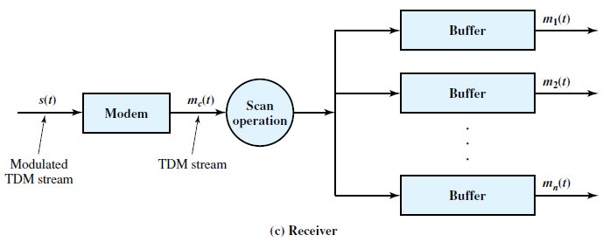
TDM receiver

Slide 18
For each input source m_{i}(t) there is an identical output destination that will receive the output data at the same rate at which it was generated.
Synchronous - because the time slots are pre-assigned to sources and fixed.
    The time slots for each source are transmitted whether or not the source has data to send.

Slide 19
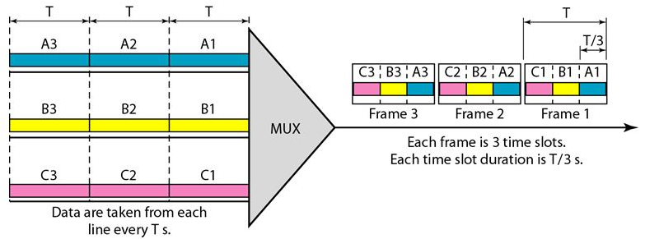
Concept of TDM

Slide 20
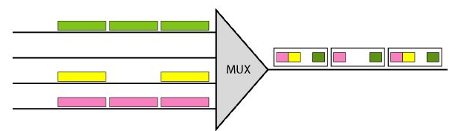
Empty slots
Synchronous TDM lacks efficiency

Slide 21
Framing
If the source and destination are out of step, data on all channels are lost.
Ensure frame synchronization – by adding framing bits (added digit framing)
An identifiable pattern of bits, from frame to frame, is used as a “control channel”
    Eg. alternating bit pattern 1 0 1 0 1 0 …..

Slide 22
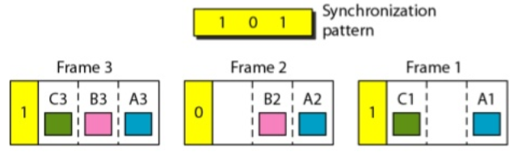
Concept of Framing
For frame synchronization
    Using alternating pattern 1 0 1
    Synchronization information consists of 1 bit per frame

Slide 23
To synchronize, a receiver compares the incoming bits of one frame position to the expected pattern.
If the pattern does not match, successive bit positions are searched until the pattern persists over multiple frames.

Slide 24
Once framing synchronization is established, the receiver continues to monitor the framing bit channel.
If the pattern breaks down, the receiver must again enter a framing search mode.

Slide 25
Data rate management in TDM
For managing sources with different data rates
  Multilevel multiplexing
  Multiple slot allocation
  Pulse stuffing

Slide 26
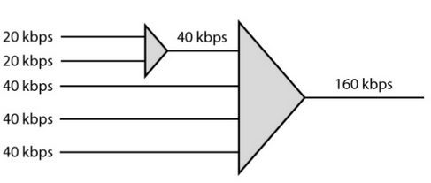
Multilevel multiplexing
Used when the data rate of an input is a multiple of others

Slide 27
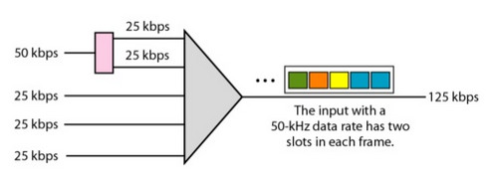
Multiple slot allocation
Two slots are provided for 50kbps line

Slide 28
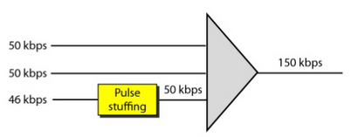
Pulse stuffing
Data rate of individual sources can be different
    Data rates of the input data streams are not related by a simple rational number

Slide 29
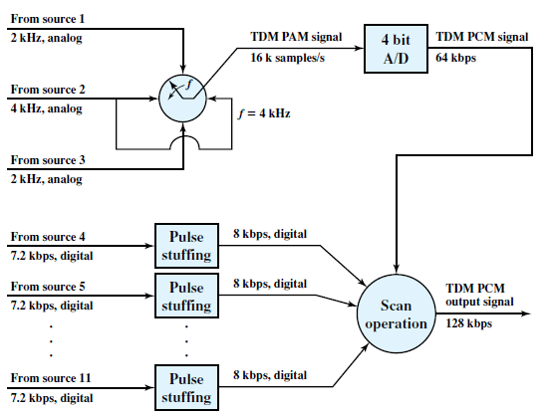

Slide 30
Statistical time division multiplexing
Synchronous TDM – time slots are wasted if source has nothing to transmit
Statistical TDM - dynamically allocates time slots on demand

Slide 31
Number of I/O lines on one side and a higher-speed multiplexed line on the other side
Let there are ‘n’ I/O line and ‘k’ output time slots
k < n

Slide 32
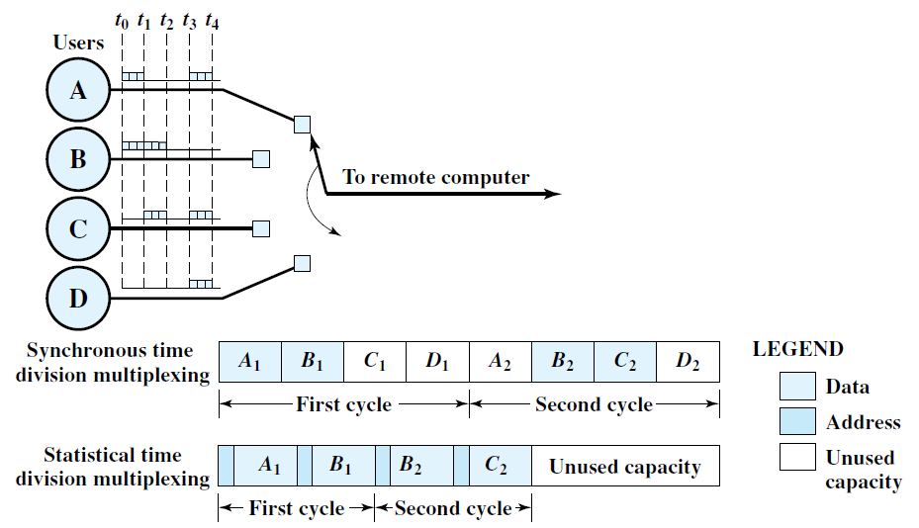

Slide 33
Multiplexer scans the input buffers – collects data until a frame is filled.
When the frame is filled, it is transmitted.
Output – multiplexer receives a frame and distributes the slots of data to the appropriate output buffers

Slide 34
Address slots are required – because self synchronization is not possible
Address information ensures proper delivery of data to required destination
More overhead per slot for statistical TDM because each slot carries an address as well as data

Slide 35
Data rate on the multiplexed line is less than the sum of the data rates of the attached devices – since all devices are not transmitting all the time
Can use a lower data rate to support as many devices as a synchronous multiplexer
If a statistical multiplexer and a synchronous multiplexer both use a link of the same data rate, the statistical multiplexer can support more devices.

Slide 36
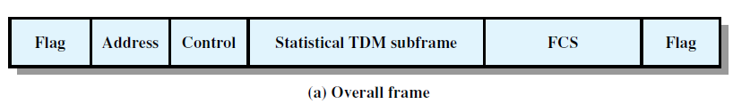
Statistical TDM frame formats
Control bits – multiplexing operation
FCS – Frame check sequence – error control
Flag – Start and stop of frame

Slide 37
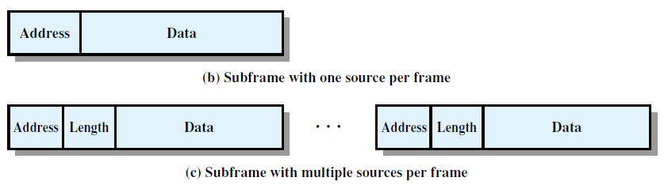
Two possible formats

Slide 38
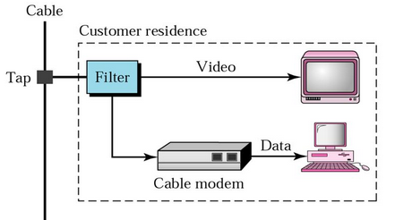
Cable Modem
Device that allows a user to access the Internet and other online services through a cable TV network
2 channels – for transmission in either direction
    Downstream: Cable head end to subscriber
    Upstream

Slide 39
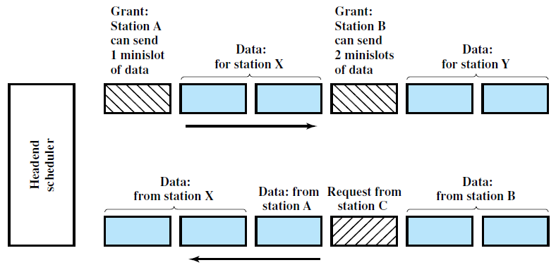
Scheduler delivers data in the form of small packets

Slide 40
Down stream direction
Grant time slots to subscribers.
When a subscriber has data to transmit, it must first request time slots on the shared upstream channel.
Each subscriber is given dedicated time slots for this request purpose.
Head-end scheduler responds to a request packet by sending back an assignment of future time slots to be used by this subscriber.

