Slide 1
Module 3

Slide 2
Signal Encoding Techniques
Data
    Digital
    Analog
Signals
    Digital
    Analog

Slide 3
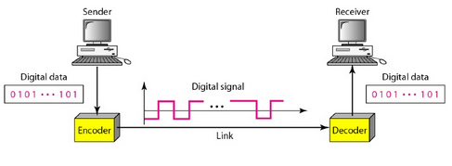
Digital data to Digital signals
Various coding schemes – Line coding schemes
    Unipolar
    Bipolar
    Multilevel binary
    Biphase

Slide 4
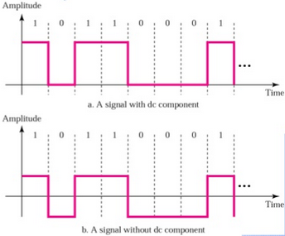
Line coding characteristics
DC components
    Undesirable
    Signal cannot be passed through a transformer or through a system that cannot pass low frequencies
    Extra energy residing on the line and is useless

Slide 5
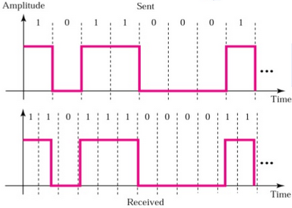
Self synchronization
    Receiver bit interval should be same as that of transmitter
    If receiver clock is slower or faster – error in decoding
    Self synchronizing digital signal includes timing information in the data being transmitted

Slide 6
Error detection
Signal interference and noise immunity
Minimal cost and complexity

Slide 7
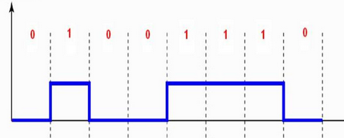
Unipolar
All the signal elements have the same algebraic sign
    Positive or Negative
    Uses only one voltage level

Slide 8
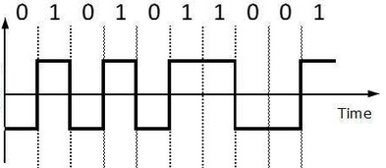
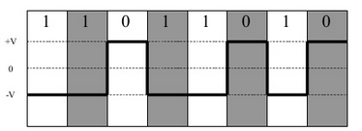
Polar
1. Non-Return to Zero-Level (NRZ-L)
    1s : positive voltage
    0s : negative voltage
    or
    1s : negative voltage
    0s : positive voltage

Slide 9
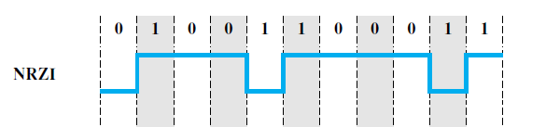
2. Non-Return to Zero-Invert on ones (NRZI)
    constant voltage pulse for the duration of a bit time
    1s : A transition (low to high or high to low) at the beginning of a bit time
    0s : No transition

Slide 10
NRZI – differential encoding
    Information to be transmitted is represented in terms of the changes between successive signal elements rather than the signal elements themselves
Benefits of differential encoding
    More reliable to detect the presence of a transition in the presence of noise
    Polarity inversion does not affect the data being transmitted

Slide 11
Limitations of NRZ signals
Lack of self synchronization in case of
    Long string of 1s or 0s for NRZ-L
    Long string of 0s for NRZ-I
Presence of dc component

Slide 12
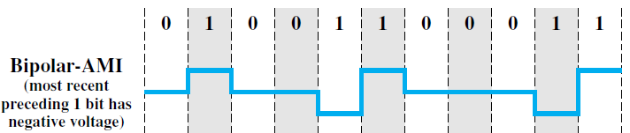
Multilevel binary
1. Bipolar-Alternate Mark Inversion (AMI)
    0s : Zero voltage
    1s : Positive or negative pulse
    The binary 1 pulses must alternate in polarity.

Slide 13
Advantages of Bipolar AMI
    No loss of synchronization if a long string of 1s occurs
    Each 1 introduces a transition, and the receiver can resynchronize on that transition
    Error detection is possible (detects deletion or addition of a pulse)
    No net dc component
Long string of 0s – No synchronization

Slide 14
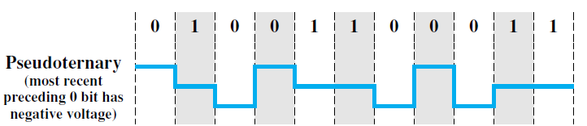
2. Pseudoternary
    1s : Zero voltage
    0s : Positive or negative pulse
    The binary 0 pulses must alternate in polarity.

Slide 15
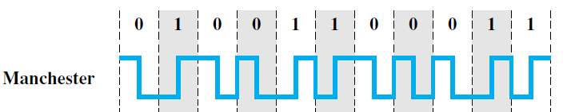
Biphase
1. Manchester code
    Transition at the middle of each bit period
    The mid-bit transition serves as a clocking mechanism and also as data
    1s : Low-to-high transition
    0s : High-to-low transition

Slide 16
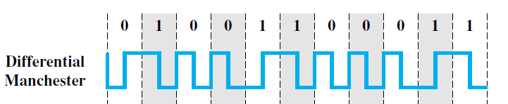
2. Differential Manchester code
    Mid-bit transition is used only to provide clocking
    0s : transition at the beginning of a bit period
    1s : absence of a transition at the beginning of a bit period

Slide 17
Biphase technique - advantages
Synchronization
    Predictable transition during each bit time - receiver can synchronize on that transition
    No dc component
    Error detection: The absence of an expected transition can be used to detect errors.

Slide 18
Biphase technique - disadvantages
One or two transition per bit time
Maximum modulation rate is twice that for NRZ
Bandwidth required is correspondingly greater.

Slide 19
Digital Data to Analog Signals
Modulation
    Amplitude Shift Keying (ASK)
    Frequency Shift Keying (FSK)
    Phase Shift Keying (PSK)

Slide 20
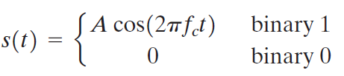
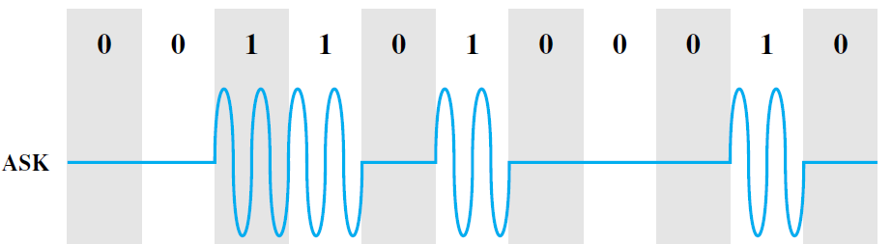
Amplitude Shift Keying (ASK)

Slide 21
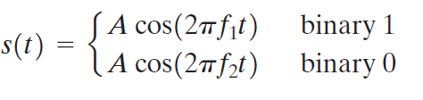
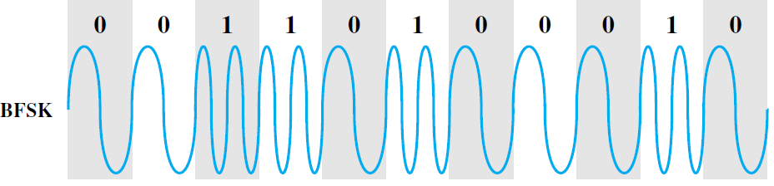
Frequency Shift Keying (FSK)
Binary Frequency Shift Keying (BFSK)

Slide 22
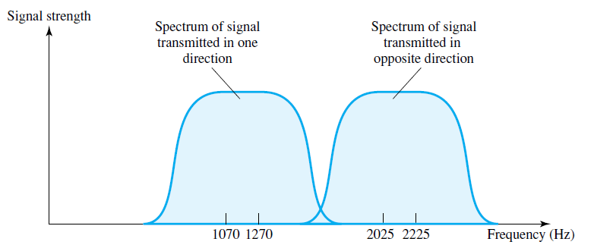
Full duplex FSK Transmission
BFSK is less susceptible to error than ASK

Slide 23
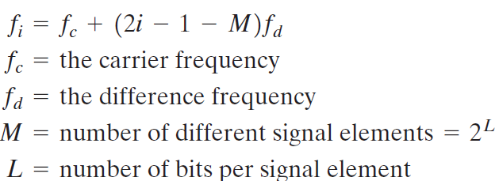
Multiple FSK

Slide 24
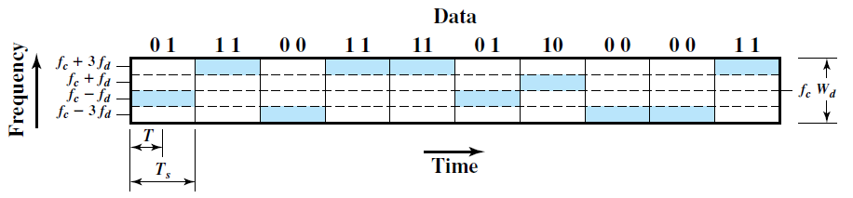
Example
M=4

Slide 25

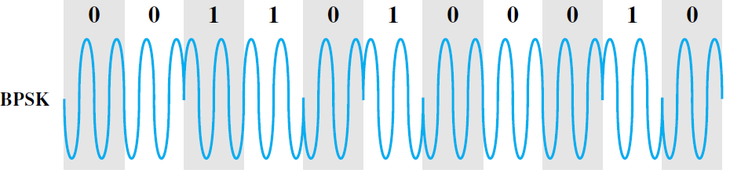
Phase Shift Keying (PSK)
Binary Phase Shift Keying (BPSK)

Slide 26
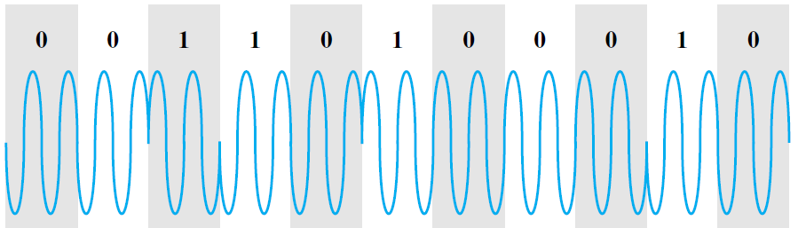
Differential phase shift keying
0s : same phase of the previous signal sent
1s : opposite phase to the preceding one

Slide 27
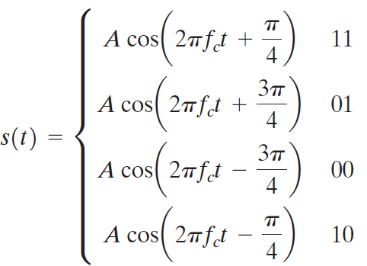
4 level PSK (QPSK)
Quadrature phase shift keying
    Transmits two bits per symbol – 00, 01, 10 11

Slide 28
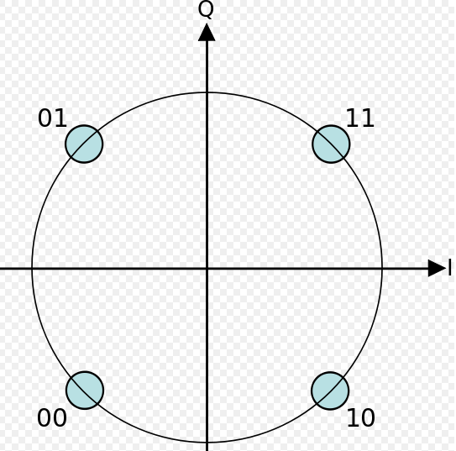

Slide 29
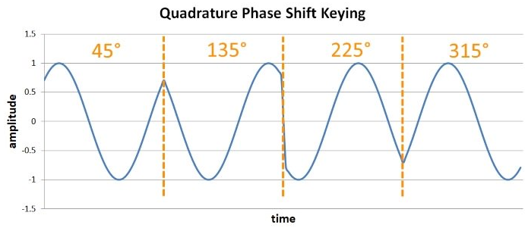
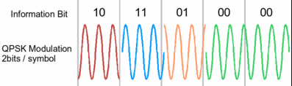

Slide 30
Analog data Analog signals

Slide 31
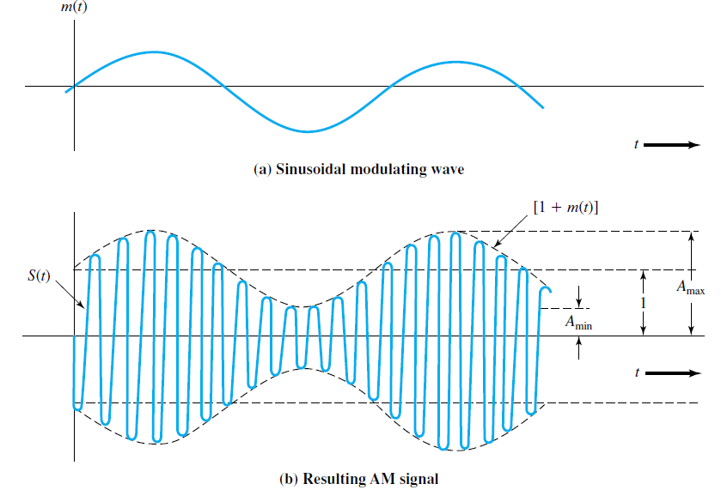
Amplitude modulation

Slide 32
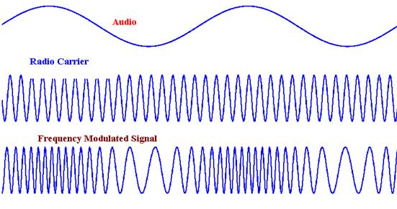
Frequency Modulation

Slide 33
Analog data to Digital signal
Pulse Code Modulation (PCM)
Delta Modulation

Slide 34
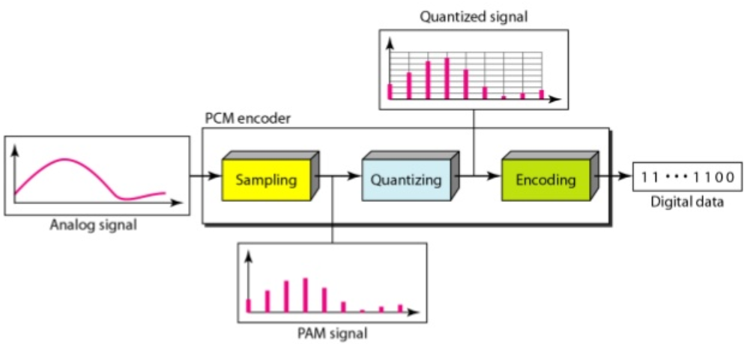
Pulse Code Modulation (PCM)
3 steps: Sampling, Quantizing, Encoding

Slide 35
Sampling: Sampling theorem (Nyquist theorem)
    Sampling rate should be greater than twice the highest frequency component of the signal
    Samples will contain the information content
    Faithful reconstruction of the analog signal is possible from the samples
Sampling process – Pulse Amplitude Modulation (PAM)

Slide 36
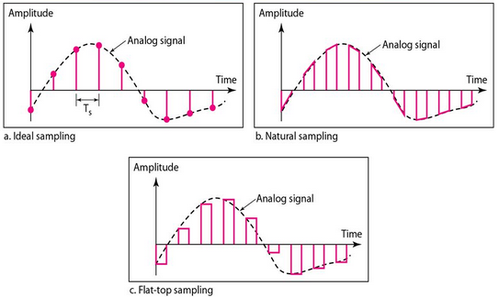
Different types of sampling
    Most common – Flat top sampling (Sample and Hold)

Slide 37
Quantization
    Sampled amplitude values cannot be encoded directly
    The set of sampled amplitudes can be infinite with non integral values between the minimum and maximum amplitude of the signal

Slide 38
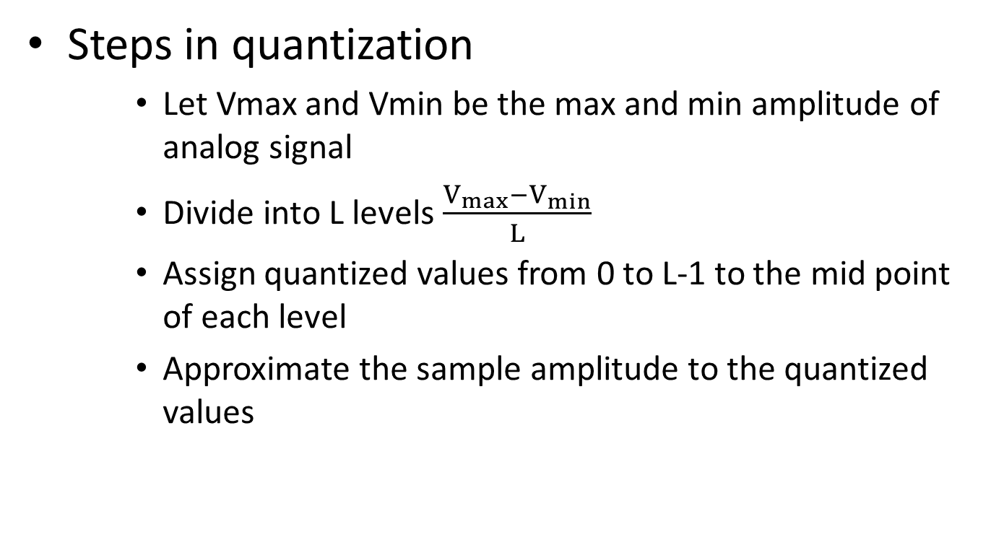
Steps in quantization
    Let Vmax and Vmin be the max and min amplitude of analog signal
    Divide into L levels $\frac{V_{max}−V_{min}}{L}$
    Assign quantized values from 0 to L-1 to the mid point of each level
    Approximate the sample amplitude to the quantized values

Slide 39
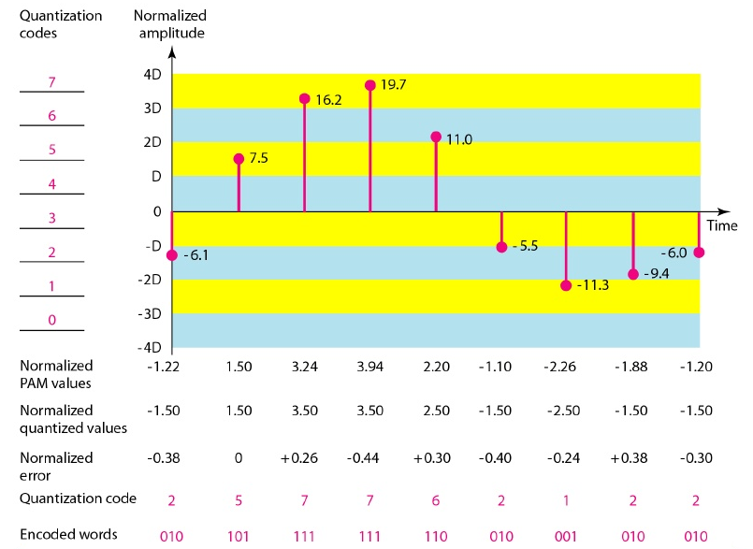

Slide 40
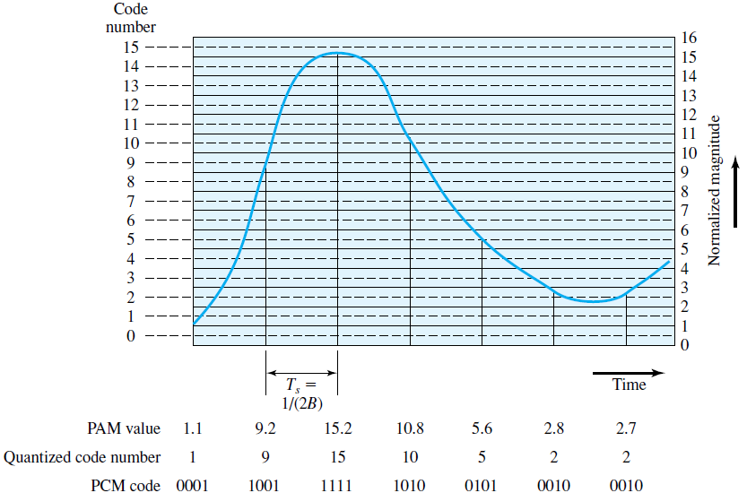

Slide 41
Quantization error
    Error introduced due to the approximation process
    Irreversible error

Slide 42
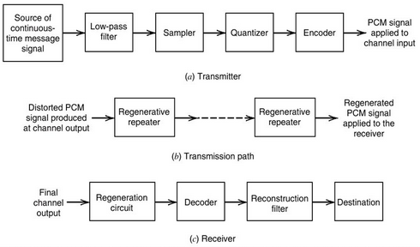
PCM Decoder

Slide 43
Delta modulation
Analog input is approximated by a staircase function
Moves up or down by one quantization level (δ) at each sampling interval Ts

Slide 44
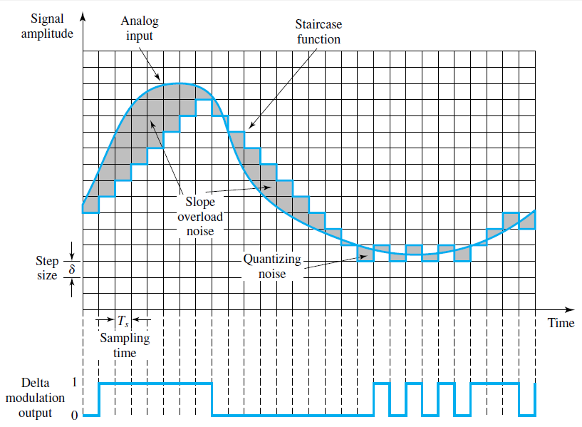

Slide 45
Delta Modulation
PCM
1. Highly complex
2. Finds the value of the signal amplitude for each sample
3. Code words are formed and is transmitted
4. Quantization error is high
DM
1. Simpler technique
2. Finds the change from the previous sample
3. Bits are sent one after the other
4. Quantization error is less

Slide 46
Output of the delta modulation process can be represented as a single binary digit for each sample
1 is generated if the staircase function is to go up during the next interval
0 is generated otherwise

Slide 47
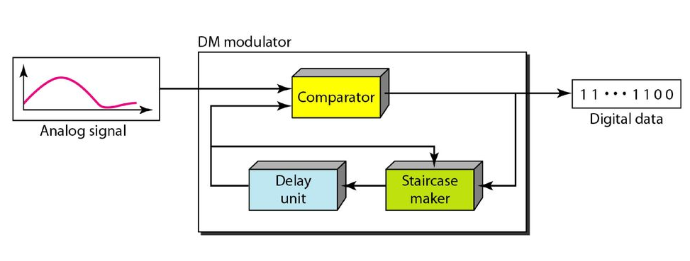
Modulator

Slide 48
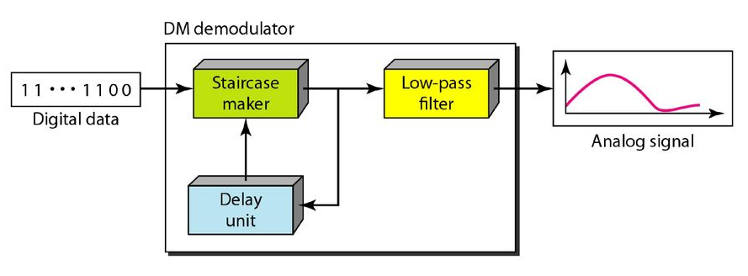
Demodulator

Slide 49
