Slide 1
Module 2

Slide 2
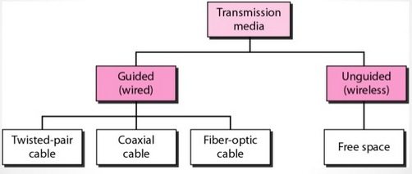
Classification

Slide 3
Guided Medium
A signal traveling along any of these media is directed and contained by the physical limits of the medium.
Twisted pair, Coaxial cable – Metallic conductors
Optical fiber – glass cable that accepts and transport signals in the form of light

Slide 4
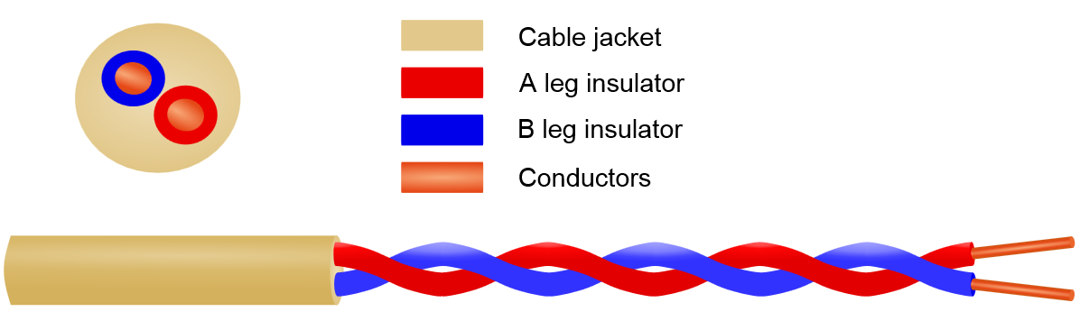
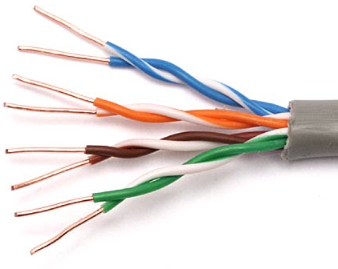
Twisted pair cable

Slide 5
Twisted pair cable
Consists of two conductors, which are insulated, twisted together
One of the wires is used to carry signals to the receiver, and the other is used as reference ground
Receiver uses the difference between the two levels

Slide 6
Interference or noise equally affects both the wires
The receiver at the end takes the difference between these unwanted signals
This makes the system immune to noise

Slide 7
If two wires are parallel, the effect of these unwanted signals is not the same in both wires because they are at different locations relative to the noise or crosstalk sources
More the number of twists, higher the immunity to noise and cross talks i.e. better clarity

Slide 8
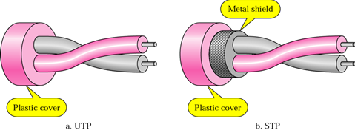
Unshielded vs. Shielded Twisted Pair Cable
Unshielded Twisted Pair (UTP)
Shielded Twisted Pair (STP)

Slide 9
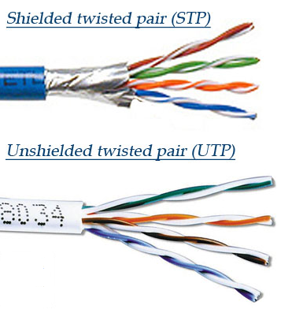
Metal shield will improve the quality of the cable by preventing the penetration of noise or crosstalk
Bulkier
Expensive

Slide 10
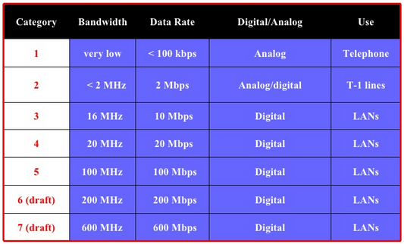
Categories of UTP

Slide 11
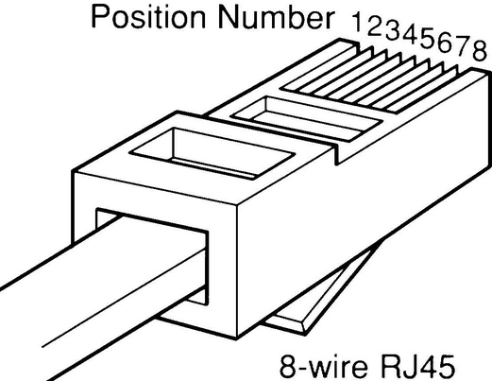
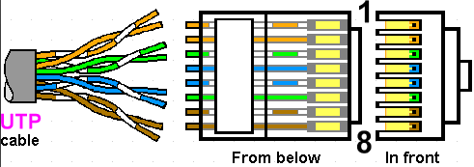
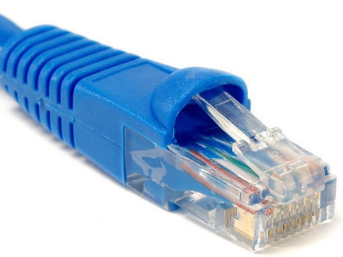
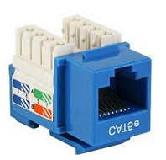
UTP Connectors
RJ45 (RJ-Registered Jack)

Slide 12
Applications
Telephone lines
LAN cables – 10Base-T, 100Base-T
DSL lines – for high speed internet

Slide 13
Transmission characteristics
Used to transmit both analog and digital signals
    Analog – amplifiers are required every 5 to 6km
    Digital – repeaters are required every 2 to 3km
Limited in distance, bandwidth and data rate (compared to coaxial cables and optical fiber)

Slide 14
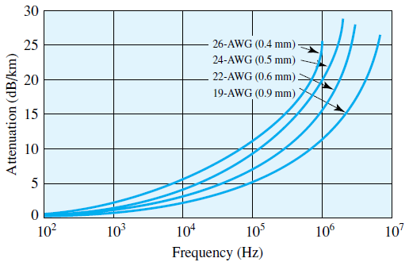
Impairments
    High attenuation (compared to coaxial cables and optical fiber)
    Easily affected by EM Interference and noise

Slide 15
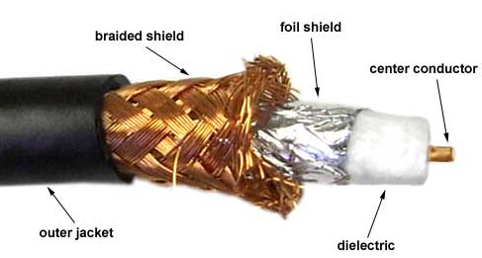
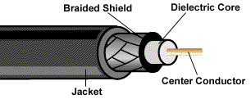
Coaxial Cables
center conductor enclosed in an insulating sheath (dielectric material)
outer conductor of metal foil, braid or a combination of both
outer conductor is covered with a jacket or shield

Slide 16
Coaxial cable standards
Thin Ethernet: 10 Base-2
    10Mbps
    max. length of each segment - 185mts
    max. 30 connections per segment
Thick Ethernet: 10 Base-5
    10Mbps
    max. length of each segment - 500mts
    max. 100 connections per segment
Category | Impedance | Use
RG-59 | 75Ω | Cable TV
RG-58 | 50Ω | Thin Ethernet
RG-11 | 50Ω | Thick Ethernet

Slide 17
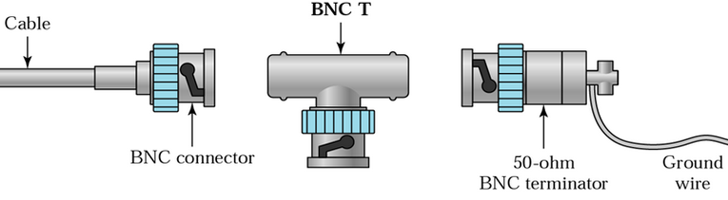
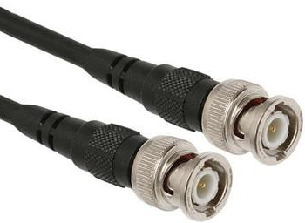
Coaxial cable connectors
BNC (Bayonet Neil-Concelman) connector

Slide 18
Applications
Television distribution
Long-distance telephone transmission
Short-run computer system links
Local area networks

Slide 19
Transmission characteristics
Used for both analog and digital signals
    Analog transmission upto 500MHz
    Amplifiers / Repeaters are needed every few kms.
    If higher frequencies are used or higher data rates are required, amplifiers / repeaters are closely spaced
Frequency characteristics are superior than twisted pair cables
    Hence used effectively at higher frequencies & data rates
Less susceptible to interference and cross talk than twisted pair
Supports more channels/stations than twisted pair

Slide 20
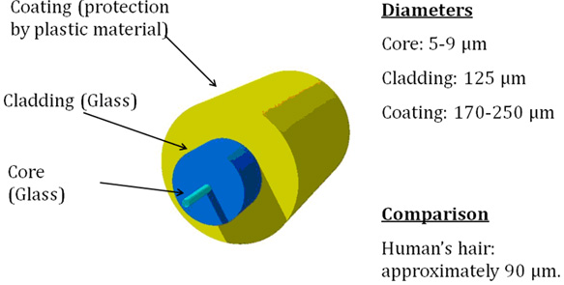
Optical Fiber Cables: Structure

Slide 21
Advantages of OFC

Slide 22
1. High Bandwidth
Optic fibers has got a very high bandwidth in the order of THz, when compared with wired transmission media.
    Coaxial cable: 500MHz
    Millimeter wave radio system: 700MHz
This leads to high data rate. 100s of Mbps to few Gbps.

Slide 23
2. Small size and weight
Very fine dimension – comparable with human hair

Slide 24
3. Electrical isolation
Fabricated from glass/plastic polymers
Electrical insulators
No sparks or short circuits
No interface problem

Slide 25
4. Immunity to interference and cross talk
Dielectric waveguide-free from EMI issues
Transmission possible through electrically noisy environment
Requires no shielding from EMI
Negligible cross talk-even when many fibers are cabled together

Slide 26
5. Signal Security
Very less spurious radiation – signal security
Very difficult to obtain optical signal in a non-invasive manner
Hence can be used for secure communication

Slide 27
6. Low transmission loss
Losses as low as 0.2dB/km
Separation between repeaters can be increased
Reduces cost of implementation and complexity

Slide 28
7. Ruggedness and flexibility
High tensile strength
Can be bent to small radii or can be twisted without damage
Storage, handling, transportation and installation of OFC is much easier than copper cables

Slide 29
8. System reliability and ease of maintenance
Long lifetime – 20 to 30 years
Few repeaters / Greater repeater spacing – system reliability increases

Slide 30
9. Low cost
Made from glass – made from silica – commonly available
But high cost for transmitters and detectors

Slide 31
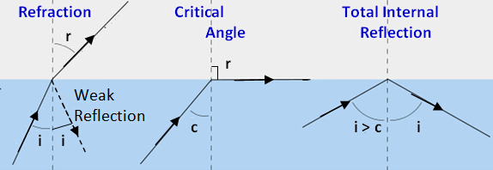
Principle
Lighter medium
Denser medium

Slide 32
Fiber classification
Step Index fibers
    Multi-mode step index
    Single mode
Graded index fibers

Slide 33
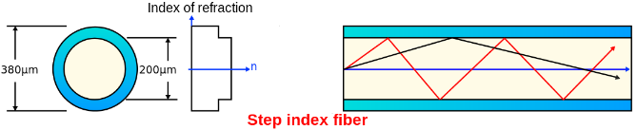
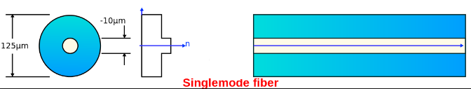

Step index fibers
$$n\left(r\right)=\left\{\begin{aligned}n_{1} core \\ n_{2} cladding\end{aligned}\right.$$

Slide 34
multi-mode step index fiber
    core diameter: >50μm
    Multiple modes are propagated through core
single mode step index fiber
    core diameter: 2 to 10μm
    Only one mode is propagated through core – axial ray

Slide 35
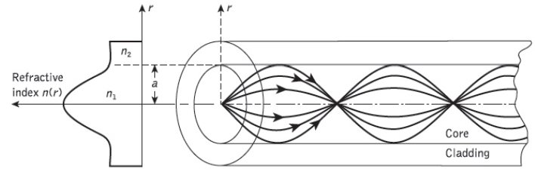
Graded index fibers
Refractive index of the core is not constant
    Maximum refractive index along core axis
Refractive index of the cladding is constant

Slide 36
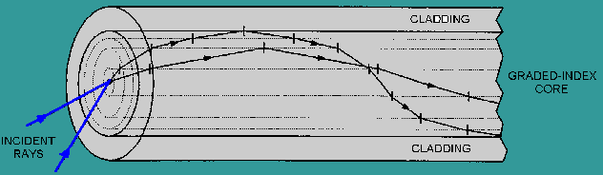
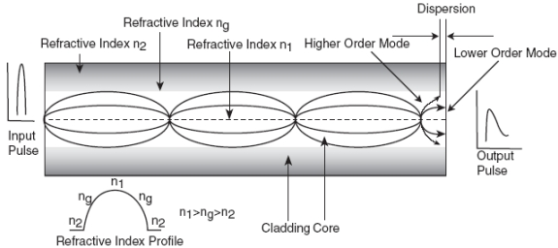
Propagation in graded index fibers

Slide 37
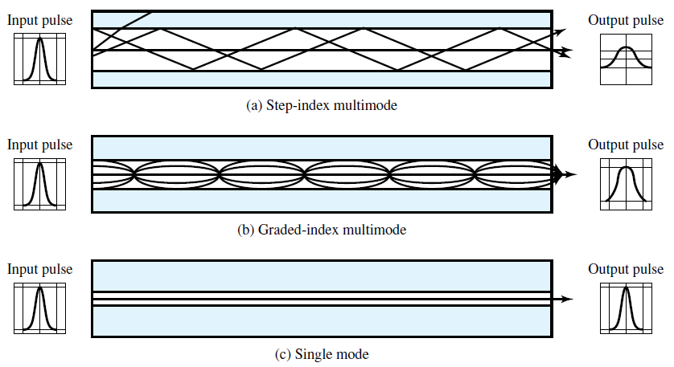
Transmission - comparison

Slide 38
Step Index Multimode
Multiple propagation paths exist, each with a different path length
Different path length – different time to propagate through the fiber
This causes signal elements (light pulses) to spread out in time – distortion/dispersion
Limits the rate at which data can be accurately received
Best suited for transmission over very short distances

Slide 39
Single mode
When the fiber core radius is reduced, fewer angles will reflect
Only a single angle or mode can pass: the axial ray
Distortion/dispersion cannot occur.
Used for long distance applications, including telephone and cable television

Slide 40
Graded Index Multimode
Higher refractive index at the center makes the light rays moving down the axis (axial ray) advance more slowly than those near the cladding.
Light in the core curves helically because of the graded index, reducing its travel distance.
The shortened path and higher speed allows light at the periphery to arrive at a receiver at about the same time as the straight rays in the core axis.
Hence distortion /dispersion will be less than multimode step index fibers
Graded-index fibers are often used in local area networks.

Slide 41
Light Sources
LED – Light Emitting Diode
    Less costly
    Operates over a greater temperature range
    Longer operational life
ILD – Injection Laser Diode
    Works on laser principle
    High efficiency
    Attain high data rates and long distance transmission
  Both are semiconductor devices that emits a beam of light when a voltage is applied

Slide 42
Light detectors
APD – Avalanche photo diode
Phototransistors

Slide 43
Digital optical fiber link
Fiber cable
Encoder
LASER drive circuit
Amplifier and Equalizer
Laser
APD
Decoder
Digital information source
Digital output

Slide 44
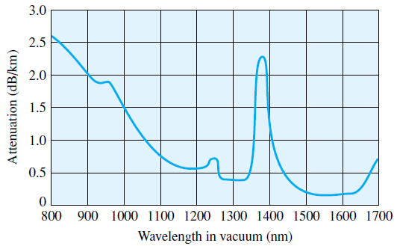
Attenuation characteristics

Slide 45
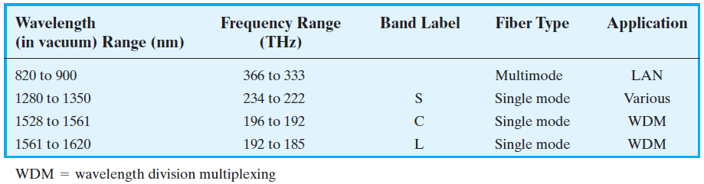
Frequency utilization for fiber applications

Slide 46
Applications
Long-distance telecommunications
Military applications
Local area networking

Slide 47
Long-haul trunks
    Avg. length 1500km length,
    High capacity - typically 20,000 to 60,000 voice channels
    Undersea optical fiber cables
Metropolitan trunks
Rural exchange trunks
Subscriber loops
Local area networks

Slide 48
Wireless Transmission
Microwave frequencies: 1GHz to 40GHz
Suitable for point-to- point communication
    highly directional beams are possible
Radio frequencies: 30MHz to 1GHz
    Suitable for omnidirectional applications
For unguided media, transmission and reception are achieved by means of an antenna

Slide 49
Antennas
Electrical conductor or system of conductors used either for radiating electromagnetic energy or for collecting electromagnetic energy

Slide 50
Transmission of a signal:
    radio-frequency electrical energy from the transmitter -> electromagnetic energy by the antenna and radiated into the surrounding environment
Reception of a signal:
    electromagnetic energy impinging on the antenna -> radio-frequency electrical energy and fed into the receiver

Slide 51
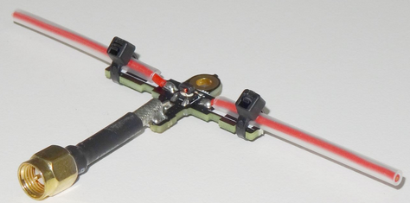
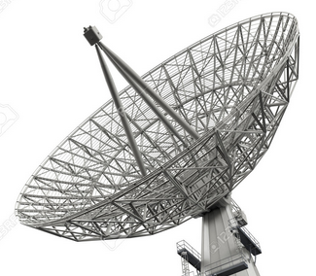
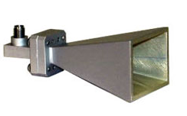
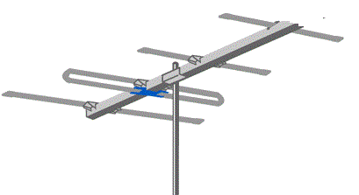
Antenna types
Dipole antenna
Horn antenna
Dish antenna
Yagi-Uda antenna

Slide 52
An antenna will radiate power in all directions but, typically, does not perform equally well in all directions
Radiation pattern: graphical representation of the radiation properties of an antenna as a function of space coordinates

Slide 53
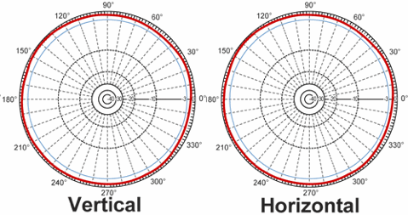
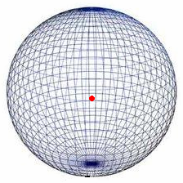
Isotropic antenna – omni directional antenna
    Ideal antenna
    Radiates equally in all direction around the antenna
    Radiation pattern for the isotropic antenna is a sphere with the antenna at the center
    Not realizable practically

Slide 54
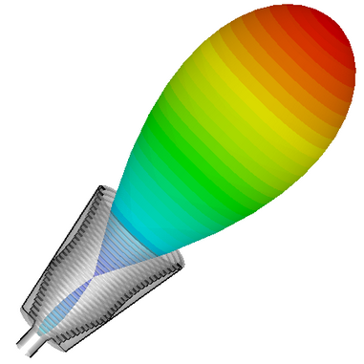
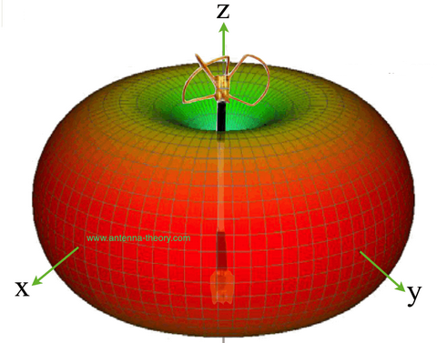
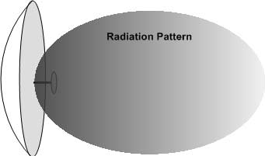
Practically realizable antennas are directional antennas
Dipole Horn Dish

Slide 55
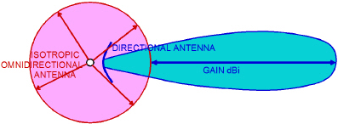

Slide 56
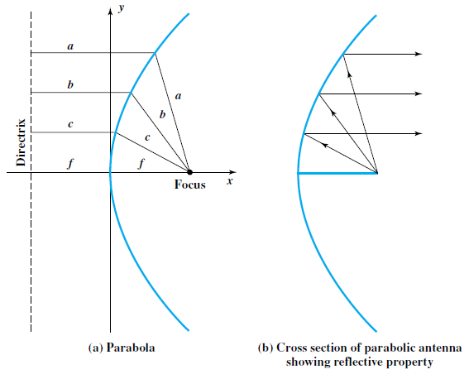
Parabolic reflective antenna
Used in terrestrial microwave and satellite applications

Slide 57
Antenna gain
Antenna gain is a measure of directionality of an antenna.
Antenna gain is defined as the power output, in a particular direction, compared to that produced in any direction by a perfect omnidirectional antenna (isotropic antenna).

Slide 58
For example, if an antenna has a gain of 3 dB, that antenna improves upon the isotropic antenna in that direction by 3 dB, or a factor of 2.
The increased power radiated in a given direction is at the expense of other directions.
    Increased power is radiated in one direction by reducing the power radiated in other directions.

Slide 59
Antenna gain does not refer to obtaining more output power than input power but rather to directionality.

Slide 60
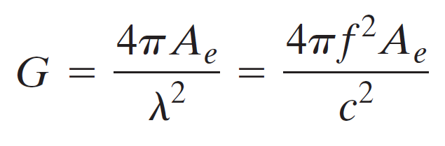
    G = antenna gain
    Ae = effective area
    c = speed of light (3 * 10⁸ m/s)
    f = carrier frequency
    λ = carrier wavelength

Slide 61
For a parabolic antenna
Ae = 0.56A
where A is the face area = πr²

Slide 62
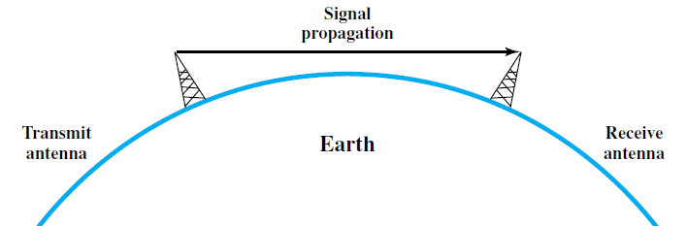
Terrestrial Microwave
Point to point microwave links with parabolic dish antennas
Line of sight transmission
To achieve long-distance transmission, a series of microwave relay towers is used

Slide 63
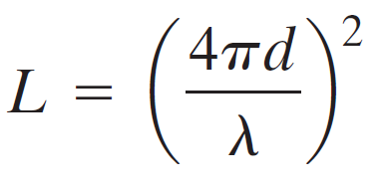
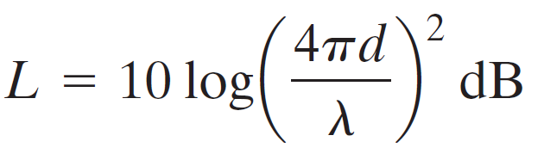
Transmission characteristics
Loss or attenuation –> path loss
d-distance between transmitter and receiver antenna

Slide 64
The higher microwave frequencies are less useful for long distance communication
    increased attenuation
    quite adequate for shorter distances
    antennas are smaller in size and cheaper

Slide 65
Applications
Long haul telecommunication service
Voice and TV transmission
Cellular communication
Short point-to-point links
    Transmitting CCTV data
    Data link between LANs

Slide 66
Satellite Microwave
Communication satellite – microwave relay station
Satellite receives transmissions on one frequency band (uplink), amplifies or repeats the signal, and transmits it on another frequency (downlink)
    Transponders

Slide 67
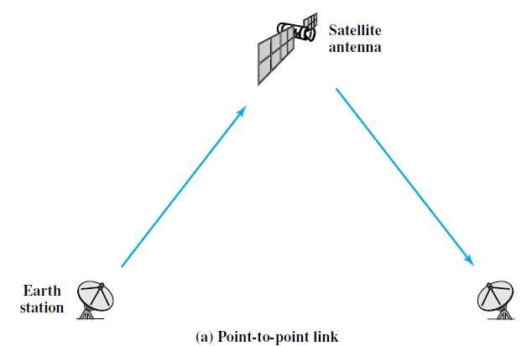

Slide 68
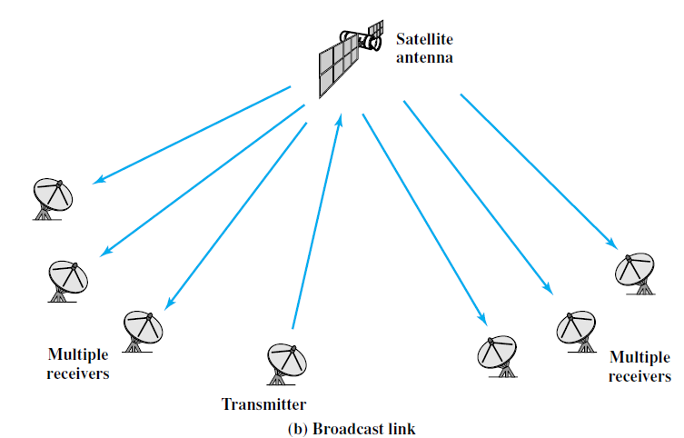

Slide 69
Transmission characteristics
Uplink: 5.925 to 6.425GHz, Downlink: 3.7 to 4.2 GHz
    This combination is referred to as the 4/6-GHz band
uplink: 14 to 14.5GHz, downlink: 11.7 to 12.2GHz
    12/14-GHz band
    Higher attenuation when compared with lower bands
    smaller and cheaper earth-station receivers
Avoid interference between uplink and downlink

Slide 70
Applications
Television distribution
Long-distance telephone transmission
Private business networks
Global positioning

Slide 71
Satellite communication properties
Because of the long distances involved, there is a considerable propagation delay
Introduces the complexity of error control
Broadcast transmission is possible

Slide 72
Broadcast radio
Broadcast radio - Omnidirectional
    Microwave - directional
Broadcast radio does not require dish-shaped antennas
Antennas need not be rigidly mounted to a precise alignment

Slide 73
Radio: general term used to encompass frequencies in the range of 3 kHz to 300 GHz
Broadcast radio: 30 MHz to 1 GHz
    This range covers FM radio and UHF and VHF television

Slide 74
Transmission impairments
Longer wavelength - radio waves suffer relatively less attenuation
Affected by multipath interference
    Reflection from land, water, and natural or human-made objects
    Creates multiple paths between antennas

Slide 75
Wireless Propagation
A signal radiated from antenna - 3 signal paths
    Ground wave
    Sky wave
    Line of Sight (LOS)

Slide 76
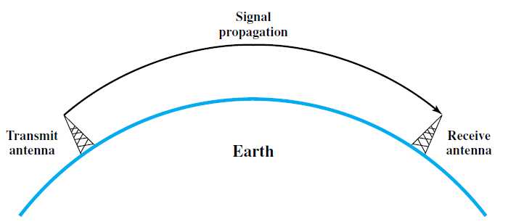
Ground wave propagation
More or less follows the contour of the earth
Can propagate considerable distances, well over the visual horizon
Up to about 2MHz
Eg. of ground wave communication - AM radio

Slide 77
Reasons for bending
Reason 1
  EM wave induces a current in the earth’s surface
  slows the wave front near the earth
  wave front to tilt downward and hence follow the earth’s curvature.

Slide 78
    Reason 2 – diffraction
      Behavior of EM waves in the presence of obstacles
      slight bending of waves as it passes around the edge of an object

Slide 79
Reason 3
  EM waves in this frequency range are scattered by the atmosphere
  do not penetrate the upper atmosphere

Slide 80
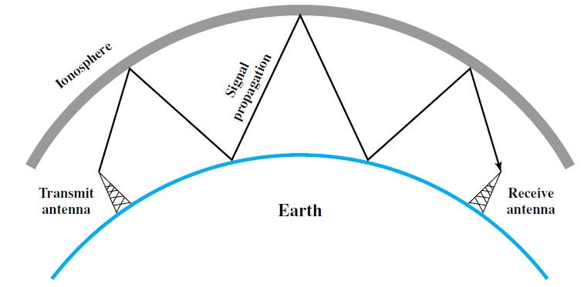
Sky wave Propagation
2MHz to 30MHz

Slide 81
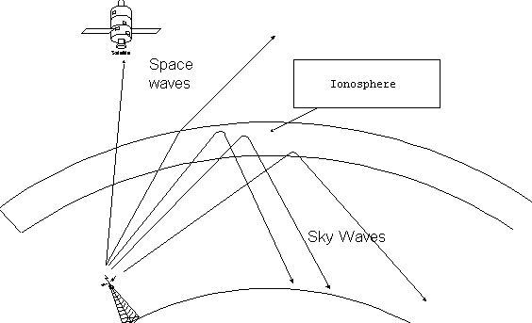
Ionosphere
    region of the upper atmosphere, from about 80 km to 1000 km in altitude
    Neutral air is ionized by solar photons and cosmic rays
Refracted by ionosphere

Slide 82
Line of Sight Propagation
Above 30 MHz
For satellite communication, a signal above 30 MHz is not reflected by the ionosphere and therefore a signal can be transmitted between an earth station and a satellite overhead

Slide 83
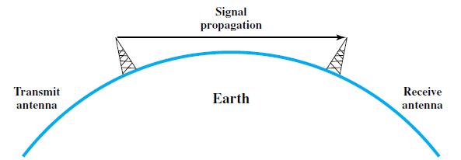
Ground-based communication - transmitting and receiving antennas must be within an effective line of sight of each other.
    microwaves are bent or refracted by the atmosphere
    will therefore propagate farther than the optical line of sight.

Slide 84
Refraction
When an EM wave moves from a medium of one density to a medium of another density, its speed changes
Moving from a less dense to a more dense medium, the wave will bend toward the more dense medium

Slide 85
Under normal propagation conditions, the refractive index of the atmosphere decreases with height
Hence radio waves travel more slowly near the ground than at higher altitudes
The result is a slight bending of the radio waves toward the earth

Slide 86


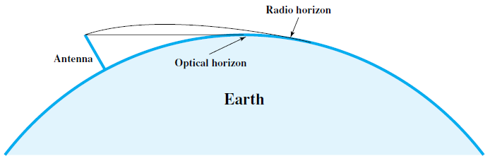
Optical and Radio line of sight
Optical LOS
Radio LOS
    d - distance between antenna and the horizon in kilometers
    h - antenna height in meters
    K - adjustment factor to account for the refraction (usually taken as 4/3

Slide 87

Maximum distance between two antennas for LOS propagation
kilometers

Slide 88




Free space loss (Isotropic antenna)

Slide 89

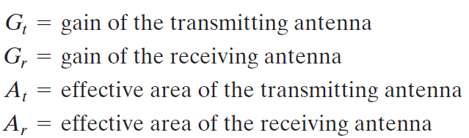
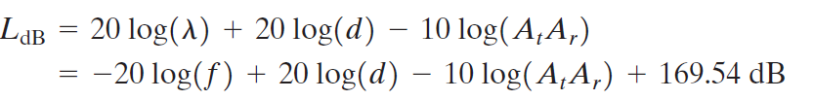
Free space loss (Non-isotropic antenna)

