Slide 1
Accessing I/O Devices

Slide 2
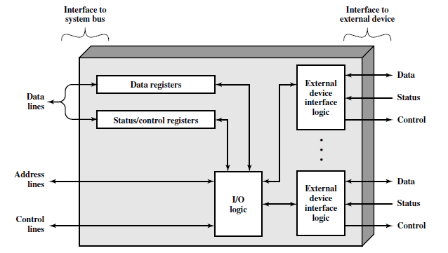
Block Diagram of an I/O Module

Slide 3
Accessing I/O devices
Processor
Memory
Bus
I/O de
vice 1
I/O de
vice
n
Multiple I/O devices may be connected to the processor and the memory via a bus.
Bus consists of three sets of lines to carry address, data and control signals.
Each I/O device is assigned an unique address.
To access an I/O device, the processor places the address on the address lines.
The device recognizes the address, and responds to the control signals.

Slide 4
Accessing I/O devices (contd..)
Address lines
Bus
Data lines
Control lines
Address
Control
Data and
I/O
decoder
circuits
status registers
int
erface
Input device
I/O device is connected to the bus using an I/O interface circuit which has:
- Address decoder, control circuit, and data and status registers.
Address decoder decodes the address placed on the address lines thus enabling the
device to recognize its address.
Data register holds the data being transferred to or from the processor.
Status register holds information necessary for the operation of the I/O device.
Data and status registers are connected to the data lines, and have unique addresses.
I/O interface circuit coordinates I/O transfers.

Slide 5
MEMORY-MAPPED I/O
Processors also use the memory interface to communicate with input/output (I/O) devices such as keyboards, monitors, and printers.
A processor accesses an I/O device using the address and data busses in the same way that it accesses memory.
A portion of the address space is dedicated to I/O devices rather than memory.
For example, suppose that addresses in the range 0xFFFF0000 to 0xFFFFFFFF are used for I/O, these addresses are in a reserved portion of the memory map.
Each I/O device is assigned one or more memory addresses in this range.
A store (instrn) to the specified address sends data to the device. A load (instrn) receives data from the device.
This method of communicating with I/O devices is called memory-mapped I/O.

Slide 6
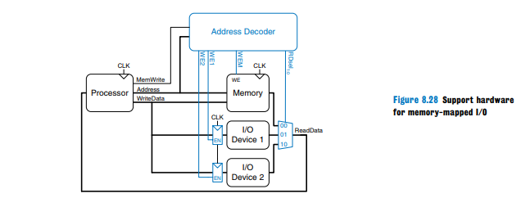

Slide 7
Programmed I/O
Most architectures use memory-mapped I/O,programs access I/O devices by reading and writing memory locations.
Eg. IA-32 uses programmed I/O, in which special IN and OUT instructions are used to read and write I/O devices.
Connecting a peripheral device to a programmed I/O system is similar to connecting it to a memory-mapped system.
When accessing an I/O port, the processor sends the port number rather than the memory address on the 16 least significant bits of the address bus.
The device reads or writes data from the data bus.
The major difference is that the processor also produces an signal. When is 1, the processor is accessing memory.
When it is 0, the process is accessing one of the I/O devices. The address decoder must also look at M/IO to generate the appropriate enables for main memory and for the I/O devices. I/O devices can also send interrupts to the processor to indicate that they are ready to communicate

Slide 8
Modes of data transfer
Three techniques are possible for I/O operations.
Program-controlled I/O
Interrupts driven I/O
Direct Memory Access.

Slide 9
In program-controlled I/O, when the processor continuously monitors the status of the device, it does not perform any useful tasks.
An alternate approach would be for the I/O device to alert the processor when it becomes ready.
  Do so by sending a hardware signal called an interrupt to the processor.
  At least one of the bus control lines, called an interrupt-request line is dedicated for this purpose.
Processor can perform other useful tasks while it is waiting for the device to be ready.

Slide 10
Interrupts (contd..)
Program 1
Interrupt Service routine
1
2
Interrupt
occurs
i
here
i
+
1
M
Processor is executing the instruction located at address i when an interrupt occurs.
Routine executed in response to an interrupt request is called the interrupt-service routine.
When an interrupt occurs, control must be transferred to the interrupt service routine.
But before transferring control, the current contents of the PC (i+1), must be saved in a known
location.
This will enable the return-from-interrupt instruction to resume execution at i+1.
Return address, or the contents of the PC are usually stored on the processor stack.

Slide 11
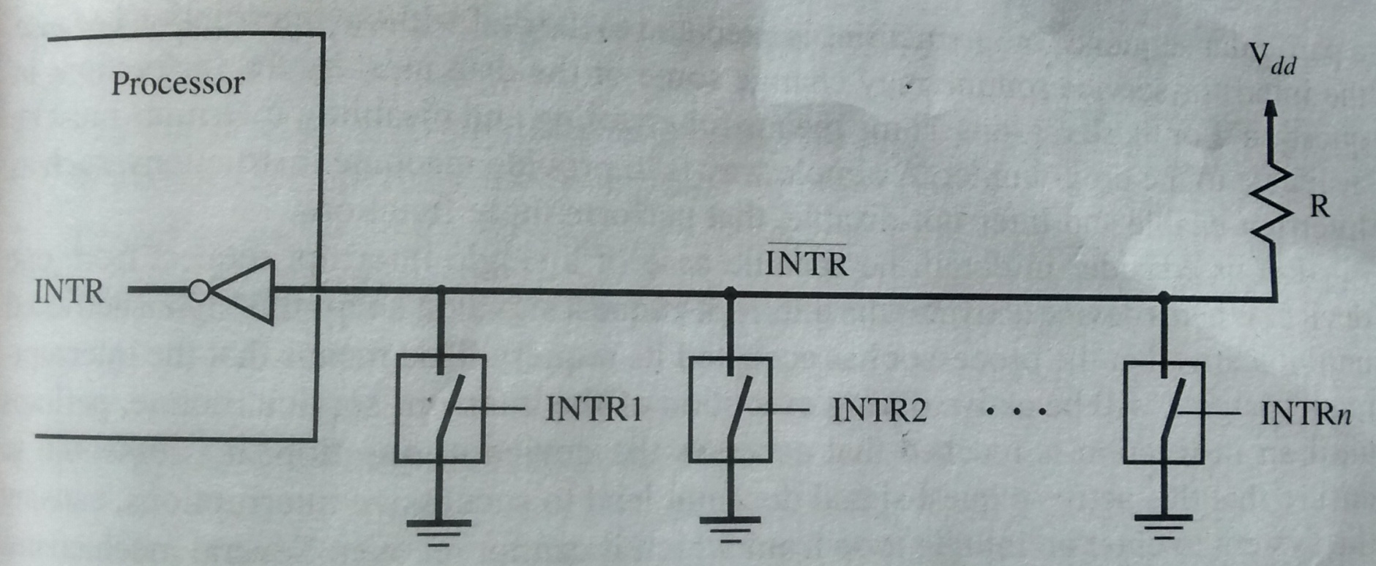
Interrupt hardware

Slide 12
Enabling and disabling interrupts
Three possibilities
First instrn of ISR to disable interrupt
With interrupt enable bit
Edge triggering

Slide 13
Simultaneous requests
Polling scheme:
If the processor uses a polling mechanism to poll the status registers of I/O devices
to determine which device is requesting an interrupt.
In this case the priority is determined by the order in which the devices are polled.
The first device with status bit set to 1 is the device whose interrupt request is
accepted.
Vectored interrupts: code is send to the processor
Daisy chain scheme:
I
N
T
R
Processor
Device 1
Device 2
Device
n
INTA

Slide 14
Direct Memory Access (contd..)
Direct Memory Access (DMA):
  A special control unit may be provided to transfer a block of data directly between an I/O device and the main memory, without continuous intervention by the processor.
Control unit which performs these transfers is a part of the I/O device’s interface circuit. This control unit is called as a DMA controller.
DMA controller performs functions that would be normally carried out by the processor:
  For each word, it provides the memory address and all the control signals.
  To transfer a block of data, it increments the memory addresses and keeps track of the number of transfers.
Notes:
This alternative approach is called as direct memory access. DMA consists of a special control unit which is provided to transfer a block of data directly between an I/O device and the main memory without continuous intervention by the processor.
A control unit which performs these transfers without the intervention of the processor is a part of the I/O device’s interface circuit, and this controller is called as the DMA controller.
DMA controller performs functions that would be normally be performed by the processor. The processor will have to provide a memory address and all the control signals. So, the DMA controller will also provide with the memory address where the data is going to be stored along with the necessary control signals. When a block of data needs to be transferred, the DMA controller will also have to increment the memory addresses and keep track of the number of words that have been transferred.

Slide 15
Direct Memory Access (contd..)
DMA controller can transfer a block of data from an external device to the processor, without any intervention from the processor.
  However, the operation of the DMA controller must be under the control of a program executed by the processor. That is, the processor must initiate the DMA transfer.
To initiate the DMA transfer, the processor informs the DMA controller of:
  Starting address,
  Number of words in the block.
  Direction of transfer (I/O device to the memory, or memory to the I/O device).
Once the DMA controller completes the DMA transfer, it informs the processor by raising an interrupt signal.
Notes:
Repeat DMA controller.
DMA controller can be used to transfer a block of data from an external device to the processor, without requiring any help from the processor. As a result the processor is free to execute other programs. However, the DMA controller should perform the task of transferring data to or from an I/O device for a program that is being executed by a processor. That is, the DMA controller does not and should not have the capability to determine when a data transfer operation should take place. The processor must initiate DMA transfer of data, when it is indicated or required by the program that is being executed by the processor.
When the processor determines that the program that is being executed requires a DMA transfer, it informs the DMA controller which sits in the interface circuit of the device of three things, namely, the starting address of the memory location, the number of words that needs to be transferred, and the direction of transfer that is, whether the data needs to be transferred from the I/O device to the memory or from the memory to the I/O device.
After initiating the DMA transfer, the processor suspends the program that initiated the transfer, and continues with the execution of some other program. The program whose execution is suspended is said to be in the blocked state.

Slide 16
Direct Memory Access
Main
Processor
memory
System bus
Disk/DMA
DMA
Printer
Keyboard
controller
controller
Disk
Disk
Network
Interface
Notes:
Let us consider a memory organization with two DMA controllers. In this memory organization, a DMA controller is used to connect a high speed network to the computer bus. In addition, disk controller which also controls two disks may have DMA capability. The disk controller controls two disks and it also has DMA capability. The disk controller provides two DMA channels. The disk controller can two independent DMA operations, as if each disk has its own DMA controller. Each DMA controller has three registers, one to store the memory address, one to store the word count, and the last to store the status and control information. There are two copies of these three registers in order to perform independent DMA operations. That is, these registers are duplicated.

Slide 17
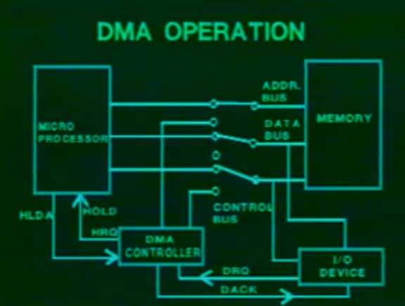

Slide 18
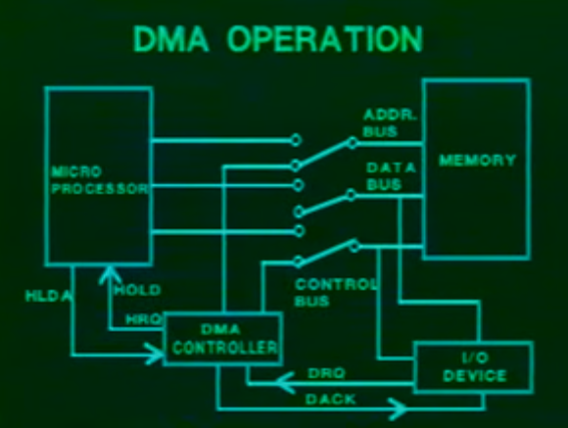

Slide 19
Direct Memory Access (contd..)
Processor and DMA controllers have to use the bus in an interwoven fashion to access the memory.
  DMA devices are given higher priority than the processor to access the bus.
  Among different DMA devices, high priority is given to high-speed peripherals such as a disk or a graphics display device.
An alternate approach is the provide a DMA controller an exclusive capability to initiate transfers on the bus, and hence exclusive access to the main memory. This is known as the block or burst mode.
Notes:
Processor also has to transfer data to and from the main memory. Also, the DMA controller is responsible for transferring data to and from the I/O device to the main memory. Both the processor and the DMA controller have to use the external bus to talk to the main memory. Usually, DMA controllers are given higher priority than the processor to access the bus. Now, we also need to decide the priority among different DMA devices that may need to use the bus. Among these different DMA devices, high priority is given to high speed peripherals such as a disk or a graphics display device.
Usually, the processor originates most cycles on the bus. The DMA controller can be said to steal memory access cycles on from the bus. Thus, the processor and the DMA controller use the bus in an interwoven fashion. This interweaving technique is called as cycle stealing.
An alternate approach would be to provide DMA controllers exclusive capability to initiate transfers on the bus, and hence exclusive access to the main memory. This is known as the block mode or the burst mode of operation.

Slide 20
Bus arbitration
Processor and DMA controllers both need to initiate data transfers on the bus and access main memory.
The device that is allowed to initiate transfers on the bus at any given time is called the bus master.
When the current bus master relinquishes its status as the bus master, another device can acquire this status.
  The process by which the next device to become the bus master is selected and bus mastership is transferred to it is called bus arbitration.
Centralized arbitration:
  A single bus arbiter performs the arbitration.
Distributed arbitration:
  All devices participate in the selection of the next bus master.
Notes:
Processor and DMA controllers both need to initiate data transfers on the bus and access main memory. The process of using the bus to perform a data transfer operation is called as the initiation of a transfer operation. At any point in time only one device is allowed to initiate transfers on the bus. The device that is allowed to initiate transfers on the bus at any given time is called the bus master. When the current bus master releases control of the bus, another device can acquire the status of the bus master. How does one determine which is the next device which will acquire the status of the bus master. Note that there may be several DMA controllers plus the processor which requires access to the bus. The process by which the next device to become the bus master is selected and bus mastership is transferred to it is called bus arbitration. There are two types of bus arbitration processes. Centralized arbitration and distributed arbitration. In case of centralized arbitration, a single bus arbiter performs the arbitration. Whereas in case of distributed arbitration all devices which need to initiate data transfers on the bus participate or are involved in the selection of the next bus master.

Slide 21
Centralized Bus Arbitration
B
B
S
Y
B
R
Processor
DMA
DMA
controller
controller
BG1
1
BG2
2

Slide 22
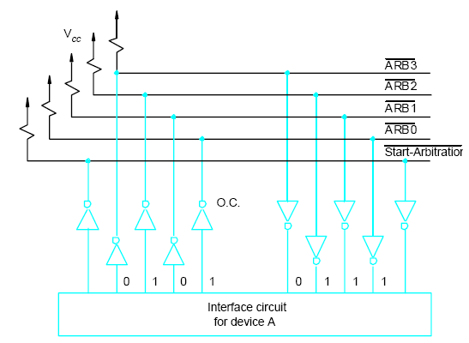
Distributed arbitration

Slide 23
Memory Hierarchy
Pr
ocessor
Re
gisters
Increasing
Increasing
Increasing
size
speed
cost per bit
Primary
L1
cache
Secondary
L2
cache
Main
memory
Magnetic disk
secondary
memory

Slide 24
Computer memory is organized into a hierarchy
At the highest level (closest to the processor) are the processor registers. Next comes one or more levels of cache, When multiple levels are used, they are denoted L1, L2, and so on.
Next comes main memory, which is usually made out of dynamic random-access memory (DRAM).
All of these are considered internal to the computer system.
Next level typically being a fixed hard disk, and one or more levels below that consisting of removable media such as optical disks and tape
Fastest access is to the data held in processor registers.
As one goes down the memory hierarchy, one finds decreasing cost/bit, increasing capacity, and slower access time.

Slide 25
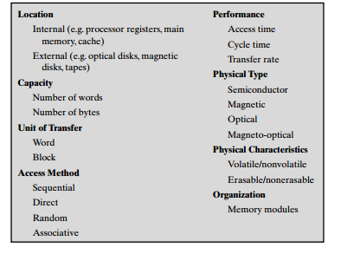
characteristics of memory system

Slide 26
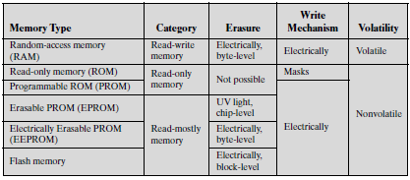

Slide 27
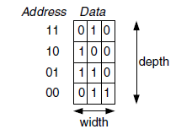
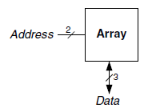

Slide 28
Memory cells:SRAM Cell
b
′
b
T
T
1
X
Y
2
Word line
Bit lines

Slide 29
SRAM WITH CMOS cell

Slide 30
DRAM cell

Slide 31
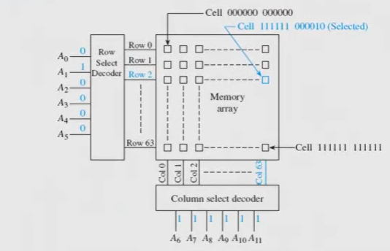
Memory cell

Slide 32
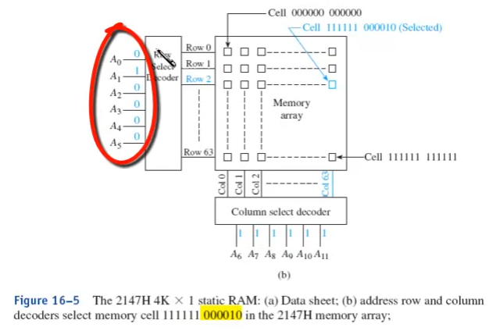

Slide 33
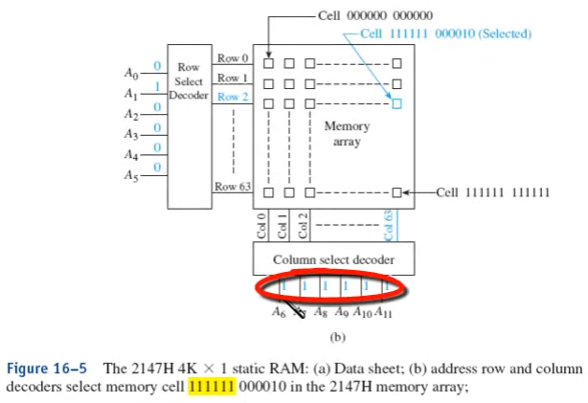

Slide 34
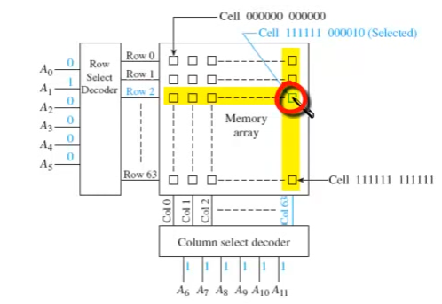

Slide 35
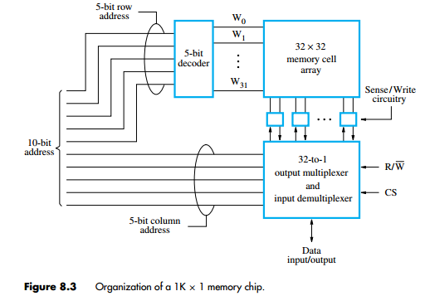

Slide 36
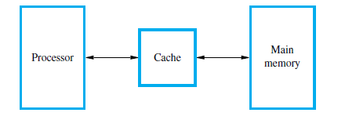
Cache Memories

Slide 37
locality of reference.
Temporal:
means that a recently executed instruction is likely to be executed again very soon.
Temporal locality suggests that whenever an information item, instruction or data, is first needed, this item should be brought into the cache, because it is likely to be needed again soon.
spatial :
means that instructions close to a recently executed instruction are also likely to be executed soon.
Spatial locality suggests that instead of fetching just one item from the main memory to the cache, it is useful to fetch several items that are located at adjacent addresses as well.

Slide 38
Cache hit
Cache miss
Write operation, the system can proceed in one of two ways.
Write through
Write back or copy back
A Read operation for a word that is not in the cache constitutes a Read miss.
load-through, or early restart, reduces the processor’s waiting time somewhat, at the expense of more complex circuitry.
Group of words is called a cache block.
The relationship between the address of data in main memory and the location of that data in the cache is called the mapping.
Notes:
The second technique is to update only the cache location and to mark the block containing it with an associated flag bit, often
called the dirty or modified bit. The main memory location of the word is updated later, when the block containing this marked word is removed from the cache to make room for a new block. This technique is known as the write-back, or copy-back, protocol.
The write-back protocol is used most often, to take advantage of the high speed with which data blocks can be
transferred to memory chips.

Slide 39
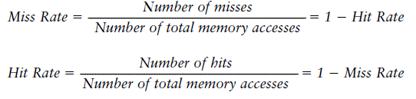
MEMORY SYSTEM PERFORMANCE ANALYSIS
quantitative ways to measure the performance of memory systems to evaluate the cost-benefit trade-offs of various alternatives.
Memory system performance metrics are miss rate or hit rate and average memory access time. Miss and hit rates are calculated as:

Slide 40
Average memory access time (AMAT) is the average time a processor must wait for memory per load or store instruction.
Thus, AMAT is calculated as:
AMAT = t_{cache} + MR_{cache} (t_{MM} + MR_{MM}t_{VM})
where tcache, tMM, and tVM are the access times of the cache, main memory, and virtual memory, and MRcache and MRMM are the cache and main memory miss rates, respectively.

Slide 41
Group of words is called a cache block.
The number of words in the cache block, b, is called the block size.
A cache of capacity C contains B = C/b blocks. A cache is organized into S sets, each of which holds one or more blocks of data.
The relationship between the address of data in main memory and the location of that data in the cache is called the mapping.
Each memory address maps to exactly one set in the cache.
Some of the address bits are used to determine which cache set contains the data.
If the set contains more than one block, the data may be kept in any of the blocks in the set.

Slide 42
Mapping Functions
Direct Mapping
A direct mapped cache has one block in each set, so it is organized into S = B sets.
An address in block 0 of main memory maps to set 0 of the cache
Because many addresses map to a single set, the cache must alsokeep track of the address of the data actually contained in each set.
The least significant bits of the address specify which set holds the data. The remaining most significant bits are called the tag and indicate which of the many possible addresses is held in that set.

Slide 43
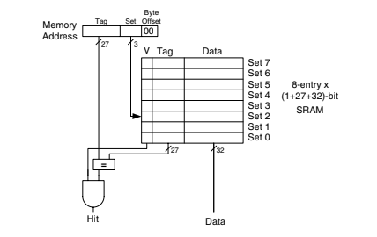

Slide 44
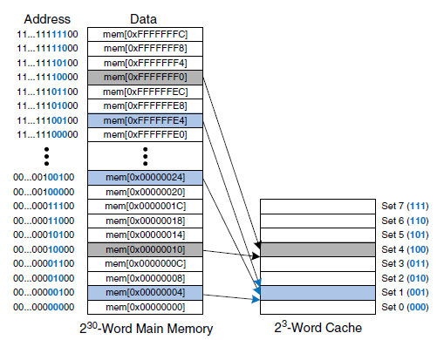
Mapping of main memory to a direct mapped cache

Slide 45

Cache fields for address 0xFFFFFFE4 when mapping to the cache
The two least significant bits of the 32-bit address are called the byte offset, because they indicate the byte within the word.
The next three bits are called the set bits, because they indicate the set to which the address maps. (In general, the number of set bits is log2S.)
The remaining 27 tag bits indicate the memory address of the data stored in a given cache set.

Slide 46
Disadvantage
Direct mapped caches have only one block in each set, so two addresses that map to the same set always cause a conflict.

Slide 47
Associative Mapping
The most flexible mapping method , main memory block can be placed into any cache block position.
Tag bits are required to identify a memory block when it is resident in the cache.
The tag bits of an address received from the processor are compared to the tag bits of each block of the cache to see if the desired block is present.
This is called the associative-mapping technique.
It gives complete freedom in choosing the cache location in which to place the memory block, resulting in a more efficient use of the space in the cache.

Slide 48
When a new block is brought into the cache, it replaces (ejects) an existing block only if the cache is full.
In this case, we need an algorithm to select the block to be replaced.
The complexity of an associative cache is higher than that of a direct-mapped cache , because of the need to search all tag patterns to determine whether a given block is in the cache.
To avoid a long delay, the tags must be searched in parallel.
A search of this kind is called an associative search.

Slide 49
Set-Associative Mapping
Another approach is to use a combination of the direct- and associative-mapping techniques.
The blocks of the cache are grouped into sets, and the mapping allows a block of the main memory to reside in any block of a specific set

Slide 50
Multi-way Set Associative Cache
An N-way set associative cache reduces conflicts by providing N blocks in each set where data mapping to that set might be found.
Each memory address still maps to a specific set, but it can map to any one of the N blocks in the set.
Hence, a direct mapped cache is another name for a one-way set associative cache. N is also called the degree of associativity of the cache.

Slide 51
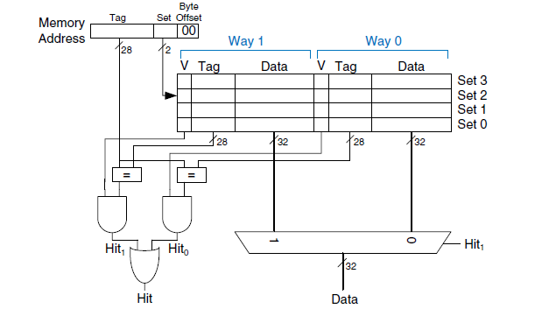
Two-way set associative cache

Slide 52
Set associative caches generally have lower miss rates than direct mapped caches of the same capacity, because they have fewer conflicts.
However, set associative caches are usually slower and somewhat more expensive to build because of the output multiplexer and additional comparators. They also raise the question of which way to replace when both ways are full

Slide 53

Fully associative
A fully associative cache contains a single set with B ways, where B is the number of blocks. A memory address can map to a block in any of these ways. A fully associative cache is another name for a B-way set these ways. A fully associative cache is another name for a B-way set associative cache with one set.

Slide 54
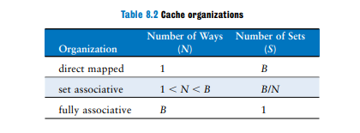

Slide 55
Replacement algorithm
(LRU)- least recently used algorithm
FIFO
Random

Slide 56
Replacement Algorithms
In associative and set-associative caches there exists some flexibility. When a new block is to be brought into the cache and all the positions that it may occupy are full, the cache controller must decide which of the old blocks to overwrite.
This is an important issue, because the decision can be a strong determining factor in system performance.
There is a high probability that the blocks that have been referenced recently will be referenced again soon.
Therefore, when a block is to be overwritten, it is sensible to overwrite the one that has gone the longest time without being referenced.
This block is called the least recently used (LRU) block, and the technique is called the LRU replacement algorithm.

Slide 57
Performance of the LRU algorithm can be improved by introducing a small amount of randomness in deciding which block to replace.
Suppose it is required to track the LRU block of a four-block set a set-associative cache. A 2-bit counter can be used for each block.
When a hit occurs , the counter of the block that is referenced is set to 0. Counters with values originally lower than the referenced one are incremented by one, and all others remain unchanged.
When a miss occurs and the set is not full, the counter associated with the new block loaded from the main memory is set to 0, and the values of all other counters are increased by one.
When a miss occurs and the set is full, the block with the counter value 3 is removed, the new block is put in its place, and its counter is set to 0.
The other three block counters are incremented by one. It can be easily verified that the counter values of occupied blocks are always distinct.

Slide 58
Virtual memory

Slide 59
Virtual memory organization
Processor
Virtual address
Data
MMU
Physical address
Cache
Data
Physical address
Main memory
DMA transfer
Disk storage

Slide 60
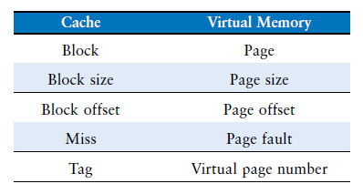

Slide 61
Information about the main memory location of each page is kept in a page table.
An area in the main memory that can hold one page is called a page frame.
The starting address of the page table is kept in a page table base register.

Slide 62
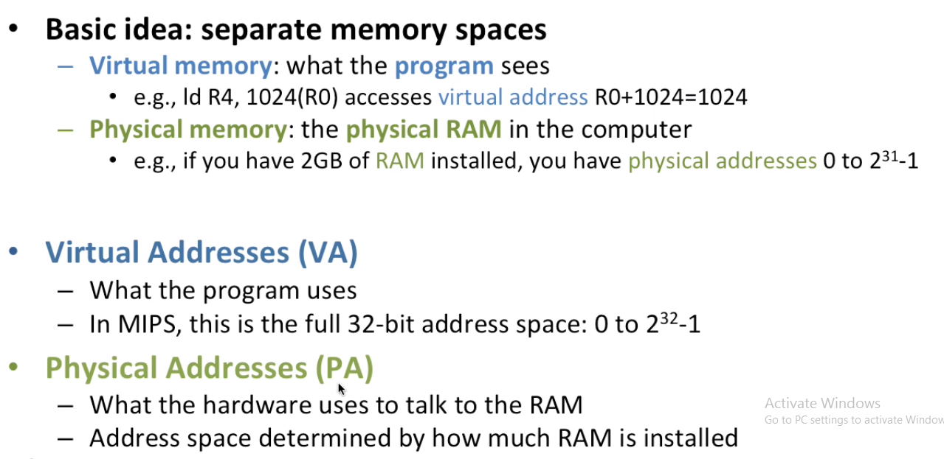

Slide 63
Address translation (contd..)
PTBR holds
the starting address of
the page table.
Virtual address from processor
Page table base register
Page table address
Virtual page number
Offset
Virtual address is
interpreted as page
number and offset.
+
PTBR + virtual
page number provide
the entry of the page
in the page table.
PAGE TABLE
This entry has the starting location
of the page.
Page table holds information
about each page..
Control
Page frame
bits
in memory
Page frame
Offset
Physical address in main memory

Slide 64
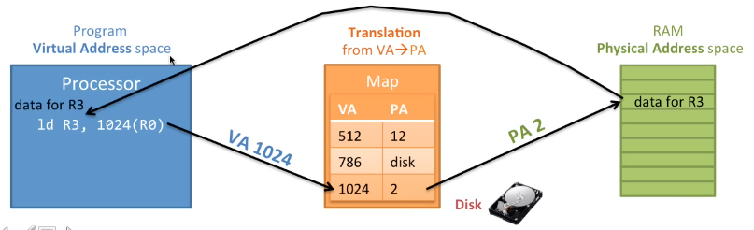

Slide 65
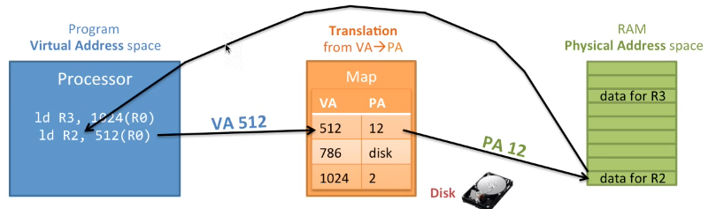

Slide 66
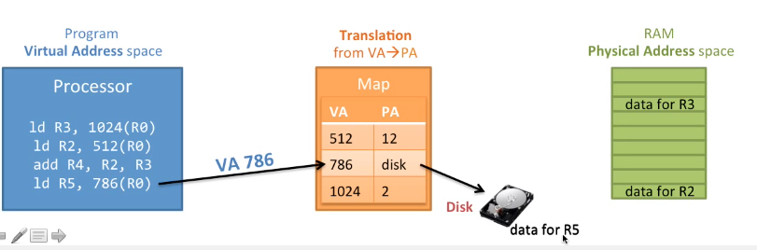

Slide 67
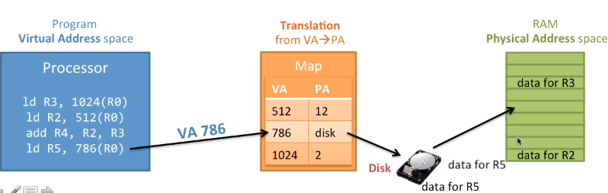

Slide 68
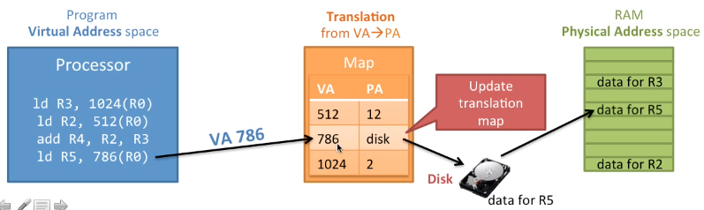

Slide 69
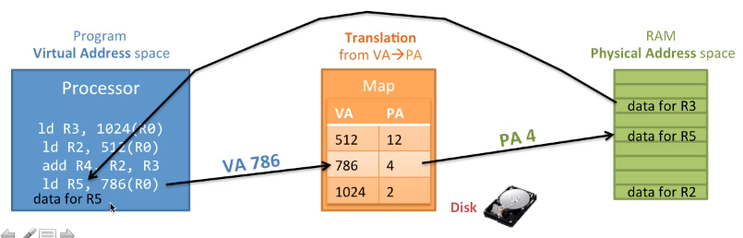

Slide 70

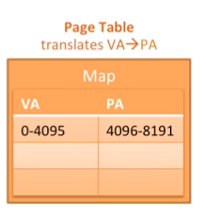

Slide 71
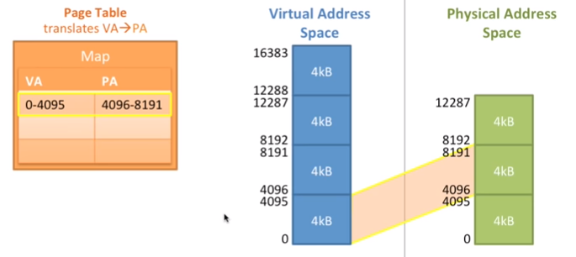

Slide 72
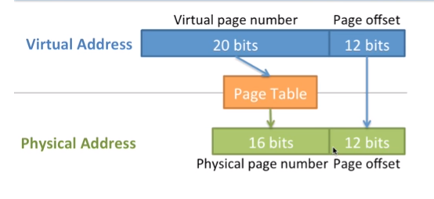

Slide 73
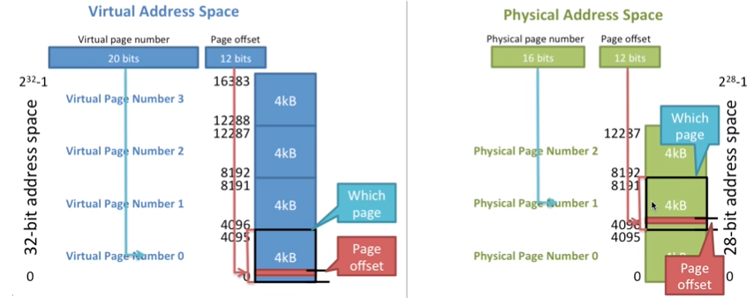

Slide 74
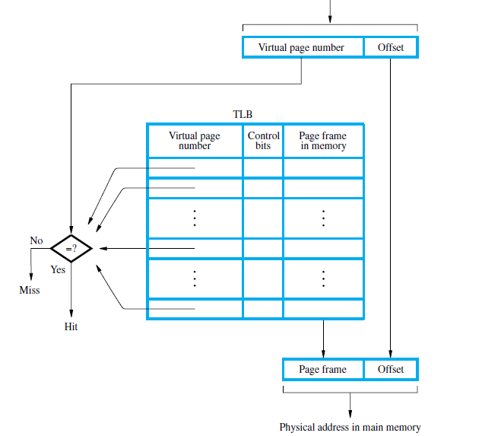
Use of an associative-mapped TLB.
Virtual address from processor

Slide 75
Replacement algorithm for virtual memory

