Slide 1
MIPS

Slide 2
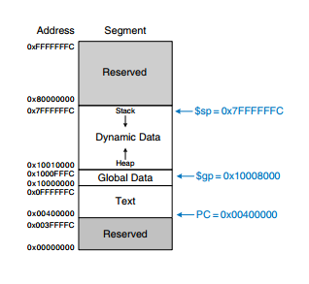
Memory map of MIPS

Slide 3
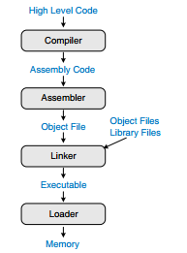
Steps for translating and starting a program

Slide 4
Steps for translating and starting a program
Step 1: Compilation
A compiler translates high-level code into assembly language.
The .data and .text keywords are assembler directives that indicate where the data and text segments begin
Their storage location will be determined by assembler.

Slide 5
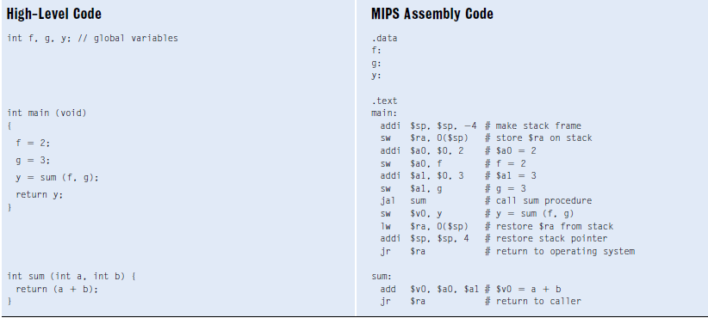

Slide 6
Step 2: Assembling
The assembler turns the assembly language code into an object file containing machine language code.
The assembler makes two passes
On the first pass, the assembler assigns instruction addresses and finds all the symbols, such as labels and global variable names.
The names and address of the symbols are kept in a symbol table
The symbol address are filled after the first pass, when the address of the labels are known.
The code after the first assembler pass is shown here.

Slide 7
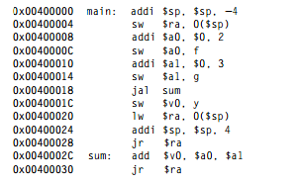

Slide 8
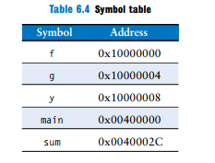
The names and addresses of the symbols are kept in a symbol table,
The symbol addresses are filled
in after the first pass, when the addresses of labels are known.

Slide 9
global variables are assigned storage locations in the global data segment of memory, starting at memory address 0x10000000.
On the second pass through the code, the assembler produces the machine language code.
Addresses for the global variables and labels are taken from the symbol table.
The machine language code and symbol table are stored in the object file.

Slide 10
Step 3: Linking
The job of the linker is to combine all of the object files into one machine language file called the executable.
The linker relocates the data and instructions in the object files so that they are not all on top of each other.
It uses the information in the symbol tables to adjust the addresses of global variables and of labels that are relocated.

Slide 11
Figure below shows the executable file.
It has three sections:
the executable file header,
the text segment, and
the data segment.
The executable file header reports the text size (code size) and data size (amount of globally declared data).
Both are given in units of bytes.
The text segment gives the instructions and the addresses where they are to be stored.

Slide 12
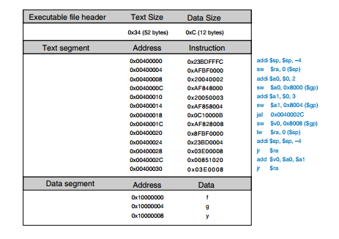

Slide 13
The data segment gives the address of each global variable.
The global variables are addressed with respect to the base address given by the global pointer, $gp. For example,

Slide 14
sw $a0, 0x8000($gp),
stores the value 2 to the global variable f, which is located at memory address 0x10000000.
offset, 0x8000, is a 16-bit signed number that is sign-extended and added to the base address, $gp.
So, $gp + 0x8000 = 0x10008000 + 0xFFFF8000 = 0x10000000, the memory address of variable f.

Slide 15
Step 4: Loading
The operating system loads a program by reading the text segment of the executable file from a storage device (usually the hard disk) into the text segment of memory.
The operating system sets $gp to 0x10008000 (the middle of the global data segment) and $sp to 0x7FFFFFFC (the top of the dynamic data segment), then performs a jal 0x00400000 to jump to the beginning of the program.
Figure shows the memory map at the beginning of program execution.

Slide 16
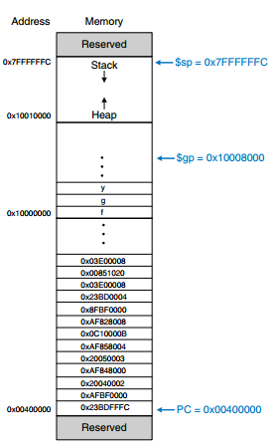
Executable loaded in memory

Slide 17
Pseudoinstructions
MIPS defines pseudoinstructions that are not actually part of the instruction set but are commonly used by programmers and compilers.
When converted to machine code, pseudoinstructions are translated into one or more MIPS instructions.
Eg: the load immediate pseudoinstruction (li) loads a 32-bit constant using a combination of lui and ori instructions.
The no operation pseudoinstruction performs no operation.
No other registers or memory values are altered. The machine code for the nop instruction is 0x00000000.

Slide 18
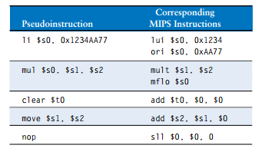

Table shows a list of some Pseudoinstructions

Slide 19
Exceptions
Exceptions may be caused by hardware or software
Eg: hardware (asynchronous exception)
The processor may stop what it is doing, when an unwanted key is pressed. Such a hardware exception triggered by an input/output (I/O) device such as a keyboard is often called an interrupt.
Eg: software(synchronous exception)
The program may encounter an error condition such as an undefined instruction which may choose to terminate the offending program. Software exceptions are sometimes called traps

Slide 20
Steps involved
The processor records the cause of an exception and the value of the PC at the time the exception occurs.
It then jumps to the exception handler procedure.
The exception handler is code (usually in the OS) that examines the cause of the exception and responds appropriately .
It then returns to the program that was executing before the exception took place.
In MIPS, the exception handler is always located at 0x80000180. When an exception occurs, the processor always jumps to this instruction address, regardless of the cause.
The MIPS architecture uses a special-purpose register, called the Cause register, to record the cause of the exception. Different codes are used to record different exception causes,

Slide 21
Eg:
0x40000004
0x80000180
Exception program counter
Different codes are used to record different exception causes
exception
Exception handler
Cause register
0x40000008

Slide 22
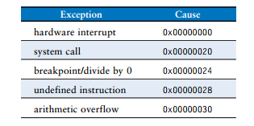
Exception cause codes

Slide 23
The exception handler code reads the Cause register to determine how to handle the exception.
Some other architectures jump to a different exception handler for each different cause instead of using a Cause register.
MIPS uses another special-purpose register called the Exception Program Counter (EPC) to store the value of the PC at the time an exception.
The processor returns to the address in EPC after handling the exception.
The EPC and Cause registers are not part of the MIPS register file.
The mfc0 (move from coprocessor 0) instruction copies these and other special-purpose registers into one of the general purpose registers.

Slide 24
The exception handler saves registers on the stack, then uses mfc0 to look at the cause and respond accordingly.
When the handler is finished, it restores the registers from the stack, copies the return address from EPC to $k0 using mfc0, and returns using jr $k0.
$k0 and $k1 are included in the MIPS register set. They are reserved by the OS for exception handling. They do not need to be saved and restored during exceptions

Slide 25
Signed and Unsigned Instructions
The MIPS architecture uses two’s complement representation of signed numbers.
MIPS has certain instructions that come in signed and unsigned flavors, including addition and subtraction, multiplication and division, set less than, and partial word loads.
Addition and Subtraction
Addition and subtraction are performed identically whether the number is signed or unsigned.
However, the interpretation of the results is different.

Slide 26
adding the following two huge positive numbers gives a negative numbers
This is called arithmetic overflow.
The MIPS processor takes an exception on arithmetic overflow.
The program can decide what to do about the overflow (for example, it might repeat the calculation with greater precision to avoid the overflow), then return to where it left off.
MIPS provides signed and unsigned versions of addition and subtraction.
The signed versions are add, addi, and sub.
The unsigned versions are addu, addiu, and subu.
The two versions are identical except that signed versions trigger an exception on overflow, whereas unsigned versions do not.

Slide 27
Multiplication and Division
Multiplication and division behave differently for signed and unsigned numbers.
multiplication and division come in both signed and unsigned flavors. mult and div treat the operands as signed numbers.
multu and divu treat the operands as unsigned numbers.
Set Less Than
Set less than instructions can compare either two registers (slt) or a register and an immediate (slti).
Set less than also comes in signed (slt and slti) and unsigned (sltu and sltiu) versions

Slide 28
Eg:
In a signed comparison, 0x80000000 is less than any other number, because it is the most negative two’s complement number.
In an unsigned comparison, 0x80000000 is greater than 0x7FFFFFFF but less than 0x80000001, because all numbers are positive
Loads
byte loads come in signed (lb) and unsigned (lbu) versions.
lb sign-extends the byte, and lbu zero-extends the byte to fill the entire 32-bit register
MIPS provides signed and unsigned half-word loads (lh and lhu), which load two bytes into the lower half and sign- or zero-extend the upper half of the word.

Slide 29
Floating-Point Instructions
The MIPS architecture defines an optional floating-point coprocessor, known as coprocessor 1
In most recent MIPS implementations, the floating-point coprocessor is built in alongside the main processor.
Floating point instructions cannot use general purpose registers.
Only floating point instructions may be used with the floating point registers.
MIPS defines 32 , 32-bit floating-point registers, $f0–$f31
MIPS supports both single- and double-precision IEEE floating point arithmetic.
Doubleprecision (64-bit) numbers are stored in pairs of 32-bit registers, so only the 16 even-numbered registers ($f0, $f2, $f4, . . . , $f30) are used to specify double-precision operations.

Slide 30
Floating-point instructions all have an opcode of 17 (100012). They require both a funct field and a cop (coprocessor) field to indicate the type of instruction.
MIPS defines the F-type instruction format for floating-point instructions.
Floating-point instructions come in both single- and double-precision flavors.
cop 16 (100002) for single-precision instructions
17 (100012) for doubleprecision instructions.
Like R-type instructions, F-type instructions have two source operands, fs and ft, and one destination, fd.

Slide 31
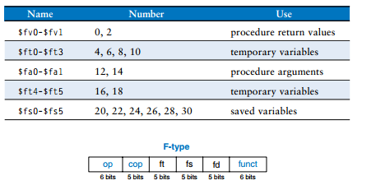
MIPS floating-point register set
F-type machine instruction format

Slide 32
Instruction precision is indicated by .s and .d in the mnemonic.
Floating-point arithmetic instructions include addition (add.s, add.d), subtraction (sub.s, sub.d), multiplication (mul.s, mul.d)etc.
Floating-point registers are loaded and stored from memory using lwc1 and swc1.

Slide 33
Microarchitecture
Microarchitecture is the specific arrangement of registers, ALUs, finite state machines (FSMs), memories, and other logic building blocks needed to implement an architecture.
A particular architecture, such as MIPS, may have many different microarchitectures, each with different trade-offs of performance, cost, and complexity.
They all run the same programs, but their internal designs vary widely.

Slide 34
Architectural State and Instruction Set
computer architecture is defined by its instruction set and architectural state.
The architectural state for the MIPS processor consists of
the program counter and
the 32 registers.
Any MIPS microarchitecture must contain all of this state.
To keep the microarchitectures easy to understand, we consider only a subset of the MIPS instruction set.

Slide 35
Design Process
microarchitectures can be divided into two interacting parts:
the datapath and the control.
The datapath operates on words of data.
It contains structures such as memories, registers, ALUs, and multiplexers.
MIPS is a 32-bit architecture, so we will use a 32-bit datapath.
The control unit receives the current instruction from the datapath and tells the datapath how to execute that instruction.
Specifically, the control unit produces multiplexer select, register enable, and memory write signals to control the operation of the datapath.

Slide 36
A good way to design a complex system is to start with hardware containing the state elements.
These elements include
the memories and
the architectural state (the program counter and registers).

Slide 37
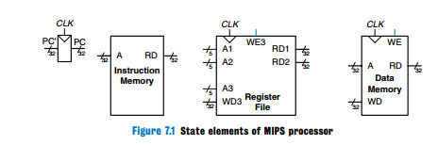

Slide 38
Heavy lines are used to indicate 32-bit data busses.
Medium lines are used to indicate narrower busses, such as the 5-bit address busses on the register file.
Narrow blue lines are used to indicate control signals, such as the register file write enable.
PC
The program counter is an ordinary 32-bit register.
Its output, PC, points to the current instruction. Its input, PC’ indicates the address of the next instruction.

Slide 39
The instruction memory has a single read port.
It takes a 32-bit instruction address input, A, and reads the 32-bit data (i.e., instruction) from that address onto the read data output, RD.
The 32-bit register file has two read ports and one write port.
The read ports take 5-bit address inputs, A1 and A2, each specifying one of the 32 registers as source operands.
They read the 32-bit register values onto read data outputs RD1 and RD2, respectively.
The write port takes a 5-bit address input, A3; a 32-bit write data input, WD; a write enable input, WE3; and a clock.
If the write enable is 1, the register file writes the data into the specified register on the rising edge of the clock

Slide 40
The data memory has a single read/write port. If the write enable, WE, is 1, it writes data WD into address A on the rising edge of the clock.
If the write enable is 0, it reads address A onto RD. The instruction memory, register file, and data memory are all read combinationally.
In other words, if the address changes, the new data appears at RD after some propagation delay; no clock is involved.
They are written only on the rising edge of the clock.
There can be 3 microarchitectures for the MIPS processor architecture: single-cycle,
multicycle, and
pipelined.
They differ in the way that the state elements are connected together and in the amount of nonarchitectural state

Slide 41
single-cycle microarchitecture executes an entire instruction in one cycle.
It is easy to explain and has a simple control unit.
Because it completes the operation in one cycle, it does not require any nonarchitectural state.
The cycle time is limited by the slowest instruction.
The multicycle microarchitecture executes instructions in a series of shorter cycles.
Simpler instructions execute in fewer cycles than complicated ones.
The multicycle microarchitecture reduces the hardware cost by reusing expensive hardware blocks such as adders and memories.

Slide 42
The pipelined microarchitecture applies pipelining to the single-cycle microarchitecture.
It therefore can execute several instructions simultaneously, improving the throughput significantly.
Pipelining must add logic to handle dependencies between simultaneously executing instructions.
It also requires nonarchitectural pipeline registers.
The added logic and registers are worthwhile; all commercial high-performance processors use pipelining today.

Slide 43
SINGLE-CYCLE PROCESSOR
MIPS microarchitecture that executes instructions in a single cycle.
The program counter (PC) register contains the address of the instruction to execute.
The first step is to read this instruction from instruction memory.
The PC is simply connected to the address input of the instruction memory.
The instruction memory reads out, or fetches, the 32-bit instruction, labeled Instr.

Slide 44
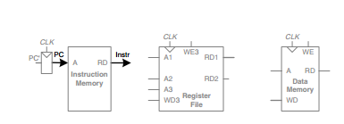
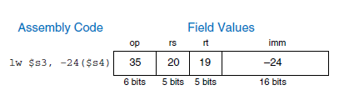
Fetch instruction from memory
consider the datapath connections for the lw instruction
Eg:

Slide 45
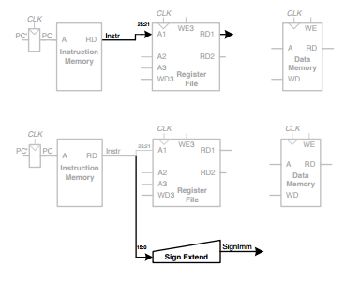
Read source operand from register file
Sign-extend the immediate

Slide 46
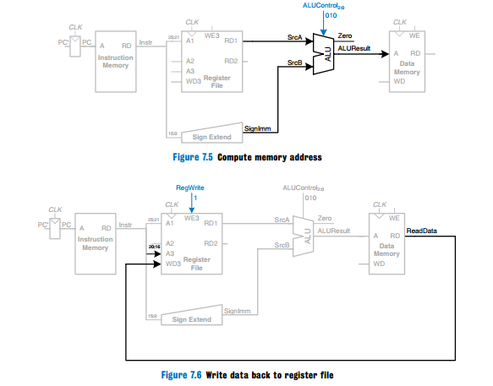

Slide 47
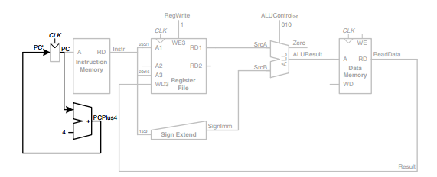
Determine address of next instruction for PC

Slide 48
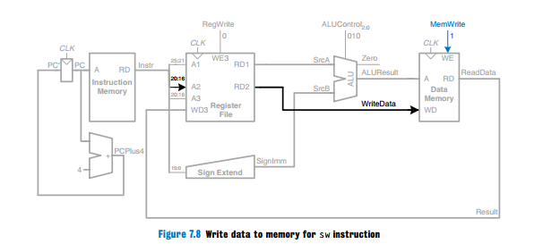
consider the datapath connections for the sw instruction

Slide 49
Datapath enhancements for R-type instruction
consider extending the datapath to handle the R-type instructions add, sub, and, or, and slt.
All of these instructions read two registers from the register file, perform some ALU operation on them, and write the result back to a third register file.
They differ only in the specific ALU operation.
Hence, they can all be handled with the same hardware, using different ALUControl signals.

Slide 50

Function 6 bits - 0 : 5
Shamt 5 bits - 6 : 10
rd 5 bits - 11 : 15
rt 5 bits - 16 : 20
rs 5 bits - 21 : 25
op 6 bits - 26 : 31
R-type machine instruction format

Slide 51
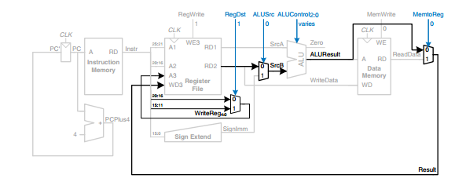
Datapath enhancements for R-type instruction

Slide 52
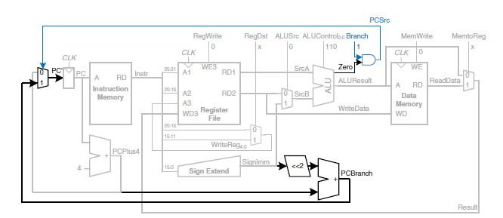
Datapath enhancements for beq instruction

Slide 53
The left shift by 2 is an easy way to
multiply by 4, because a shift by a constant amount involves just wires

Slide 54
control unit
The control unit into two blocks of combinational logic
The main decoder computes most of the outputs from the opcode.
It also determines a 2-bit ALUOp signal.
The ALU decoder uses this ALUOp signal in conjunction with the funct field to compute ALUControl

Slide 55
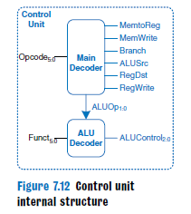

Slide 56
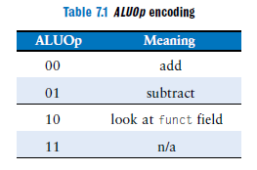

Slide 57
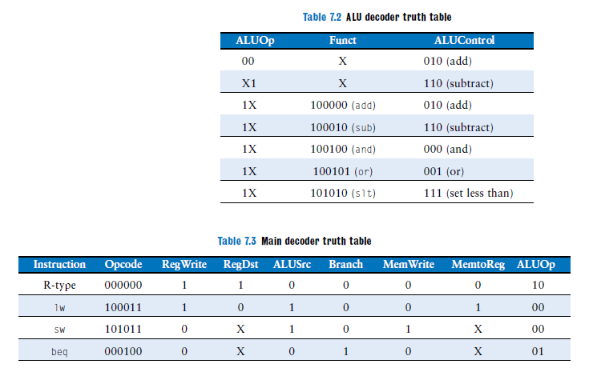

Slide 58
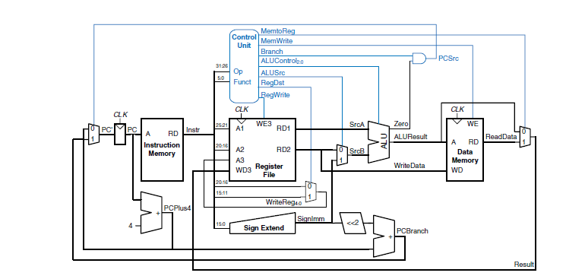
Complete single-cycle MIPS processor

Slide 59
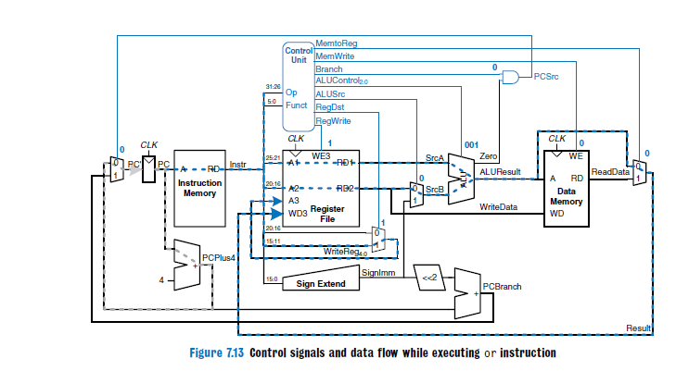

Slide 60
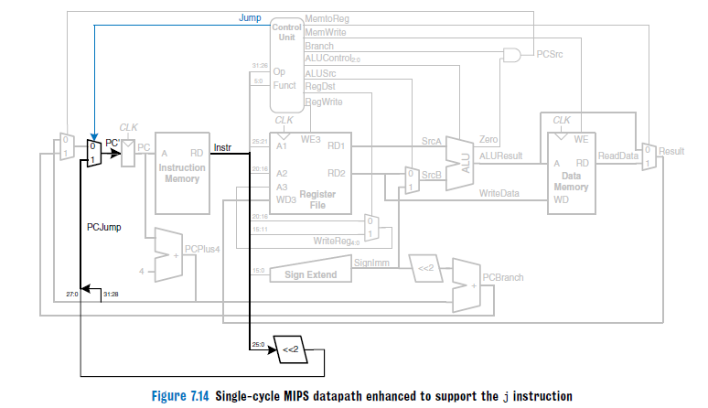

Slide 61

Performance Analysis

Slide 62
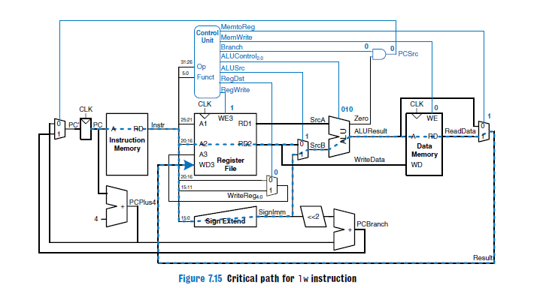

Slide 63
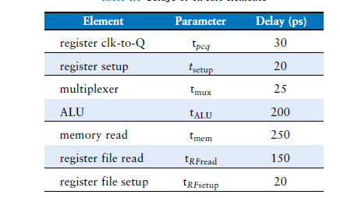
Determine the total cycle time for a single cycle processor. The logic elements have the
delays given in Table.

Slide 64
solution

Slide 65
MULTICYCLE PROCESSOR
single-cycle processor has three primary weaknesses
First, it requires a clock cycle long enough to support the slowest instruction (lw), even though most instructions are faster.
Second, it requires three adders (one in the ALU and two for the PC logic); adders are relatively expensive circuits, especially if they must be fast.
third, it has separate instruction and data memories, which may not be realistic.

Slide 66
The multicycle processor addresses these weaknesses by breaking an instruction into multiple shorter steps. In each short step, the processor can read or write the memory or register file or use the ALU.
Different instructions use different numbers of steps, so simpler instructions can complete faster than more complex ones. The processor needs only one adder; this adder is reused for different purposes on various steps.
And the processor uses a combined memory for instructions and data.
The instruction is fetched from memory on the first step, and data may be read or written on later steps.
design a multicycle processor following the same procedure we used for the single-cycle processor.
First, we construct a datapath by connecting the architectural state elements and memories with combinational logic. But, this time, we also add nonarchitectural state elements to hold intermediate results between the steps. Then we design the controller.

Slide 67
The controller produces different signals on different steps during execution of a single instruction, so it is now a finite state machine rather than combinational logic.
In the single-cycle design, we used separate instruction and data memories because we needed to read the instruction memory and read or write the data memory all in one cycle.
Now, we choose to use a combined memory for both instructions and data.
This is more realistic, and it is feasible because we can read the instruction in one cycle, then read or write the data in a separate cycle. The PC and register file remain unchanged.

Slide 68
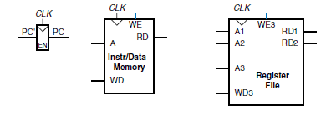
datapath connections for the lw instruction
State elements with unified instruction/data memory

Slide 69
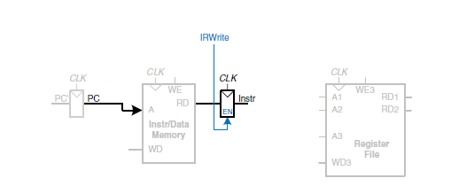
Fetch instruction from memory

Slide 70
The PC contains the address of the instruction to execute.
The first step is to read this instruction from instruction memory.
The PC is simply connected to the address input of the instruction memory.
The instruction is read and stored in a new nonarchitectural Instruction Register so that it is available for future cycles.
The Instruction Register receives an enable signal, called IRWrite, that is asserted when it should be updated with a new instruction

Slide 71
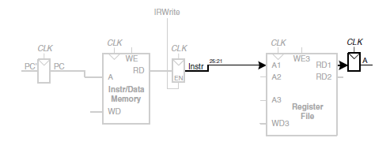
Read source operand from register file

Slide 72
For a lw instruction, the next step is to read the source register containing the base address.
This register is specified in the rs field of the instruction, Instr25:21.
These bits of the instruction are connected to one of the address inputs, A1, of the register file
The register file reads the register onto RD1. This value is stored in another nonarchitectural register, A.
The lw instruction also requires an offset. The offset is stored in the immediate field of the instruction, Instr15:0 and must be signextended to 32 bits
The 32-bit sign-extended value is called SignImm.
To be consistent, we might store SignImm in another nonarchitectural register.

Slide 73
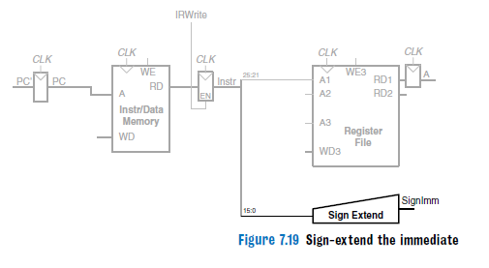

Slide 74
SignImm is a combinational function of Instr and will not change while the current instruction is being processed, so there is no need to dedicate a register to hold the constant value.
The address of the load is the sum of the base address and offset. We use an ALU to compute this sum.
ALUResult is stored in a nonarchitectural register called ALUOut
Now to load the data from the calculated address in the memory. We add a multiplexer in front of the memory to choose the memory address, Adr, from either the PC or ALUOut.
The multiplexer select signal is called IorD, to indicate either an instruction or data address. The data read from the memory is stored in another nonarchitectural register, called Data

Slide 75
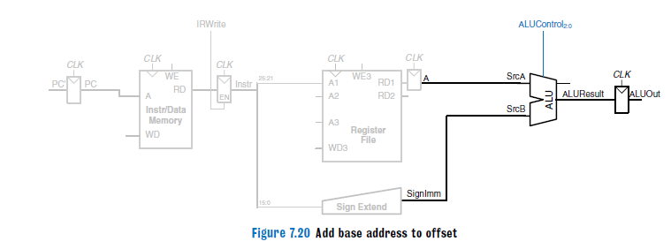

Slide 76
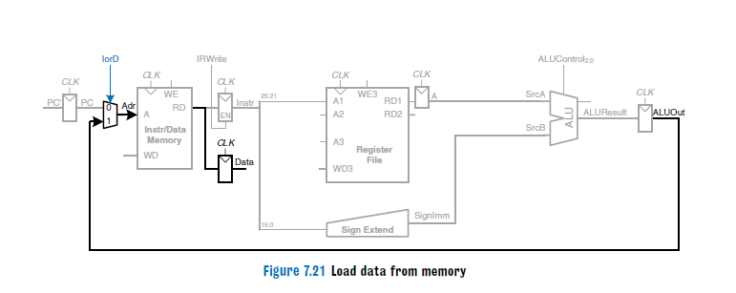

Slide 77
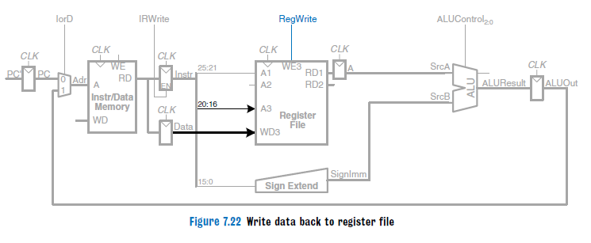

Slide 78
Notice that the address multiplexer permits us to reuse the memory during the lw instruction.
On the first step, the address is taken from the PC to fetch the instruction. On a later step, the address is taken from ALUOut to load the data.
Hence, IorD must have different values on different steps
we develop the FSM controller that generates these sequences of control signals.
The destination register is specified by the rt field of the instruction, Instr20:16.
While all this is happening, the processor must update the program counter by adding 4 to the old PC. In the single-cycle processor, a separate adder was needed

Slide 79
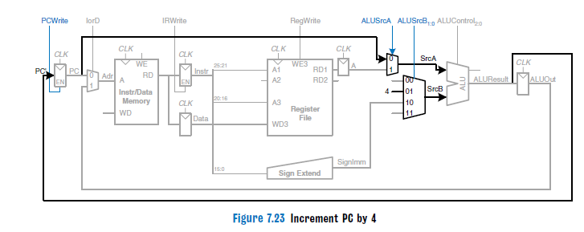

Slide 80
In the multicycle processor, we can use the existing ALU on one of the steps when it is not busy.
A two-input multiplexer controlled by ALUSrcA chooses either the PC or register A as SrcA. A four-input multiplexer controlled by ALUSrcB chooses either 4 or SignImm as SrcB.
The PCWrite control signal enables the PC register to be written only on certain cycles.

Slide 81
Datapath to handle the sw instruction
The only new feature of sw is that we must read a second register from the register file and write it into the memory

Slide 82
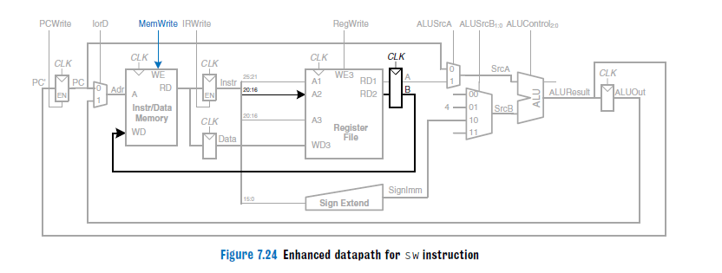

Slide 83
The register is specified in the rt field of the instruction,Instr20:16, which is connected to the second port of the register file.
When the register is read, it is stored in a nonarchitectural register, B.
On the next step, it is sent to the write data port (WD) of the data memory to be written.
The memory receives an additional MemWrite control signal to indicate that the write should occur

Slide 84
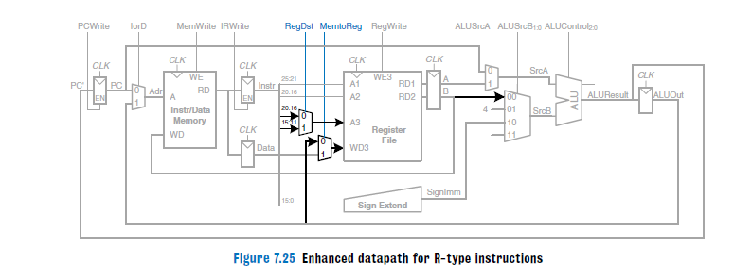
Datapath to handle the R type instructions

Slide 85
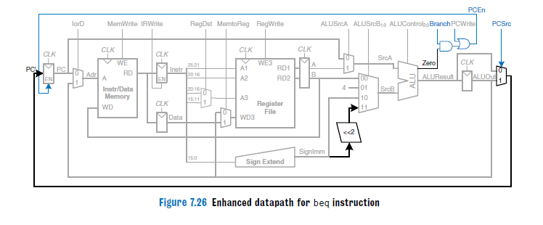
Datapath to handle the beq instructions

Slide 86
For the beq instruction, the instruction is again fetched, and the two source registers are read from the register file.
To determine whether the registers are equal, the ALU subtracts the registers and examines the Zero flag.
Meanwhile, the datapath must compute the next value of the PC if the branch is taken: PC= PC + 4 + SignImm x 4.
In the single-cycle processor, yet another adder was needed to compute the branch address.
In the multicycle processor, the ALU can be reused again to save hardware

Slide 87
On one step, the ALU computes PC+ 4 and writes it back to the program counter, as was done for other instructions.
On another step, the ALU uses this updated PC value to compute PC + SignImm x 4.
The SrcB multiplexer chooses this value and adds it to the PC.
This sum represents the destination of the branch and is stored in ALUOut.
A new multiplexer, controlled by PCSrc, chooses what signal should be sent to PC. The program counter should be written either when PCWrite is asserted or when a branch is taken.
A new control signal, Branch, indicates that the beq instruction is being executed.
The branch is taken if Zero is also asserted. Hence, the datapath computes a new PC write enable, called PCEn, which is TRUE either when PCWrite is asserted or when both Branch and Zero are asserted

Slide 88
The design process is much like that of the single-cycle processor in that hardware is systematically connected between the state elements to handle each instruction.
The main difference is that the instruction is executed in several steps.
Nonarchitectural registers are inserted to hold the results of each step.
Thus , the ALU can be reused several times , saving the cost of extra adders.
Similarly, the instructions and data can be stored in one shared memory

Slide 89
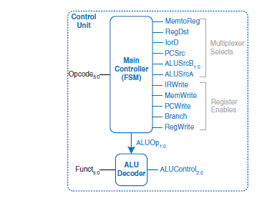
Control unit internal structure

Slide 90
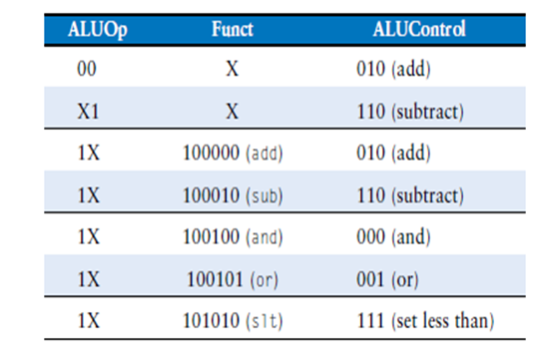
As in the single-cycle processor, the control unit computes the control signals based on the opcode and funct fields of the instruction, Instr31:26 and Instr5:0.
The control unit is partitioned into a main controller and an ALU decoder.
The ALU decoder is unchanged and follows the truth table below

Slide 91
The main controller is an FSM that applies the proper control signals on the proper cycles or steps.
The sequence of control signals depends on the instruction being executed.
The main controller produces multiplexer select and register enable signals for the datapath.
Enable signals are listed only when they are asserted; otherwise, they are 0.

Slide 92
The first step for any instruction is to fetch the instruction from memory at the address held in the PC.
The FSM enters this state on reset. To read memory, IorD 0, so the address is taken from the PC.
IRWrite is asserted to write the instruction into the instruction register,IR. Meanwhile, the PC should be incremented by 4 to point to the next instruction.
The ALU is not being used for anything else, the processor can use it to compute PC + 4 at the same time that it fetches the instruction.

Slide 93
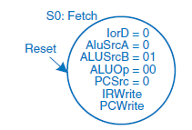
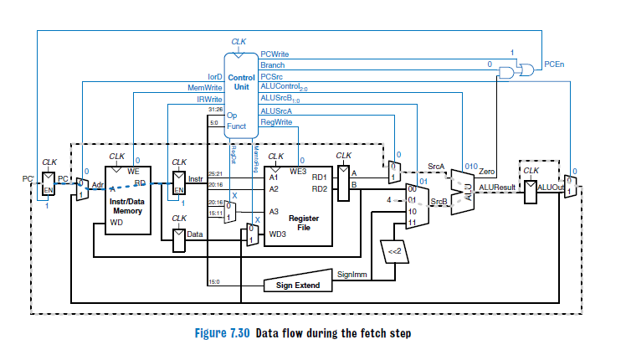

Slide 94
The next step is to read the register file and decode the instruction.
The register file always reads the two sources specified by the rs and rt fields of the instruction. Meanwhile, the immediate is sign-extended.
Decoding involves examining the opcode of the instruction to determine what to do next.
No control signals are necessary to decode the instruction,but the FSM must wait 1 cycle for the reading and decoding to complete.

Slide 95
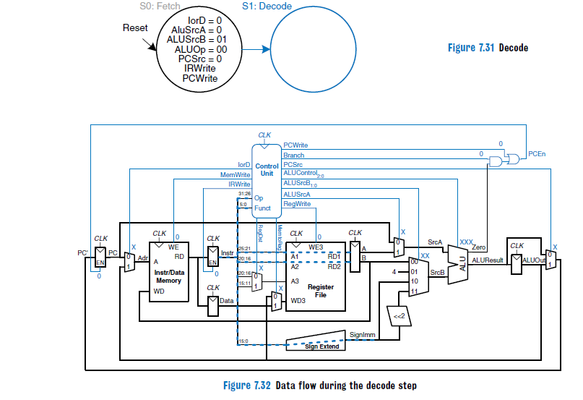

Slide 96
Now the FSM proceeds to one of several possible states, depending on the opcode.
If the instruction is a memory load or store (lw or sw), the multicycle processor computes the address by adding the base address to the sign-extended immediate.
This requires ALUSrcA = 1 to select register A and ALUSrcB = 10 to select SignImm. ALUOp= 00,so the ALU adds. The effective address is stored in the ALUOut register for use on the next step.

Slide 97
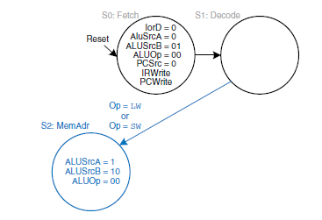
Memory address computation

Slide 98
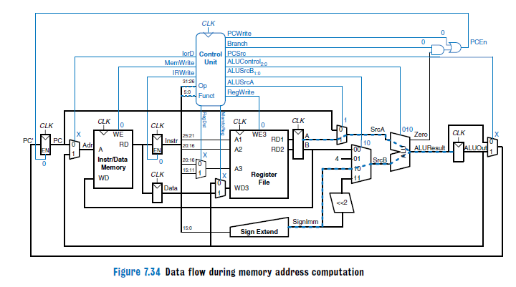

Slide 99
If the instruction is lw, the multicycle processor must next read data from memory and write it to the register file.
To read from memory, IorD = 1 to select the memory address that was just computed and saved in ALUOut.
This address in memory is read and saved in the Data register during step S3.
On the next step, S4, Data is written to the register file.
MemtoReg = 1 to select Data, and RegDst 0 to pull the destination register from the rt field of the instruction.
RegWrite is asserted to perform the write, completing the lw instruction.
Finally, the FSM returns to the initial state, S0, to fetch the next instruction

Slide 100
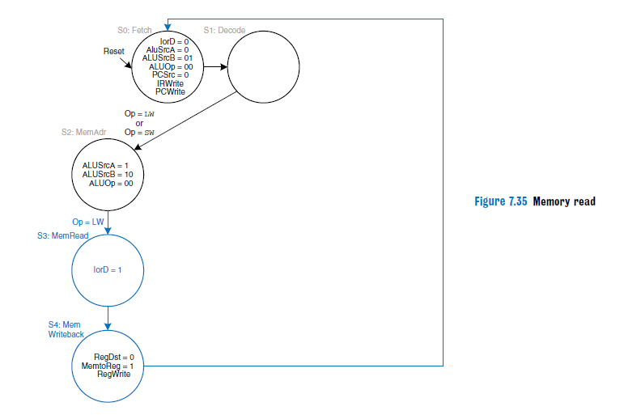

Slide 101
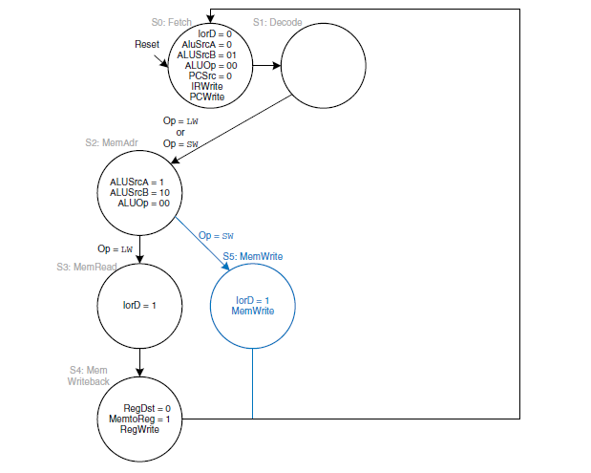
Memory write(if the instruction is sw)

Slide 102
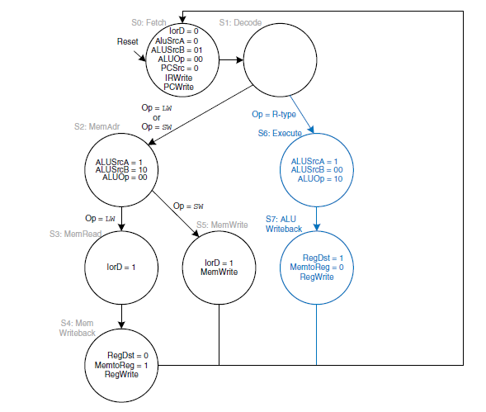
If the opcode indicates an R-type instruction

Slide 103
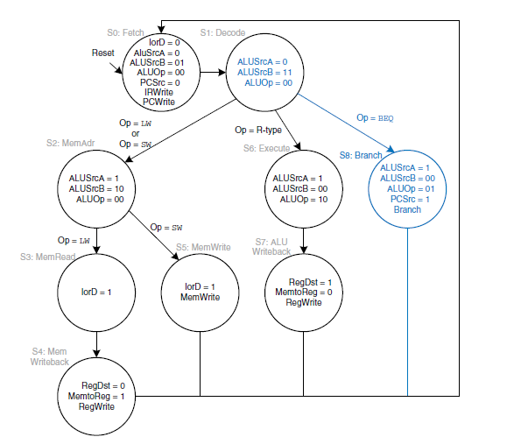
For a beq instruction, the processor

Slide 104
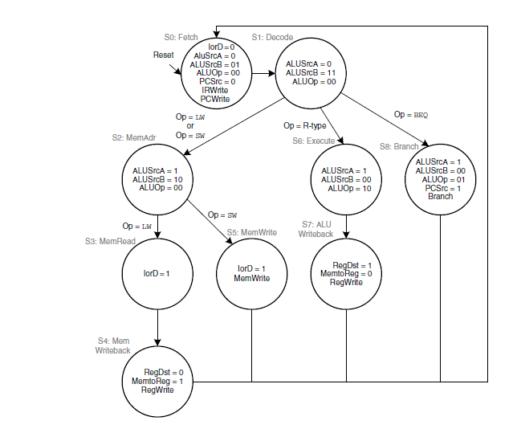
Complete multicycle control FSM

Slide 105
Performance Analysis
The execution time of an instruction depends on both the number of cycles it uses and the cycle time.
Whereas the single-cycle processor performed all instructions in one cycle, the multicycle processor uses varying numbers of cycles for the various instructions.
However, the multicycle processor does less work in a single cycle and, thus, has a shorter cycle time.
The multicycle processor requires three cycles for beq and j instructions, four cycles for sw, addi, and R-type instructions, and five cycles for lw instructions.

Slide 106
we designed the multicycle processor so that each cycle involved one ALU operation, memory access, or register file access.
Let us assume that the register file is faster than the memory and that writing memory is faster than reading memory.
Examining the datapath reveals two possible critical paths that would limit the cycle time:
Tc = tpcq + tmux +max(tALU + tmux, tmem) + tsetup

Slide 107

Module V

Slide 108


Slide 109
DMA controller eg: IC 8257

Slide 110
The Memory System

Slide 111
Memory Hierarchy
Pr
ocessor
Re
gisters
Increasing
Increasing
Increasing
size
speed
cost per bit
Primary
L1
cache
Secondary
L2
cache
Main
memory
Magnetic disk
secondary
memory

Slide 112
Computer memory is organized into a hierarchy
At the highest level (closest to the processor) are the processor registers. Next comes one or more levels of cache, When multiple levels are used, they are denoted L1, L2, and so on.
Next comes main memory, which is usually made out of dynamic random-access memory (DRAM).
All of these are considered internal to the computer system.
Next level typically being a fixed hard disk, and one or more levels below that consisting of removable media such as optical disks and tape
Fastest access is to the data held in processor registers.
As one goes down the memory hierarchy, one finds decreasing cost/bit, increasing capacity, and slower access time.

Slide 113

characteristics of memory system

Slide 114


Slide 115
Internal organization of memory chips
7
7
1
1
0
0
W
0
•
•
•
FF
FF
A
0
W
1
•
•
•
A
1
Address
Memory
decoder
•
•
•
•
•
•
•
•
•
•
•
•
•
•
•
•
•
•
cells
A
2
A
3
W
15
•
•
•
Sense / Write
Sense / Write
Sense / Write
R
/
W
circuit
circuit
circuit
CS
Data input
/output lines:
b
7
b
1
b
0

Slide 116



Slide 117
Memory cells:SRAM Cell
b
′
b
T
T
1
X
Y
2
Word line
Bit lines

Slide 118
CMOS cell

Slide 119

Memory cell

Slide 120


Slide 121


Slide 122


Slide 123


Slide 124
DRAM cell

Slide 125
Asynchronous DRAMs
R
A
S
Row
Row
4096
×
(
512
×
8
address
)
latch
decoder
cell array
A
20
⁄
A
Sense / Write
CS
-
9
8
-
0
circuits
R
/
W
Column
Column
address
decoder
latch
C
A
S
D
D
7
0

Slide 126
Fast Page Mode
Suppose if we want to access the consecutive bytes in the selected row.
This can be done without having to reselect the row.
  Add a latch at the output of the sense circuits in each row.
  All the latches are loaded when the row is selected.
  Different column addresses can be applied to select and place different bytes on the data lines.
Consecutive sequence of column addresses can be applied under the control signal CAS, without reselecting the row.
  Allows a block of data to be transferred at a much faster rate than random accesses.
  A small collection/group of bytes is usually referred to as a block.
This transfer capability is referred to as the
fast page mode feature.

Slide 127
Synchronous DRAMs
Refresh
counter
Row
Ro
w
address
decoder
Cell array
latch
Row/Column
address
Column
Co
lumn
Read/Write
address
decoder
circuits & latches
counter
Clock
R
A
S
Mode register
C
A
S
and
Data input
Data output
R
/
W
timing control
register
register
C
S
Data

Slide 128


Slide 129

Cache Memories

Slide 130
The cache is a small and very fast memory, interposed between the processor and the main memory.
Its purpose is to make the main memory appear to the processor to be much faster than it actually is.
The effectiveness of this approach is based on a property of computer programs called locality of reference.
The point is that many instructions in localized areas of the program are executed repeatedly during some time period.
This behavior manifests itself in two ways: temporal and spatial

Slide 131
Temporal:
means that a recently executed instruction is likely to be executed again very soon.
Temporal locality suggests that whenever an information item, instruction or data, is first needed, this item should be brought into the cache, because it is likely to be needed again soon.
spatial :
means that instructions close to a recently executed instruction are also likely to be executed soon.
Spatial locality suggests that instead of fetching just one item from the main memory to the cache, it is useful to fetch several items that are located at adjacent addresses as well.

Slide 132
The cache is usually built out of SRAM on the same chip as the processor
The cache speed is comparable to the processor speed, because SRAM is inherently faster than DRAM, and because the on-chip memory eliminates lengthy delays caused by traveling to and from a separate chip.
Caches can store both instructions and data, but we will refer to their contents generically as “data.”
If the processor requests data that is available in the cache, it is returned quickly. This is called a cache hit.
Otherwise, the processor retrieves the data from main memory (DRAM). This is called a cache miss.
If the cache hits most of the time, then the processor seldom has to wait for the slow main memory, and the average access time is low.

Slide 133

MEMORY SYSTEM PERFORMANCE ANALYSIS
quantitative ways to measure the performance of memory systems to evaluate the cost-benefit trade-offs of various alternatives.
Memory system performance metrics are miss rate or hit rate and average memory access time. Miss and hit rates are calculated as:

Slide 134
Average memory access time (AMAT) is the average time a processor must wait for memory per load or store instruction.
Thus, AMAT is calculated as:
AMAT = t_{cache} + MR_{cache} (t_{MM} + MR_{MM}t_{VM})
where tcache, tMM, and tVM are the access times of the cache, main memory, and virtual memory, and MRcache and MRMM are the cache and main memory miss rates, respectively.

Slide 135
Group of words is called a cache block.
The number of words in the cache block, b, is called the block size.
A cache of capacity C contains B = C/b blocks. A cache is organized into S sets, each of which holds one or more blocks of data.
The relationship between the address of data in main memory and the location of that data in the cache is called the mapping.
Each memory address maps to exactly one set in the cache.
Some of the address bits are used to determine which cache set contains the data.
If the set contains more than one block, the data may be kept in any of the blocks in the set.

Slide 136
Mapping Functions
Direct Mapping
A direct mapped cache has one block in each set, so it is organized into S = B sets.
An address in block 0 of main memory maps to set 0 of the cache
Because many addresses map to a single set, the cache must alsokeep track of the address of the data actually contained in each set.
The least significant bits of the address specify which set holds the data. The remaining most significant bits are called the tag and indicate which of the many possible addresses is held in that set.

Slide 137

Mapping of main memory to a direct mapped cache

Slide 138

Cache fields for address 0xFFFFFFE4 when mapping to the cache
The two least significant bits of the 32-bit address are called the byte offset, because they indicate the byte within the word.
The next three bits are called the set bits, because they indicate the set to which the address maps. (In general, the number of set bits is log2S.)
The remaining 27 tag bits indicate the memory address of the data stored in a given cache set.

Slide 139
Disadvantage
Direct mapped caches have only one block in each set, so two addresses that map to the same set always cause a conflict.

Slide 140
Associative Mapping
The most flexible mapping method , main memory block can be placed into any cache block position.
Tag bits are required to identify a memory block when it is resident in the cache.
The tag bits of an address received from the processor are compared to the tag bits of each block of the cache to see if the desired block is present.
This is called the associative-mapping technique.
It gives complete freedom in choosing the cache location in which to place the memory block, resulting in a more efficient use of the space in the cache.

Slide 141
When a new block is brought into the cache, it replaces (ejects) an existing block only if the cache is full.
In this case, we need an algorithm to select the block to be replaced.
The complexity of an associative cache is higher than that of a direct-mapped cache , because of the need to search all tag patterns to determine whether a given block is in the cache.
To avoid a long delay, the tags must be searched in parallel.
A search of this kind is called an associative search.

Slide 142
Set-Associative Mapping
Another approach is to use a combination of the direct- and associative-mapping techniques.
The blocks of the cache are grouped into sets, and the mapping allows a block of the main memory to reside in any block of a specific set

Slide 143
Multi-way Set Associative Cache
An N-way set associative cache reduces conflicts by providing N blocks in each set where data mapping to that set might be found.
Each memory address still maps to a specific set, but it can map to any one of the N blocks in the set.
Hence, a direct mapped cache is another name for a one-way set associative cache. N is also called the degree of associativity of the cache.

Slide 144


Slide 145

Two-way set associative cache

Slide 146
Set associative caches generally have lower miss rates than direct mapped caches of the same capacity, because they have fewer conflicts.
However, set associative caches are usually slower and somewhat more expensive to build because of the output multiplexer and additional comparators. They also raise the question of which way to replace when both ways are full

Slide 147
Replacement Algorithms
In associative and set-associative caches there exists some flexibility. When a new block is to be brought into the cache and all the positions that it may occupy are full, the cache controller must decide which of the old blocks to overwrite.
This is an important issue, because the decision can be a strong determining factor in system performance.
There is a high probability that the blocks that have been referenced recently will be referenced again soon.
Therefore, when a block is to be overwritten, it is sensible to overwrite the one that has gone the longest time without being referenced.
This block is called the least recently used (LRU) block, and the technique is called the LRU replacement algorithm.

Slide 148
Performance of the LRU algorithm can be improved by introducing a small amount of randomness in deciding which block to replace.
Suppose it is required to track the LRU block of a four-block set a set-associative cache. A 2-bit counter can be used for each block.
When a hit occurs , the counter of the block that is referenced is set to 0. Counters with values originally lower than the referenced one are incremented by one, and all others remain unchanged.
When a miss occurs and the set is not full, the counter associated with the new block loaded from the main memory is set to 0, and the values of all other counters are increased by one.
When a miss occurs and the set is full, the block with the counter value 3 is removed, the new block is put in its place, and its counter is set to 0.
The other three block counters are incremented by one. It can be easily verified that the counter values of occupied blocks are always distinct.

Slide 149
Virtual Memory
If a program does not completely fit into the main memory, the parts of it not currently being executed are stored on a secondary storage device, typically a magnetic disk.
As these parts are needed for execution, they must first be brought into the main memory, possibly replacing other parts that are already in the memory.
These actions are performed automatically by the operating system, using a scheme known as virtual memory.
Under a virtual memory system, programs, and hence the processor, reference instructions and data in an address space that is independent of the available physical main memory space.
The binary addresses that the processor issues for either instructions or data are called virtual or logical addresses.
These addresses are translated into physical addresses by a combination of hardware and software actions

Slide 150
A special hardware unit, called the Memory Management Unit (MMU), translates the virtual address into the corresponding physical address.
If the data are not in the main memory, the MMU causes the operating system to transfer the data from the disk to the memory.
The cache bridges the speed gap between the processor and the main memory and is implemented in hardware.
The virtual-memory mechanism bridges the size and speed gaps between the main memory and secondary storage and is usually implemented in part by software techniques

Slide 151


Slide 152
Virtual memory organization
Processor
Virtual address
Data
MMU
Physical address
Cache
Data
Physical address
Main memory
DMA transfer
Disk storage

Slide 153
Address Translation
A simple method for translating virtual addresses into physical addresses is to assume that all programs and data are composed of fixed-length units called pages, each of which consists of a block of words that occupy contiguous locations in the main memory.
They constitute the basic unit of information that is transferred between the main memory and the disk whenever the MMU determines that a transfer is required.

Slide 154
Each virtual address generated by the processor,whether it is for an instruction fetch or an operand load/store operation, is interpreted as a virtual page number (high-order bits) followed by an offset (low-order bits) that specifies the location of a particular byte (or word) within a page.
Information about the main memory location of each page is kept in a page table.
This information includes the main memory address where the page is stored and the current status of the page.
An area in the main memory that can hold one page is called a page frame.
The starting address of the page table is kept in a page table base register.

Slide 155
Address translation (contd..)
PTBR holds
the starting address of
the page table.
Virtual address from processor
Page table base register
Page table address
Virtual page number
Offset
Virtual address is
interpreted as page
number and offset.
+
PTBR + virtual
page number provide
the entry of the page
in the page table.
PAGE TABLE
This entry has the starting location
of the page.
Page table holds information
about each page..
Control
Page frame
bits
in memory
Page frame
Offset
Physical address in main memory

Slide 156
By adding the virtual page number to the contents of this register, the address of the corresponding entry in the page table is obtained.
The contents of this location give the starting address of the page if that page currently resides in the main memory.
Each entry in the page table also includes some control bits that describe the status of the page while it is in the main memory.
One bit indicates the validity of the page, that is, whether the page is actually loaded in the main memory.
It allows the operating system to invalidate the page without actually removing it.
Another bit indicates whether the page has been modified during its residency in the memory
Other control bits indicate various restrictions that may be imposed on accessing the page. For example, a program may be given full read and write permission, or it may be restricted to read accesses only.

Slide 157


Slide 158


Slide 159


Slide 160


Slide 161


Slide 162


Slide 163
Translation Lookaside Buffer
MMU is normally implemented as part of the processor chip, it is impossible to include the complete page table within the MMU.
Instead, a copy of only a small portion of the table is accommodated within the MMU, and the complete table is kept in the main memory.
The portion maintained within the MMU consists of the entries corresponding to the most recently accessed pages. They are stored in a small table, usually called the Translation Lookaside Buffer (TLB).
Each entry in the TLB includes a copy of the information in the corresponding entry in the page table
It includes the virtual address of the page, which is needed to search the TLB for a particular page

Slide 164

Use of an associative-mapped TLB.
Virtual address from processor

Slide 165
Address translation proceeds as follows.
Given a virtual address, the MMU looks in the TLB for the referenced page.
If the page table entry for this page is found in the TLB, the physical address is obtained immediately.
If there is a miss in the TLB, then the required entry is obtained from the page table in the main memory and the TLB is updated.
It is essential to ensure that the contents of the TLB are always the same as the contents of page tables in the memory.
When the operating system changes the contents of a page table, it must simultaneously invalidate the corresponding entries in the TLB.
One of the control bits in the TLB is provided for this purpose.

Slide 166
Page Faults
When a program generates an access request to a page that is not in the main memory , a page fault is said to have occurred.
The entire page must be brought from the disk into the memory before access can proceed.
Processing of the program that generated the page fault is interrupted, and control is transferred to the operating system.
The operating system copies the requested page from the disk into the main memory. Since this process involves a long delay, the operating system may begin execution of another program whose pages are in the main memory.
When page transfer is completed, the execution of the interrupted program is resumed.

