Slide 1
BJT

Slide 2
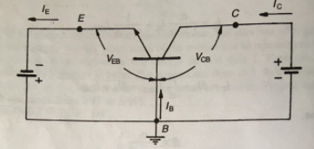
COMMON BASE CHARA

Slide 3
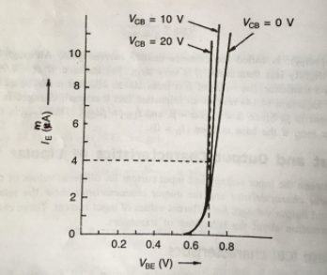
I/P CHARA OF CB

Slide 4
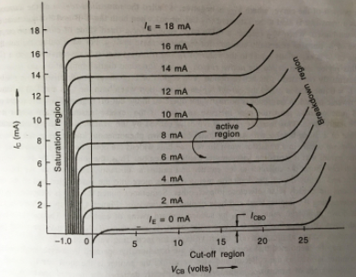
O/P CHARA OF CB

Slide 5
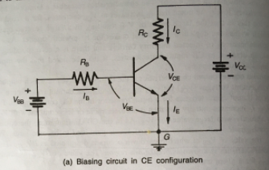
COMMON EMITTER CHARA

Slide 6
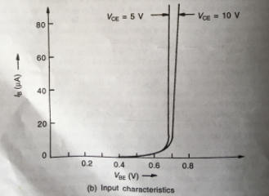
I/P CHARA OF CE

Slide 7
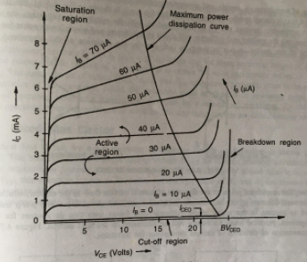
O/P CHARA OF CE

Slide 8
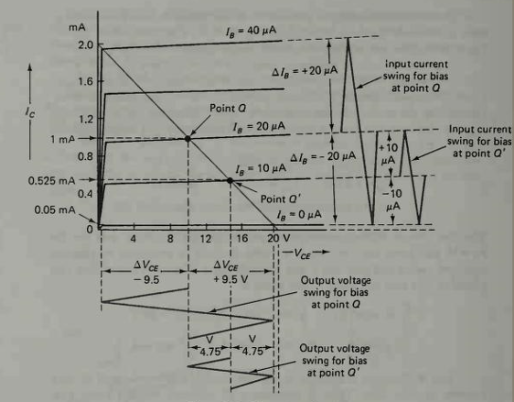

Slide 9
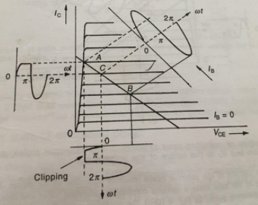
QPOINT MOVED TO SAT REGION

Slide 10
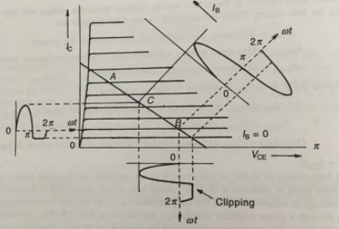
QPOINT MOVED TO CUTOFF REG

Slide 11
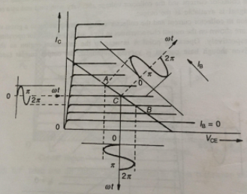
QPONT IN MIDDLE OF DC LOADLINE

Slide 12
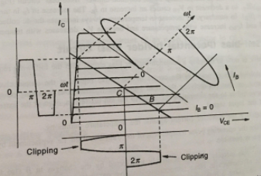

Slide 13
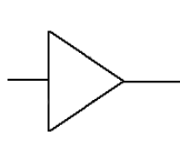
Amplifiers
Vi
Vo

Slide 14
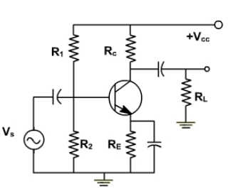


RC Coupled Amplifier
Cc
Cin
i_{C}=I_{C}+i_{c}
i_{B}=I_{B}+i_{b}
i_{E}=I_{E}+i_{e}
I_{E}
i_{e}
Ce

Slide 15
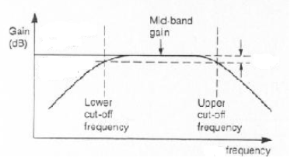
Frequency Response
3 dB
f_{l}
f_{u}

Slide 16
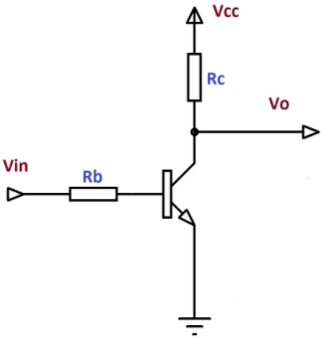
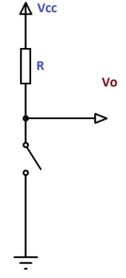
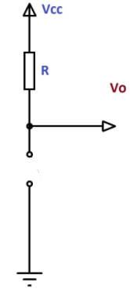
Transistor as a switch
0 v

Slide 17
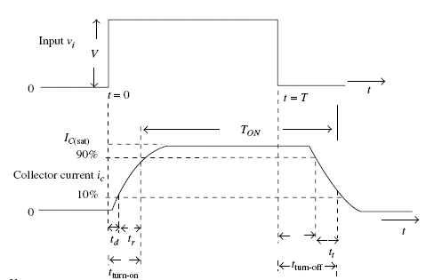
t_{s}
t_{f}

