Slide 1
SEMICONDUCTORS

Slide 2
SEMICONDUCTORS
INTRISIC EXTRINSIC
(Pure) (doped)
N type P type

Slide 3
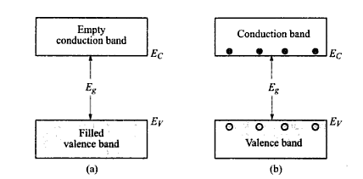
INTRINSIC SEMICONDUCTORS
No impurities or defects
EHP’s generated on thermal excitation

Slide 4
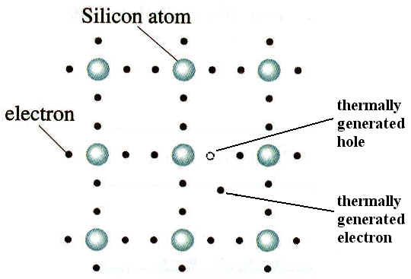
Generation due to thermal excitation – intrinsic generation
Vacancy of electron-hole-positively charged
Recombination occurs after sometimes

Slide 5
Extrinsic s/c
Charge carriers purposely introduced by adding impurities – this process- doping
Depending on type of impurities- doped s/c may be – n type or p type
Such semiconductor- extrinsic s/c

Slide 6
N type s/c
A s/c doped with pentavalent impurity
Pentavalent impurity- donor impurity- phosphorous,arsenic,antimony
Extra electron-if detatched from donor atom-will be available as a carrier of current
Donor atoms-donor ions
Electrons-majority carriers & holes minority carriers

Slide 7
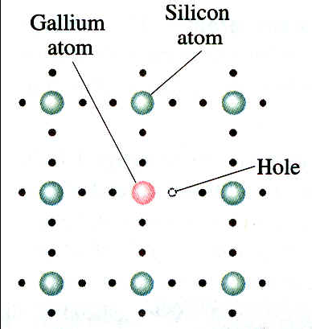
P type s/c
A s/c doped with trivalent impurity-gallium
Vacancy-hole
Ga atom-has the tendancy to accept electron from neighboring atoms on application of energy
This electron completes covalent bond of Ga atom-Ga ion- negatively charged

Slide 8
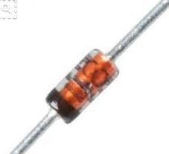
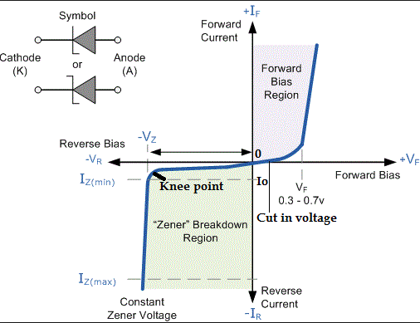
Zener diode

Slide 9
By controlling the thickness of depletion layer and doping concentration it is possible to make the zener diode to break down at a specified voltage,called zener voltage(2.4v to 200 v)
During the operation in brk down region, it does not burn out immediately. As long as the current through the diode is limited by external circuit, it does not burn out

Slide 10
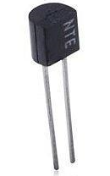
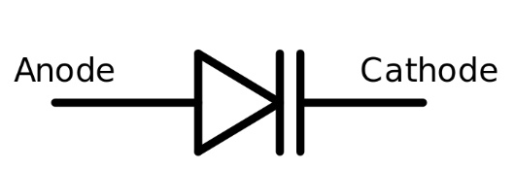
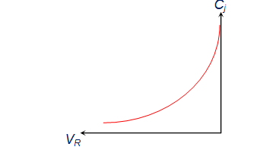
Varactor diode

