Slide 1
ELECTRONIC COMPONENTS
By,Neethu Kuriakose,Asst Professor,ECE, MACE

Slide 2
Resistors
Carbon composition potentiometer
Wire wound rheostat
Metal film Trimmer
Carbon film
linear
Non linear
fixed
variable

Slide 3
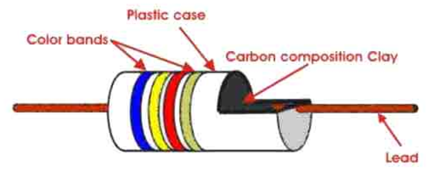
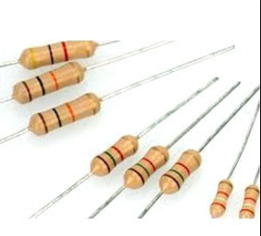
Carbon composition
Resistive material- carbon clay composition
Leads –made of tinned copper
Enclosed in plastic case to prevent moisture

Slide 4
Advantage- cheap and reliable
- high stability
Disadvantage – highly sensitive to temperature variations
Available range- 1Ω - 22MΩ
Tolerance – 5% – 20%
Max power – 2W

Slide 5
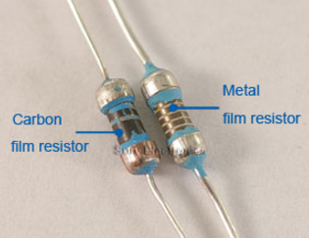
Thin film resistor-metal film &carbon film
Made by depositing very thin layer of conducting material on an insulated rod,tube or plate made of ceramic or glass
Only approximate value of resistance can be obtain by film deposition method
Desired values are obtained by trimming the layer thickness

Slide 6
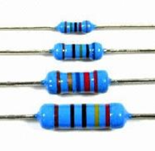
Metal film resistor
Size-much smaller than wire wound type
Thin layer of metal is deposited-nichrome
Metal film is spiral cut to the desired resistance
Protective coating
Resistance – 10Ω - 100MΩ
Power descipation – 2 W
Tolerance – 0.5%

Slide 7
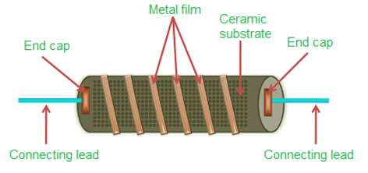

Slide 8
Variable resistor
Resistance – varied from 0 to a specific value
Application-changing volume of sound,brightness of television picture etc
Potentiometer
Rheostat
trimmer

Slide 9
Potentiometer
3 terminals
2 terminals – connected to 2 ends of resistive element & 3rd connected to sliding contact
Rotating shaft – at centre of core
Shaft moves an arm & a contact point from end to end of resistance element
Manufactured from resistive element like – carbon composition,metallic film and wire wound type
Can be linear or non-linear

Slide 10
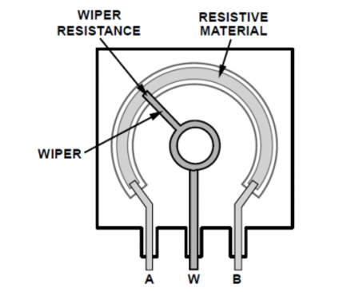
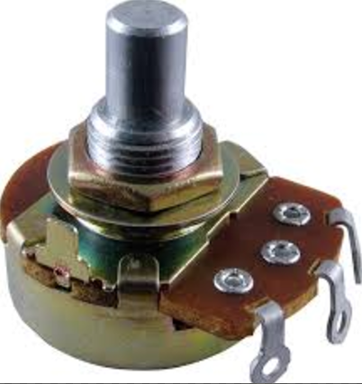
100Ω-1MΩ

Slide 11
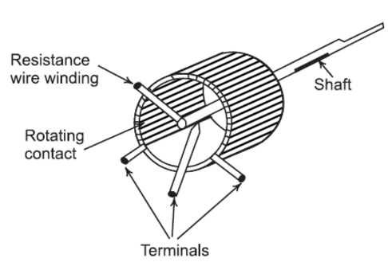
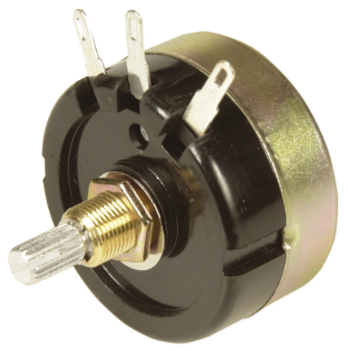
5Ω-50KΩ

Slide 12
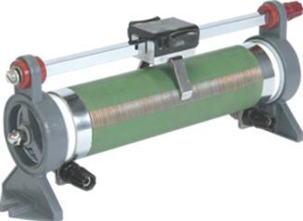
Rheostat
Wire wound variable resistor
Also known as slide wire resistor
Resistive wire wound over an insulating ceramic core & wiper slides over the winding
Used in high power application such as controlling the speed of motor,intensity of light etc

Slide 13
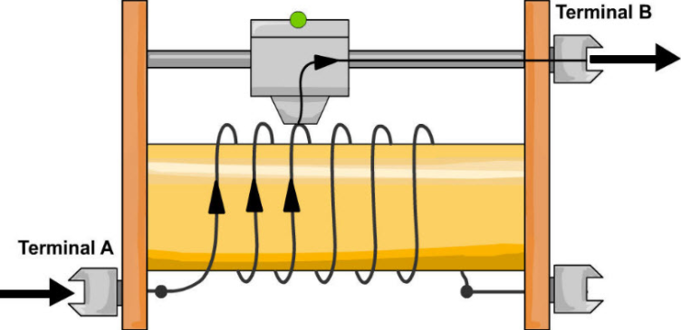

Slide 14
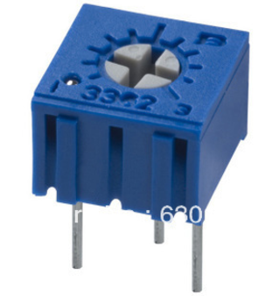
Trimmers (presets)
Used in application where variation of resistance is not done frequently
Once setting is made it may be undisturbed
Resistance-adjusted by inserting a small screw driver into a slot & turning one or more times
Materials used for construction- carbon film,wire
Resistance- 50Ω - 5MΩ
Power rating – ¼ - ¾ W

Slide 15
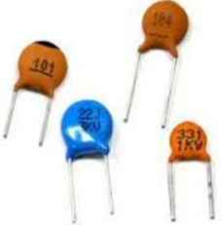
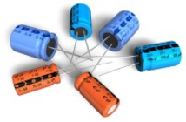
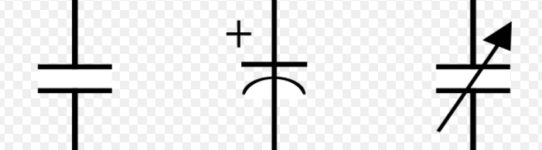
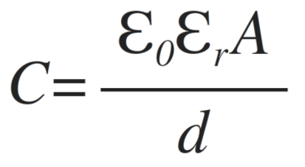
Capacitors
Electronic components used to store electric charge in form of electrostatic energy
Q=CV
C comes in µf OR Pf
µf f (x 10⁻⁶ )
f µf (x 10⁶ )
Pf f (x 10⁻¹² )
f Pf (x 10¹² )
Pf µf (x 10⁻⁶ )

Slide 16


- absolute permitivity = 8.854 x 10⁻¹² f/m
- relative permitivity
Air or vaccum | 1
Aluminium oxide | 7-10
ceramic | 6-7500
glass | 7-8
mica | 3-6
Paper(waxed) | 3-5
polystyrene | 2-6
Tantalum oxide | 11
bakelite | 4.5-5.5

Slide 17
Application
Starting motors
Blocking dc current, passing ac current
Filtering unwanted signals
Tuning ckt to a specific frequency
Coupling electronic ckts
Bypassing signals

Slide 18
capacitor
Fixed Variable
Electrostatic Electrolytic
Aluminium Tantalum
Ceramic Mica Plastic paper

Slide 19
Electrostatic capacitors
Made up of 2 metal conductors(plates) seperated by a dielectric
Very low leakage current and high leakage resistance
Ceramic,plastic,mica,paper

Slide 20
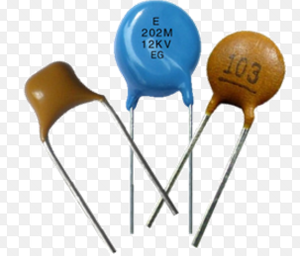
Ceramic capacitors
Dielectric-ceramic material-mixture of barium-strontium-titanate
10 pf to more than 1µf
Very high dielectric constant and usually smaller in size than paper or mica capacitors for the same capacitance value
High leakage resistance but not as in mica or paper capacitor
Available in disc and tubular types
Used as bypassing and coupling capacitor in electronics ckts, as
Cheaper than paper or mica

Slide 21
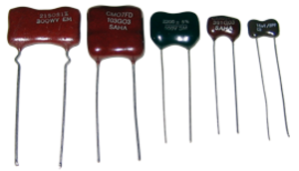
Mica capacitor
Capacitance ranging from- 1 pf - 10,000 pf
Able to withstand very high voltages(about 500v)
Widely used in radio and telecommunications.

Slide 22
Plastic film capacitor
Plastic materials as dielectric- polyester,polypropylene, polystyrene,teflon etc
Polyester- Capacitance ranges from 0.001 µf to 10 µf
Polystyrene - Capacitance ranges from 5pf to 0.05 µf- has very low leakage
Teflon capacitors- operated upto 250° c

Slide 23
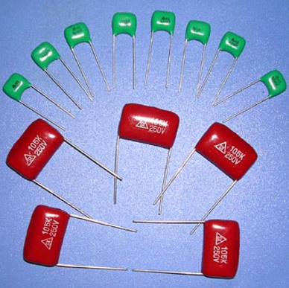

Slide 24
Paper capacitors
Made by using strips of aluminium foil with treated paper as dielectric
Foil and paper rolled in a ribbon form and leads are connected to aluminium foil and taken out at each end
Sealed in a wax paper or plastic
Capacitance: 0.001µf to 1µf
Working voltage: as high as 2000v
Excellent stability and reliability

Slide 25
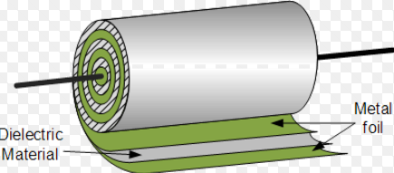
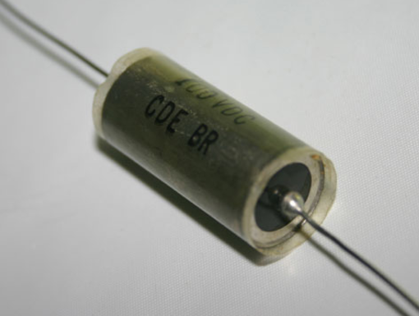

Slide 26
Electrolytic capacitors
Aluminium type
C value ranges from 1 to 6800 µf
Electrolyte of borax,phosphate or carbonate
Absorbant gauze soaks up electrolyte
Disadvntg- leakage current is more
Tantalum type
Larger c in smaller size
Longer shelf life
Less leakage current
Disadvtg- cost more than Al type

Slide 27
Variable capacitor
C in pico farad range
With air as dielectric
Ganged capacitor
Trimmers and padders

Slide 28
Trimmers and padders
For making fine adjustments
Flexible metal plate seperated by dielectric(ceramic,mica,plastic)
Screw adjustment
Trimmers – c value- 5 pf to 30 pf
Padders-larger in size/more plstes
C range- 10 pf to 500 pf

Slide 29
Capacitance reading
code | 0.1 | 10 | 104 | 10k
value | 0.1µF | 10 pF | 10x10⁴ pF | 10kpF
Code | 10n | 1M | 2M2 | 4k7
value | 10 nF | 1µF | 2.2 µF | 4.7kpF
3 DIGITS-FOLLOWED BY FOLLOWING NUMBER-TOLERANCE
F = + 1% G= + 2% J= + 5%
K = + 10% M= + 20% Z= -20% , + 80%

Slide 30
Colour coding
colour | digits | multiplier | tolerance
Black | 0 | 1 | +/- 20%
Brown | 1 | 10¹ | +/- 1%
Red | 2 | 10² | +/- 2%
Orange | 3 | 10³ | +/- 3%
Yellow | 4 | 10⁴ | +/- 4%
Green | 5 | 10⁵ | +/- 5%
Blue | 6 | 10⁶
Violet | 7 | 10⁷
Gray | 8 | 0.01
White | 9 | 0.1 | +/- 10%

Slide 31
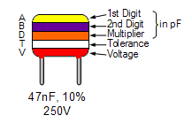
colour | V
BR | 100
R | 250
Y | 400
B | 630

Slide 32
INDUCTORS
Inductance-property which opposes a change of current flowing through it
coil
Energy storage in form of magnetic field(flux)
Strength of magnetic field-propotional to amount of current
Current constant-flux constant, current varying – flux also varies
Change in flux- induces a voltage or emf in coil
Polarity of induced voltage- it opposes change in current through coil
Magnitude of this voltage-propotional to rate of change of current

Slide 33
Application of inductors
Tuning and filter circuits
Used in radio recievers
Used in transformers and coupled circuits to transfer energy from one circuit to another
Minimize AC ,passes DC-Choke
Chokes for audio frequency and video frequency range

Slide 34
Types of inductor
Fixed and variable
Fixed-3 types- air core,iron core and ferrite core

Slide 35
Air core
Thin copper wire-wound over a former made of thick cardboard
Low value of inductance
Suitable for radio frequency application

Slide 36
Iron core
Copper wire- wound on a laminated iron core
Laminated iron core-prevent eddy current loss
Laminated core- thin iron sheets pressed together and insulated from each other
Very stable for audio frequency application

Slide 37
Ferrite core
Wire wound on a solid core made of ferromagnetic material-ferrite-fine particles of iron,cobalt or nickel- embedded in an insulator binder
Has a very low eddy current loss
In variable type ferrite core moves- in and out of coil
Variable inductors-used in frequency tuning application

Slide 38
Inductance of a coil

Slide 39
Transformers
Consist of 2 or more coils to transfer electrical energy from one ckt to another at different voltages without changing frequency
Principle of mutual induction
2 windings- primary and secondary
Change in current in primary winding- magnetic flux is induced in the core-induces voltage in secondary winding

Slide 40
Power transformer
Step up and step down transformer
Stepup - no:of turns in primary less than secondary
Step down- opposite to stepup

Slide 41
Transformer specifications
Voltage rating-rated primary and secondary voltage of the transformer
Current rating- max current that the transformer winding can carry
Power rating- max power which can be continously delivered by the transformer-vA
Frequency range- range of frequency in which transformer operates without failure

Slide 42
Types of transformers-tutorial
Power transformer
Audio frequency transformer
Radio frequency transformer
Isolation transformer
Auto transformer

Slide 43
RELAYS
Electrical switch used to provide electrical connection b/w 2 or more points in a ckt in response to the application of a controll signal
Relays- electromagnetic relay,solid state relay(SSR),dry reed relay,crystal can relay,mercury wetted relay,time delay relay etc

Slide 44
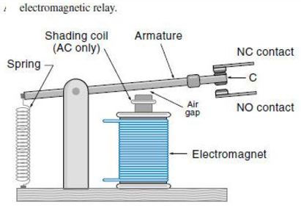

Slide 45
PARAMETERS OF RELAYS
COIL VOLTAGE- voltage that must be applied across the coil to open or close the contacts
COIL CURRENT- amount of current that must be passed through the coil to open or close the contacts
CONTACT RATING or CONTACT CURRENT- amount of current that can pass through the contact lead

Slide 46
POLES- number of circuits connected at a time
THROW- describes what happens to contact when the coil is energized
SPST
SPDT
DPST
DPDT

Slide 47
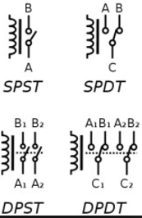
Switches

Slide 48
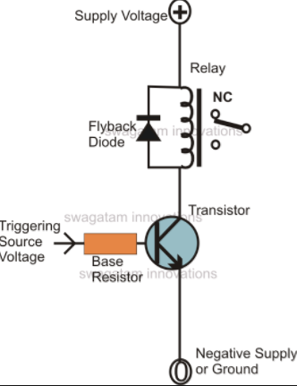
Flyback diode

Slide 49
contactors
Relays that switch high current loads
Uses a small controll current to energize or deenergize the load connected to it
Usually used to switch current to an electric motor or other high power load
Motors can be protected from over current damage through the use of overload heaters and overload contacts
Contactor consist of – contact,spring &electromagnet
Contact part-power contact+auxillary contact-connected to contact springs

Slide 50
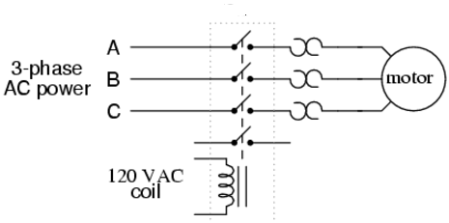
contactor
Overload heaters
Auxillary contact

