Slide 1
MACHINE VISION OR ROBOTIC VISION

Slide 2


Machine Vision in Automation
Use a camera to inspect parts to:
  Guide a robot or control automated equipment
  Support statistical analysis in a computer-assisted-manufacturing (CAM) system
  Ensure quality in manufacturing process:
    dimensions/alignment
    Determine if all components are present
    Other quality issues: color, placement, …

Slide 3
I Can See It – Why can’t the Computer?
Minimize possible problems – The human eye and brain are elaborate and versatile systems, capable of identifying objects in a wide variety of conditions. For example, we are able to identify familiar people even when they are wearing different clothes, and recognize familiar landmarks when driving on a foggy day. A PC-based imaging system is not as versatile; it can only perform what it has been programmed to perform. Knowing what the system can and cannot "see" are important points to keep in mind to obtain the results you want, and reduce errors and incorrect measurements. Common variables include:
  · Changes in object’s color
  · Changes in surrounding lighting
  · Changes in camera focus or position
  · Improperly mounted camera
  · Environmental vibration
A vibration-free environment with all extraneous light removed will eliminate many common problems.

Slide 4
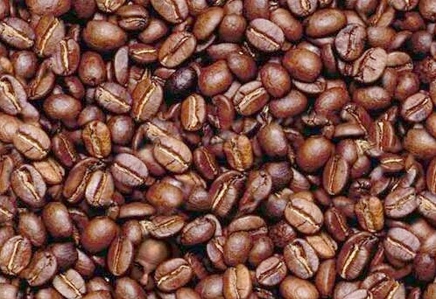
Find the man….
Visual tasks can be made difficult!

Slide 5
Computer and robot vision
Robot vision is concerned with the sensing of vision data and its interpretation by a computer and thus serves as a versatile robotic sensor.
Goal:
  Obtain useful information about the 3D world from 2D images.

Slide 6
APPLICATIONS
MACHINE VISION

Slide 7
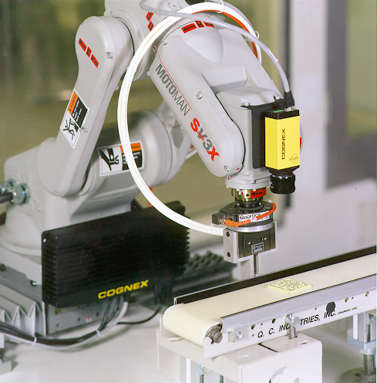
Flexible Feeding with Vision Part Finding

Slide 8
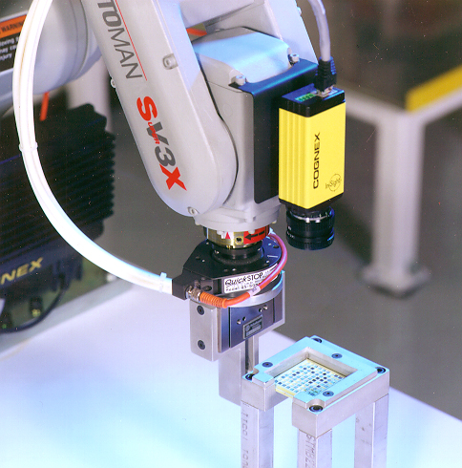
Part Finding/Inspection

Slide 9
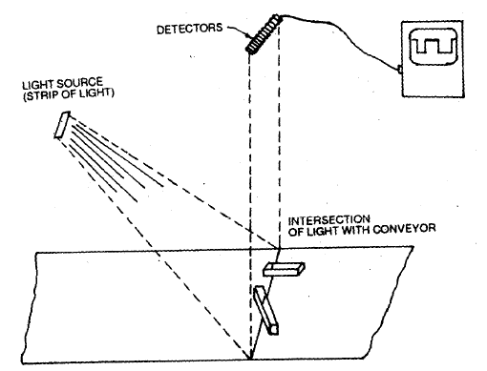
Use of a sensing array to determine the Orientation of Object moving on a conveyor belt

Slide 10
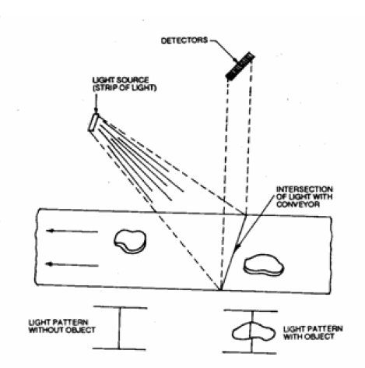
Sensing array to identify the presence of an object moving on a conveyor belt and to measure the width of the object

Slide 11
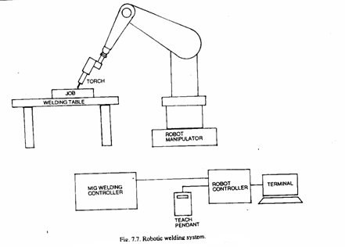
Robot Welding System with Vision
Teach box is used to position the end-effector at various points
The terminal is used for communicating with robot and also to indicate system conditions, editing and executing the robot work program
The welding path is traversed by the robot manipulator and can be programmed using programming languages such as VAL, RAIL, etc.
The various welding parameters such as feed rate, voltage, current, etc. can be incorporated in the program

Slide 12
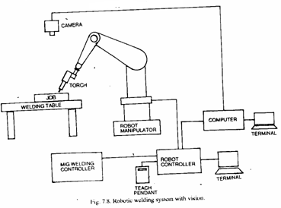
Robot Welding System with Vision
The data is processed by a set of algorithms and the relevant information is analyzed by the computer and compared by the programmed path for welding
Any kind of deviations from the programmed path can be taken care by the system itself, giving welds of uniforms and consistent quality

Slide 13




Thread inspection
Bad Component
Good Component
MACHINE VISION

Slide 14
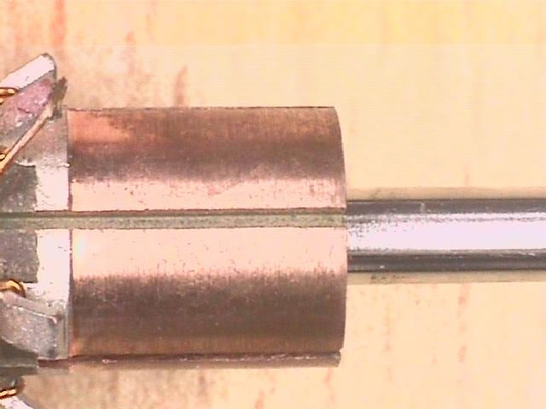
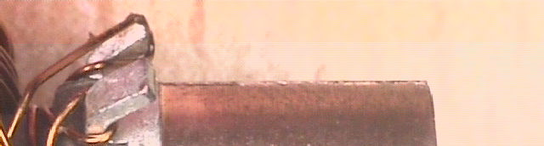
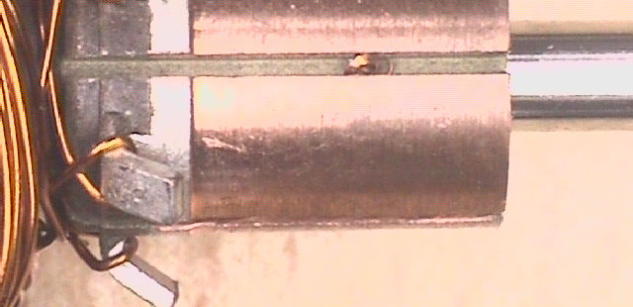
Burr inspection
Good Component
Bad Component
MACHINE VISION

Slide 15
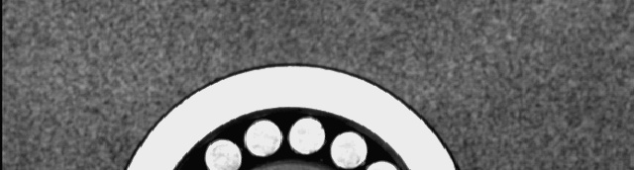
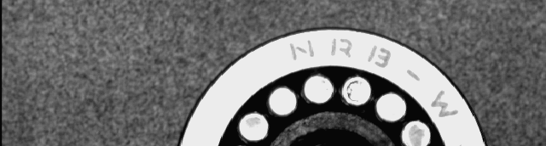
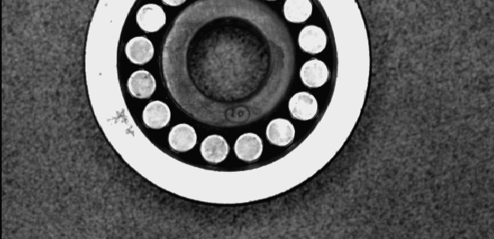
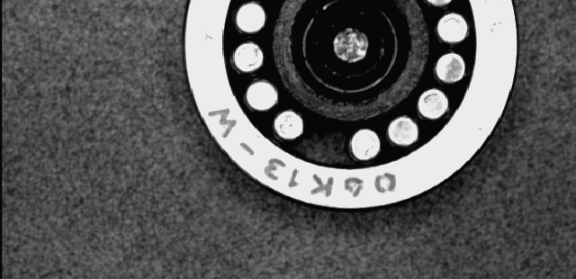
Presence/absence check of
Bearing pins
Good Component
Bad Component
MACHINE VISION

Slide 16

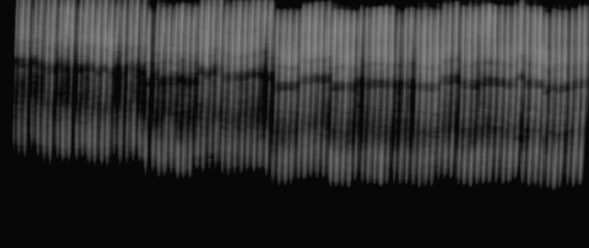
Automotive industry
• Counting the number of Piston Rings in a stack
MACHINE VISION

Slide 17
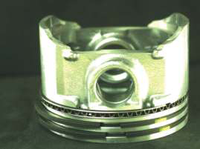
Piston Ring Inspection
Identification of Piston Ring as Face-up or Face-Down
MACHINE VISION

Slide 18
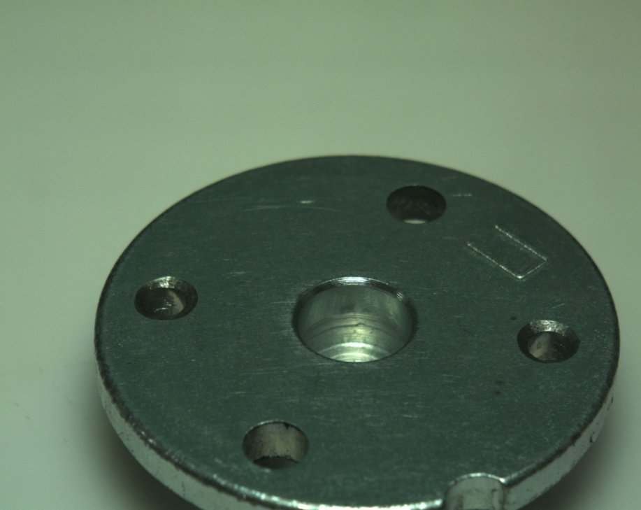
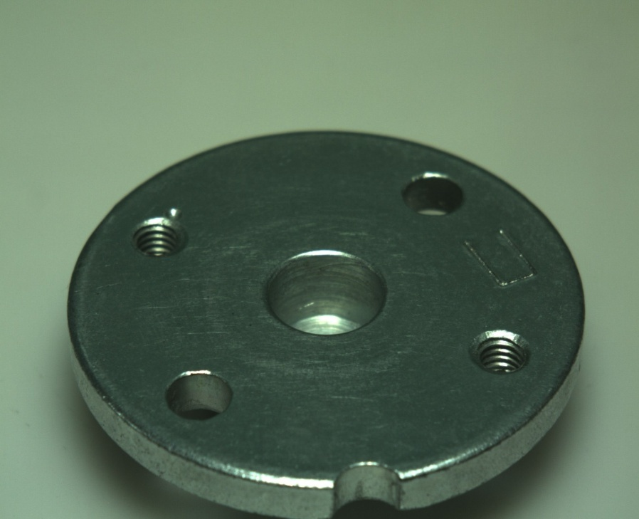
Presence/Absence of threading
Bad Component
Good Component
MACHINE VISION

Slide 19


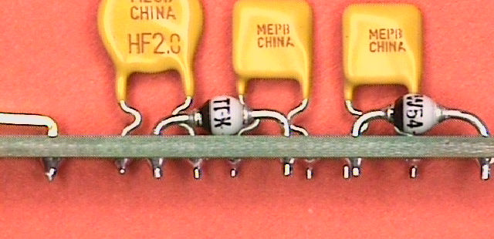
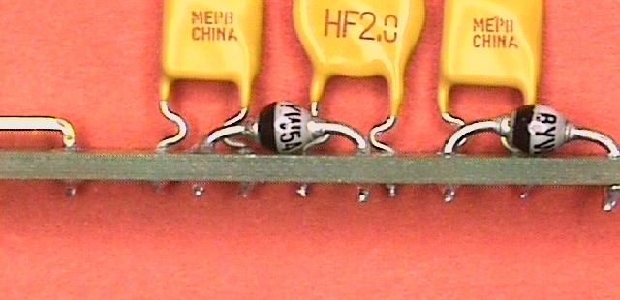
Component position check
MACHINE VISION

Slide 20
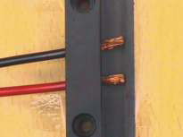
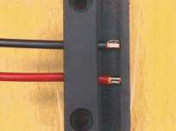
Wire Harness Inspection
Bad Component
Good Component
MACHINE VISION

Slide 21
Surface Inspection
MACHINE VISION
2-D and 3-D defects such as shrink holes, pores and indentations can be reliably recognized in different test areas and then classified based on the type of defect. Part and area contours are checked for dimensional accuracy, fractions and notches.

Slide 22
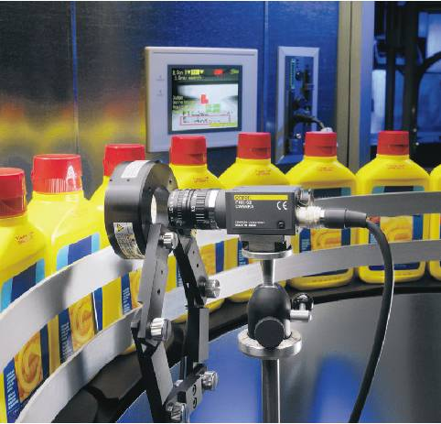
Quality Inspection in Packing Industry
Technological improvements have made Machine Vision accessible to small- and medium-size packagers so they can achieve improved results and even pursue brand risk avoidance to maintain consumer and retailer confidence.
MACHINE VISION

Slide 23
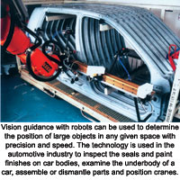
Automotive Industry
In the automotive industry, machine vision systems are used to guide industrial robots, gauge the fit of stamped metal components, and inspect the surface of the painted vehicle, weld seams, engine blocks and many other components for defects.
MACHINE VISION

Slide 24
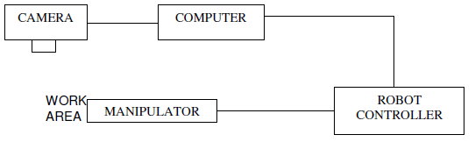
Block Diagram Of Vision System
ANALOG SIGNAL
I/F
LIGHT
FRAME
GRABBER

Slide 25
A machine vision system often includes the following elements:
  Image Acquisition (generally from a camera placed above the production line),
  Image Pre-Processing (e.g. increasing the contrast, motion de-blur, etc),
  Feature Extraction (e.g. measuring a distance, checking a screw is in place etc),
  Decisions (i.e. is the part OK to a tolerance, is a label in the correct position), and,
  Control (e.g. give the result to a Programmable Logic Controller (PLC) or robot controller).

Slide 26
A typical robot or machine vision system for assembly tasks consists of several of the following components
One or more digital or analogue cameras (black-and-white or colour) with suitable
optics for acquiring images.
A camera interface for digitizing images (frame grabber) – depends on the application,
A processor (often a PC or embedded processor, such as a DSP) – when processors
and frame grabbers integrated into the camera itself, such cameras are called
»smart cameras«,
Input/Output hardware or communication links,
Lenses to focus the desired field of view onto the image sensor,
Light source (LED, fluorescent or halogen lamps etc.),
Aa program to process images and detect relevant features,
A synchronizing sensor for part detection to trigger image acquisition and processing,
Actuators to sort or reject the processed parts.

Slide 27


Why Lighting?
If we don’t have lighting effects nothing looks three dimensional!

Slide 28
Reflected Light
The colours that we perceive are determined by the nature of the light reflected from an object
For example, if white
light is shone onto a
green object most
wavelengths are
absorbed, while green
light is reflected from
the object
White Light
Colours Absorbed
Green Light

Slide 29
Functions of Machine vision system
Image formation
Processing of Image
Analyzing the Image
Interpretation of Image

Slide 30
Vision System – Stages
Analog to digital conversion
Remove noise
Find regions (objects) in space
Take relationships(measurements)
Match the description with similar description of known objects

Slide 31
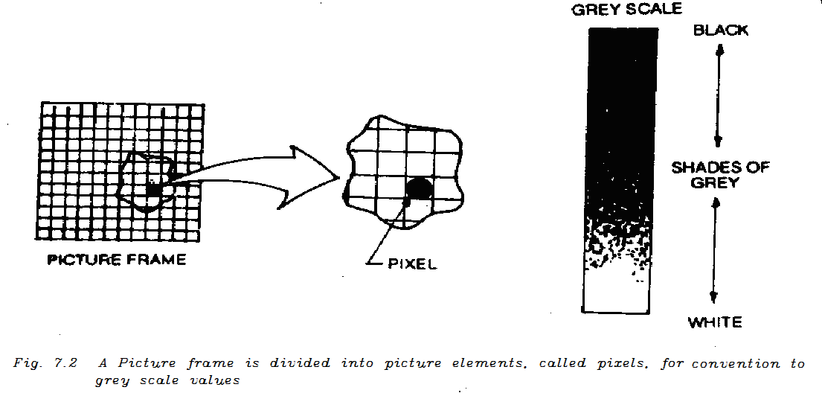
Processing of Image
An analog to digital convertor is used to convert analog voltage of each into digital value
Voltage level for each pixel is given by either 0 or 1 depends on threshold value
On the other hand grey scale system assigns upto 256 different values depending on intensity to each pixel

Slide 32
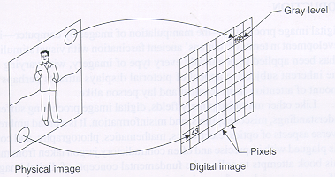
Image digitization
Sampling means measuring the value of an image at a finite number of points.
Quantization is the representation of the measured value at the sampled point by an integer.

Slide 33
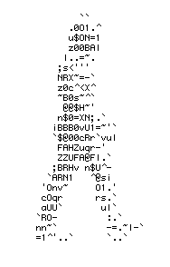
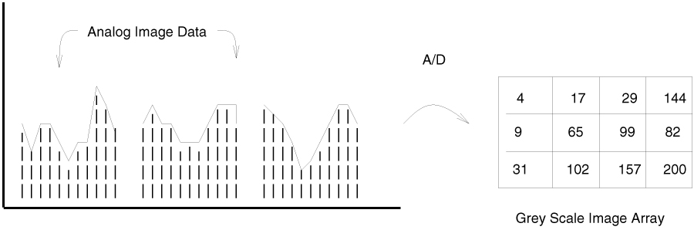
Digitization of Camera Signal
Analog image data (voltage) is sampled and quantized (often to 8 bits greyscale or 24 bits of color)

Slide 34
Object recognition
In robot assembly, a vision recognition system aims to mimic the human sense of vision and
must be capable of perceiving and detecting assembly parts as good as the humans can.
Three-dimensional object recognition entails representation of a 3-D object, identification of
the object from its image, estimation of its position and orientation and registration of
multiple views of the object for automatic model construction.

Slide 35
A typical assembly cell can functionally accomplish or support one or all of the following tasks
• grasping of an organized/randomly positioned target part from a belt or a bin,
• manipulation and placement/assembly of parts,
• part and object recognition before, during and after assembly,
• quality control and inspection,
• planning and control of the actuators and grippers to accomplish the physical
assembly.

Slide 36
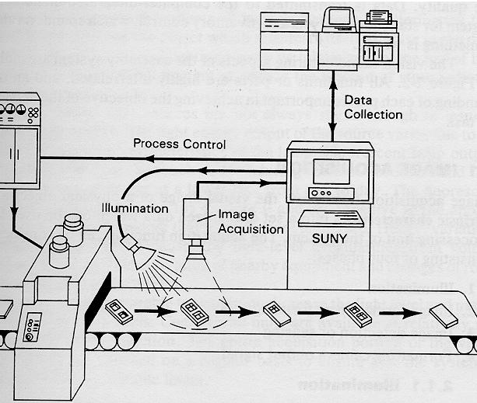
An Industrial Computer Vision System

Slide 37
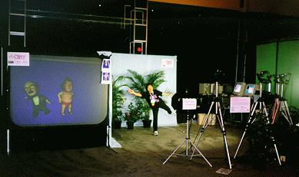
What is Computer Vision?
Deals with the development of the theoretical and algorithmic basis by which useful information about the 3D world can be automatically extracted and analyzed from a single or multiple o 2D images of the world.

Slide 38
After the image being grabbed by a robot’s computer mounted frame grabber, and ready to be processed by the vision system, this module tries to gather information from the image just by analyzing it. One example of information to acquire is the robot position within the field.

Slide 40
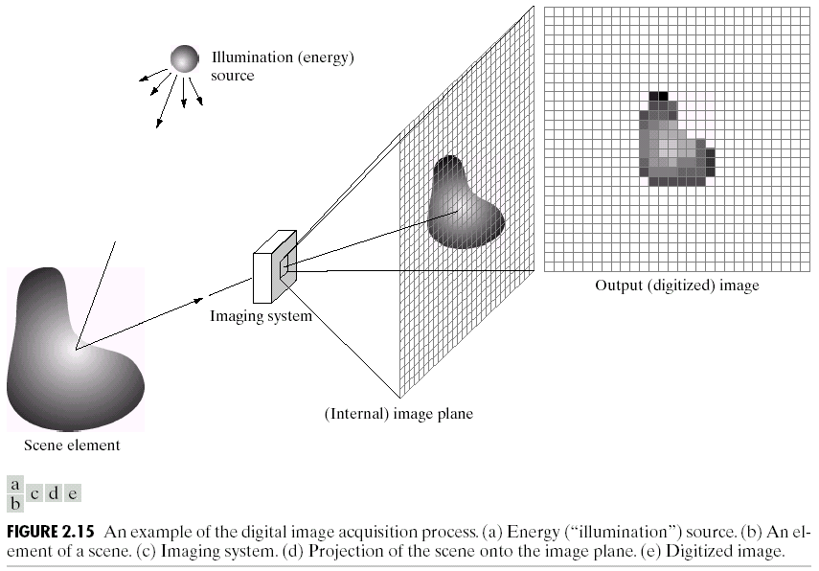

What is a Digital Image?
A digital image is a representation of a two-dimensional image as a finite set of digital values, called picture elements or pixels
Images taken from Gonzalez & Woods, Digital Image Processing (2002)
Notes:
Real world is continuous – an image is simply a digital approximation of this.

Slide 41
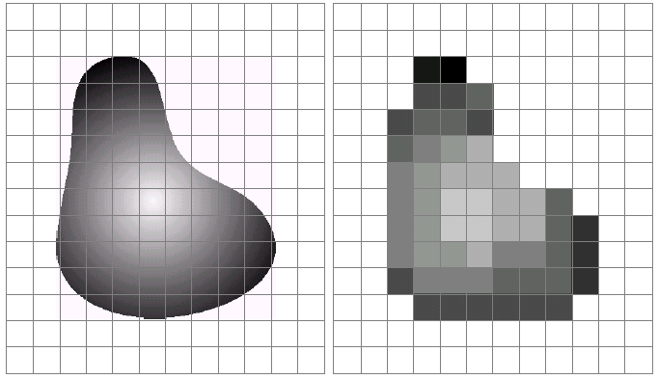
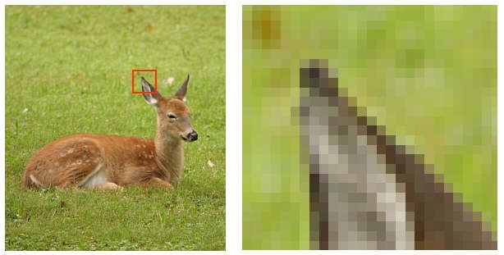
What is a Digital Image? (cont…)
Pixel values typically represent gray levels, colours, heights, opacities etc
Remember digitization implies that a digital image is an approximation of a real scene
Images taken from Gonzalez & Woods, Digital Image Processing (2002)
1 pixel

Slide 42
Key Stages in Digital Image Processing
Image Restoration
Morphological Processing
Image Enhancement
Segmentation
Image Acquisition
Object Recognition
Representation & Description
Problem Domain
Colour Image Processing
Image Compression

Slide 43
Key Stages in Digital Image Processing:
Image Aquisition
Image Restoration
Morphological Processing
Image Enhancement
Segmentation
Image Acquisition
Object Recognition
Images taken from Gonzalez & Woods, Digital Image Processing (2002)
Representation & Description
Problem Domain
Colour Image Processing
Image Compression

Slide 44
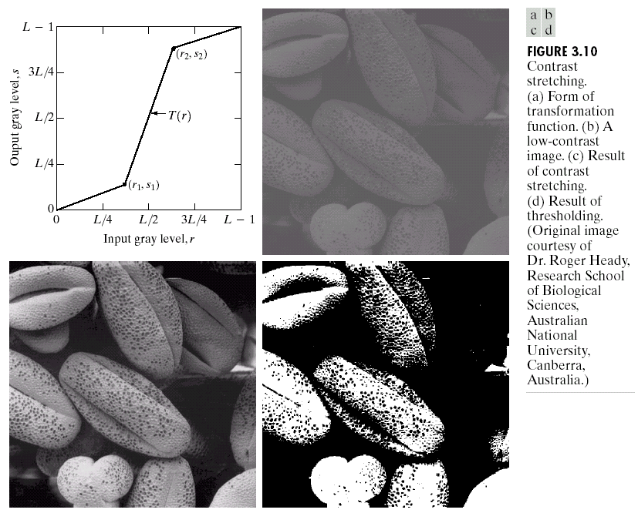
Key Stages in Digital Image Processing:
Image Enhancement
Image Restoration
Morphological Processing
Image Enhancement
Segmentation
Image Acquisition
Object Recognition
Images taken from Gonzalez & Woods, Digital Image Processing (2002)
Representation & Description
Problem Domain
Colour Image Processing
Image Compression

Slide 45
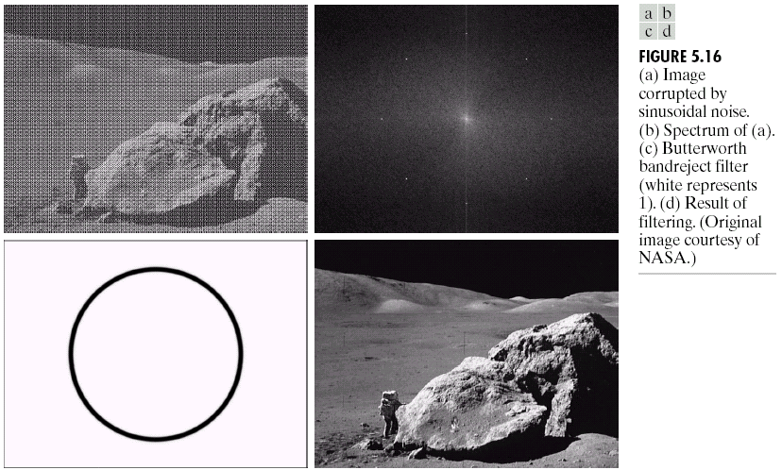
Key Stages in Digital Image Processing:
Image Restoration
Image Restoration
Morphological Processing
Image Enhancement
Segmentation
Image Acquisition
Object Recognition
Images taken from Gonzalez & Woods, Digital Image Processing (2002)
Representation & Description
Problem Domain
Colour Image Processing
Image Compression

Slide 46
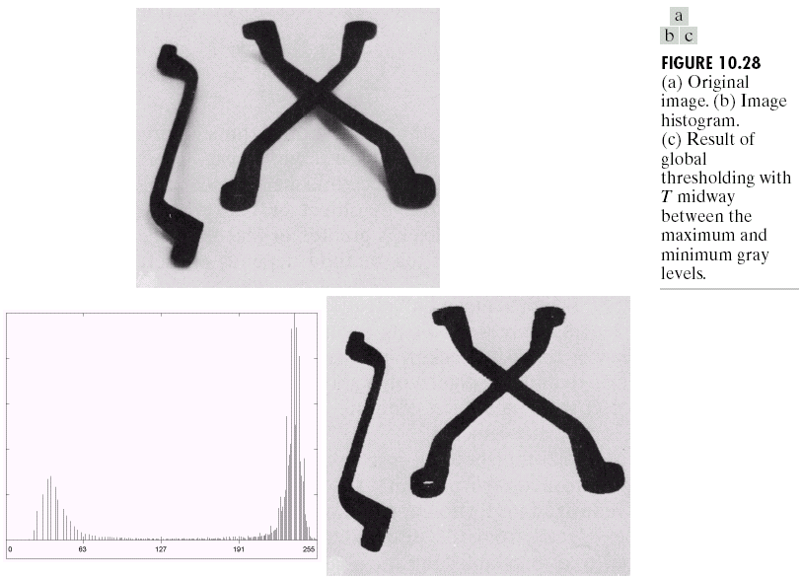
Key Stages in Digital Image Processing:
Segmentation
Image Restoration
Morphological Processing
Image Enhancement
Segmentation
Image Acquisition
Object Recognition
Images taken from Gonzalez & Woods, Digital Image Processing (2002)
Representation & Description
Problem Domain
Colour Image Processing
Image Compression

Slide 51
Ambient Light
A surface that is not exposed to direct light may still be lit up by reflections from other nearby objects – ambient light
The total reflected light from a surface is the sum of the contributions from light
sources and reflected
light

Slide 52
A Robot's More Complex World
It gets more complex when you expect an arm to pick up objects which can be in any orientation.
There are several problems
  How do you pick it up?
  How do you recognize it is there?
  How do you know you are holding it firmly?
  How do you have to change your grip to hold it the way you need to?
This is still a subject of much research

Slide 54
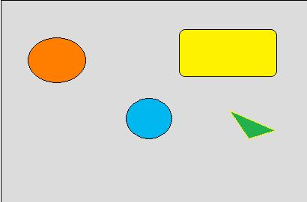
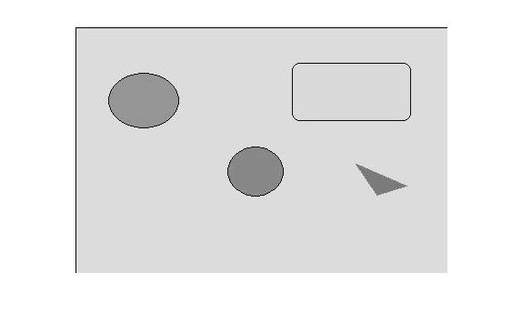
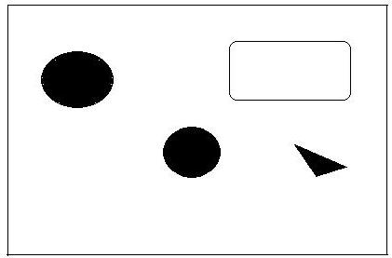
Color Space Conversion
RGB
Grayscale
Binary
I = rgb2gray(imrgb);
threshold = graythresh(I);
bw = im2bw(I,threshold);
imshow(bw)

Slide 55


Image Thresholding Using RGB Image
for i=1:279
for j=1:396
if((RGB(i,j,1)<100 ) && (RGB(i,j,2)>100 && RGB(i,j,2)<200) && (RGB(i,j,3)>200 ))
GREY(i,j)=255;
else
GREY(i,j)=0;
end
end
end

Slide 56

Labeling Connected Objects
[L,num] = bwlabel(BW,n)
BW =
[1 1 1 0 0 0 0 0
1 1 1 0 1 1 0 0
1 1 1 0 1 1 0 0
1 1 1 0 0 0 1 0
1 1 1 0 0 0 1 0
1 1 1 0 0 0 1 0
1 1 1 0 0 1 1 0
1 1 1 0 0 0 0 0];
L = bwlabel(BW,4)
L =
1 1 1 0 0 0 0 0
1 1 1 0 2 2 0 0
1 1 1 0 2 2 0 0
1 1 1 0 0 0 3 0
1 1 1 0 0 0 3 0
1 1 1 0 0 0 3 0
1 1 1 0 0 3 3 0
1 1 1 0 0 0 0 0
4 Connected
8 Connected

Slide 57
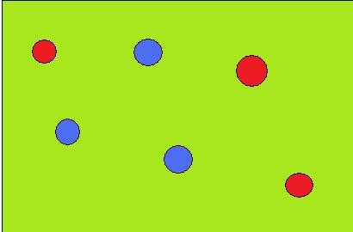
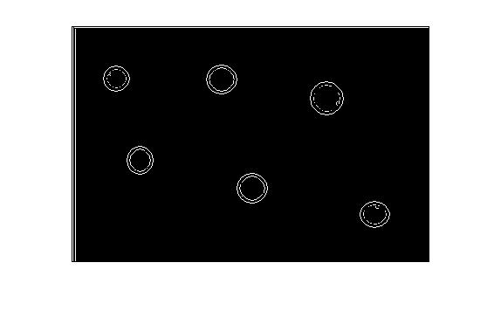
Edge Detection
Canny, Sobel
Edge Operator
Basic idea: Finding the gradient of the image in the x and y directions. Around the boundary of the objects, the intensity varies steeply, hence a derivative of intensities results in the edge of the boundaries.

Slide 58
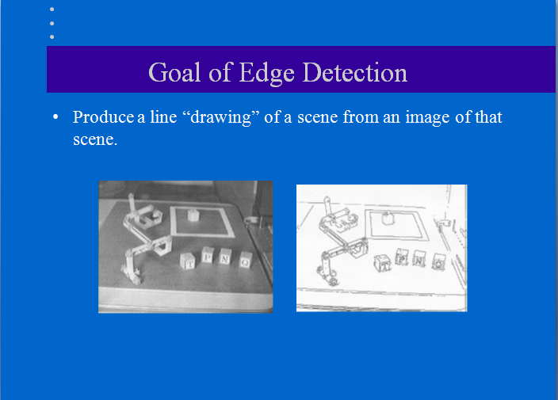

Slide 59
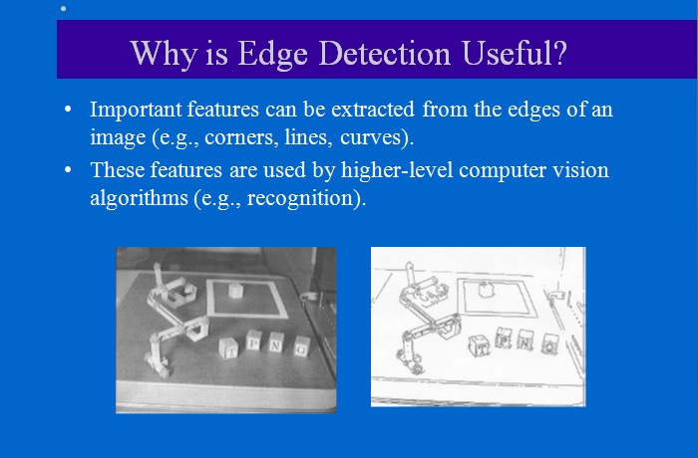

Slide 60
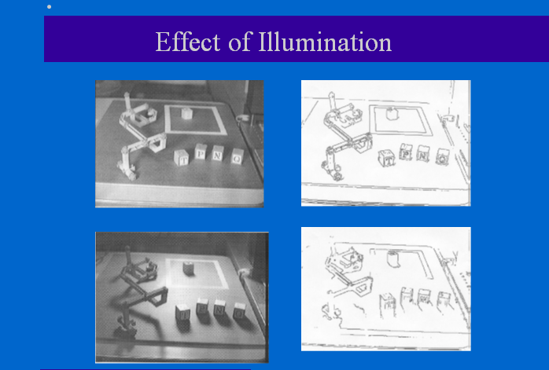

Slide 61
Feature Extraction/Analysis
2D Geometric Analysis:
  Must have high contrast to separate (“segment”) part from background
    In practice back lighting is often used
    The silhouette is used to determine:
      part dimensions: Width, height, orientation, etc
      Part features (e.g. number of holes)
      Relationships between parts

Slide 62

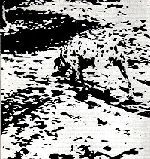
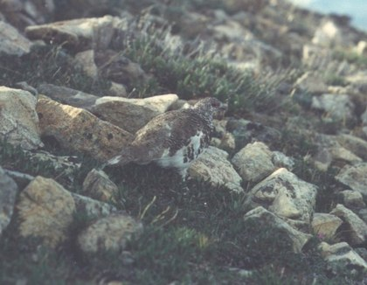

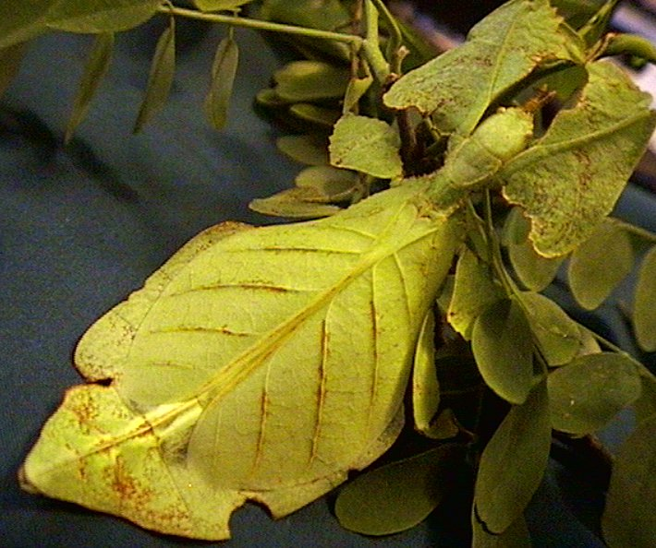
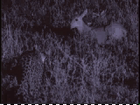
Distractors
Natural systems take advantage of the fact that visual tasks can be made difficult!

Slide 63
In robotic assembly, vision sensors have a different role than - for example - in mobile robots, where the tasks usually involve exploration of the environment. A robotic assembly cell represents a relatively well ordered environment and is part of an integrated manufacturing process, rather than operating in isolation.
The application of vision systems in robot-based assembly systems can be simplified, when products and components are designed for a robot-based assembly and if parts are fed to the system with a relatively accurate position and orientation.
The major role of vision sensors in a robot assembly cell is to compare reality with
expectations and to evaluate discrepancies. Essentially this means detecting presence or
absence of correct parts and measuring to allow for the detection of component tolerances
and positioning errors during relevant stages of assembly.

