Slide 1
ACTUATORS
Actuator-is a type of motor for moving or controlling a mechanism or system . It is operated by a source of energy, usually in the form of an electric current, hydraulic fluid pressure or pneumatic pressure, and converts that energy into some kind of motion.

Slide 2
Types of Actuators
ELECTRIC
PNEUMATIC
HYDRAULIC

Slide 3
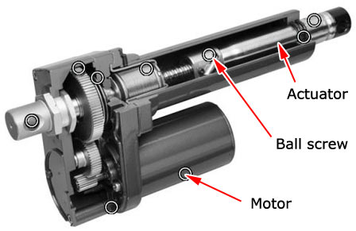
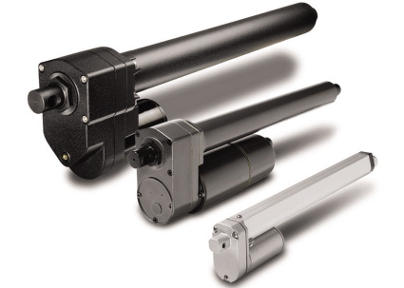
ELECTRIC

Slide 4
ELECTRIC MOTORS
is an electromechanical device that converts electrical energy into mechanical energy.

Slide 5
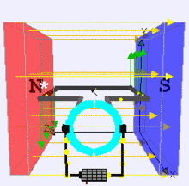
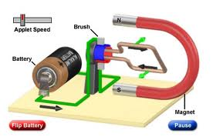
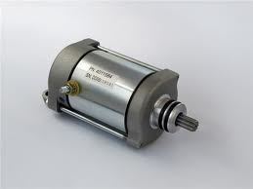
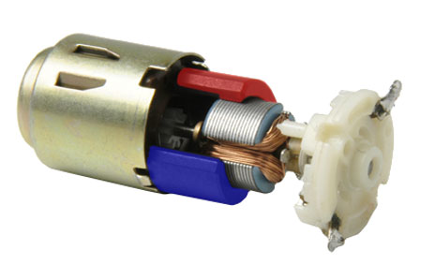
DC Motors

Slide 6
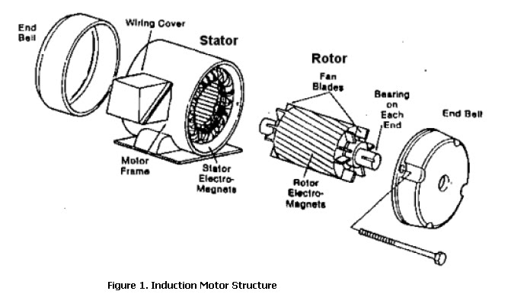
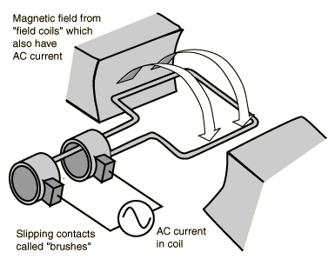
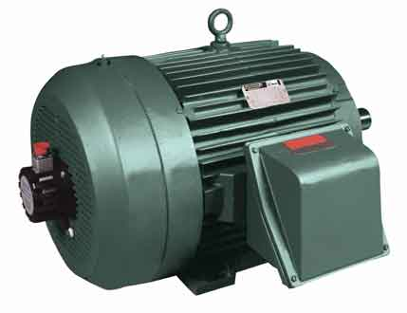
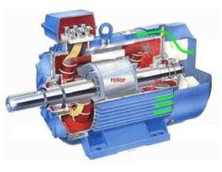
AC Motor

Slide 7
STEPPER MOTOR
(or step motor) is a brushless DC electric motor that divides a full rotation into a number of equal steps.

Slide 8
Types
Permanent magnet
Hybrid synchronous stepper
Variable reluctance stepper

Slide 9
Permanent magnet stepper
PM stepper motors generally are thought of as low-torque, large step-angle devices. Torque developed by the stepper motors is far below that for equivalent-size hybrid stepper motors, and step angle generally is 90 or 45°.

Slide 10
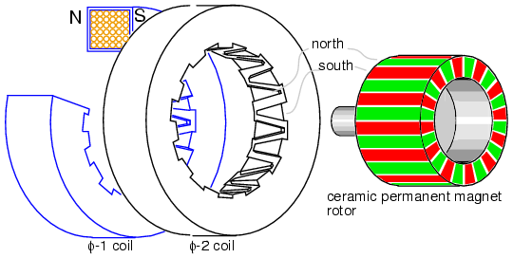
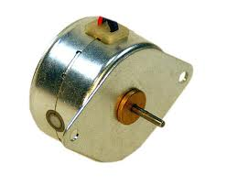

Slide 11
Hybrid synchronous stepper
are named because they use a combination of PM and VR techniques to achieve maximum power in a small package size.

Slide 12
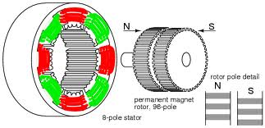
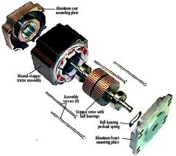

Slide 13
Variable reluctance stepper
  have a plain iron rotor and operate based on the principle that minimum reluctance occurs with minimum gap, hence the rotor points are attracted toward the stator magnet poles.

Slide 14
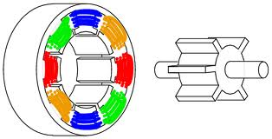
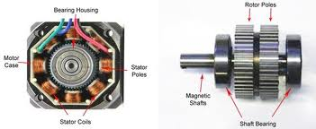

Slide 15
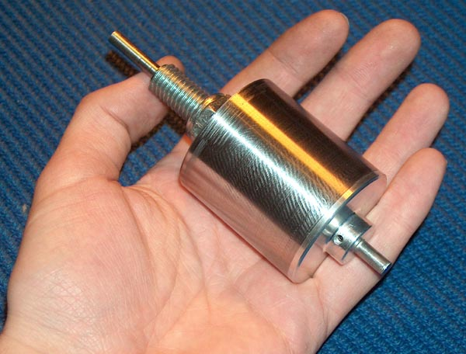
BLDC MOTOR

Slide 16
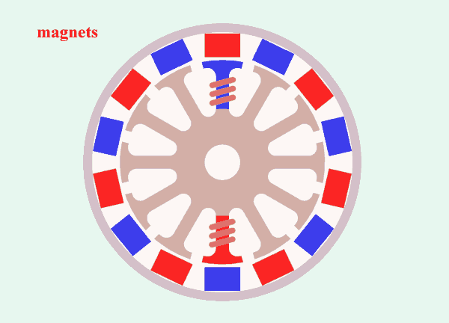
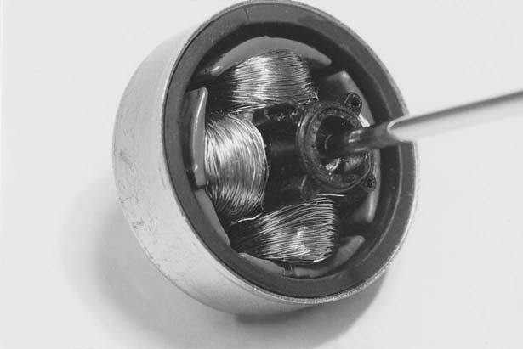
BLDC – OUTER ROTOR
Outer-Rotor Motors. These motors are generally used where relatively high rotor
inertia is beneficial to system performance. Common applications are computer disk
drives and cooling fans.
The outer-rotor motor has much more magnetic material than the inner-rotor device, which means it is capable of more flux when the identical materials are used.

Slide 17
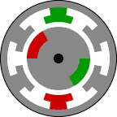
BLDC – INSIDE ROTOR
The inertia of the inner-rotor motor is lower because of its smaller rotor diameter.
Therefore, it accelerates more rapidly than the outer-rotor motor.
It would be necessary to use a higher-energy-product magnet to get the same performance from an inner rotor motor.

Slide 18
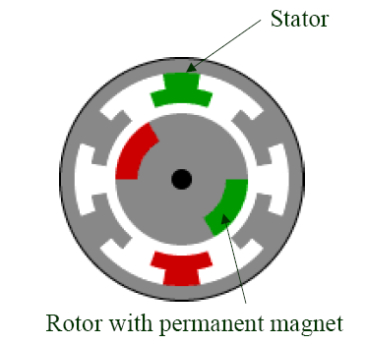
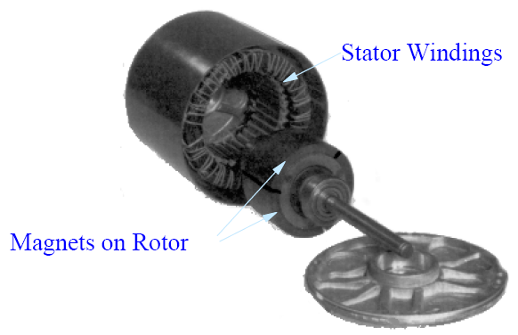
2. BLDC motor structure
(A)
(B)
Cross-section view of a brushless dc motor
(B) A picture of a brushless dc motor
Fig1. Structure of a brushless dc motor

Slide 19
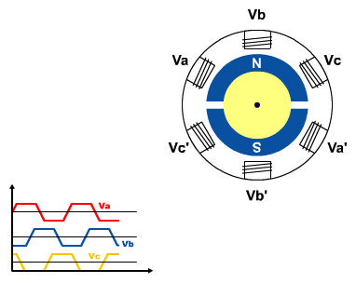
2. BLDC motor structure
Fig 2. BLDC motor rotation
In a brushless DC motor the position of the coils (phases), with respect to the permanent magnet field, are sensed and the current switched electronically (commutated) to the appropriate phases. Hall Effect sensors are typically used to sense the rotor position. Otherwise, sensorless techniques are used.

Slide 20
As the phases are switched in sequence A-B-C, the rotor moves to line
up with the subsequent phase. When the rotor has moved 180° electrical, it is necessary
to reverse the current in the windings, starting with phase A, in order to properly
polarize the stator poles with respect to the magnet poles.

Slide 21
PNEUMATICS & HYDRAULICS ACTUATORS

Slide 22
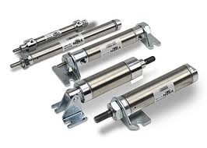
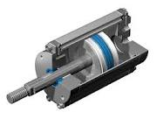
PNEUMATIC

Slide 23
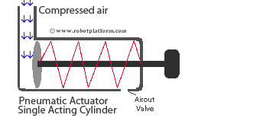
Pneumatic actuator
converts energy (typically in the form of compressed air) into mechanical motion. The motion can be rotary or linear, depending on the type of actuator.
convert energy formed by compressed air at high pressure into ether linear or rotary motion. Pneumatic energy is more desirable for main engine controls because it can quickly respond in starting and stopping as the power source does not need to be stored in reserve for operation.

Slide 24

Pneumatic artificial muscles
(PAMs) are contractile or extensional devices operated by pressurized air filling a pneumatic bladder.
Air muscle contracting and extending

Slide 25
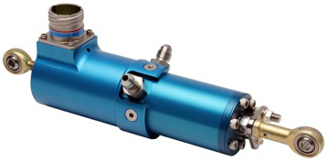
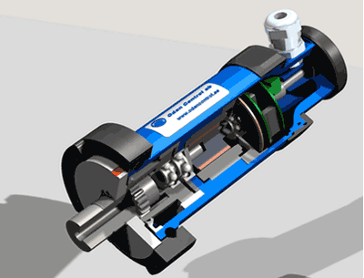
HYDRAULIC

Slide 26
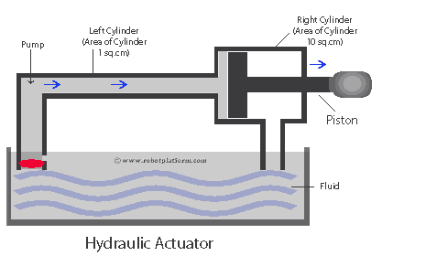
Hydraulic actuator
A cylinder or fluid motor that converts hydraulic power into useful mechanical work. The mechanical motion produced may be linear, rotary, or oscillatory. Operation exhibits high force capability, high power per unit weight and volume, good mechanical stiffness, and high dynamic response. These features lead to wide use in precision control systems and in heavy-duty machine tool, mobile, marine, and aerospace applications.

Slide 27
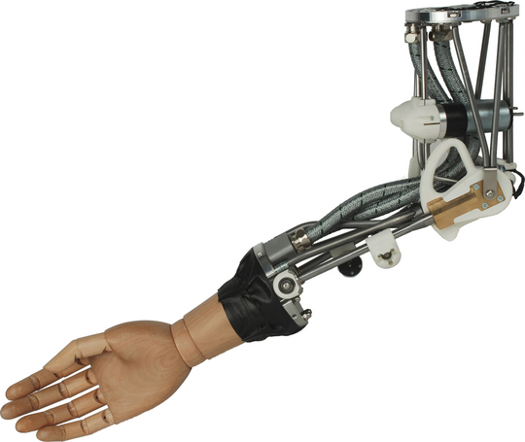
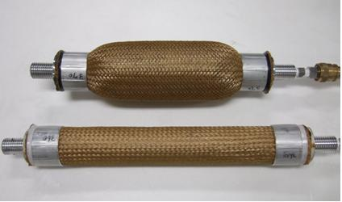
Hydraulic artificial muscles
offer all the same advantages of pneumatic artificial muscles, such as compliance, light weight, low maintenance, and low cost, when compared to traditional fluidic cylinder actuators.

Slide 28
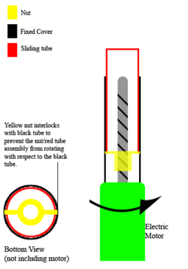
The system converts rotary motion (in the form of an electric motor) to linear motion. When an electrical source is applied to the motor, the threaded shaft is driven and the nut rides up and down the shaft in the corresponding direction. This action provides an extension and retraction capability for tasks requiring a linear displacement. Note that in this example the nut and red tube do not rotate, merely "ride" the threads on the spinning shaft up and down.

Slide 29
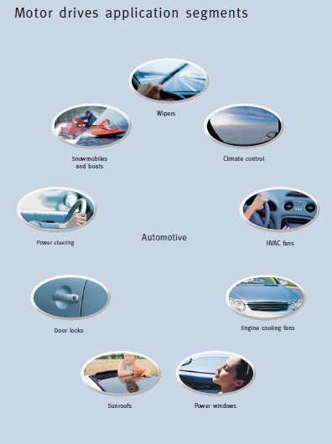

Slide 30
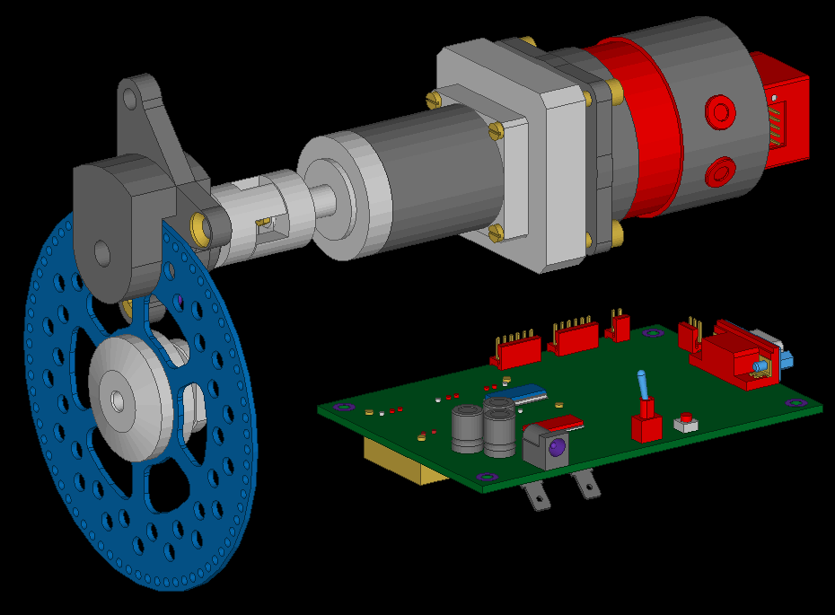

Slide 31
