Slide 1
ROBOT CLASSIFICATION
Robots may be classified, based on:
Depending on Configuration
Depending on type of control system
Fixed or variable sequence
Point to Point or continuous controlling robots

Slide 2
Robot Classification Based On Kinematic Structure
Normally, robot manipulators are classified
according to their arm geometry or kinematic
structure
CartesianTypeConfiguration(LOO)
Cylindrical Type Configuration (TLO)
Spherical Type Configuration (TRL)
SCARA Type Configuration (VRO)
Revolute Type Configuration (RRR/TRR)

Slide 3
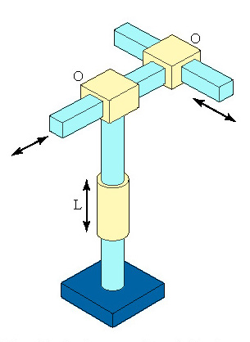
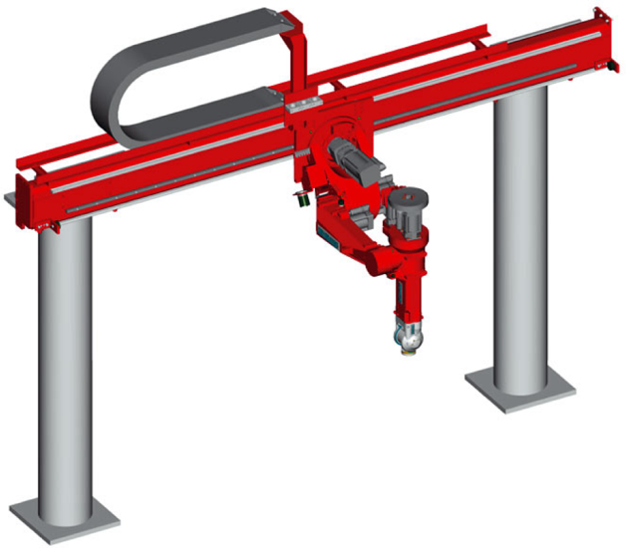
Cartesian Coordinate
Body-and-Arm Assembly
Notation LOO:
Consists of three sliding joints, two of which are orthogonal
Other names include rectilinear robot and x-y-z robot
These are low technology robot

Slide 4
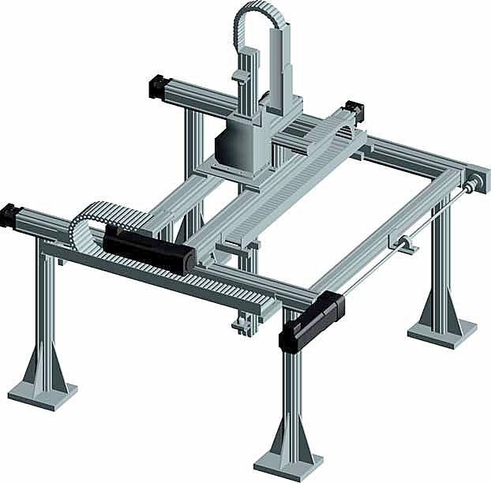
Application, Uses and Advantages of Cartesian robot or Gantry robot
1. Cartesian robot is used in - CNC machine..
- drawing machines and milling.
-glue gun testing plant.
-handling machine tools.
-assembly operations.
-arc welding.
ADVANTAGES
simple controls
easy to visualize
rigid structure
easy to program
good accuracy and repeatability
DISADVANTAGES
exposed guiding surfaces need covering to prevent corrosion
Requires large floor space
can reach only infront of itself
Iimited in movement

Slide 5
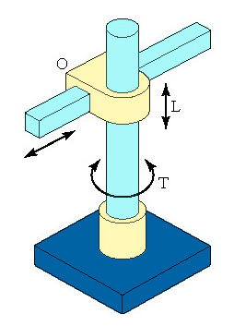
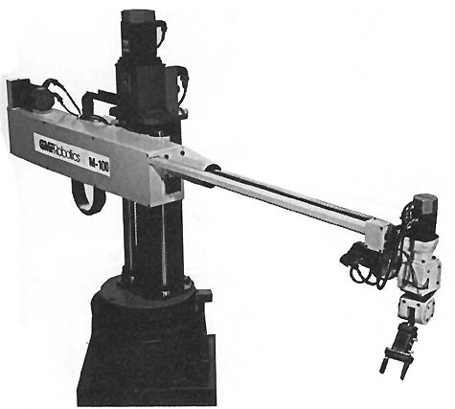
Cylindrical Body-and-Arm Assembly
Notation TLO:
Consists of a vertical column, relative to which an arm assembly is moved up or down
The arm can be moved radially in or out relative to the column
cylindrical work space
Have one rotary joint at the base and linear joints to connect tne succeeding links

Slide 6
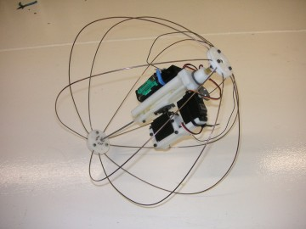
Application, Uses and Advantages of Cylindrical robot or spherical robot
1. Cylindrical robot is used in -controlling cylindrical coordinate system.
-handling at machine tools
-gearing and belt system.
-assembly operations.
- Grinders and grinding machines
- spot welding.
-diecasting machines.
-component handling machines
ADVANTAGES
rigid structure
easy to program
good repeatability and accuracy
Larger workspace than cartesian robot
DISADVNTAGES
can’t reach above itself
linear axes hard to seal
requires sophisticated contro system
cannot each around obstacles

Slide 7
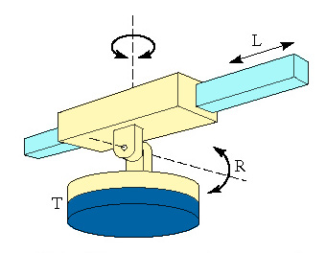
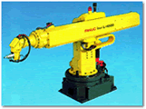
Polar Coordinate
Body-and-Arm Assembly
Notation TRL:
Consists of a sliding arm (L joint) actuated relative to the body, which can rotate about both a vertical axis (T joint) and horizontal axis (R joint)
Also called spherical robot

Slide 8
Application, Uses and Advantages of Polar robot
Polar robot is used for - spot welding.
        - rotational motion.
        - polar environments.
        - arc welding.
        - medical benefits.
        - gas welding.
        ADVANTAGES
        -simple design
        -high payloads
        -light weight
        -easy to programme
        -good precision
        DISADVANTAGES
        -sophisticated control system
        -limited vertical movement
        -lower mechanical rigidity
        -positional error is proportional to the radius of arm movement

Slide 9
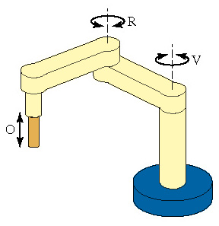
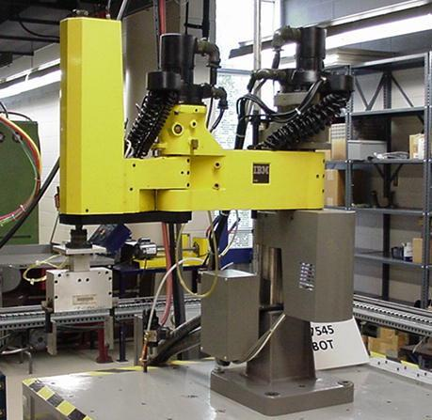
SCARA ROBOT
Notation VRO
SCARA stands for Selectively Compliant Assembly Robot Arm
Similar to jointed-arm robot except that vertical axes are used for shoulder and elbow joints to be compliant in horizontal direction for vertical insertion tasks

Slide 10
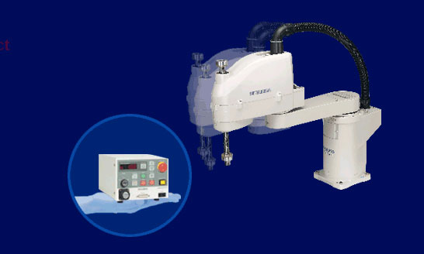
Application, Uses and Advantages of SCARA robot
SCARA robot is used for- assembly operations.
- three axes to traverse.
- as machine tools.
- pick and place operations
ADVANTAGES
-High speed
-Large work area for floor space
-Height axis rigid
-Easy to program
DISADVANTAGES
-Limited applications
-highly complex arm

Slide 11
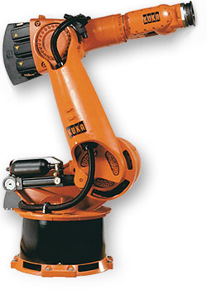
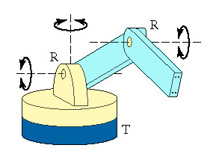
Jointed-Arm Robot
Configuration similar to human arm
The links are connected by two rotational joints corresponding to human shoulder and elbow
Awrist is attached to the end of the forearm
Notation TRR:

Slide 13
Application, Uses and Advantages of Articulated robot
Articulated robot is used for - diecasting.
- carrier robot.
- gas welding
- high-performance hardware.
- arc welding.
-Synchronous Positioning Control Technique
- rapidly calculation and integration.
- assembly operations.
- spray painting.

