Slide 1
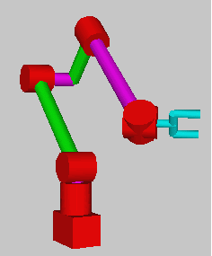
ROBOT ANATOMY
– Arm or Manipulator
– End effectors
– Drive Mechanism
– Controller
– Custom features: e.g. sensors and transducers
Links
Joints:
End Effector
Robot Base

Slide 2
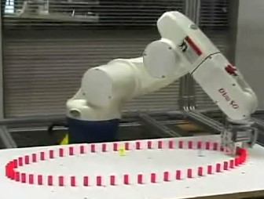
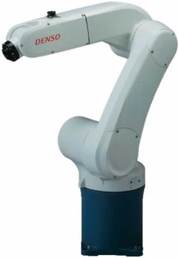
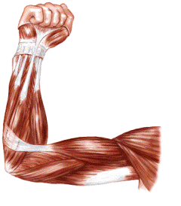
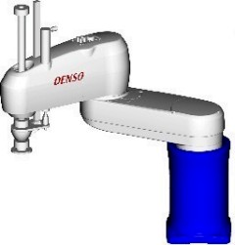
ROBOT ARM (MANIPULATOR)
The most common manufacturing robot is the robotic arm
The robot arm is probably the most mathematically complex robot you could ever build.
A collection of links inter- connected by flexible joints. At the end of the robot there is a tool or end-effector

Slide 3
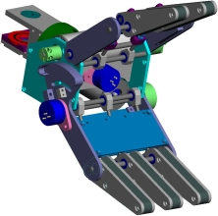
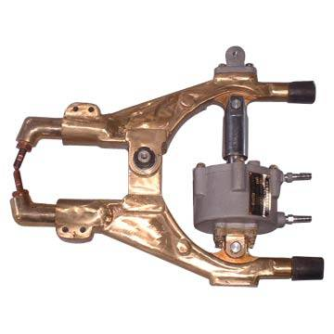
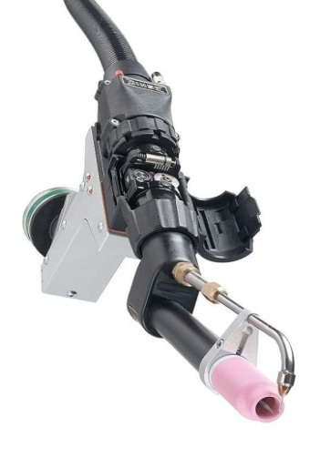
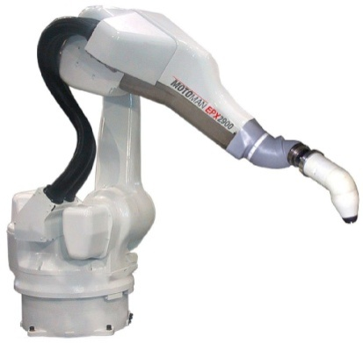
  Grippers – to grasp and manipulate objects (e.g., parts) during work cycle
:mechanical, magnetic and pneumatic.
Tools: Tools are used where a specific operation needs to be carried out such as welding, painting drilling etc. - the tool is attached to the robotic arm

Slide 4
ROBOT LINK
Links are rigid components that form a chain connected together by joints
Each joint has two links, known as an input link and an output link

Slide 5
JOINT
A joint of robot is similar to a joint in the human body
Relative movements between the various components of the body, arm and the wrist are provided by a series of joints
Each joint gives the robot with a degree-of-freedom (DOF) of motion
In the nearly all cases, only 1 DOF is allowed to a joint

Slide 6
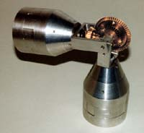
Types of joints
Linear joint
Orthogonal joint
Rotational joint
Twisting joint
Revolving joint
A robot joint

Slide 7
LINEAR JOINTS
Linear joints are also known as prismatic joints as the cross section of the joint is considered as a prism. These joints permit links to move in a linear relationship.
Two types : prismatic joint
: orthogonal joint

Slide 8
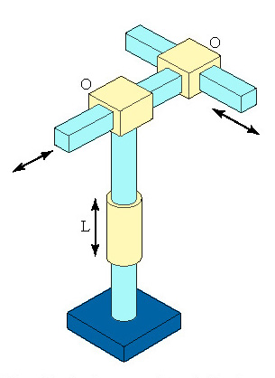

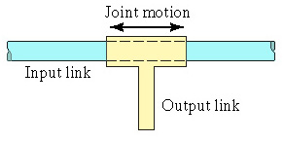
PRISMATIC JOINT (L)
ORTHOGONAL JOINT(O)
This is also linear sliding motion, but the input and output links
are perpendicular to each other during the move
The relative movement between the input link and the output link is a linear sliding motion, with the axes of the two links being parallel

Slide 9
REVOLUTE JOINTS
Revolute joints permit only angular motion between the links.The various types are
Rotational (R)
Twisting (T)
Revolving (V)

Slide 10
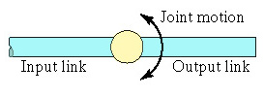
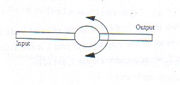
ROTATIONAL JOINT ( R)
This type provides a rotational relative motion of the joints, with the axis of rotation perpendicular to the axes of the input and output links

Slide 11
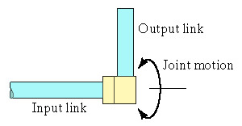
REVOLVING JOINT (V)
In this types, the axis of the input link is parallel to the axis of rotation of the joint, and the axis of the output link is perpendicular to the axis of rotation

Slide 12
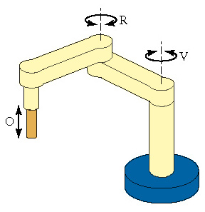
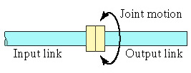
TWISTING JOINT
This joint also involves a rotary motion, but the
axis of rotation is parallel to the axes of the two links

Slide 13
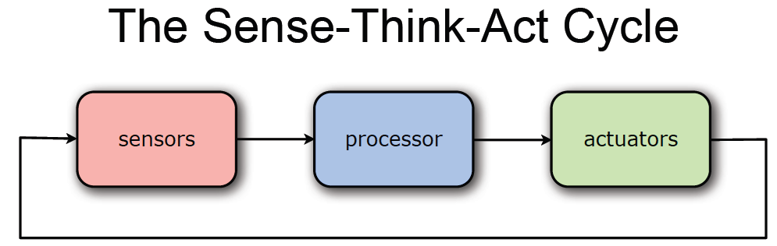
ROBOT CONTROLLER

Slide 14
Humans pick things up without thinking about the steps involved. In order for a robot or a robotic arm to pick up or move something, someone has to tell it to perform several actions in a particular order — from moving the arm, to rotating the “wrist” to opening and closing the “hand” or “fingers.” .So, we can control each joint through computer interface

Slide 15
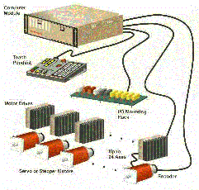
ROBOT CONTROLLER
The controller is the robot's brain and controls the robot's movements. It's usually a computer of some type which is used to store information about the robot and the work environment and to store and execute programs which operate the robot. The control system contains programs, data algorithms, logic analysis and various other processing activities which enable the robot to perform.

Slide 16
The control system helps to get your robot actuators to do what you want without going out of control.
The sensor on the actuator will determine what is changing.
The program you write defines what the final result should be.
The actuator actually makes the change.
Another sensor could sense the environment, giving the robot a higher-level sense of where to go.
Adding intelligence to the robot means adding new sequences to the program.

Slide 17
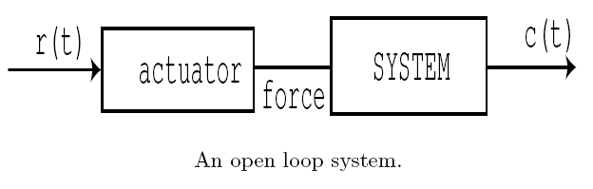
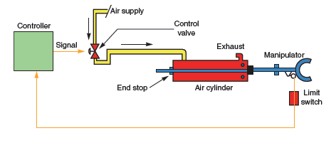
This type of control does not require the use of sensors, since state is not fed back into the system.
Such systems can operate (perform repetitive, state-independent tasks) only if they are extremely well calibrated and their environment does not change in a way that affects their performance.

Slide 18
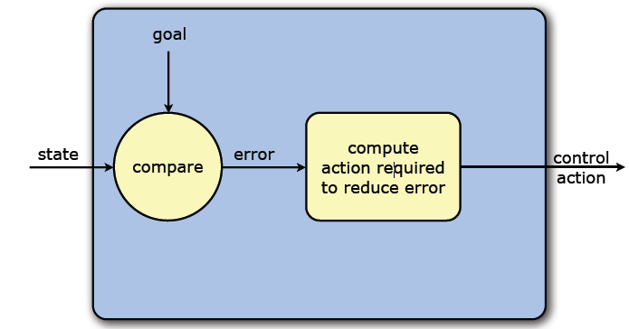
CLOSED LOOP SYSTEM
Feedback Control Loop
Determine rotor position and/or speed from one or more sensors. Position of robot arm is monitored by a position sensor, power to the actuator is altered so that the movement of the arm conforms to the
desired path in terms of direction and/or velocity. Errors in positioning are corrected.

Slide 19
