Slide 1
ROBOTICS
The robot is seen as a machine that is able to modify the environment in which it operates.
Accomplished by -actions that are conditioned by certain rules of behavior
    -data the robot acquires on its status and on the environment.

Slide 2
Robotics is commonly defined as the science studying the intelligent connection between perception and action.
The essential component of a robot
T he mechanical system with a locomotion apparatus (wheels, crawlers, mechanical legs)
A manipulation apparatus (mechanical arms, end-effectors, artificial hands).

Slide 3
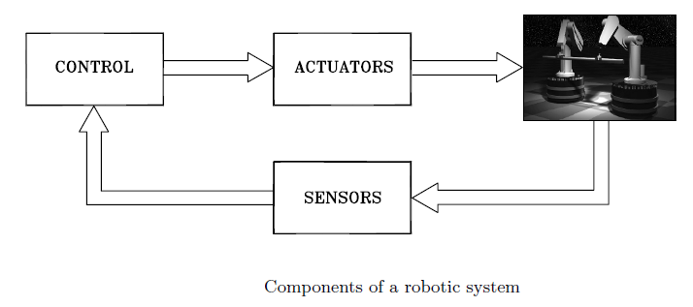
The capability to exert an action, both locomotion and manipulation, is provided by an actuation system-motion control system ,drives, transmission systems
The capability for perception is achieved by a sensory system which can acquire data on the internal status of the mechanical system as well as on the external status of the environment.
The capability for connecting action to perception in an Intelligent fashion is provided by a control system which can command the execution of the action depending on the constraints imposed by the robot and the environment
Therefore, it can be recognized that robotics is an interdisciplinary subject
concerning the areas of mechanics, control , computers, and electronics.

Slide 4
ROBOT CELL LAYOUT
How robots are arranged in an automated industry?

Slide 5
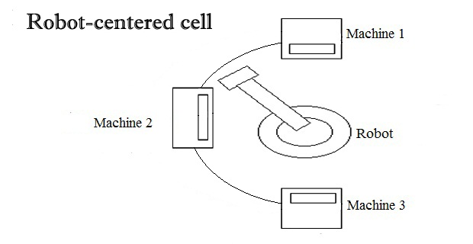
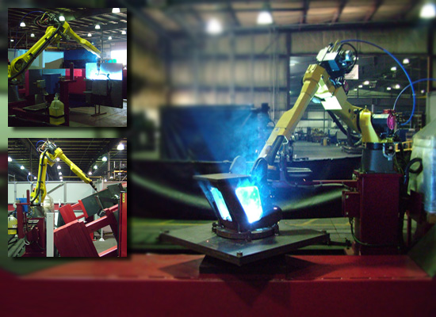
Robot-centered cell
  commonly used layouts in the industrial applications. In this arrangement, a single robot will be incorporated at the centre of the work cell for performing operations on several machines that are set in a semi-circle form.

Slide 6
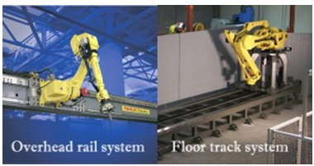
MOBILE ROBOT WORKCELL
In the mobile robot work cells, the robots are arranged to move at different places in the cell. It is made possible by attaching the robot in a movable bottom, which is connected to the rail system. This system can be done by either anyone of the following methods:
Overhead rail system
Floor track systemIn the mobile robot work cells, the robots are arranged to move at different places in the cell. It is made possible by attaching the robot in a movable bottom, which is connected to the rail system. This system can be done by either anyone of the following methods:
Overhead rail system
Floor track system

Slide 7
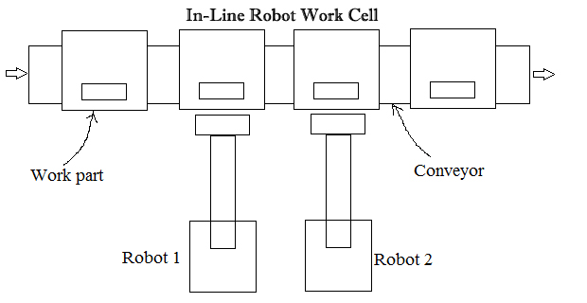
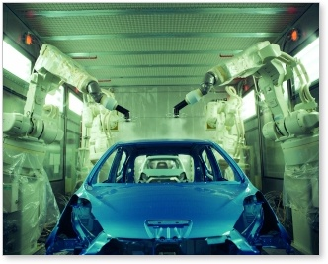
IN-LINE ROBOT CELL
An In-Line robot cell arrangement has a movable conveyor with the work parts. This conveyor travels near the robots for performing a function on the work parts. This type of arrangement is mostly used in the automobile industries for assembling the car bodies. To be more specific, the robots are placed beside the assembly line to carry out some operations like spot welding.

Slide 8
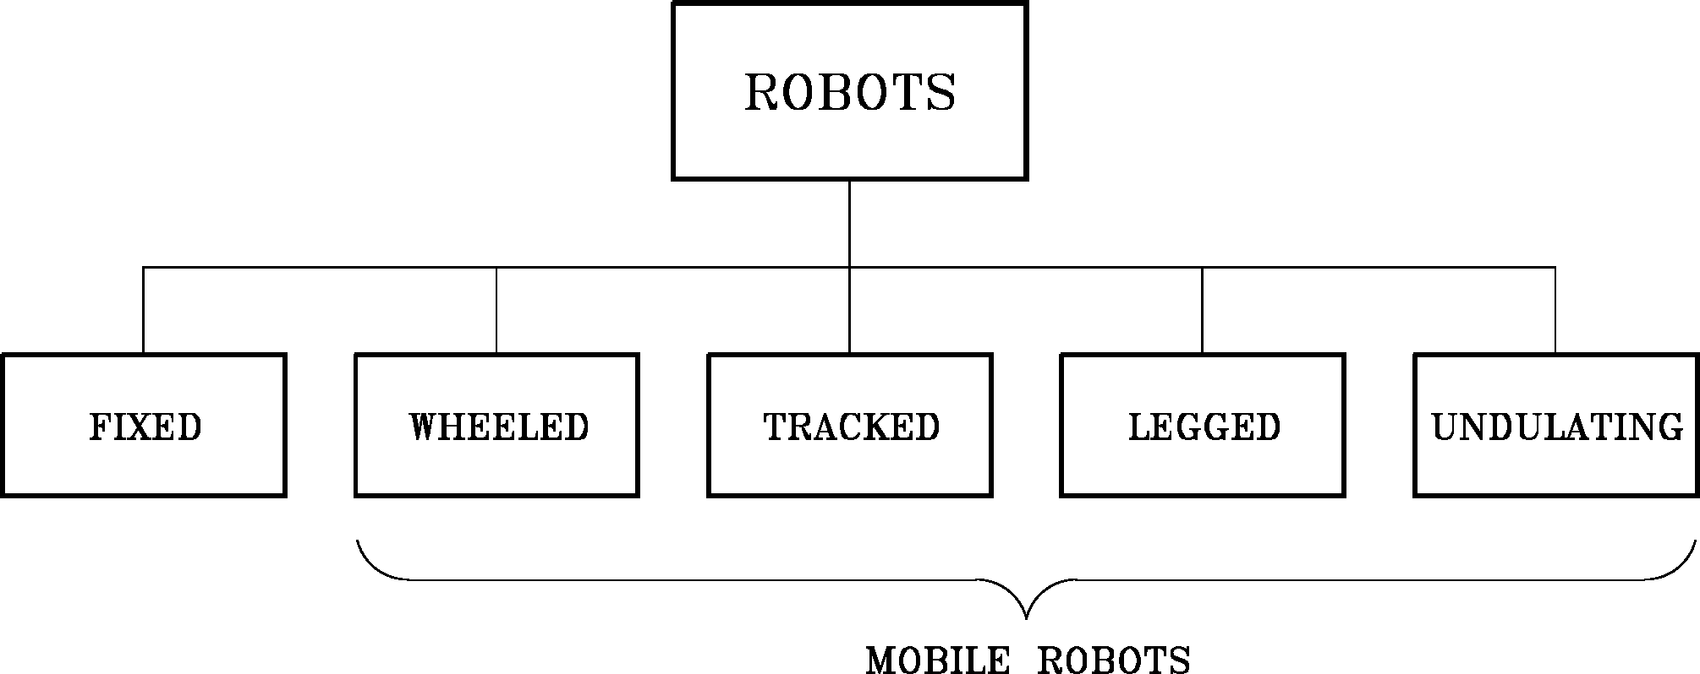
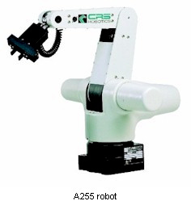
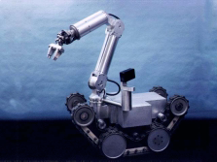
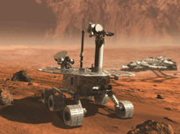
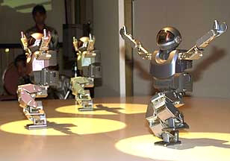

Slide 9
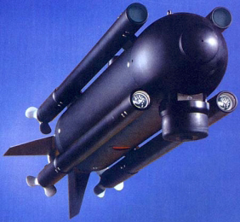
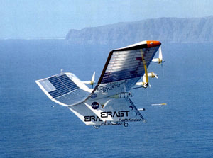
AUTONOMOUS ROBOTS
Autonomous robots are self supporting or in other words self contained. In a way they rely on their own ‘brains’.
Autonomous robots run a program that give them the opportunity to decide on the action to perform depending on their surroundings. At times these robots even learn new behavior. They start out with a short routine and adapt this routine to be more successful at the task they perform. The most successful routine will be repeated as such their behavior is shaped. Autonomous robots can learn to walk or avoid obstacles they find in their way. Think about a six legged robot, at first the legs move ad random, after a little while the robot adjust its program and performs a pattern which enables it to move in a direction.
Autonomous Underwater Vehicle
Unmanned Aerial Vehicle

Slide 10
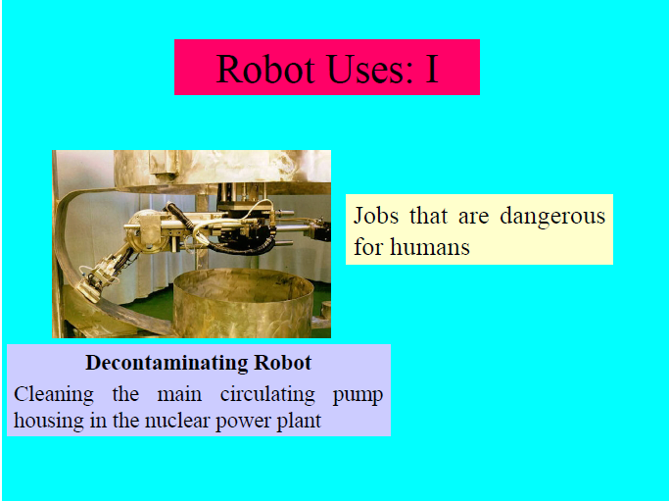

Slide 11
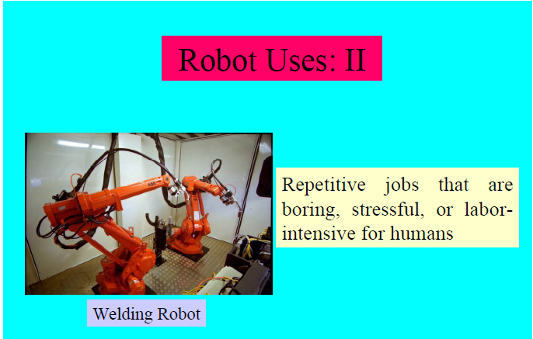

Slide 12
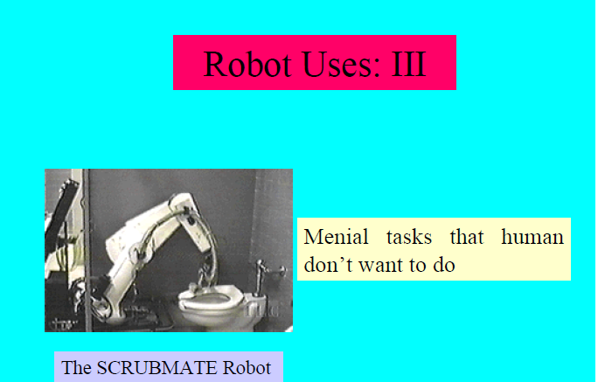

Slide 13
ADVANTAGES
Greater flexibility, reprogrammability
Greater response time to inputs than humans
Improved product quality
Maximize capital intensive equipment in multiple work shifts
Accident reduction
Reduction of hazardous exposure for human workers
Automation less susceptible to work stoppages

Slide 14
DISADVANTAGES
Replacement of human labour
More unemployment
Significant retraining costs for both unemployed and users of new technology
Advertised technology does not always disclose some of the hidden disadvantages
Hidden costs because of the associated technology that must be purchased and integrated into a functioning cell. Typically, a functioning cell will cost 3 - 10 times the cost of the robot

Slide 15
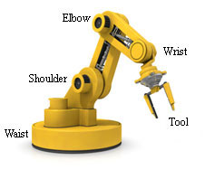
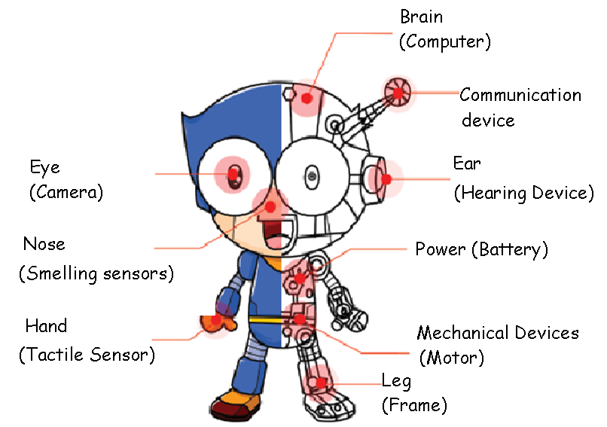
ROBOT ANATOMY

