Slide 1
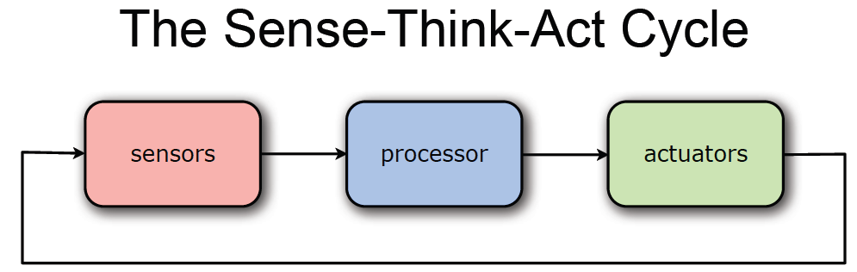
ROBOT CONTROLLER

Slide 2
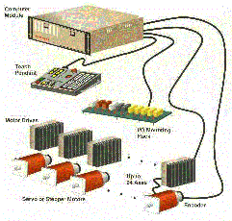
ROBOT CONTROLLER
The controller is the robot's brain and controls the robot's movements. It's usually a computer of some type which is used to store information about the robot and the work environment and to store and execute programs which operate the robot. The control system contains programs, data algorithms, logic analysis and various other processing activities which enable the robot to perform.

Slide 3
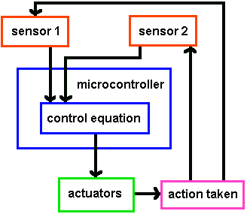
The point of a control system helps to get your robot actuators to do what you want without going out of control.
The sensor on the actuator will determine what is changing.
The program you write defines what the final result should be.
The actuator actually makes the change.
Another sensor could sense the environment, giving the robot a higher-level sense of where to go.

Slide 4
Humans pick things up without thinking about the steps involved. In order for a robot or a robotic arm to pick up or move something, someone has to tell it to perform several actions in a particular order — from moving the arm, to rotating the “wrist” to opening and closing the “hand” or “fingers.” .So, we can control each joint through computer interface

