Slide 1
ROBOTICS AND AUTOMATION

Slide 2
AUTOMATION
Automation is a technology that is concerned with the use of mechanical, electronic, and computer-based systems in the operation and control of production

Slide 3
AUTOMATION
Fixed automation
Programmable automation
Flexible automation

Slide 4
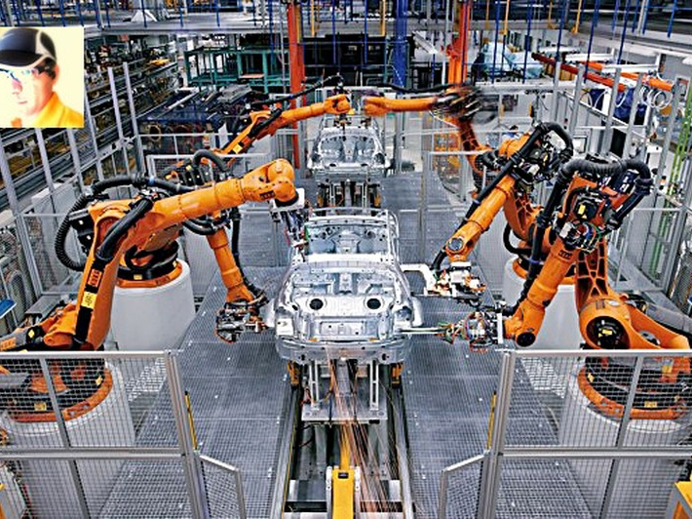
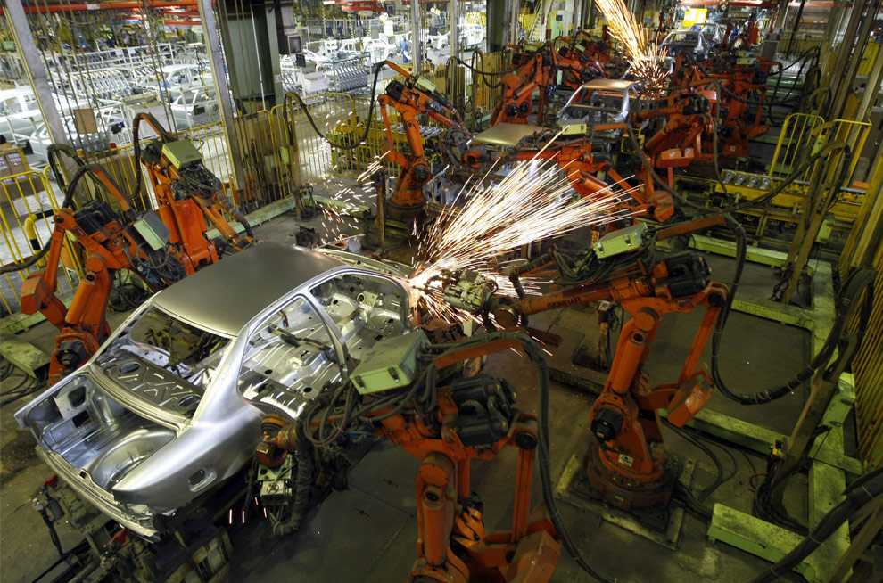
Automated car manufacturing industry

Slide 5
Demerits
Fixed automation
  Since the Initial investment cost is high if the volume of production turns to be lower than anticipated, then the unit cost becomes greater than anticipated.
  Tendency of the product to become outdated is high as there is no change incorporated on the basis of customers demand.

Slide 6
Merits
Programmable automation
  Production equipment is adaptable to variations in the product configurations
  Adaptability is achieved by operating the production equipment under the control of program
  Different and unique products can be made economically

Slide 7
Flexible automation=fixed+programmable
  Bulk production
  Versatility in production

Slide 8
Difference between automation and robotics
Learning from mistakes
Reaction to stimuli
Artificial intelligence
Adaptable algorithms
Programming
Smart sensors, control techniques, programming

Slide 9
ROBOTICS
  Robotics is a prominent component of manufacturing automation
  Successful implementation of robotics in useful applications is obviously a function of the technology and programming

Slide 10
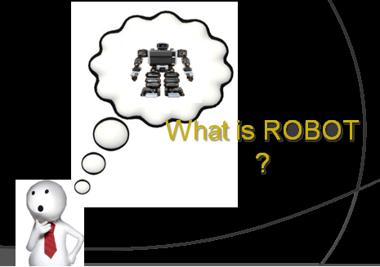
A robot is a machine that is able to modify its operations depending upon the environment which it works.

Slide 11
DEFINITION
“A reprogrammable, multifunctional manipulator designed to move material, parts, tools, or specialized devices through various programmed motions for the performance of a variety of tasks.”
-Robot Institute of America, 1979
“A ROBOT IS A PROGRAMMABLE ARM SIMULATOR”

Slide 12
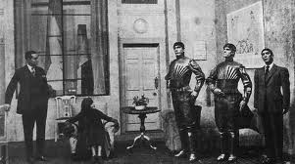
HISTORY OF ROBOTS
This concept was introduced by the Czech playwright
Karel ˇCapek who wrote the play Rossum’s Universal Robots (R.U.R.)
in 1920. On that occasion he coined the term robot — derived from the term robota that means executive labour
Rossum’s robots were represented as creatures
made with organic material.

Slide 13
The image of the robot as a mechanical artifact starts in the 1940s when the Russian Isaac Asimov, the well-known science fiction writer, conceived the robot as an automaton of human appearance but devoid of feelings.
Its behaviour was dictated by a “positronic” brain programmed by a human being in such a way as to satisfy certain rules of ethical conduct.
The term robotics was then introduced by Asimov as the science devoted to the study of robots which was based on the three fundamental laws:

Slide 14
Asimov’s laws for robotics
1. A robot may not injure a human being or, through inaction, allow a human being to come to harm.
2. A robot must obey the orders given by human beings, except when such orders would conflict with the first law.
3. A robot must protect its own existence, as long as such protection does not conflict with the first or second law.

Slide 15
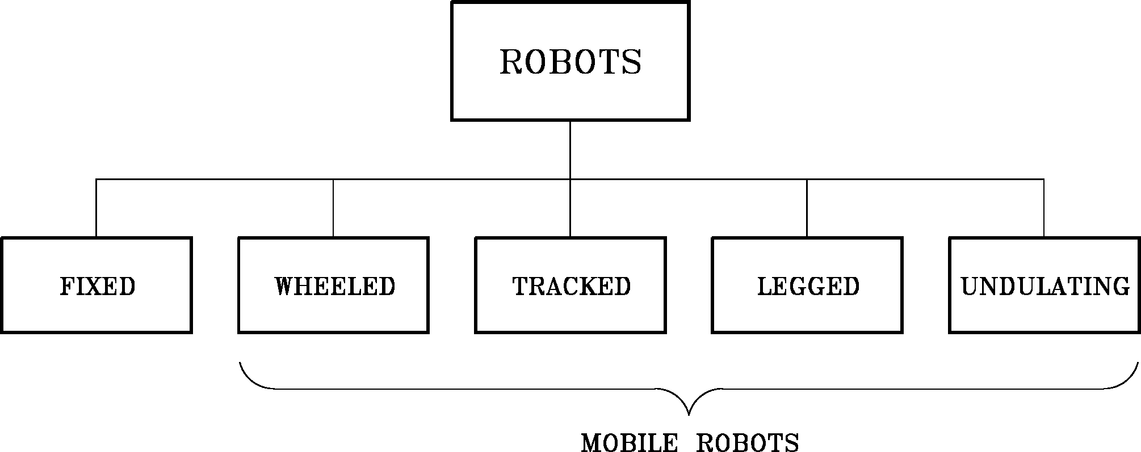

Slide 16
