Slide 1
Industrial Electronics
ANNA JOY
M Tech, P E
NO:6

Slide 2
V-I converter with floating load
V-I converter with grounded load
Voltage to current converter(Transconductance Amplifier)

Slide 3
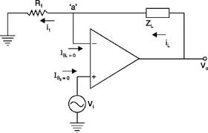
V-I Converter with floating load
Vi=iL*R1
iL=Vi/R1

Slide 4
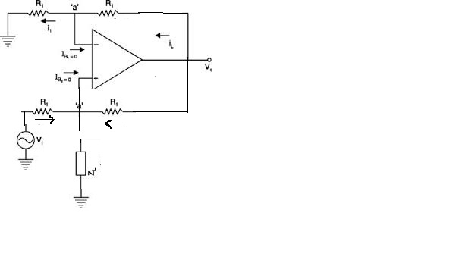
V-I Converter with grounded load
i1+i2=IL
(Vi-V1)/R +(V0-V1)/R=IL
V1=(Vi+V0-ILR)/2
i2
i1 v1 i21
Gain=1+R/R= 2
V0=2V1=Vi+V0-ILR
Vi=ILR
IL=Vi/R

Slide 5
FEATURES
1. OTAs are versatile building blocks that intrinsically offer wide bandwidth for many types of amplifiers.
2. The OTA ( voltage-controlled current source) can be viewed as an ideal transistor.
3. OTA is self-biased and has bipolar output, meaning that the output current source can either source or sink the output current.
4. an OTA element simplifies designs of automatic gain control (AGC) amplifiers, light-emitting diode (LED) driver circuits, fast-pulse integrators, control loops for capacitive sensors, and active filters.
Operational Transconductance Amplifier

Slide 6
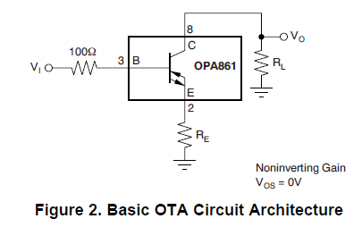
Recommended OTA Devices
• OPA860 (an OTA and a closed-loop buffer)
• OPA861 (an OTA)
• OPA615 (a wide-bandwidth dc restoration circuit that contains an OTA and a switching OTA, or SOTA)

Slide 7
Current-Feedback Amplifier (CFB)
Control-Loop Amplifier
Sample/Hold Circuit
DC-Restore Circuit
Instrumentation Amplifier
Advanced uses of OTA

Slide 8

The CA3080 and CA3080A are similar in generic form to conventional operational amplifiers
1. contains an additional control terminal which enhances the device's flexibility for use in a broad spectrum of applications.
2. communications and industrial applications including modulators, multiplexers, sample-and-hold-circuits, gain control circuits and micro power comparators
CA3080 High-Performance Operational Transconductance Amplifiers

Slide 9
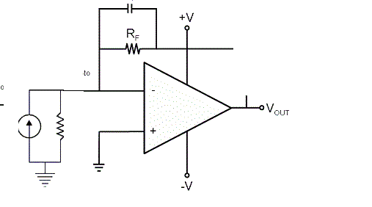
Current to Voltage Converter (Transresistance Amplifier)
cf
is
RS
V0= -is *Rf

Slide 10
FEATURES
1. OVER 250kHz TRANSIMPEDANCE BANDWIDTH
2. DYNAMIC RANGE: 5 Decades
3. EXCELLENT LONG-TERM STABILITY
4. BIAS CURRENT: 3pA
5. GAIN BANDWIDTH: 18MHz
6. FAST OVERLOAD RECOVERY
7.SUPPLY RANGE: 2.7V to 5.5V
8.SINGLE AND DUAL VERSIONS
OPA381 and OPA2381

Slide 11
PRECISION I - V CONVERSION
PHOTODIODE MONITORING
OPTICAL AMPLIFIERS
PHOTOLAB EQUIPMENT
          APPLICATION

Slide 12
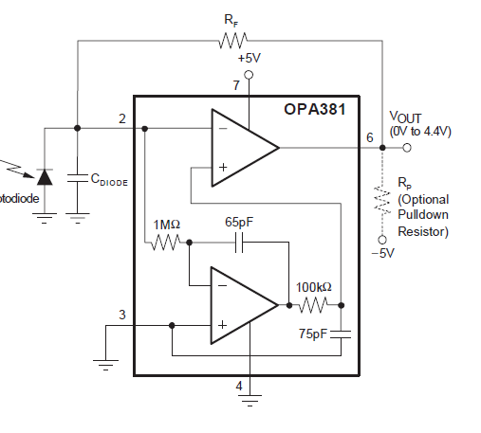
Circuit diagram of OPA381

Slide 13
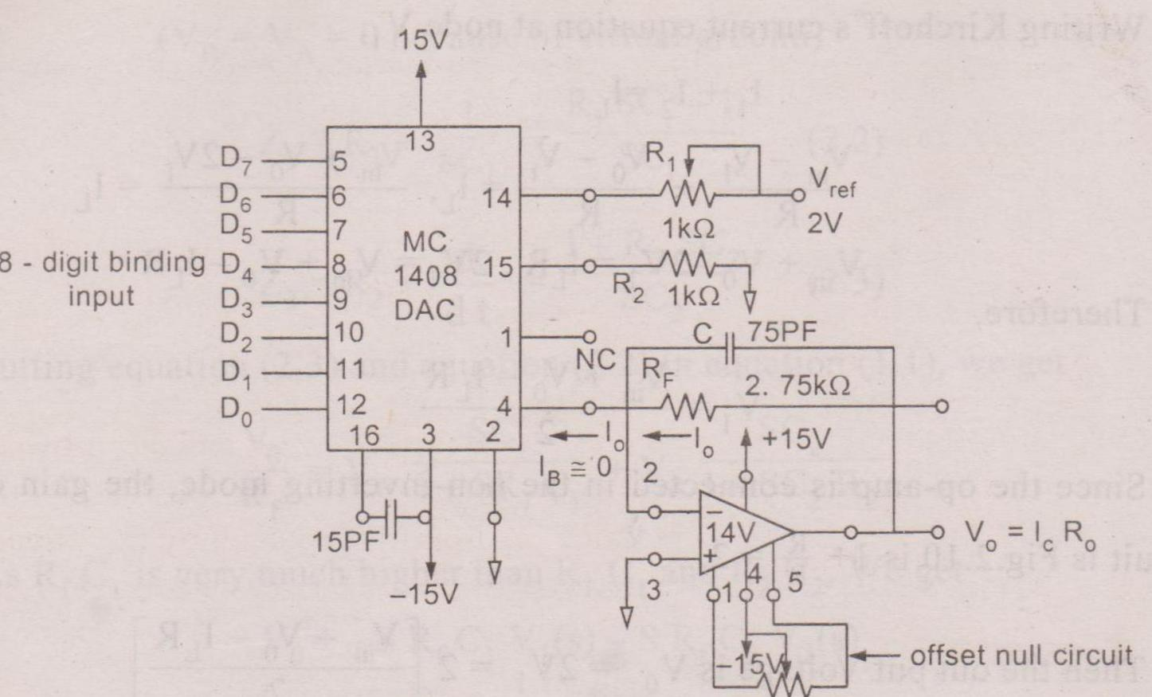
DAC USING I-V CONVERTER

Slide 14
V0=I0*RF
I0=Vref/R1 (D7/2 + D6/4 + D5/8………..+D0/256)

Slide 15
THANK YOU

