Slide 1
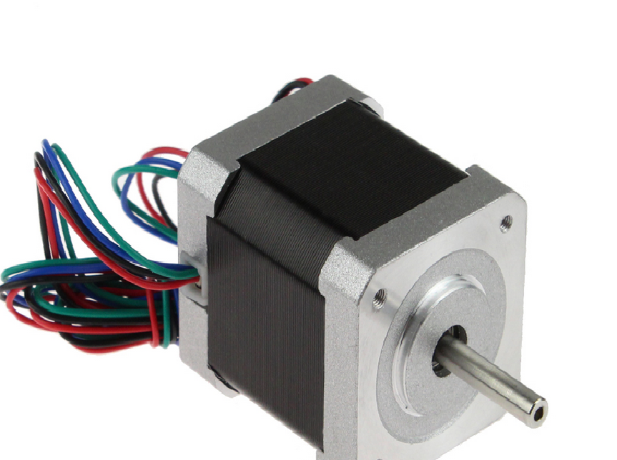
STEPPER MOTOR
SWITCHING SEQUENCE
NEETHU SALIM
Ad. No: M13EE037
Roll No: 13

Slide 2
Introduction to Stepper Motor:
A stepper motor is a brushless, synchronous electric motor that converts digital pulses into mechanical movement.
Shaft of a stepper motor rotates in discrete step increments when electrical pulses are applied.
Each pulse moves the shaft through a fixed angle
Used when controlled movement is required.

Slide 3
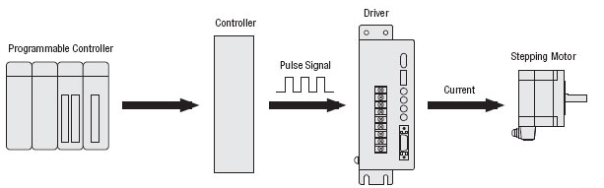
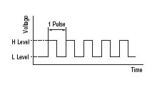
System configuration
Command with one pulse causes shaft to turn by one step

Slide 4
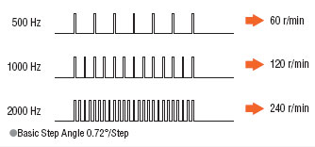
Speed of rotation is directly related to the frequency of input pulses applied

Slide 5
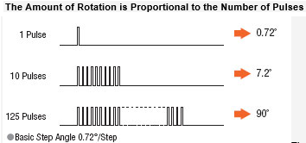
The amount of rotation is related to the number of pulses.

Slide 6
Outside Casing
Stator
Rotor
Internal components of a Stepper Motor

Slide 7
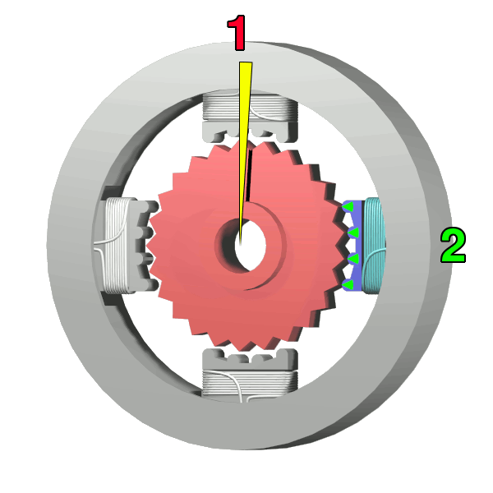
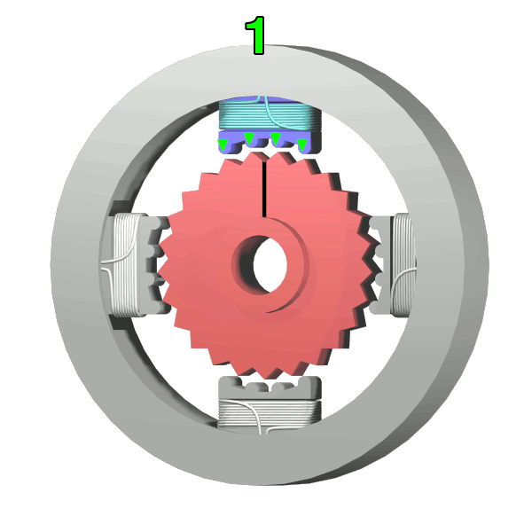
Stepper motor working:
The top electromagnet (1) is turned on, attracting the nearest teeth of a gear-shaped iron rotor. With the teeth aligned to electromagnet 1, they will be slightly offset from electromagnet 2
The top electromagnet (1) is turned off, and the right electromagnet (2) is energized, pulling the nearest teeth slightly to the right. This results in a rotation of 3.6° in this example.

Slide 8
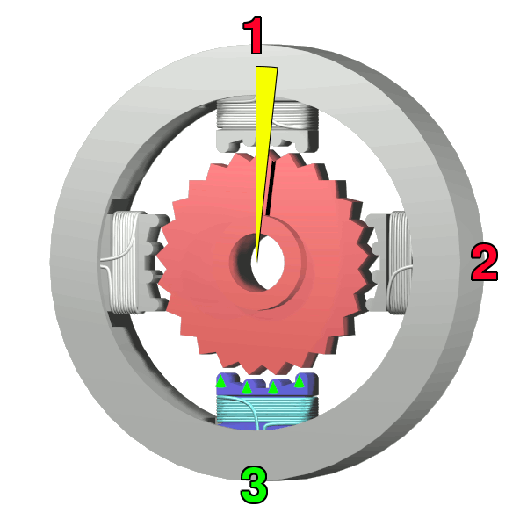
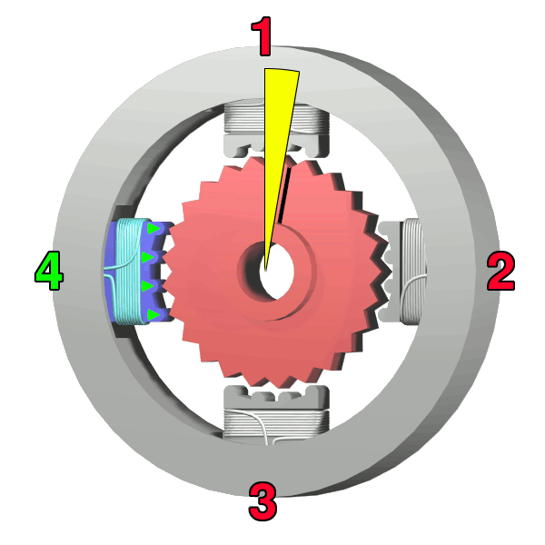
The left electromagnet (4) is enabled, rotating again by 3.6°. When the top electromagnet (1) is again enabled, the teeth in the sprocket will have rotated by one tooth position; since there are 25 teeth, it will take 100 steps to make a full rotation in this example.
The bottom electromagnet (3) is energized; another 3.6° rotation occurs.

Slide 9
Types of Stepper Motors:
Permanent Magnet
Variable Reluctance
Hybrid

Slide 10
Switching Sequences
Full Step – 200 full steps per revolution
Half Step - 400 full steps per revolution

Slide 11
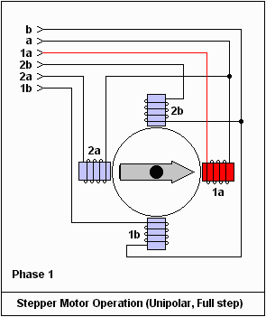
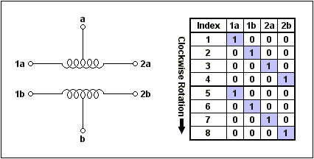
FULL STEP
Four step switching sequence

Slide 12
HALF STEP
Eight step switching sequence.
Double the resolution.
200 step motor, resolution 1.8 degree – have a resolution of 400 steps and 0.9 degree.
Smoother motion than full step.

Slide 13

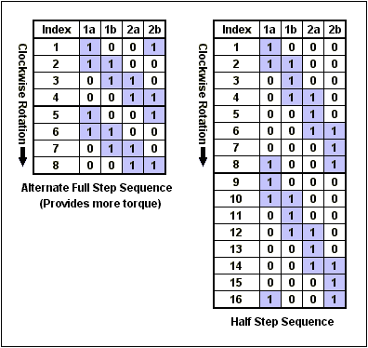

Slide 14
Advantages and disadvantages of stepper motors:
Advantages
Low cost
Simplicity of construction
Low maintenance (no brushes)
Less likely to slip
Will work in any environment
Disadvantages
Require a dedicated control circuit
Use more current than D.C. motors
Not easy to operate at extremely high speed

Slide 15
Application :
Paper Feeder On Printers
CNC Machine
Stepping Motor to move read-write head in computer CD drive
Labeling Machine
Moving Positioning System
Medical Equipment
Automotive and scientific equipment etc.
Packing Machine
Robotic Arm
Fiber Optic Splicing Machine

Slide 16
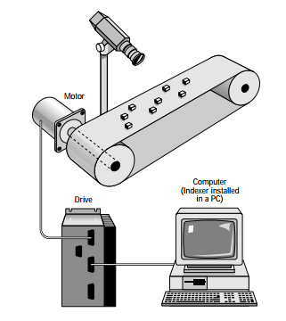
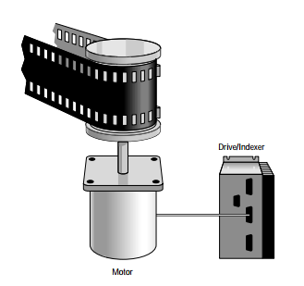
Industrial Application :
Film Camera
Conveyor

Slide 17
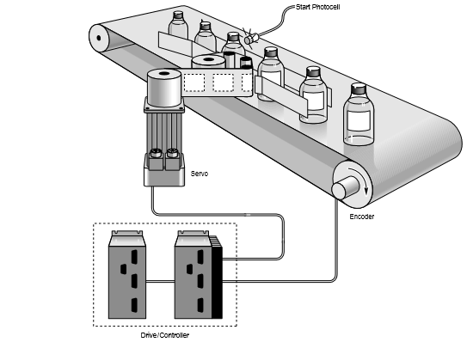
Labelling Machine

Slide 18
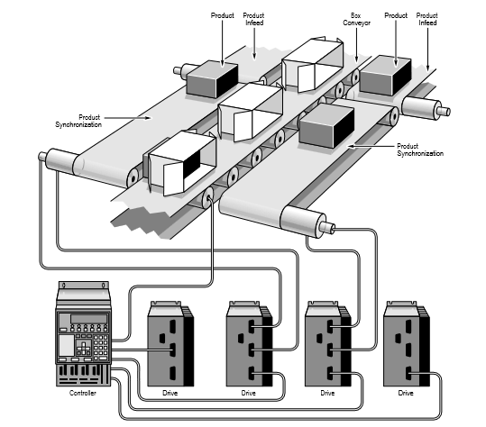
Moving Positioning System

Slide 19
Thank You!!

