Slide 1
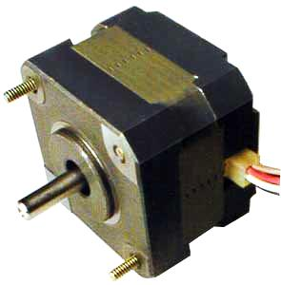
STEPPER MOTOR
VARIABLE RELUCTANCE STEPPER MOTOR
NEETHU P UDAY
ROLL NO: 12
M13EE098
S2 MTECH PE

Slide 2
Step motors are essentially incremental motion devices.
A step motor receives a rectangular pulse train and responds by rotating its shaft a certain number of degrees as dictated by the number of pulses in the pulse train.
Usually the pulse train is controlled by means of a microcomputer or an electronic circuit.
Since the motion in a step motor is generally governed by counting the number of pulses, no feedback loops and sensors are needed for its control.
Therefore, step motors are suitable for position control in an open loop system.

Slide 3
They are relatively inexpensive and simple in construction and can be made to step in equal increments in either direction.
Step motors are excellent candidates for such applications as printers, XY plotters, electric typewriters, control of floppy disk drives, robots etc.
Step motors can be classified into three broad categories—variable-reluctance, permanent-magnet, and hybrid.

Slide 4
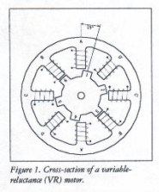
TYPES OF STEPPER MOTORS
  VARIABLE RELUCTANCE (VR)
    It is probably the easiest to understand from a structural point of view.
    Figure 1 shows a cross section of a typical V.R. stepper motor.
    This type of motor consists of a soft iron multi-toothed rotor and a wound stator.
    When the stator windings are energized with DC current the poles become magnetized.
    Rotation occurs when the rotor teeth are attracted to the energized stator poles.

Slide 5
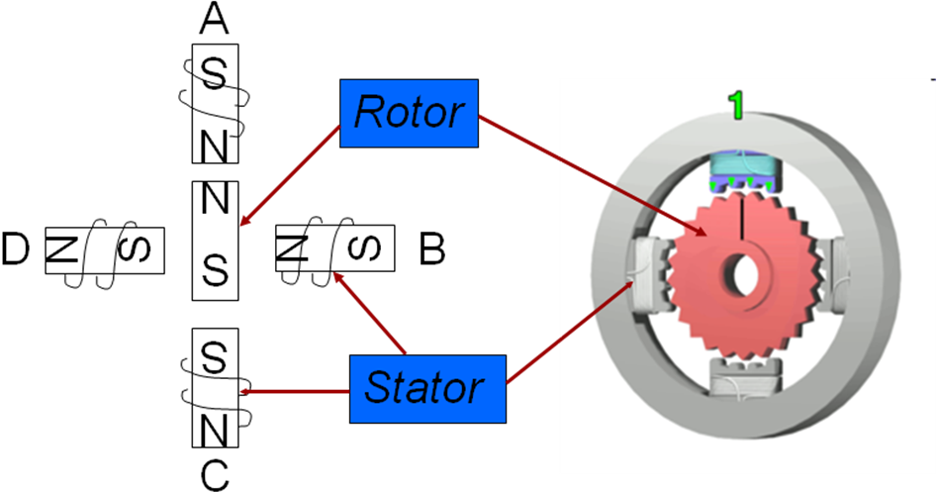
Construction

Slide 6
The stator is a magnet over which the electric coil is wound.
One end of the coil is connected commonly either to ground or +5V. The other end is provided with a fixed sequence such that the motor rotates in a particular direction.
Stepper motor shaft moves in a fixed repeatable increment, which allows one to move it to a precise position. Direction of the rotation is dictated by the stator poles. Stator poles are determined by the current sent through the wire coils.

Slide 7
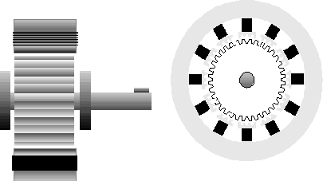
The variable reluctance or V.R. (fig 1) motor consist of a rotor and stator each with a different number of teeth. As the rotor does not have a permanent magnet it spins freely i.e. it has no detent torque. Although the torque to inertia ratio is good, the rated torque for a given frame size is restricted. Therefore small frame sizes are generally used and then very seldom for industrial applications.
Figure 1. cross section through a variable reluctance stepping motor

Slide 8
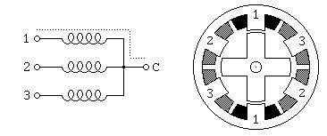
Variable Reluctance Motors
This is usually a four wire motor – the common wire goes to the +ve supply and the windings are stepped through
Our example is a 30º motor
The rotor has 4 poles and the stator has 6 poles
Example
Notes:
Rotor is magnet

Slide 9
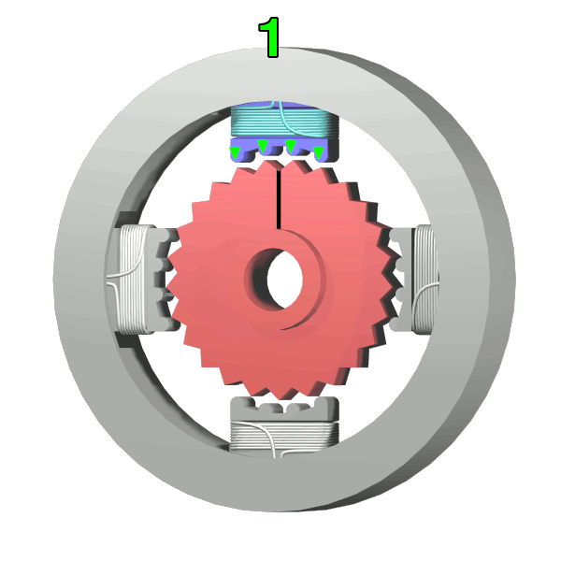

Slide 10
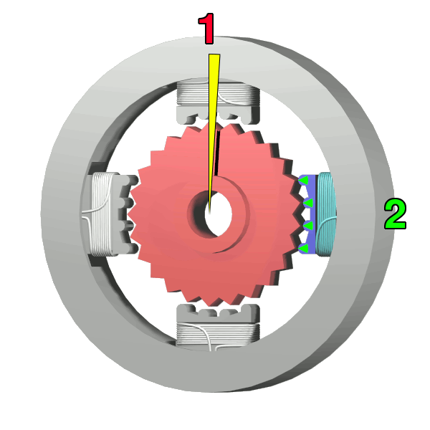

Slide 11
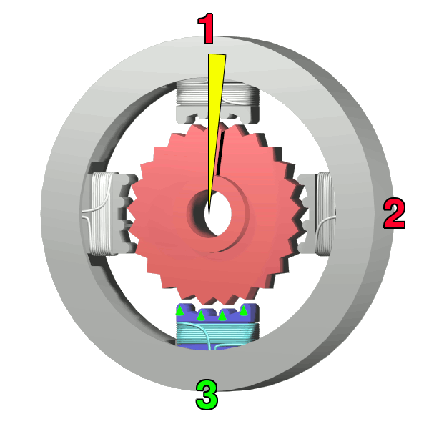

Slide 12
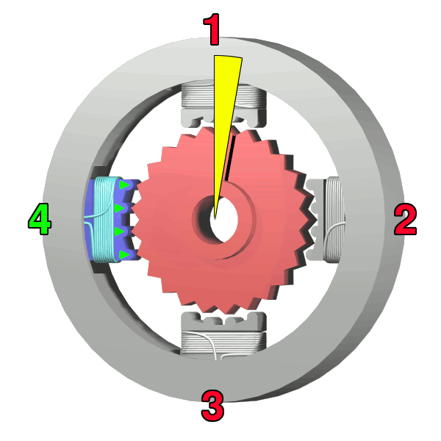

Slide 13
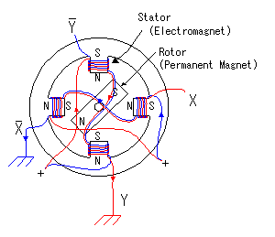

Slide 14
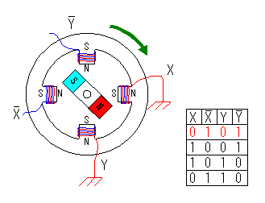
CLOCKWISE CONTROL

Slide 15
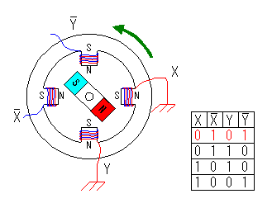
COUNTERCLOCKWISE CONTROL

Slide 16
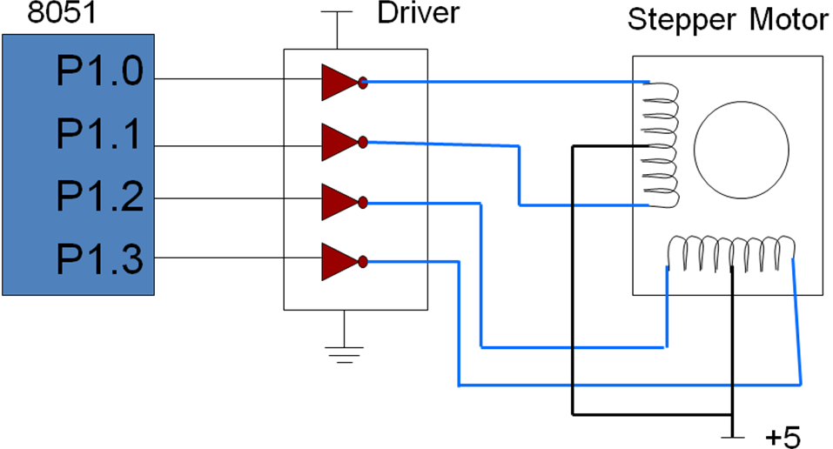
8051 connection to stepper motor

Slide 17
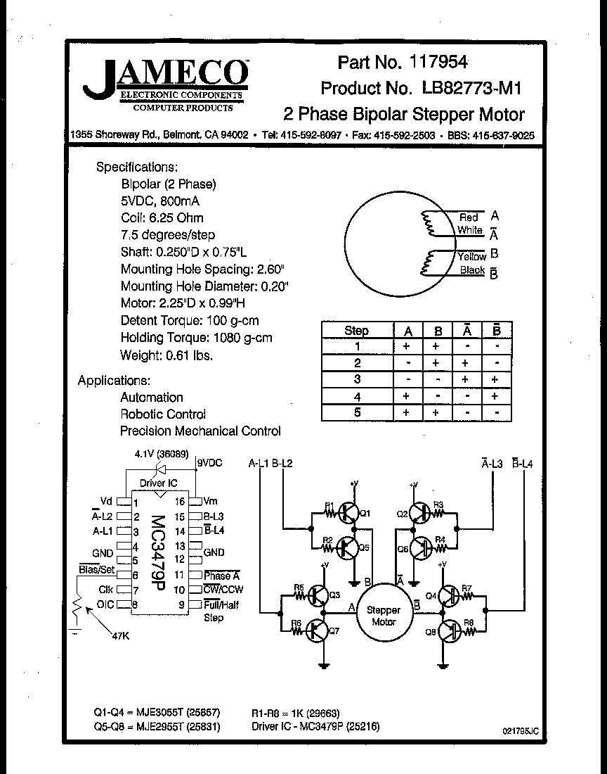

Slide 18
Stepper motors | DC Motors
No encoded/sensor to determine position (Does not require feedback to determine position – controlled by pulses sent to stepper motor) When load is to high to stepper motor, it may stall - no way to report this to microcontroller No brushes, no EMI Slow speed with high torque | Brushless DC motors require more complex control DC motors with feedback can report stalls on high loads or other conditions High torque at high speed; DC motors loses torque at low speed because of low current
In summary: Systems with stepper motors and without feedback cannot determine what motor is really doing (e.g. stalling). For this reason stepper motors are usually used where loads are known (e.g. disk drivers or printers). When the load is not known, a DC motor with appropriate feedback might be a better option. Feedback allows adjusting of supply current to correct a DC motor's speed or position.

Slide 19
When to use a Stepper Motor
  Whenever controlled movement is required.
    In applications where you need to control rotation angle, speed, position and synchronism.
  Used in many different applications.
    Some of these include printers, plotters, high end office equipment, hard disk drives, medical equipment, fax machines, slot machines, automotive and many more.

Slide 20
APPLICATIONS
There are many times when fixed amounts of rotation are needed instead of continuous rotation.
One example is a printer. In order to print text and graphics, the printer needs to know where the printer head is in relation to the frame. Using a stepper motor allows this information to be known, because the printer can keep track of how many pulses it has sent to the stepper motors. If the printer has an algorithm telling it how far the printer head moves with one pulse, then the exact position of the printer head is known, assuming there is not a malfunction in the motor.
Other examples of stepper motor use are robotic arms, hard disk drives and clocks.
All of these things require precise movement or require knowledge of the exact location of the rotating equipment.

Slide 21
THANK YOU…!!

