Slide 1
Isolation amplifier
Isolation amplifier are the form of differential amplifier .
High common mode voltage by providing electrical isolation and an electrical safety barrier.
In applications like industrial and medical instrumentation, amplifiers must have
  Very high common mode voltage capabilities (extending to kilovolts).
  High isolation resistance,
  High common mode rejection voltage.
Amplifying low-level signals in multi-channel applications.
Eliminate measurement errors caused by ground loops.

Slide 2
Isolation can be achieved by the use of
    Transformer
    Photo resistor
    Hall effect
    Thermal coupler

Slide 3
FEATURES
High Isolation-mode Rejection:10kV/μs (min)
Large Signal Bandwidth: 85kHz
Differential Input/Differential Output
Voltage Offset Drift Vs Temperature: 4.6μV/°C
Offset Voltage 1.8mV (max)
Input Referred Noise: 300μVrms
Nonlinearity: 0.25% (max)
Available in 8-pin plastic DIP and 8-pin gull-wing plastic surface mount

Slide 4
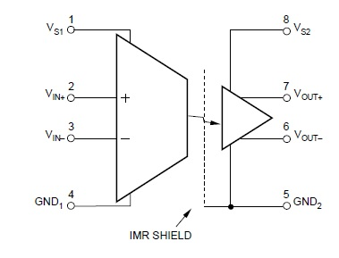
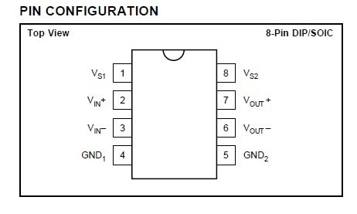
ISO130

Slide 5
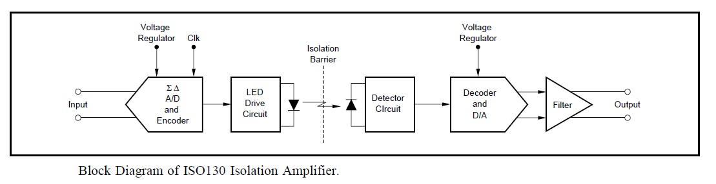
THEORY OF OPERATION
An input and output section isolated by a high speed optical barrier built into the plastic package.
This coding scheme reduces the effects of
Non-ideal characteristics of the LED,
Such as non-linearity and drift over time and temperature.

Slide 6
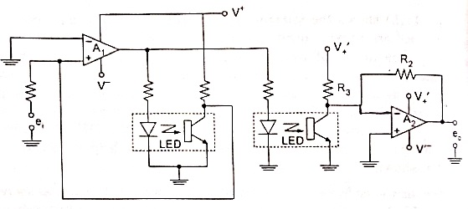
LED- Phototransitor Linearized Isolation Amplifier
Vcom
V1
Amplifier A1 act as a Non-inverting comparator.
Input voltage: e1
Output voltage Vcom= V+ e1>VREF
V- e1<VREF
Amplifier A2 act as an Inverting amplifier.
Output voltage eo:= -V1(R2/R3)
{

Slide 7
For the isolation,
LED1 is connected in feedback to amplifier A1.
LED2 is connected in feedback to amplifier A2.
Due to the matched characteristics of the two LED phototransitor pairs, the non linear characteristics and temperature dependence get compensated .

Slide 8
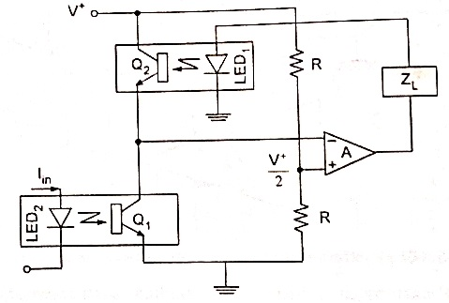
Isolated Current Amplifier With Feedback Linearization
For providing isolation.
With equal resistor connected to the positive input of the amplifiers,
The amplifiers gain forces a current through the load ZL and LED1,
Current in the transistor Q1 and Q2 are equal.
With the equal matched characteristics of the LED and phototransistor pairs, the load current is equal to the current IIN through LED2.

Slide 9
Reduction of non-linearity .
The error produced by the bias current of the amplifier can be reduced by use of a low input bias current amplifier.
A typical high quality low profile isolation amplifier is “ISO130”, manufactured by Burr Brown .
It is specially suited for use in transducer channel isolation for thermocouples, RTDs, pressure sensors and flow meters

Slide 10
APPLICATIONS
Motor And SCR Control
Motor Phase Current Sensing
Industrial Process Control: Transducer Isolator, Isolator For Thermocouples, RTDs
General Purpose Analog Signal Isolation
Power Monitoring
Ground Loop Elimination

Slide 11
THANK YOU

