Slide 1
POWER DUMPING CONTROL FOR A CHOPPER DRIVE AMPLIFIER
Vaseem Faizal
S2 M.Tech PE
No.18

Slide 2
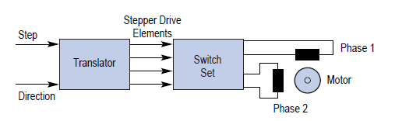
Basic stepper motor configuration
Unipolar drive
Bipolar drive
Chopper drive

Slide 3
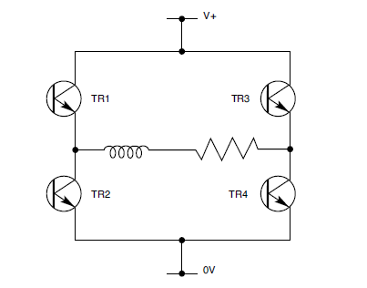
Bipolar drive
TR1-TR4 Pair
TR2-TR3 Pair

Slide 4
Need of power dumping
Stepper motor act as a generator
Acceleration period
Deceleration period
Regenerative action

Slide 5
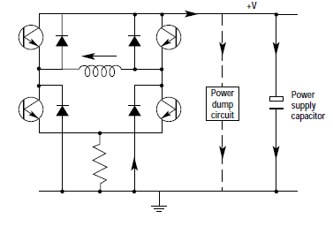
Chopper drive circuit

Slide 6
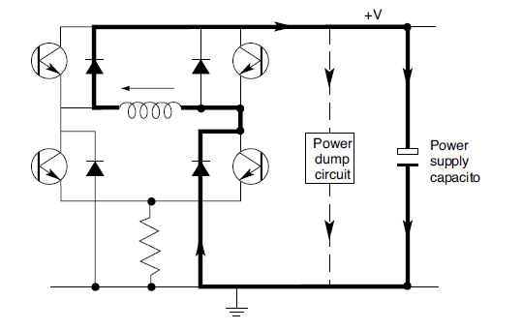
SOLUTION BY POWER DUMPING CIRCUIT
Elimination of regenerative current

Slide 7
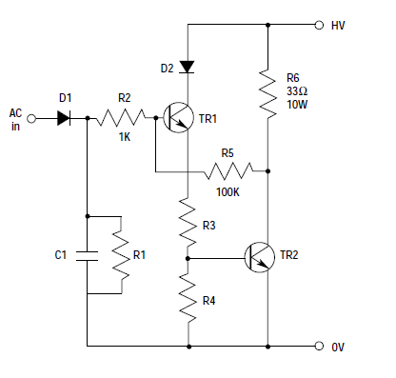
Circuit diagram

Slide 8
Industrial applications
When use high inertial load
To avoid large votage spikes from inductive generators
In automotive industry

Slide 9
INDUSTRIALLY AVAILABLE STEPPER MOTOR WITH POWER DUMPING
PARKER Z 900 SERIES
SPECIFICATION | RATING
Motor step/rev. | 400, 1000, 2000 step/rev.
Input voltage | 110-240 v Ac
Power | V A
Maximum stepping rate | 50 Khz@1000, 2000

Slide 10
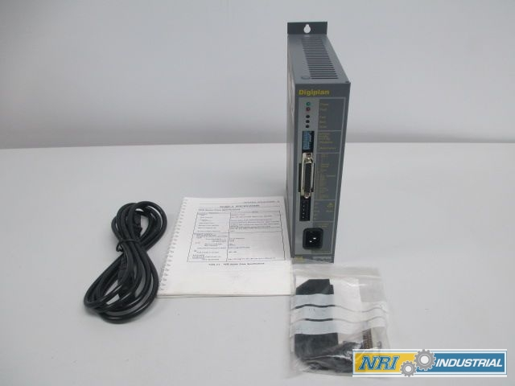
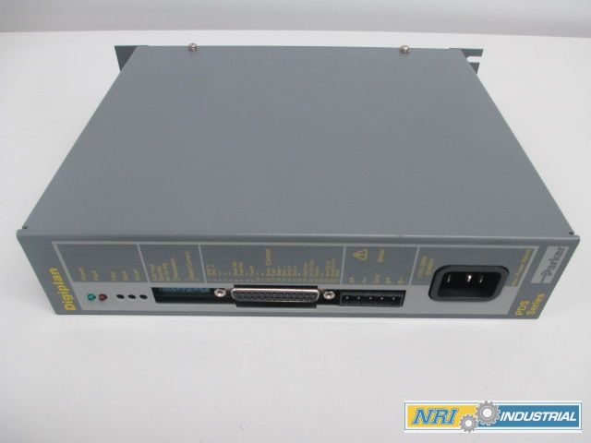
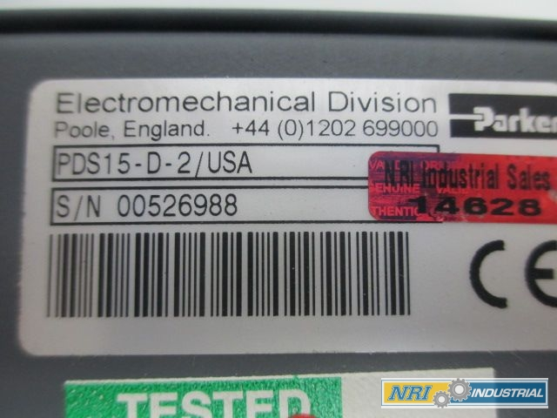
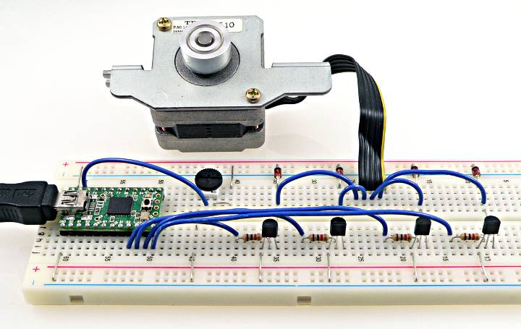
PDS15D-2

Slide 11
REFERENCE
www.Drive technlogies, engineering reference.om
Industrial electronics, application for programmable controllers-
Stepper motor drives.com
digiplan parker controller.com
parker automation.org

Slide 12
Thank you

