Slide 1
Microprocessor Based Control Of DC Servo Motors
Presented by
Cicy Mary Mathew
Roll no. 9
S2 M.Tech.

Slide 2
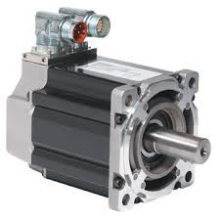
What is a servo motor?
A rotary actuator that allows for precise control of angular position, velocity and acceleration.
Small in size
Very energy efficient
Controlled with an electric signal which determines the amount of movement of the shaft.

Slide 3
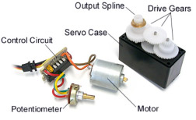
An assembled servo
The motor is attached by gears to the control wheel
Control circuit+ potentiometer = servo rotates according to our wishes

Slide 4
How it works?
As the motor rotates, the potentiometer's resistance changes, so the control circuit can precisely regulate how much movement there is and in which direction.
When the shaft of the motor is at the desired position, power supplied to the motor is stopped.
If not, the motor is turned in the appropriate direction.
The desired position is sent via electrical pulses through the signal wire.
Speed of motor-propostional to difference between the actual and desired position

Slide 5
How is it controlled?
By sending electrical pulses of variable width(PWM) via control wires, which may be :
Minimum pulse
Maximum pulse
Repetitive rate
The motor turns 90 degrees in either direction for a total of 180 degree movement.
The neutral position is defined as the position where the servo has the same amount of potential rotation in the both the clockwise or counter-clockwise direction.

Slide 6
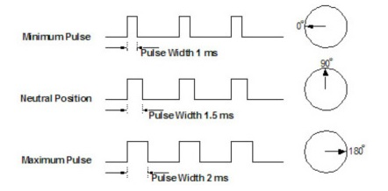
Control of servo motor(contd)
The PWM sent to the motor determines position of the shaft, and based on the duration of the pulse sent via the control wire; the rotor will turn to the desired position.

Slide 7
Applications
Radio-controlled airplanes
To position control surfaces like elevators, rudders, walking a robot, or operating grippers.
To operate remote-controlled or radio-controlled toy cars, robots.

Slide 8
Application
POSITION CONTROL OF DC SERVO MOTORS USING SOFT-CORE PROCESSOR ON FPGA TO MOVE ROBOT ARM

Slide 9
Microprocessor based control scheme
Advantages:
Flexibility
Reliability
Lower cost
Drawbacks:
The demanding control requirements of modern power conditioning systems will overload most general purpose micro-processors
The computing speed of microprocessor limits the use of microprocessor in complex algorithms

Slide 10
For applications where there is a need to integrate custom logic for faster control and additional peripherals, the microcontroller or microprocessor board is augmented by a FPGA.

Slide 11
Why FPGA?
Its circuit can be programmed easily in both hardware and software.
Here FPGA is used to control the motion of the robot arm that contains five DC servo motors by PicoBlaze soft-core processor.

Slide 12
Picoblaze soft core processor
A soft-core processor is a hardware description language (HDL) model of a specific processor (CPU) that can be customized for a given application and synthesized for FPGA target.

Slide 13
Picoblaze soft core processor
Advantages over custom designed processors:
Reduced cost
flexibility,
Platform independence
Greater immunity to obsolescence

Slide 14
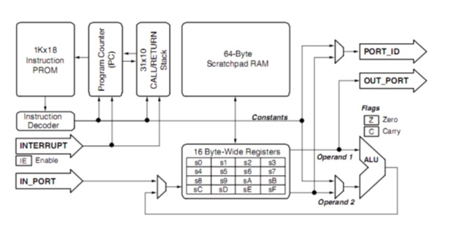
Picoblaze soft core processor
Block diagram:
8-bit soft core processor for FPGA devices.
It consists of KCPSM3 and single block RAM
The KCPSM3 is 8-bit processor connected together with single block RAM that is used to form a ROM store for a program of up to 1024 instructions

Slide 15
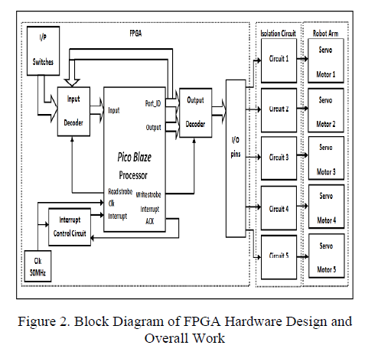
Hardware design
The input and output decoders are designed outside the processor using VHDL language to check the port address.
Read strobe signal and write strobe signal are coming from the processor to determine the input and output port.

Slide 16
Interrupt circuit:
Contains up-counter to count from 0 to 499 and comparator to compare the counter value with 499.
This will interrupt the PicoBlaze every 500 clock.
Since the system clock is 50MHz, this means that the interrupt occur every 10μs.

Slide 17
Isolation circuit
To prevent the FPGA I/O pins from being overloaded by excessive currents
To be isolated from the high voltage coming back from servo motor drive circuit because the motor voltage and current are higher than FPGA.

Slide 18
Software position control
The controller must generate a continuous pulsewidth modulation(PWM) for the DC servo motor at 20ms (50 Hz).
The duration of the on pulse (logic high) determines the position of the servo shaft, the range of duration between 0.5ms (0º) and 2.5ms (180º).
A short on pulse (0.5ms) moves the servo to the far left, while a long on pulse (2.5ms) moves the servo to the far right.
Intermediate length pulses (1.5ms) correspond to intermediate positions.

Slide 19
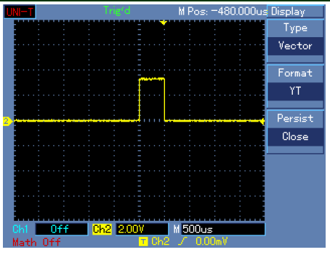
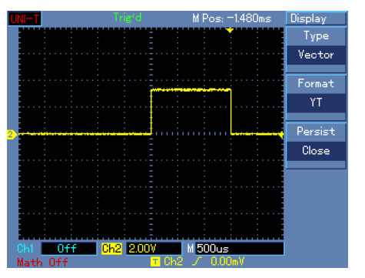
Practical oscilloscope results
For the pulse that
moving the motor to position (0º) with a pulse width of
0.5ms
For the pulse that
moving the motor to position (90º) with a pulse width of1.5ms

Slide 20
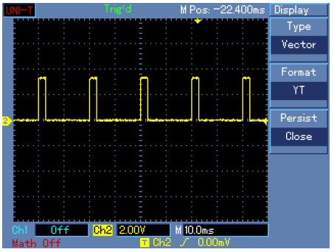
Practical oscilloscope results
Moving the motor to position (180º) with a
pulse width of 2.5ms

Slide 21
Software speed control
Speed is measurement of the time that the servo take to rotate a certain number of degrees.
The software speed control of the servo motor is determined by the amount of increment or decrement of an on pulse (logic high) between current on pulse and next on pulse.

Slide 22
ROBOT ARM
The robot arm has 4 dgree of freedom(4DOF).
The arm uses five servo motors:
1 x HS-475HB in the base
1 x HS-755HB in the shoulder
1 x HS-645MG in the elbow
1 x HS-475HB in the wrist,
1 x HS-422 in the gripper.

Slide 23
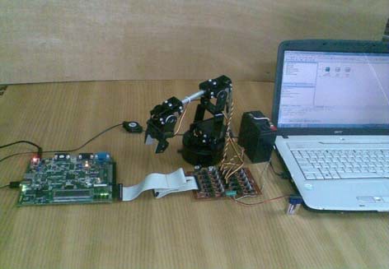
Hardware:

Slide 24
References
Microprocessor-Based Robust Control of a DC Servo Motor.
Kenji Tamaki, Kiyoshi Ohishi, Kouhei Ohnishi, and Kunio Miyachi.
Position Control Of Dc Servo Motors Using Soft-core Processor On Fpga To Move Robot Arm
A. Z. Mansoor, M. R. Khalil, O. A. Jasim
Soft-Core Processors for Embedded Systems
Jason G. Tong, Ian D. L. Anderson and Mohammed A. S. Khalid
Electrical4u.com
Jamecom.com

Slide 25
Thank you!!!!!

