Slide 1
INSTRUMENTATION AMPLIFIER

Slide 2
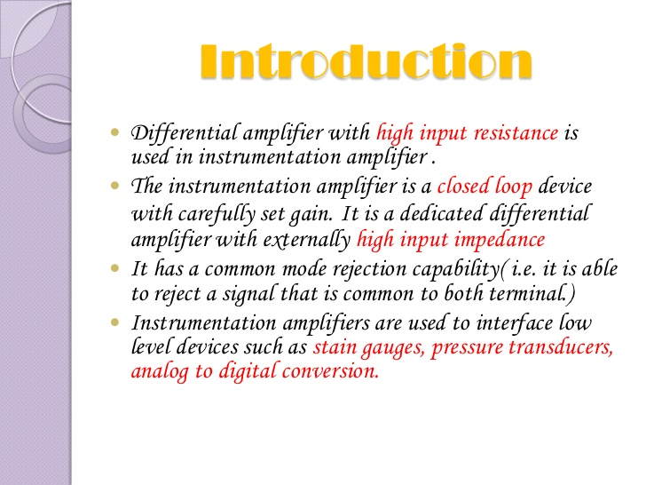

Slide 3
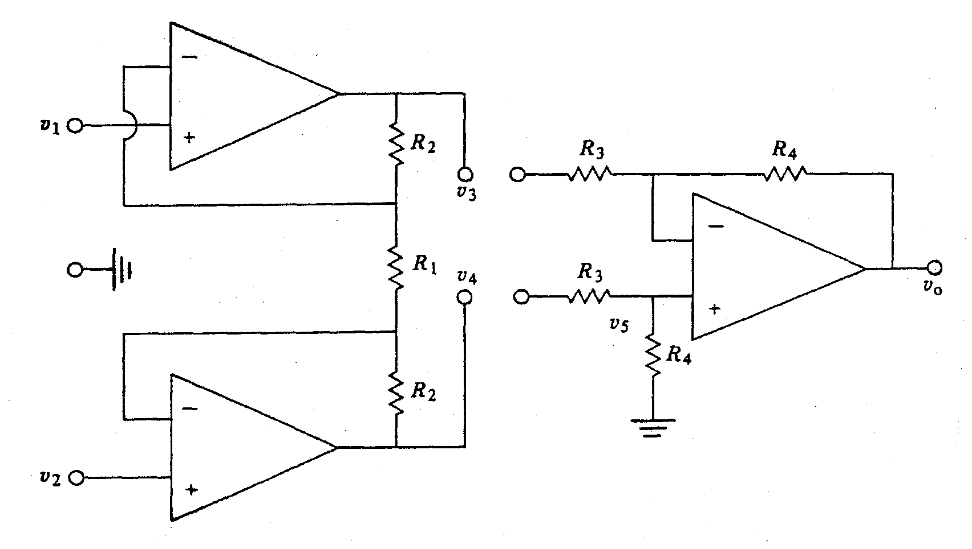
Instrumentation Amplifiers:
Three Op Amp Instrumentation Amplifier:
CMRR and Z_{in} are very important attributes of an IA
Can increase Z_{in} of difference amplifier configuration by adding buffers
Common mode signals are not amplified if common R₁ is used and
connection to ground is removed.

Slide 4
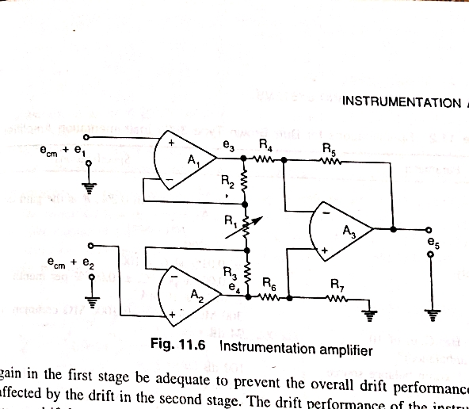
CIRCUIT DIAGRAM gain= 1+(2R2/R1)
Three Amplifier Configration

Slide 5
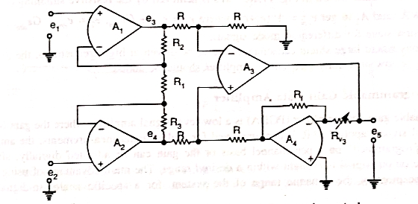
LINEAR GAIN CONTROL
gain= (1+(2R2/R1))(Rx/Rf)

Slide 6
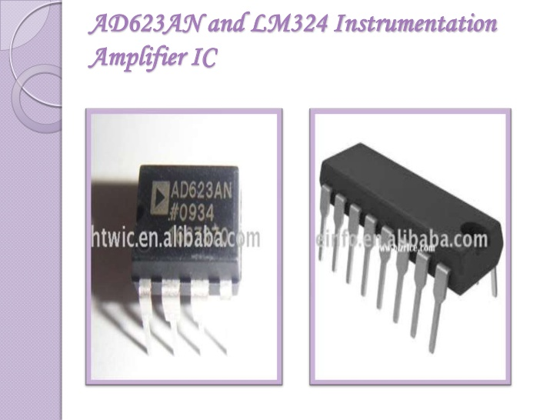

Slide 7
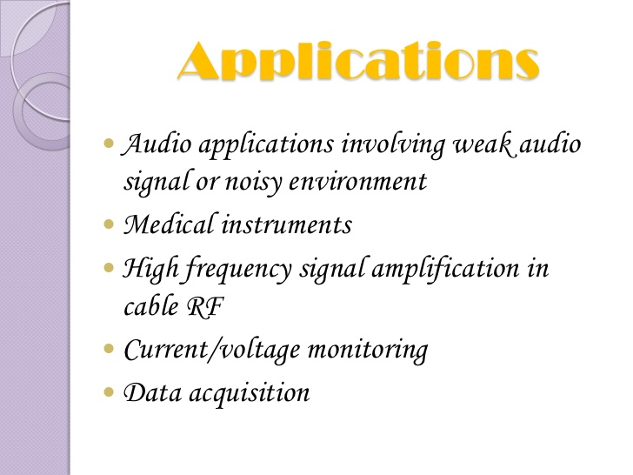

Slide 8
MERITS OVER OTHER AMPLIFIERS
Combination of dc opamps wired with feedback and require little design effort
Gain is selectable to a precise value by a single external resistance
It offer high common mode rejection even with source impedence exceeding 1 MΩ & with source unbalance of a large value (1 to 10KΩ)

Slide 9
Thank You

