Slide 1
INPUT GUARDING
ANILKUMAR KK
Admsn No: M13EE084
Reg No: 81055

Slide 2
The Ideal Op-Amp
1) The input impedance is
infinite - i.e. no current ever
flows into either input of the
op-amp
2) The output impedance is
zero - i.e. the op-amp can
drive any load impedance to
any voltage.
3) The open-loop gain (A) is
infinte.
The Op-Amp produces an output
voltage that is the difference between
the two input terminals, multiplied by
the gain A...
4) The bandwidth is infinite
5) The output voltage is zero
when the input voltage
difference is zero.

Slide 3
What You WANT
What You GET
1) The input impedance is infinite
- i.e. no current ever flows into
either input of the op-amp.
2) The output impedance is zero -
i.e. the op-amp can drive any
load impedance to any voltage.
3) The open-loop gain (A) is
infinte.
4) The bandwidth is infinite.
5) The output voltage is zero
when the input voltage
difference is zero.
NO, but it is often GIGA
or TERA !
NO, but is can be a few
ohms in many cases!
NO, but it is usually
several million!
NO, usually several MHz.
NO, offset voltages exist,
but can be trimmed.
What You WANT

Slide 4
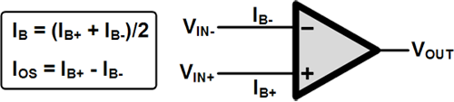
OFFSET CURRENT
The two bias be IB+ and IB-
In ideal case both bias currents are equal.
Practically they are not the same.
ie. IB+ - IB- = Ioffset

Slide 5
Offset current is the quantity that is given by most of the operational amplifier manufactures.
for 7 4 1 op amp. I offset current is equal to about 10 nano ampere
fet version available for 7 4 1, the offset current is 10 pi amps .
Offset current drift.

Slide 6
HOW TO REDUCE OFFSET CURRENT???
FET version of 741 Op-Amp.
By changing the resistance.

Slide 7
STILL PROBLEM EXISTS???????

Slide 8
Leakage current that is getting in to the PCB.
Much serious problem than offset current.
The leakage current in the PCB will introduce large error.
Leakage current exceed the input bias current
Purpose of low IB defeated.

Slide 9
HOW TO OVERCOME???
Mainly two methods:
1. Mounting Op-Amp on Teflon IC Socket.
2. Use of INPUT GUARDING

Slide 10
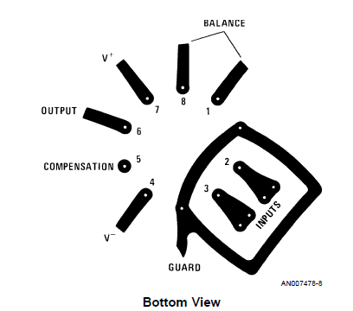
GUARD RING
Consist of a conductive ring.
Surrounds the inverting and noninverting terminals.

Slide 11
The guard ring has to have low impedance path to ground.
Leakage current on the surface of circuit board can exceed the input bias current of the amplifier.
For example, a circuit board resistance of 10¹²Ω from a 15V power supply pin to an input pin produces a current of 15pA.
To minimize surface leakage, a guard trace should completely surround the input terminals

Slide 12
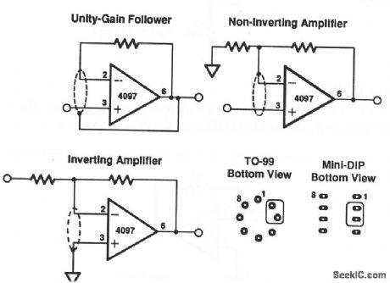

Slide 13
Guard ring should be equipotential bias
Act as shield against noise pick up.
consider the case of INSTRUMENTATION AMPLIFIER…….
In that case we consider CMRR
CMRR- Common Mode Rejection Ratio.
It is the rejection of unwanted noise signals.

Slide 14
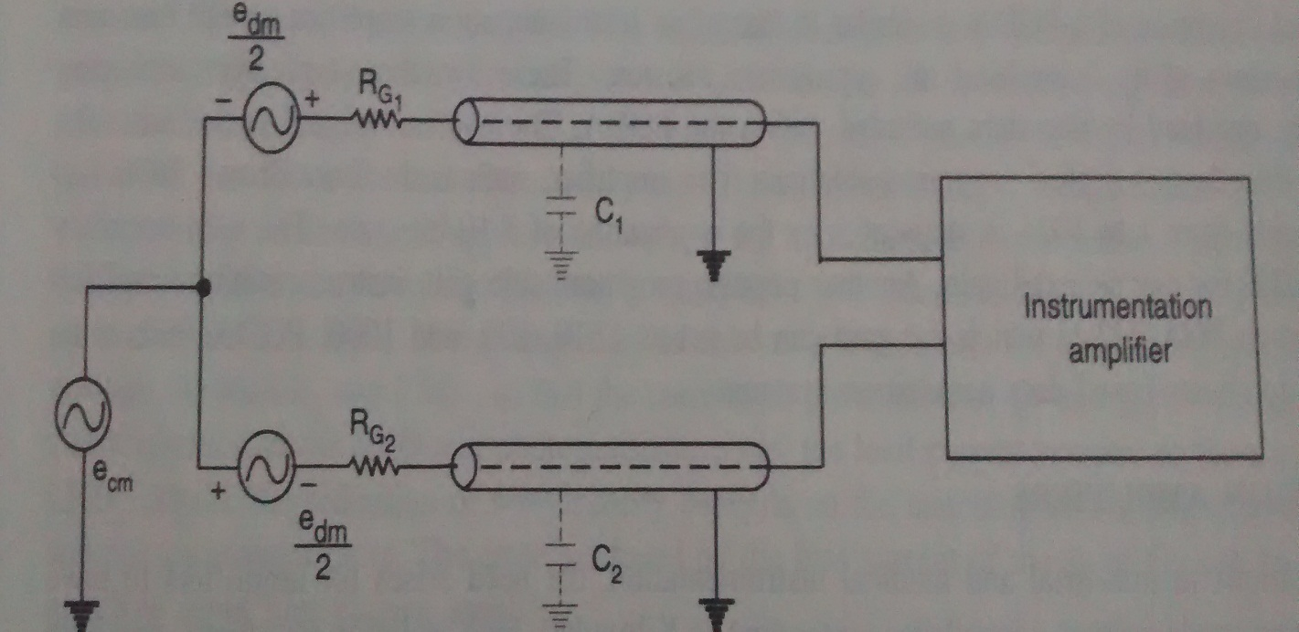
Instrumentation amplifiers have high CMRR
Gain for common mode signals is low compared to differential mode signals
In case RG1C1not equal to RG2C2
CMRR of the system deteriorates significantly.

Slide 15
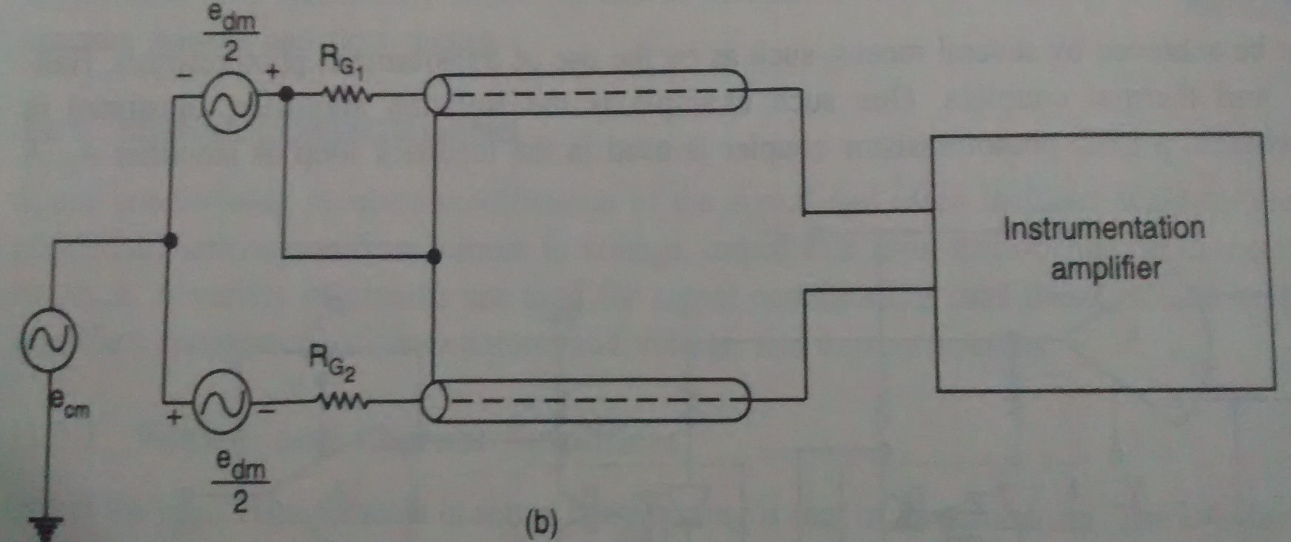
To alleviate this problem
cables should be preferably be connected to common mode signals.
signals reach input terminals unattenuated by capacitor.
Done when ecm is high.

Slide 16
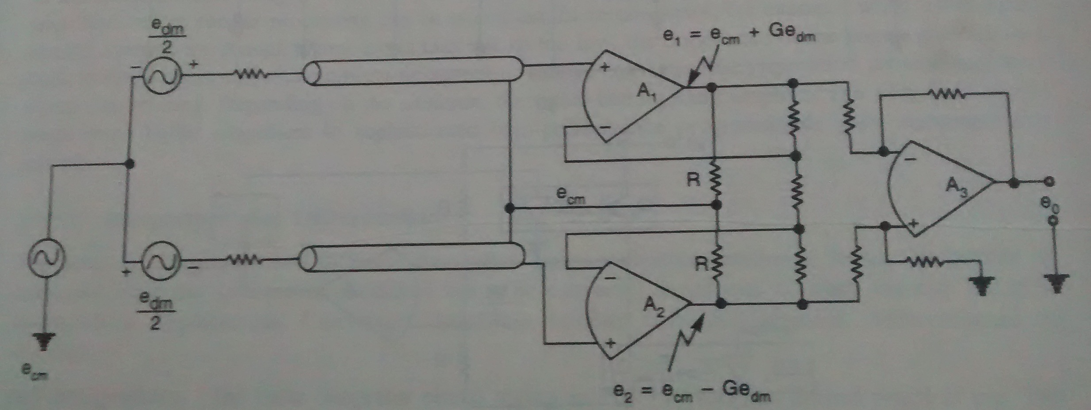
When common mode signal is not much larger as compared to differential mode signals….
Derive the common mode voltage as the average of two input signals.

Slide 17
ecm= ½(e1+e2)
e1 = ecm+Gedm
e2 = ecm-Gedm
when large shield capacitances are to be driven at high frequencies…..

Slide 19
NEED FOR INPUT GUARDING
Reduce the common mode capacitance
Improves the CMRR
Eliminates leakage currents

Slide 20
THANK YOU

