Slide 1
OPAMP DIFFERENTIATOR
AMRITA MARIAM VARGHESE
M13EE053
S₂ M.Tech. PE

Slide 2
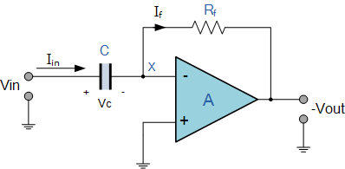
BASIC DIFFERENTIATOR
X_{c} is connected to the input terminal of the inverting amplifier while the resistor, R_{ƒ} forms the negative feedback
performs the mathematical operation of Differentiation
output is proportional to the input voltage’s rate-of-change with respect to time

Slide 3
BASIC CIRCUIT…..
At low frequencies the reactance of the capacitor is “High” resulting in a low gain ( R_{ƒ}/X_{c} ) and low output voltage from the op-amp.
At higher frequencies the reactance of the capacitor is much lower resulting in a higher gain and higher output voltage from the differentiator amplifier.
At high frequencies an op-amp differentiator circuit becomes unstable and will start to oscillate
To avoid this the high frequency gain of the circuit needs to be reduced by adding an additional small value capacitor across the feedback resistor R_{ƒ}.

Slide 4


BASIC CIRCUIT…..
Node voltage of the operational amplifier at its inverting input terminal is zero, the current, i flowing through the capacitor will be given as:
The charge on the capacitor ,
The rate of change of charge

Slide 5
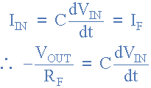

BASIC CIRCUIT…..
Voltage output for the op-amp differentiator,

Slide 6
DISADVANTAGES
Suffers from instability at high frequencies
The capacitive input makes it very susceptible to random noise signals and any noise or harmonics present in the source circuit will be amplified more than the input signal itself.
This is because the output is proportional to the slope of the input voltage so some means of limiting the bandwidth in order to achieve closed-loop stability is required

Slide 7
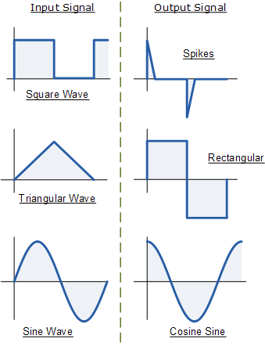
WAVEFORMS

Slide 8
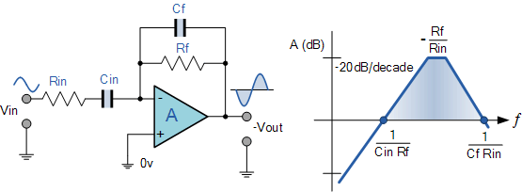
MODIFIED CIRCUIT

Slide 9
MODIFIED CIRCUIT…..
An extra resistor, R_{in} is added to the input
R_{in} limits the differentiators increase in gain at a ratio of R_{ƒ}/R_{in}.
Circuit now acts like a differentiator amplifier at low frequencies and an amplifier with resistive feedback at high frequencies.
Additional attenuation of higher frequencies is accomplished by connecting a capacitor C_{ƒ} in parallel with the differentiator feedback resistor, Rƒ
An active high pass filter

Slide 10
APPLICATION
The circuit is used in analogue computers where it is able to provide a differentiation manipulation on the input analogue voltage.
In process instrumentation,
  Here it can be used to monitor the rate of change of various points. If the measurement device returns a rate of change greater than a certain value, this will give an output voltage above a certain threshold and this can be measured using a comparator and used to set an alarm or warning indication.
Many signal conditioning applications where a differentiator may be required.

Slide 11
THANK YOU

