Slide 1
Stepper motor amplifier drive circuits
Presented by :-
Thasreef H R
Roll no: 17
S2 M.tech PE
MACE

Slide 2
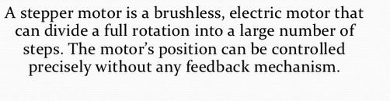
What is stepper motor?

Slide 3
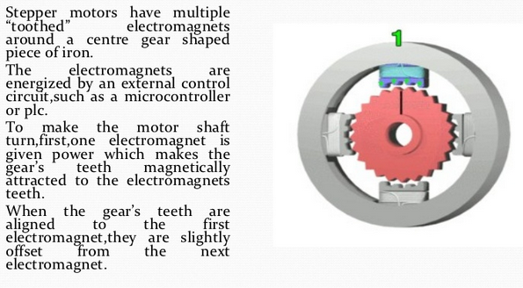
Operation principle

Slide 4
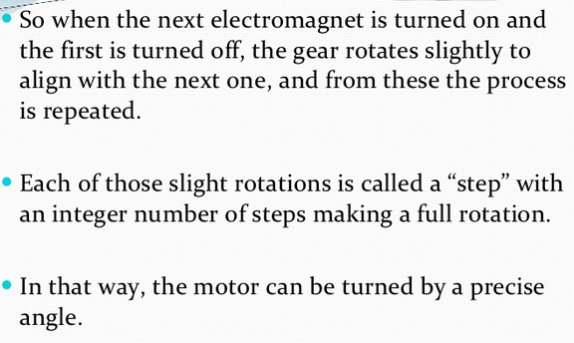

Slide 5
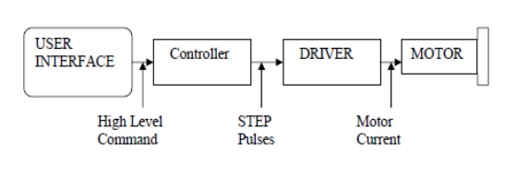
Basic control circuit.

Slide 6
Drive circuit schemes
Two major functions:-
1) To change the current and flux direction in the phase windings
2) To drive a controllable amount of current through the windings, and enabling as short current rise and fall times as possible for good high speed performance.

Slide 7
1) Flux direction control:-
Stepping of the stepper motor requires a change of the flux direction, independently in each phase.
The direction change is done by changing the current direction, and may be done in two different ways, using a bipolar or a unipolar drive.

Slide 8
Bipolar drive
Principle:- the current direction in one winding is changed by shifting the voltage polarity across the winding terminals. To change polarity a total of four switches are needed, forming an H-bride.
The bipolar drive method requires one winding per phase.

Slide 9
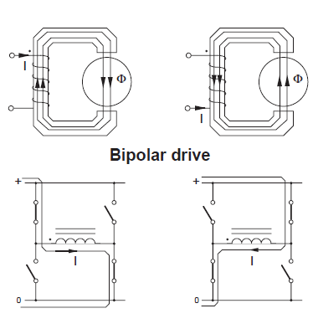

Slide 10
Unipolar drive
The uni polar drive principle requires a winding with a center-tap, or two separate windings per phase.
Flux direction is reversed by moving the current from one half of the winding to the other half.
This method requires only two switches per phase.

Slide 11
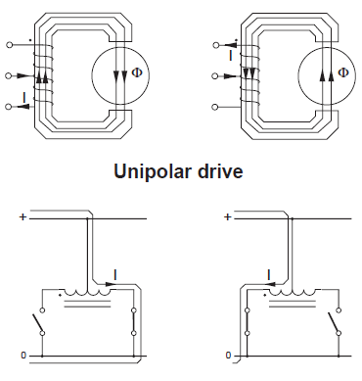

Slide 12
2) Current control
To control the torque as well as to limit the power dissipation in the winding resistance, the current must be controlled or limited
Two principles to limit the current are described here,
resistance limited drive(L/R drive)
the chopper drive.

Slide 13
Resistance limitation of the current (L ⁄ R drive).
For a given motor, high speed performance is increased by increasing the supply voltage.
(Rext) in series with the winding to limit the current to the previous level.
Im = Vsupply ⁄ ( R + Rext )
The time constant: te = L ⁄ ( R + Rext ) decreases, which shortens the current rise time.
Disadvantage of this method is the power loss in the additional external resistors.(2- 5W)

Slide 14
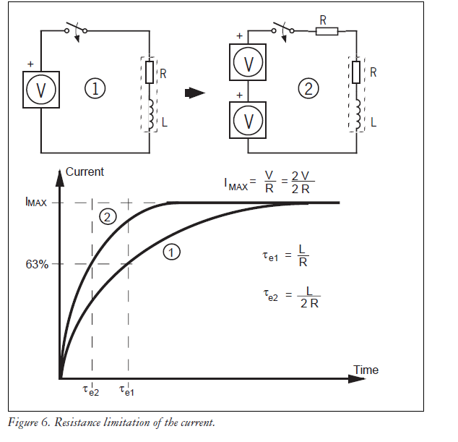

Slide 15
The bilevel L⁄R-drive
The bilevel L⁄R-drive provides a solution to the power waste using dropping resistors.
In the beginning of the current build-up period, the winding is connected to a secondary high voltage supply.
After a short time, when the current has reached its nominal level, the second level supply is disconnected.
Disadvantage is need of second level power supply.

Slide 16
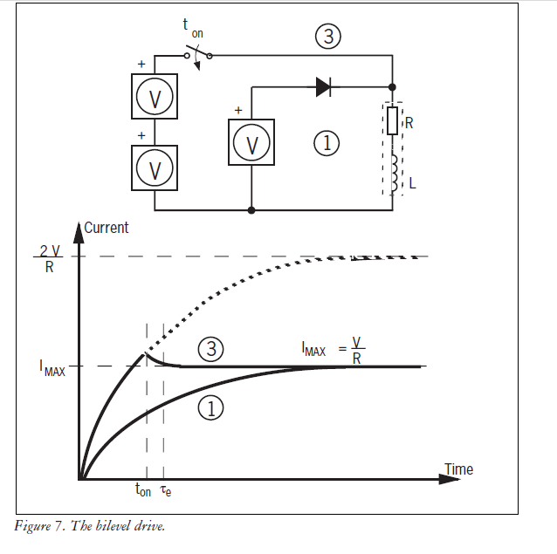

Slide 17
ii)Chopper control
The chopper driver provides an optimal solution both to current control and fast current build-up and reversal.
The basic idea is to use a supply voltage which is several times higher than the nominal voltage of the motor. The current rise rate, which initially is V ⁄ L, is thereby possible to increase substantially.
By controlling the duty cycle of the chopper, an average voltage and an average current equal to the nominal motor voltage and current are created.

Slide 18
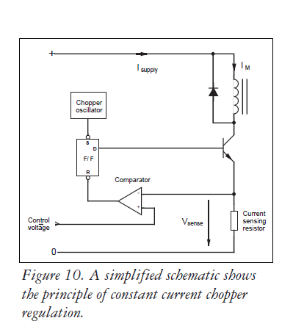

Slide 19
Constant current regulation :- is achieved by switching the output current to the windings.
This is done by sensing the peak current through the winding via a current-sensing resistor, effectively connected in series with the motor winding.
As the current increases, a voltage develops across the
sensing resistor, which is fed back to the comparator.
At the predetermined level, defined by the voltage at the reference input, the comparator resets the flip-flop, which turns off the output transistor.

Slide 20
The current decreases until the clock oscillator triggers the flip-flops, which turns on the output transistor again, and the cycle is repeated.
The advantage of the constant current control is a precise control of the developed torque, regardless of power
supply voltage variations.
It also gives the shortest possible current build-up
and reversal time.
Power dissipation is minimized, as well as supply current.
Supply current is not the same as the motor current in a copper drive.
It is the motor current multiplied by the dutycycle, at standstill typically , Isupply = IM · ( VM ⁄ Vsupply )

Slide 21
Figure shows an H-bridge configured
as a constant current chopper.
Depending on how the H-bridge is switched during the turn-off period, the current will either recirculate
through one transistor and one diode (path 2), giving the slow current decay, or re circulate back through the power supply (path 3).
The advantage of feeding the power back to the
power supply is the fast current decay and the ability to quickly reduce to a lower current level.

Slide 22
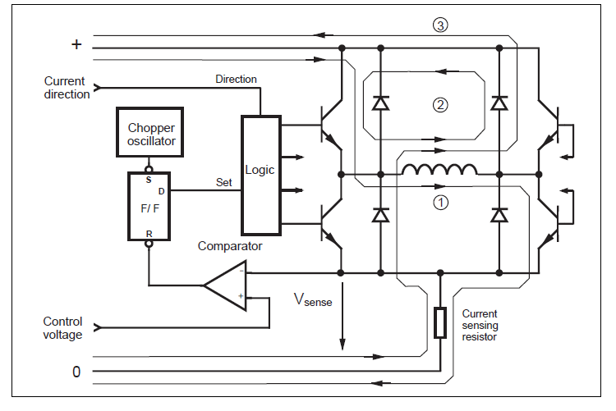
H-bridge constant current chopper

Slide 23
THANK YOU

