Slide 1
DC MOTOR DRIVES
ARYA RAVEENDRAN
ROLL NO:8
MACE

Slide 2
The DC drive is relatively simple and cheap
(compared to induction motor drives). But DC
motor itself is more expensive.
Due to the numerous disadvantages of DC motor (esp. maintenance), it is getting less popular, particularly in high power applications.
For low power applications the cost of DC motor plus drives is still economical.
For servo application, DC drives is still popular
because of good dynamic response and ease of control. The efficiency of the converter is usually greater than 98% and the overall efficiency of the D.C. drive plus the D.C. motor is about 90%.

Slide 3
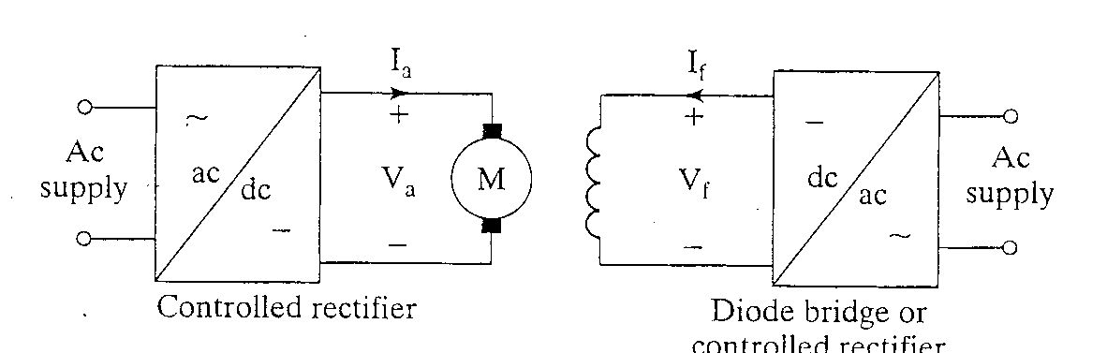
Controlled-Rectifier Fed Drive
Armature Field

Slide 4
Phase Controlled converter are
Simple
Less expensive
High power conversion efficiency

Slide 5
Types of DC motor Drive
Single Phase Half Controlled Drive
Single Phase Fully Controlled Drive
Three Phase Half Controlled Drive
Three Phase Fully Controlled Drive

Slide 6
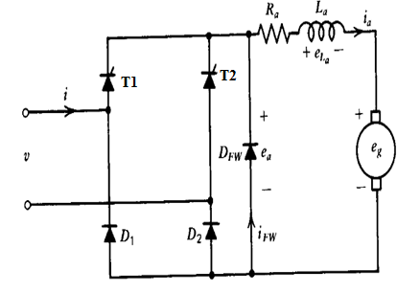
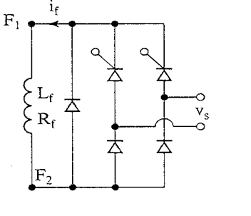
Single-Phase Half controlled Drive

Slide 7
Armature voltage is controlled by semiconverter.
T1 and T2 is triggered at a phase difference of 180⁰,alternatively.
D1 and D2 provides a path for the return current.
In the positive half cycle T1D2starts conduction at ωt = α. Output voltage is v
In the negative half cycle, T2D1 starts conduction at ωt = π+ α.

Slide 8
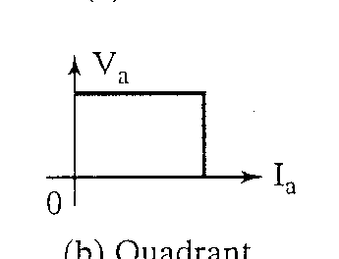
Provides one quadrant operation
Used upto 15 KW DC drives
Regenerative braking of the drive is not possible.
Provides higher input power factor .
Avg o/p voltage=Vm/ π [1+cos α ]

Slide 9
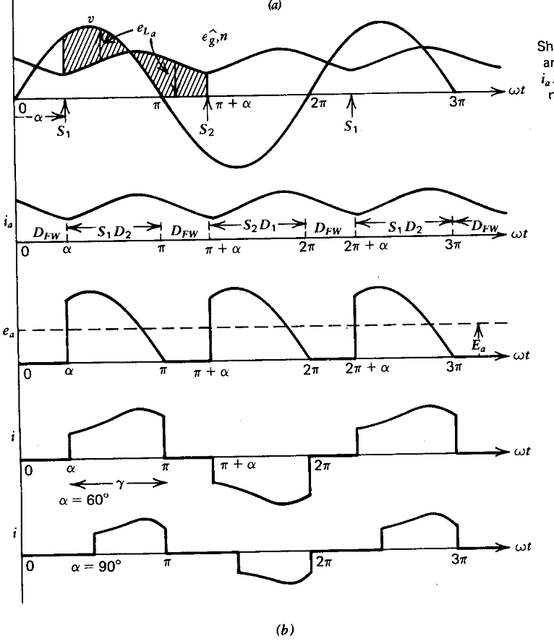
Voltage and current waveforms for continuous motor current

Slide 10
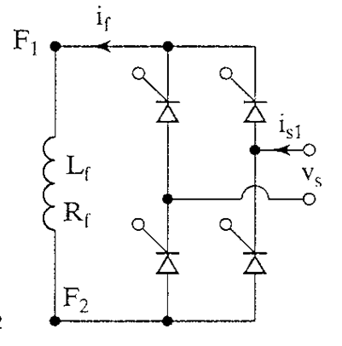
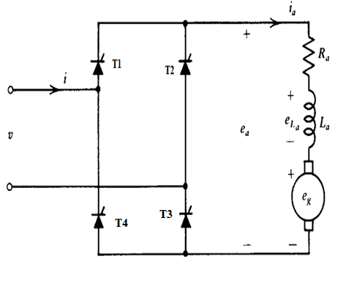
Single-Phase Fully-Controlled Drives

Slide 11
Thyristors T1 and T3are fired together in positive half cycle
T2 and T4 are fired 180º after T1and T2
For any load current to flow at least one thyristor from the top group (T1, T2) and one thyristor from the bottom group (T3, T4) must conduct.
neither T1T4 nor T2T3can conduct simultaneously

Slide 12
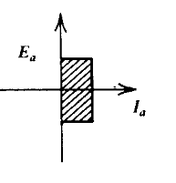
Its use is limited upto 15KW
Provides two quadrant operation
For firing angle0< α <90,operation is in 1 st quadrant ,gives motoring action
2 nd quadrant gives inverter action.(90< α<180)
Avg o/p voltage=2V/π[cosα]

Slide 13
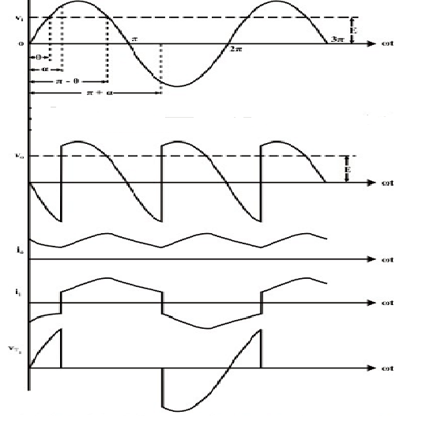
Voltage and current waveforms forms

Slide 14
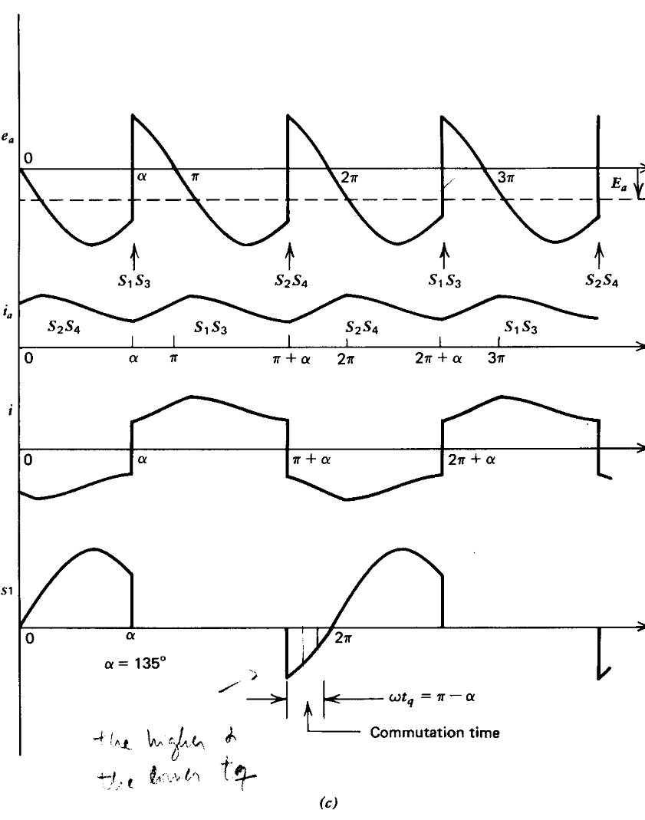
Waveforms for inverter operation

Slide 15
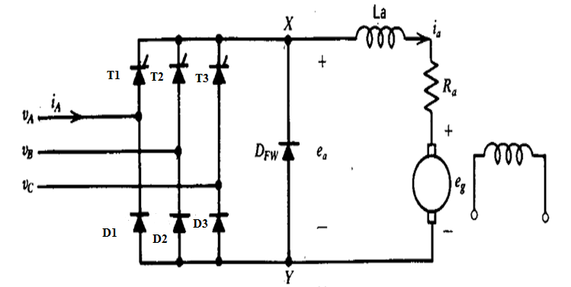
THREE PHASE HALF CONTROLLED DRIVE
THREE PHASE AC SUPPLY

Slide 16
Consists of 3 thyristor and 3 diodes
Each thyristor and diodes conduct for 120 degree
Diodes provide a return path for the current to the most negative line terminal
By adjusting the firing angle of SCR ,output voltage can be controlled.
In the continuous conduction mode only one thyristor from top group and only one diode from the bottom group conduct at a time

Slide 17
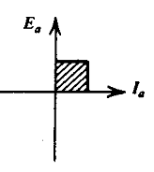
Drive offers one quadrant operation
Used upto 115 KW ratings
output voltage is periodic over one third of the input cycle
Avg o/p voltage=3Vml/2 π[1+cosα]

Slide 18
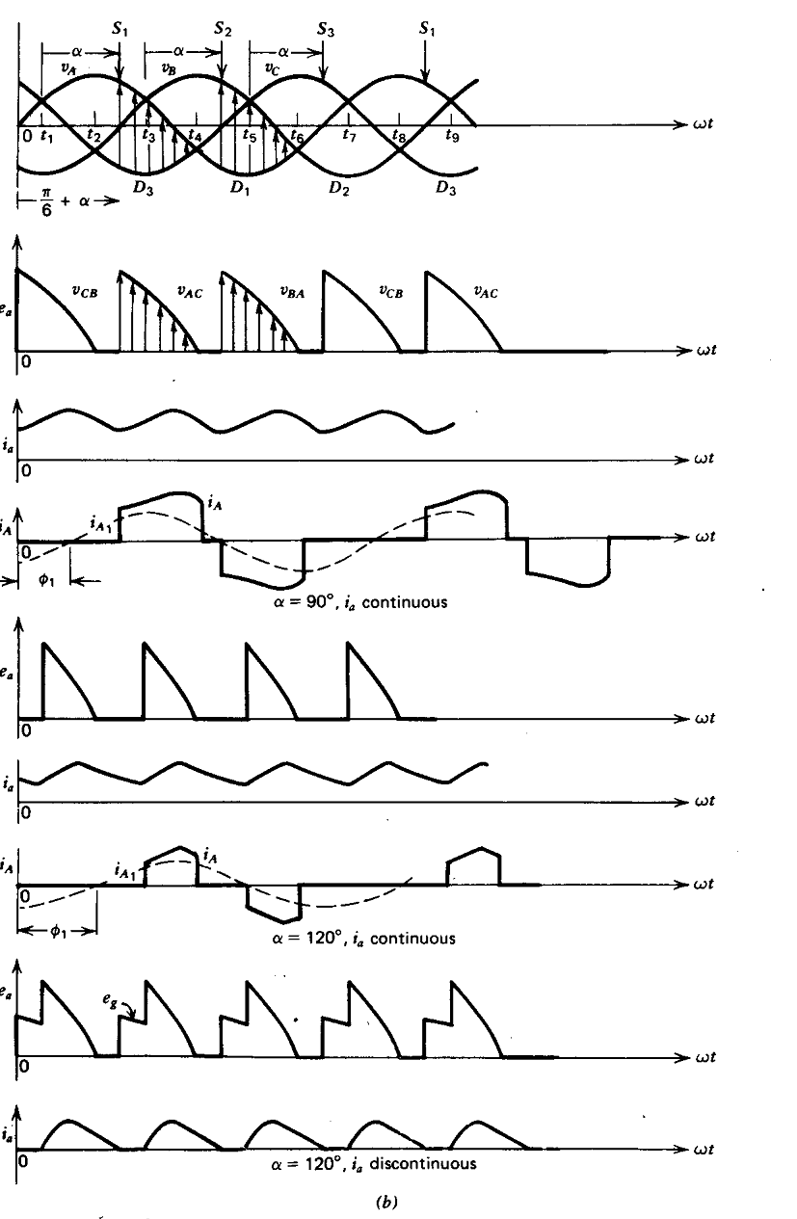
Waveforms

Slide 19
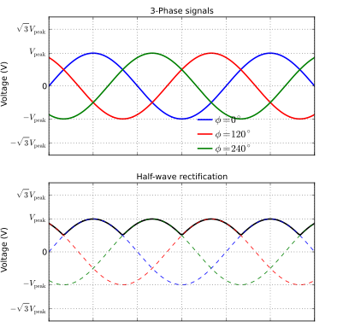
Output voltage waveform

Slide 20
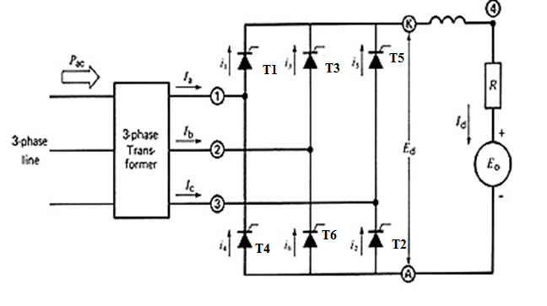
THREE PHASE FULLY CONTROLLED DRIVE

Slide 21
Offers two quadrant operation
Quadrant one gives motoring action
Quadrant two gives regenerative action
Used upto 1500 KW drives

Slide 22
Operation
Each thyristor conducts for 120° of the input cycle
the thyristors are fired in the sequence T1 →T2 →T3 →T4 →T5 →T6 →T1 with 60° interval between each firing
Thyristors on the same phase leg are fired at an interval of 180° and hence can not conduct simultaneously.
Six possible conduction mode for the converter in the continuous conduction mode of operation
These are T1T2, T2T3, T3T4, T4T5, T5T6, T6T1
The most common configuration is the full-wave, 6-pulse bridge because it produces less distortion on the DC side of the converter and has lower losses in the DC motor than a 3-pulse bridge

Slide 23
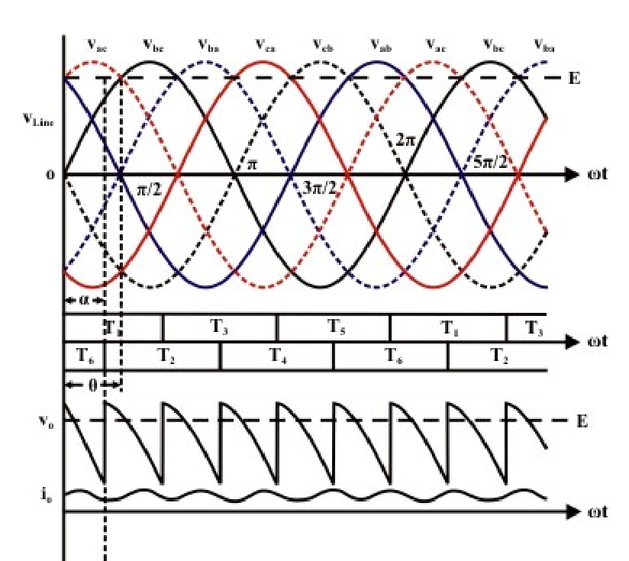
Waveforms

Slide 24
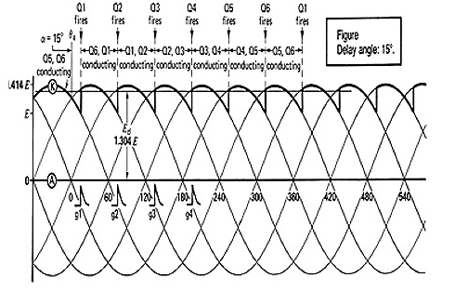

Slide 25
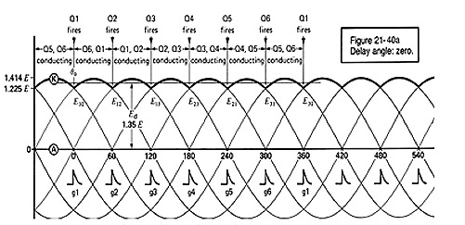

Slide 26
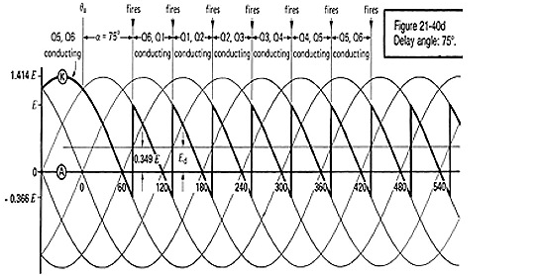

Slide 27
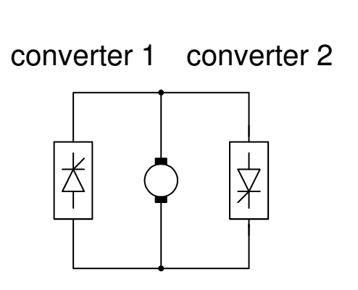
DUAL CONVERTER

Slide 28
Two converters are connected back to back
Offers four quadrant operation
Two functional modes-Non circulating mode and circulating mode

Slide 29
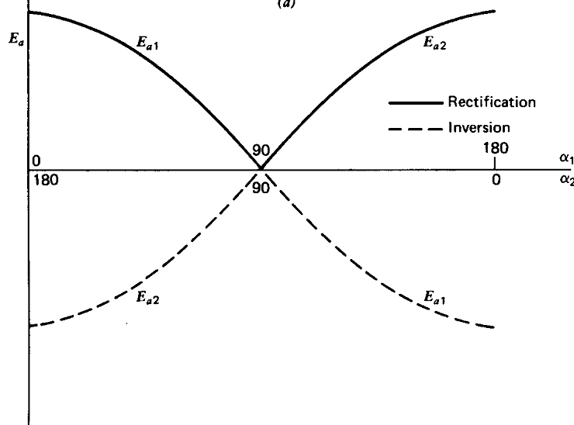
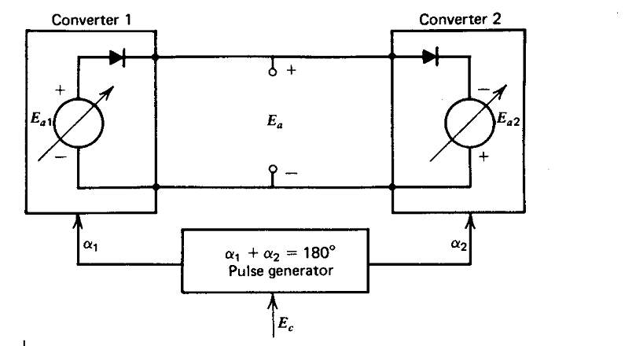
Ideal dual converter

Slide 30
Firing angle of both the converters are controlled in such a manner that their average output voltages are equal in magnitude and polarity
It happen only when one converter act as rectifier and other as inverter

Slide 31
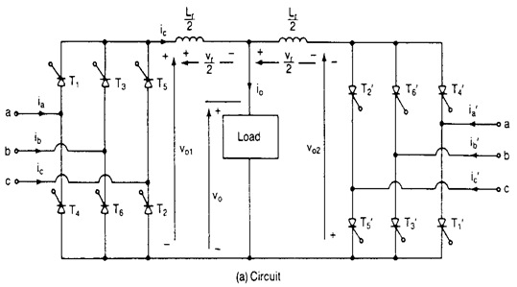
PRACTICAL THREE PHASE DUAL CONVERTER

Slide 32
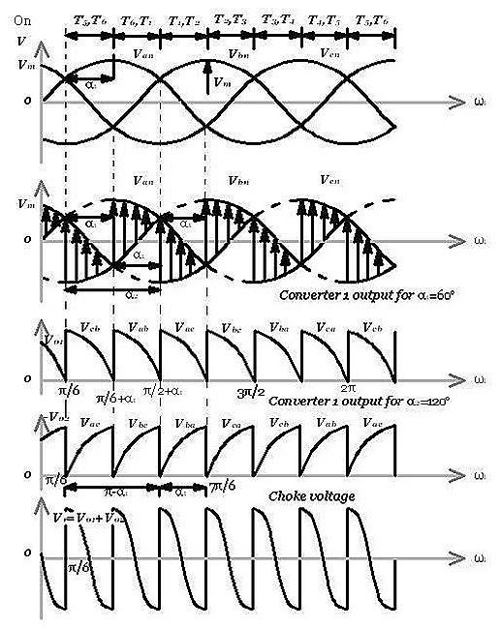
THREEPHASE DUAL CONVERTER WAVE FORMS

Slide 33
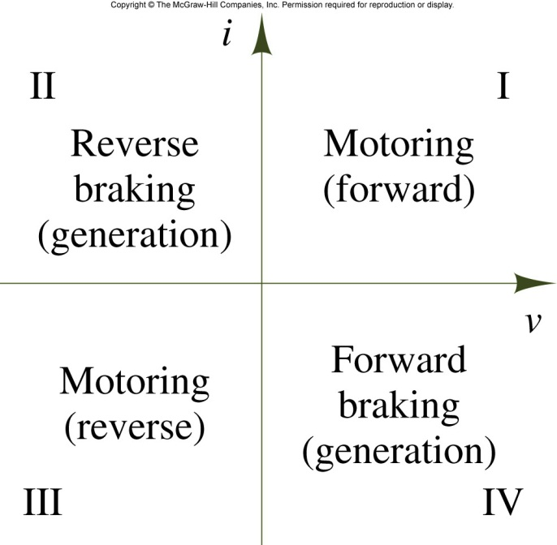
FOUR QUADRANT OPERATION

Slide 34
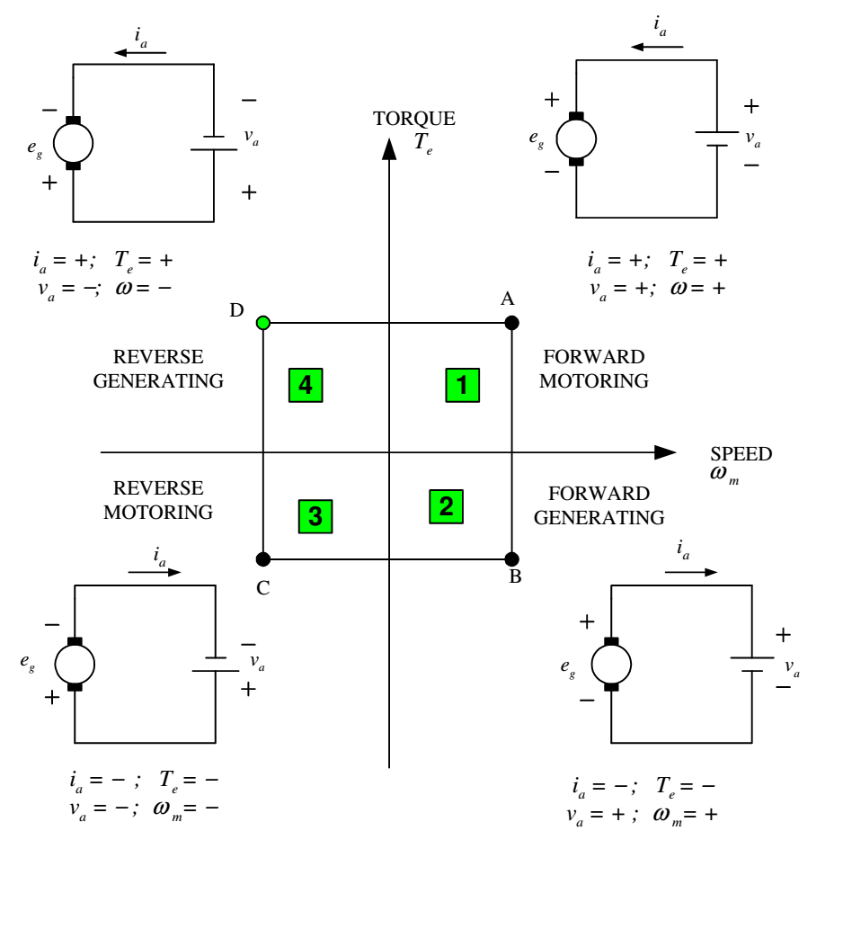

Slide 35
Applications
KBIC SCR Drrive-The KBIC Series of DC Drives consist of six models rated for 1/100 to 3 horsepower motors
KBMM SCR Drive-The KBMM Series of DC Drives consist of three models rated for 1/100 to 3horsepower motors. This chassis full-wave DC motor control is the ultimate in reliability and performance.

Slide 36
KBCC SCR Drive-The KBCC Series of DC Drives consist of two models rated for 1/100 to 3 horsepower motors.
These chassis drives utilize the KBMM speed control to provide a low-cost, reliable SCR drive.
Features include KBMM plus the Auxiliary Heat Sink and Barrier Terminal Block with a supplied AC line fuse and an Armature fuse holder.

Slide 37
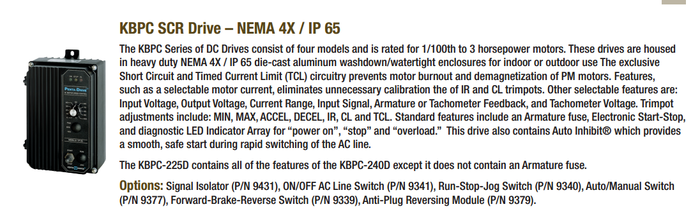

Slide 38
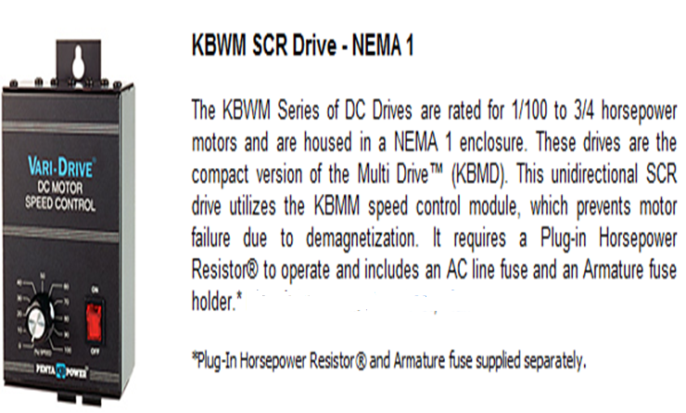

Slide 39
THANK YOU

