Slide 1
DC SERVOMOTORS
ANU RAVEENDRAN
ROLL NO:7

Slide 2
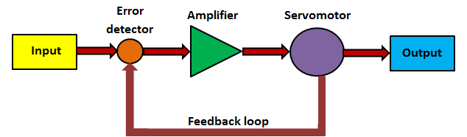
SERVOMOTOR
Motors used in automatic control systems
Servomechanism
Convert control voltage to angular movement.

Slide 3
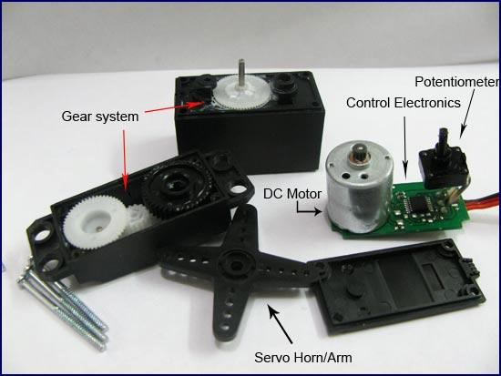
DC SERVOMOTOR
DC Servomotor consists of four components:-
a DC motor
a gear assembly
a position-sensing device
a control circuit.

Slide 4
DC SERVOMOTORS
ADVANTAGES
respond to error signal abruptly
the speed-torque relationship is linear.
Easier to control
Higher output
Easier speed control
High torque to inertia ratio.
Light weight , low inertia
Used for large power applications(machine tools and robotics)

Slide 5
Applications
For very high voltage power systems, dc motors are preferred because they operate more efficiently than comparable ac servomotor.
It also prevents power wastage, cooling process is easier.
DC servomotors are widely used in robots, toy cars and other position
controlled devices.
Widely used in radars, computers, robots, machine tools tracking system, process controllers etc .

Slide 6
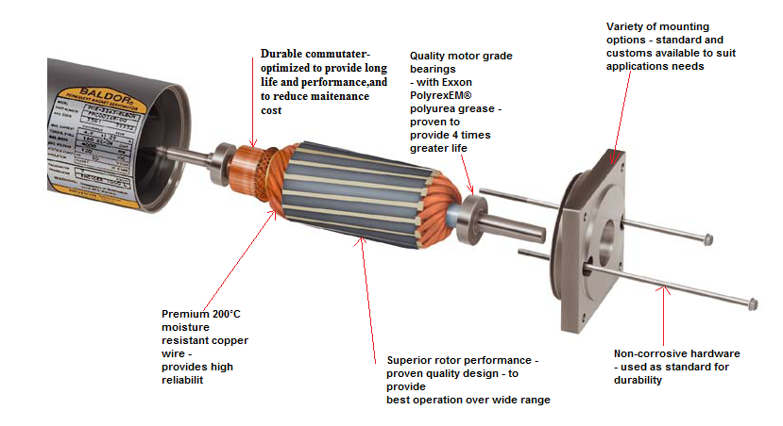
Baldor's DC Servo Motors

Slide 7
FEATURES
used in high performance industrial motion control applications
Quality servo grade bearings with Exxon
PolyrexEM® grease for longer life
Optimum selected copper-graphite brushes
for maximizing life
Variety of electrical winding for versatility in
your application needs
Variety of termination options to suit your
requirements
Variety of feedback devices
Stock and custom design available

Slide 8
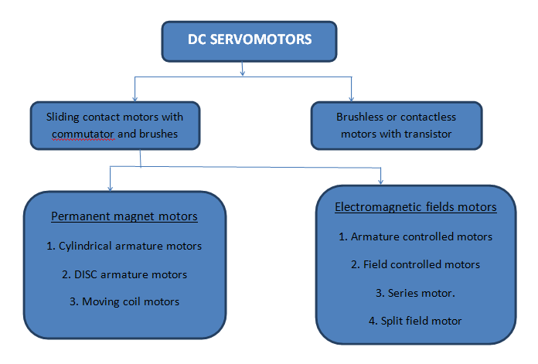
CLASSIFICATIONS

Slide 9
PERMANENT MAGNET DC MOTORS
Field winding replaced by permanent magnet
Economical for power rating upto a few kw
Armature is placed in the rotor and permanent magnet poles are fixed to the stator
Rotor employs a special type of construction(small diameter and longer axial length) to reduce the weight
Advntages:-
Simpler more reliable
Higher efficiency
Field flux is less effected by temperature rise

Slide 10
Less heating
More linear torque Vs speed curve
Higher power output at the same dimmension and temperature rise
Disadvatages:-
Magnets deteriorate with time
Demagnetised by large current transients

Slide 11
ELECTRO-MAGNETIC FIELD MOTORS
Economical for higher power rating
Similar to conventional dc motors
Features:-
Number of slots and commutator segment is large
Compoles and compensating are provided to eliminate sparking
Diammeter to length ratio is kept low
Oversize shafts are employed to withstand high torque stress
Eddy currents are reduced by lammination

Slide 12
Armature controlled dc motor
DC Shunt motor
Field is excited by constant dc supply
Speed is directly proportional to armature voltage
Torque directly proportional to armature current
Field controlled dc motor
Armature is supplied with a constant voltage or current
Torque is directly proportional to field flux

Slide 13
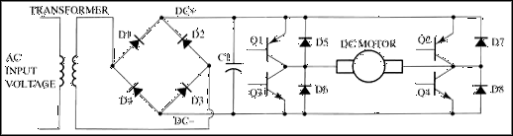
Four transistor servoamplifier
A rectifier is fed from the three phase ac line and delivers power into a dc bus
Buffer capacitor is thus working as generator and supplies electrical energy
Motor can be controlled selectively for clockwise or counterclockwise rotation

Slide 14
Four quadrant operation of motor is possible:-
(a) Forward running—quadrant I
(b) Reverse running—quadrant III
(c) Forward braking—quadrant II
(d) Reverse braking—quadrant IV

Slide 15
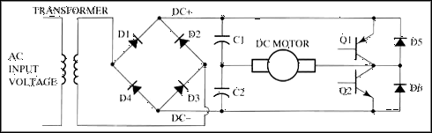
Two transistor Servoamplifier
This amplifier uses two transistors and two capacitors
The base of each of the power transistors is controlled by a switching circuit.
The amount of bias voltage to the transistor base will increase or decrease to change the speed of the motor.

Slide 16
THANK YOU

