Slide 1
HYBRID STEPPER MOTOR
Rosemary Mathai
No.15

Slide 2
INTRODUCTION
Although all electric machines have the same basic principle of operation, special-purpose machines have some features that distinguish them from conventional machines.
Some of these devices find applications in computer peripheral equipment or in process-control systems whereas others can be used in devices such as home appliances.
For example, step motors are employed extensively in computers where precise positioning is required, as in the case of a magnetic head for a disk drive.

Slide 3
Stepper motor
Electromechanical device which converts electrical pulses into discrete mechanical movements.
Each step causes the shaft to rotate a certain number of degrees.
A step angle represents the rotation of the output shaft caused by each step, measured in degrees.
Stator
Rotor

Slide 4
Types of stepper motor
Permanent Magnet stepper motor
Variable Reluctance stepper motor
Hybrid Stepper motor

Slide 5
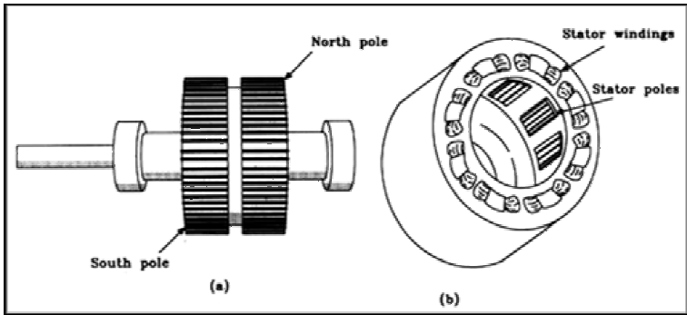
Permanent magnet(PM) stepper motor
Rotor- permanent magnet
Stator – stationary electromagnets
operates on the reaction between a permanent-magnet rotor and an
electromagnetic field.
Typical step angles- 7.5 to 15 degrees
(a)Rotor (b)stator

Slide 6
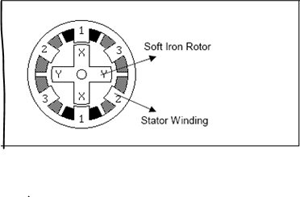
Variable Reluctance(VR) stepper motor
Stator –electromagnet
Rotor- piece of soft iron
As the rotor does not have a permanent
magnet it spins freely i.e. it has no detent
torque.
The electromagnet produced by activating
stator coils in sequence, attracts the metal bar towards the minimum reluctance position.

Slide 7
How a stepper motor works?
Works on the principle of electromagnetism.
There is a soft iron or magnetic rotor shaft surrounded by the electromagnets.
When the stators are energized the rotor moves to align itself along with the stator(in case of a permanent magnet type) or moves to have a minimum gap with the stator(in case of variable reluctance stepper).

Slide 8
Terminology
Holding torque: The amount of torque required to move the rotor one full step with the stator energized.
When no power is applied to the windings, a small magnetic force is developed between the permanent magnet and the stator. This magnetic force is called a residual, or detent torque.
Step angle is defined as the minimum degree of rotation with a single step.

Slide 9
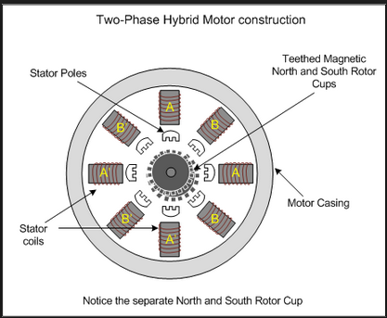
Hybrid(HB) stepper motor
Construction of permanent magnets becomes very complex below 7.5degrees.
Combines the principles of permanent
magnet and variable reluctance motor.
Stator core structure same as PM motor.
Rotor is cylindrical and magnetized like
PM motor with multiple teeth like VR
motor.
Step angle as small as 0.9 degrees.

Slide 10
        The teeth on the rotor provide an even better path which helps guide the magnetic flux to preferred locations in the air gap.
Step angles range from 0.9 to 3.6 degrees.
Hybrid motors have a smaller step angles compared to the permanent magnet motor, but they are expensive.
In low cost application, the step angle of a permanent magnet motor is divided into smaller angles using better control techniques.
PM and HB motors are more popular than the VR motor.

Slide 11
Relation between number of stator and rotor teeth
  No. of rotor teeth= N_{r}
  No. of stator teeth= N_{s}
  No. of poles/phase=P
  N_{r}=q*N_{s} +(P/2)
  Where q is an integer.

Slide 12
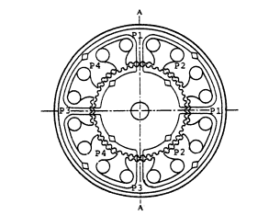
Hybrid stepper motor
For the configuration shown,
The stator is wound 2 phase, hence P=(8/2)=4
  if N_{r}=50 ,then N_{S}=48
  (q=1)

Slide 13
When to use a stepper motor?
Good choice whenever a controlled movement is required.
Can be used where you need to control rotational angle, speed, position & synchronism.

Slide 14
Advantages
Can operate in open loop control system.
Simplicity of construction.
The rotation angle of the motor is proportional to the input pulse.
Disadvantages
Require a dedicated control circuit.
Use more current than D.C. motors.

Slide 15
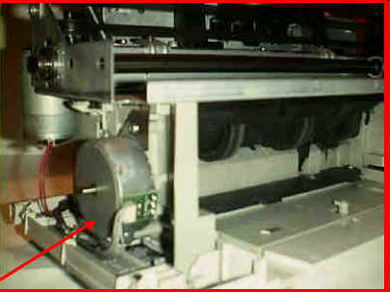
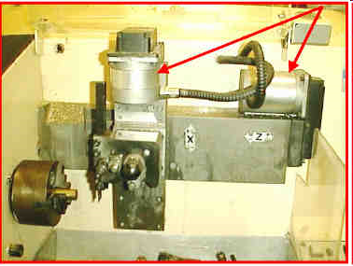
Stepper motor applications
1)Paper feeder on printers
2)CNC lathes
Stepper motor
Stepper motor

Slide 16
THANK YOU

