Slide 1
INTEGRATOR
AKHILJITH P J
ADMISSION NO: M13EE106
S2 M.Tech. POWER ELECTRONICS

Slide 2
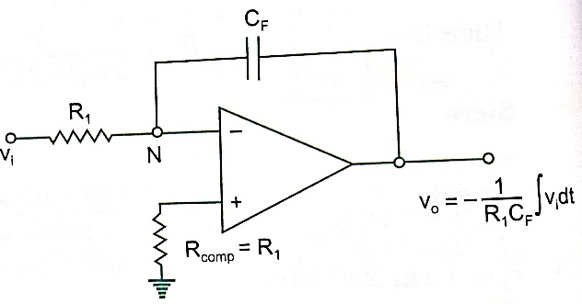
BASIC CIRCUIT
Integrators are used for signal conditioning

Slide 3
Since the inverting terminal is at virtual ground.
Applying KCL at inverting terminal
i₁+i₂ = 0

Slide 4
The output voltage proportional to the integral of input voltage
RC is the time constant of integrator
Also known as inverting integrator
Rcom =R₁ for minimizing i/p bias current

Slide 5


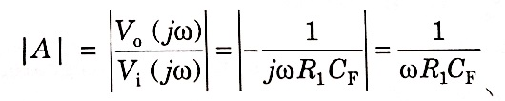
Analysis Of Ideal Integrator

Slide 6
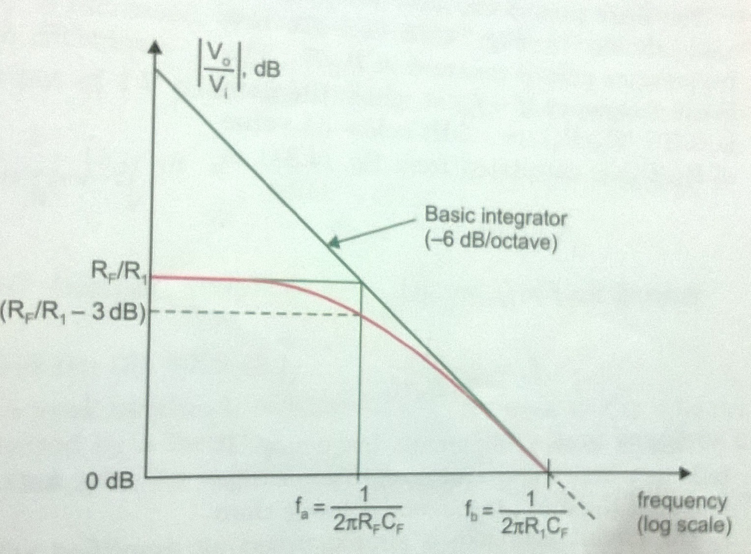
Bode plot of basic integrator

Slide 7
f_{b} is the frequency at which gain of the integrator is zero
F_{b} = 1/2πR₁C_{f}
At lower frequency the capacitor act as an open circuit, resulting an infinite gain
Gain of integrator decreases with increasing frequency

Slide 8
Limitations of ideal integrator
Ideal integrator is used for a very small frequency range
Offset and bias current contribute an error voltage at the output
Output voltage saturates at lower frequency

Slide 9
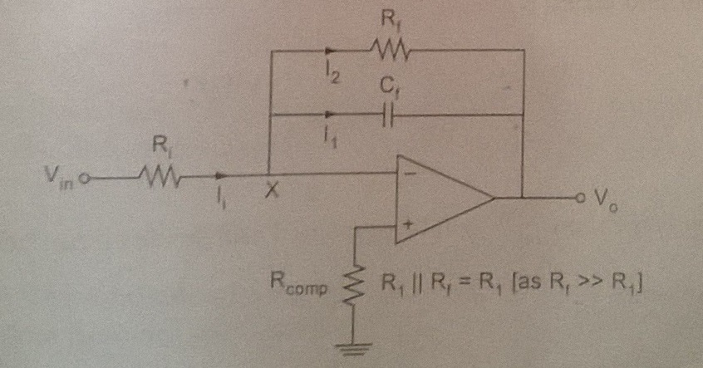
Practical Circuit

Slide 10
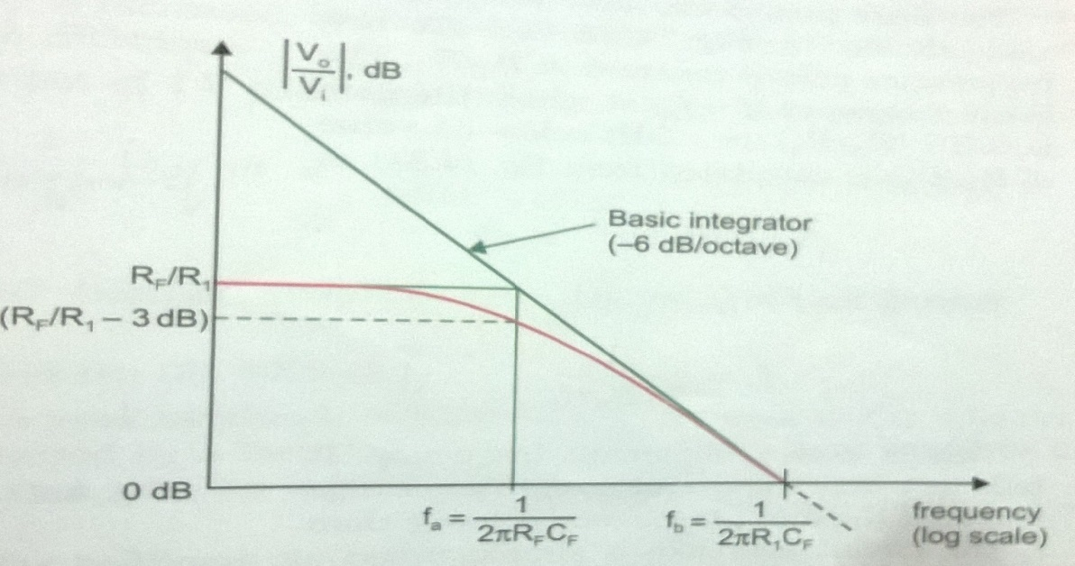
Practical circuit also known as lossy integrator
The resistor R_{f} limits the low frequency gain to -R_{f}/R₁
Bode plot of lossy integrator

Slide 11



Analysis of Practical Integrator

Slide 12
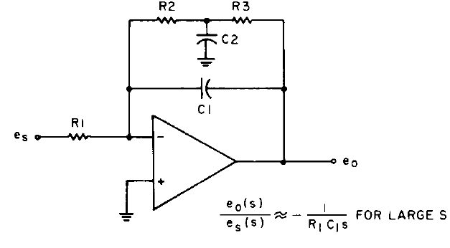
INTEGRATOR WITH REDUCED DC ERROR

Slide 13
In order to reduce the DC error high feedback is provided
The lowest frequency which can be accurately integrated is limited by the capacitor C₂
The general expressions for corner frequencies are obtained by trial and error method
The lowest signal frequency ω_{s} should be at least ten times greater than ω₂.

Slide 14
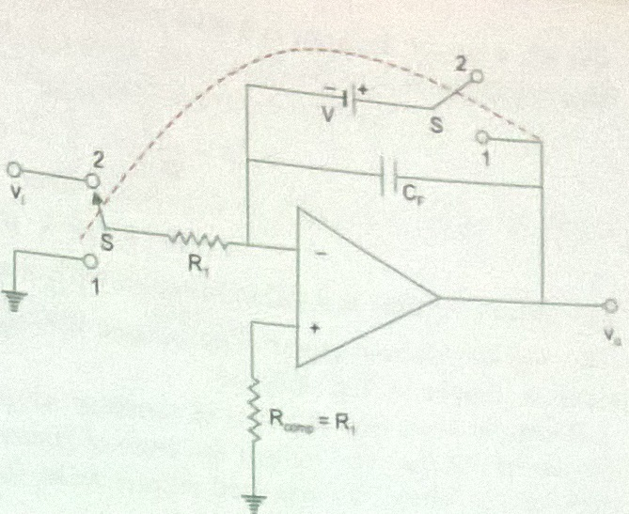
Initial conditions of integrator

Slide 15
An integrator is provided with an external circuit to introduce initial conditions
Switch at position 1 gives initial output voltage V₀
Switch at position 2 gives integrator output
Capacitor should have low leakage , usually teflon, polystrene are used

Slide 16
Applications
In analogue computers
In analogue to digital converters
Various signal wave shaping devices
Ramp generator

Slide 17
THANK YOU

