Slide 1
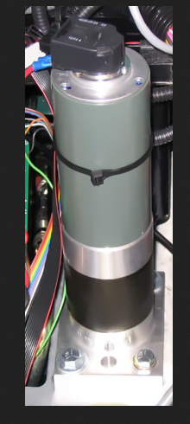
AC SERVO MOTOR
PRESENTED BY,
EDWIN BASIL LAL
ROLL NO – 10
POWER ELECTRONICS

Slide 2
What is SERVO MOTOR ?
A servomotor is a rotary actuator that allows for precise control of angular position, velocity and acceleration.
Servomotors are used in applications such as robotics, CNC machinery or automated manufacturing.

Slide 3
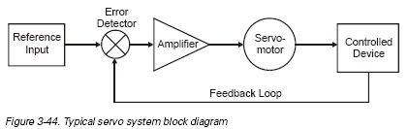
PRINCIPLE OF OPERATION

Slide 4
BLOCKS FUNCTION
REFERENCE INPUT
ERROR DETECTION
AMPLIFIER
SERVO MOTOR
CONTROLED DEVICE

Slide 5
AC SERVO MOTOR
2 phase induction motor
small diameter, low inertia, and high-resistance rotors
The high-resistance rotor- linear speed/ torque characteristics and accurate control.

Slide 6
An AC servomotor is designed with two phases set at right angles to each other.
A fixed or reference winding is excited by a fixed voltage source.
The control winding is excited by a variable voltage source.
same voltage per turns ratio.

Slide 7
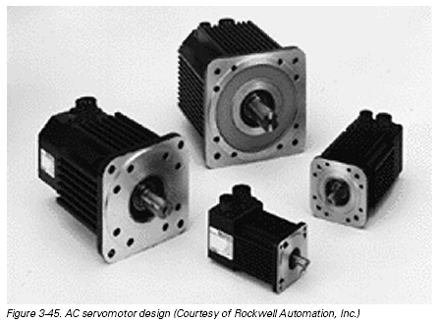
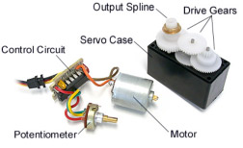
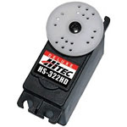
HS-322HD

Slide 8
How is the servo controlled?
Servos are controlled by sending an electrical pulse of variable width, or pulse width modulation (PWM), through the control wire.
A servo motor can usually only turn 90 degrees in either direction for a total of 180 degree movement.
The servo motor expects to see a pulse every 20 milliseconds (ms) and the length of the pulse will determine how far the motor turns

Slide 9
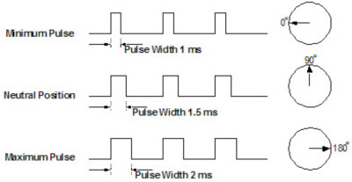
PULSES

Slide 10
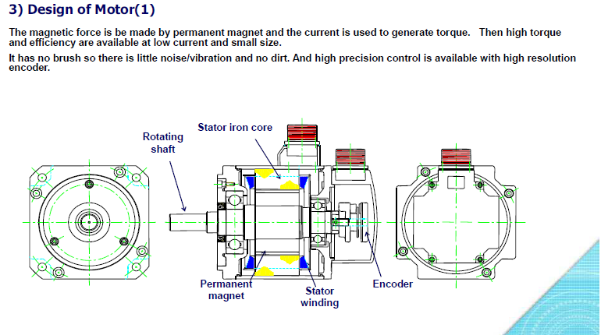
CONSTRUCTION

Slide 11
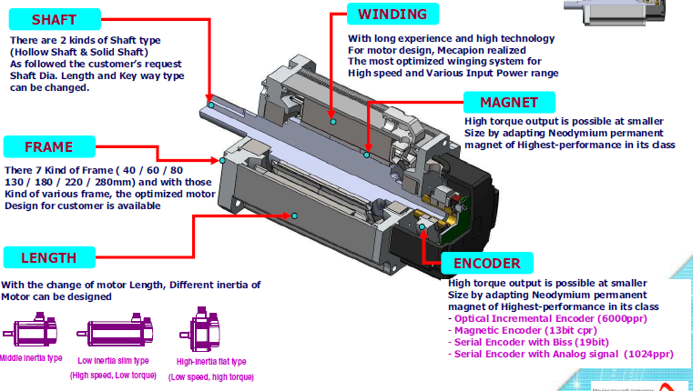
CHARACTERISTICS

Slide 12
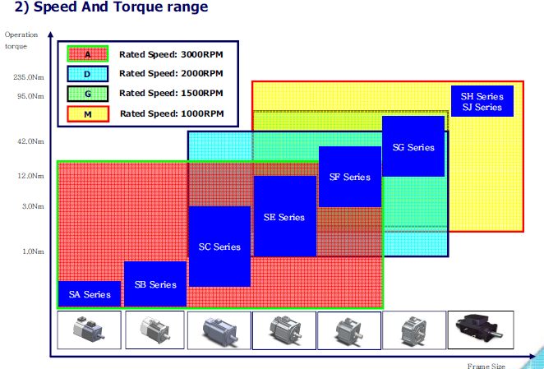
INDUSTRIAL APPLICATION

Slide 13
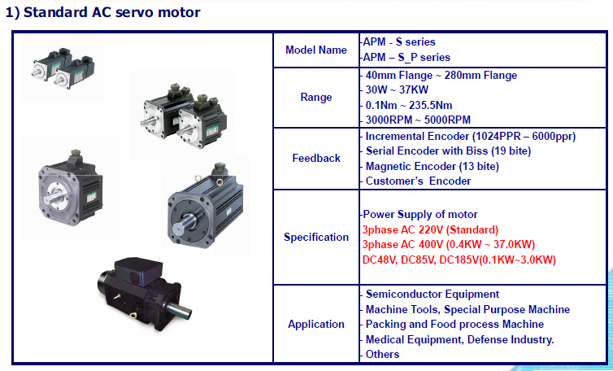

Slide 14
APPLICATION
AC motors are in widespread use today, both in the industrial and commercial HVAC markets.
Servos are used in radio-controlled airplanes to position control surfaces like elevators, rudders, walking a robot, or operating grippers. Servo motors are small, have built-in control circuitry and have good power for their size.

Slide 15
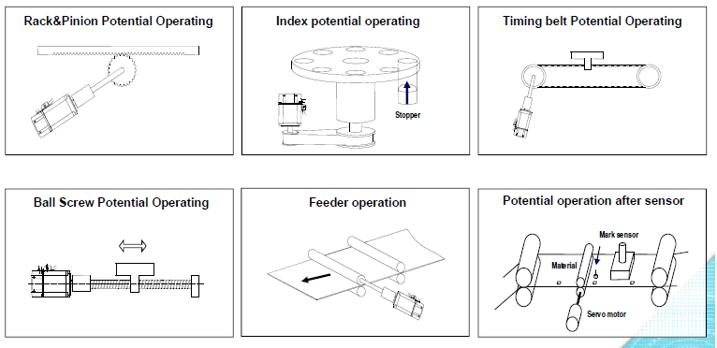
INDUSTRIAL APPLICATION

Slide 16
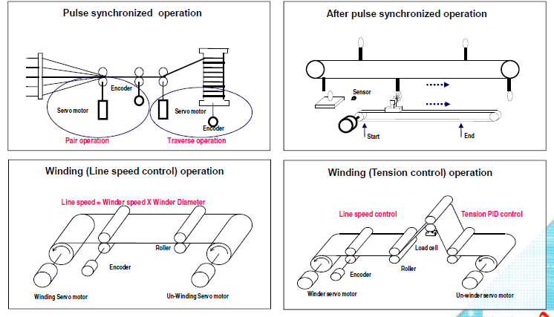

Slide 17
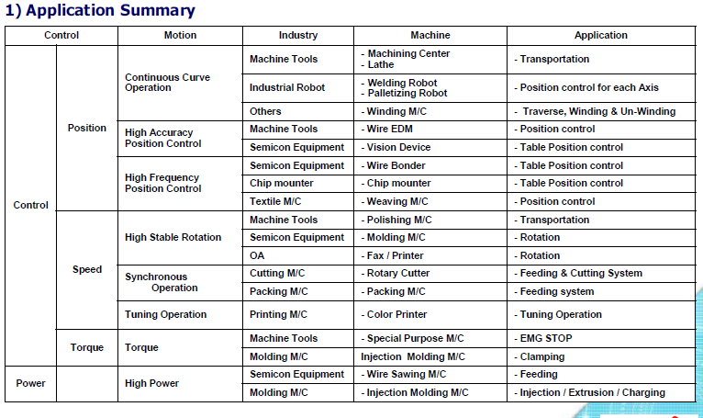

Slide 18
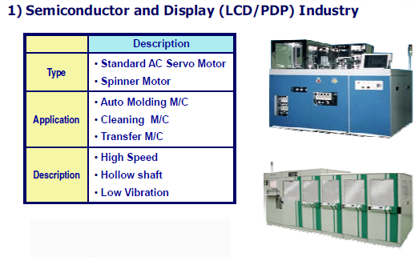
AC SERVO MOTOR SUCCESS ?

Slide 19
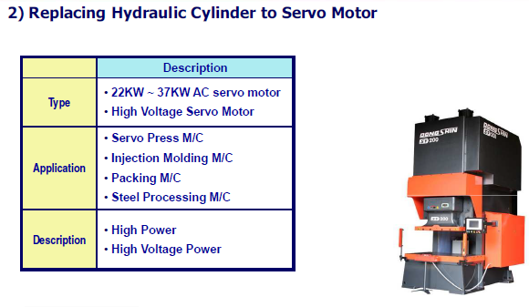
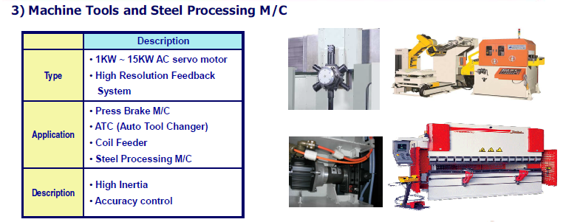

Slide 20
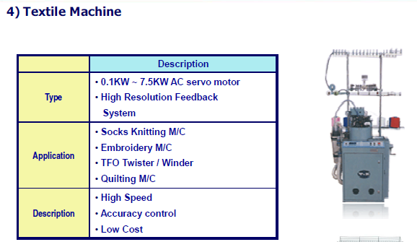
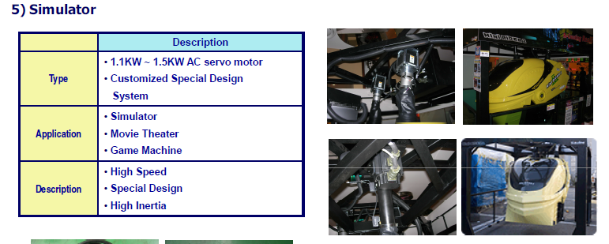

Slide 21
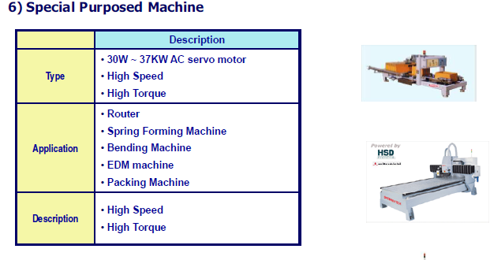
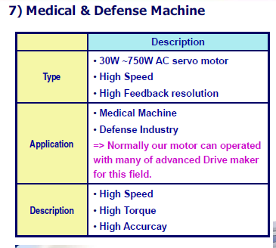
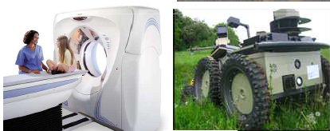

Slide 22
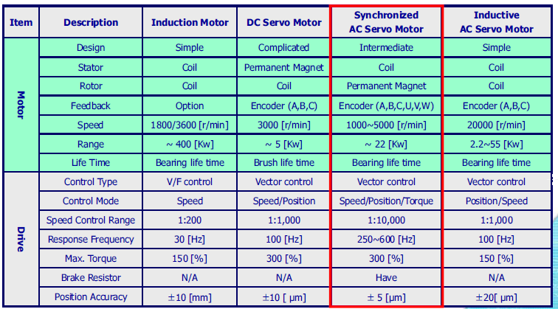
COMPARISON

Slide 23

DESIGN OF AC SERVO MOTOR

Slide 24
THANK YOU

