Slide 1
KEIL

Slide 2
INTRODUCTION
Founded in 1982 by Günter and Reinhard Keil.
Initially as a German GbR.
In April 1985 the company was converted to Keil Elektronik GmbH.
Implemented the first C Compiler.
In October 2005, Keil were acquired by ARM

Slide 3
Broad range of tools:
        ANSI C compiler
        macro assemblers
        debuggers and simulators
        Linkers
        IDE
        library managers
        real-time operating systems and evaluation boards for Intel 8051, Intel MCS-251, ARM

Slide 4
KEIL uVISION3
Popular IDE from Keil Software
KEIL combines
      Project Management
      Source Code Editing
      Program Debugging
      Flash Programming in a single, powerful environment

Slide 5
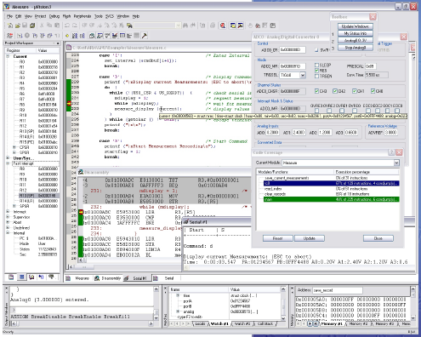
INTERFACE

Slide 6
μ Vision3 Features
Project Management, Device Setup, and Tool Configuration.
Editor facilities for Creating, Modifying, and Correcting Programs.
Target Debugging or CPU & Peripheral Simulation

Slide 7
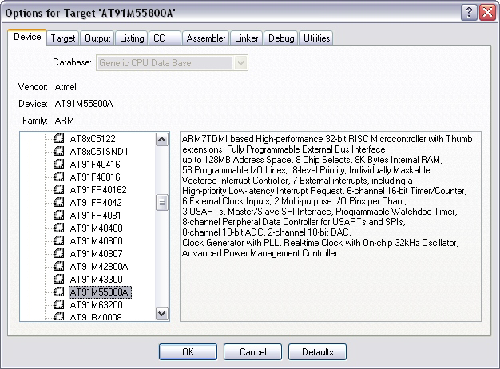
Project Management
Ensures easy and consistent Project Management.

Slide 8
Contd…
Open Project... loads existing project files.
New Project... allows you to create your
own projects.

Slide 9
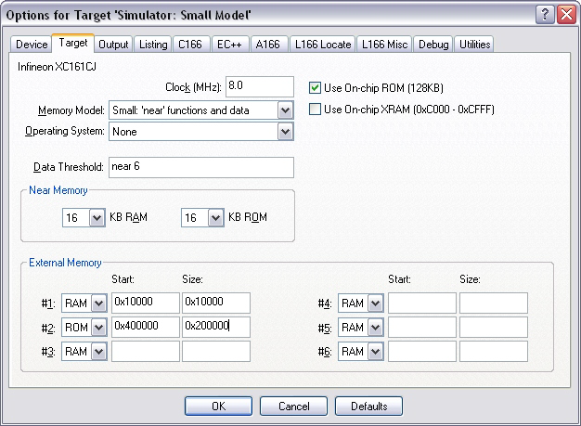
Development Tool Options

Slide 10
Contd…
Device: Allows you to view and change the selected target CPU.
Target: Allows you to specify CPU and memory options.
Output/Listing: Allow you to configure the generated object and listing files.
Compiler/Assembler/Linker: Allow you to view and change Vision3 allows you to set tool options.
Debug: Allows you to configure the Vision3 Simulator and Debugger.
Utilities: Allows you to configure project specific tools (like Flash programming).

Slide 11
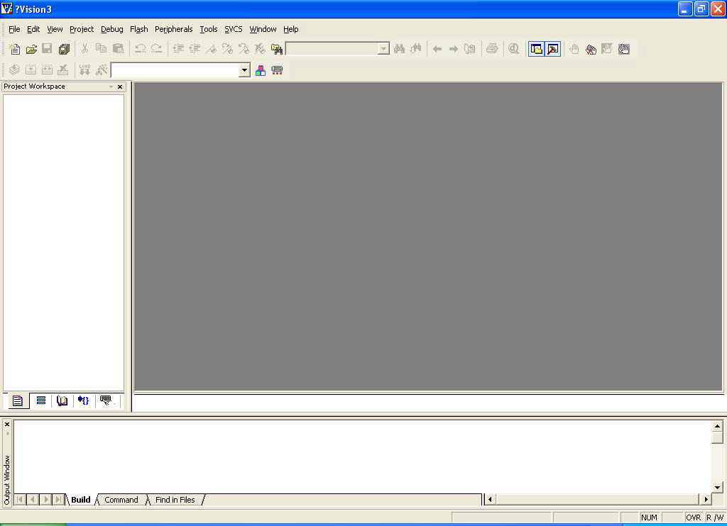
Create Project File
Open program Keil uVision3

Slide 12
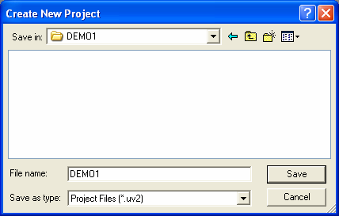
2. Create new Project File by using command Project → New Project

Slide 13
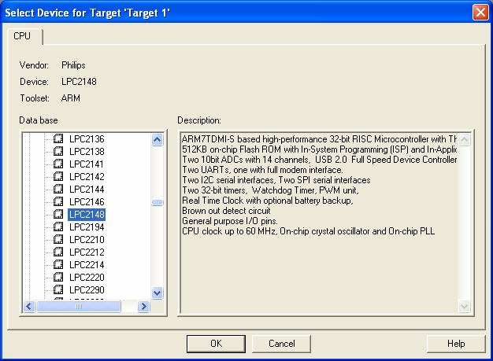
3. Select the microcontroller

Slide 14
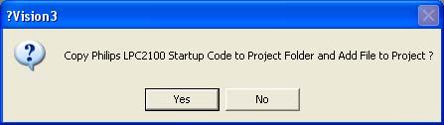
4. In the command prompt window click NO.

Slide 15
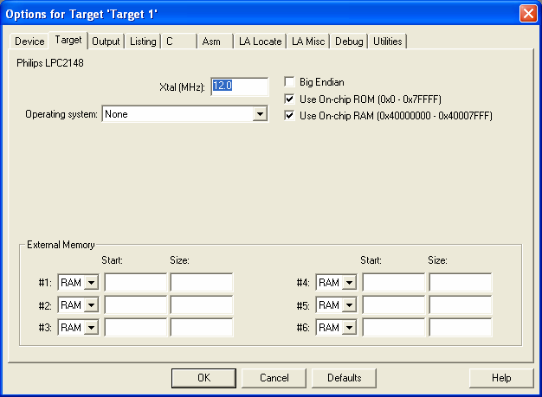
5. Configure Option value of Project File by using command Project → Option for Target ’Target 1’

Slide 16
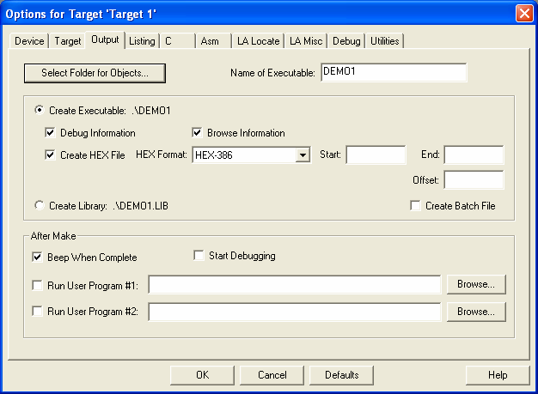
6. To get .HEX file
OUTPUT→ Check CREATE HEX FILE

Slide 17
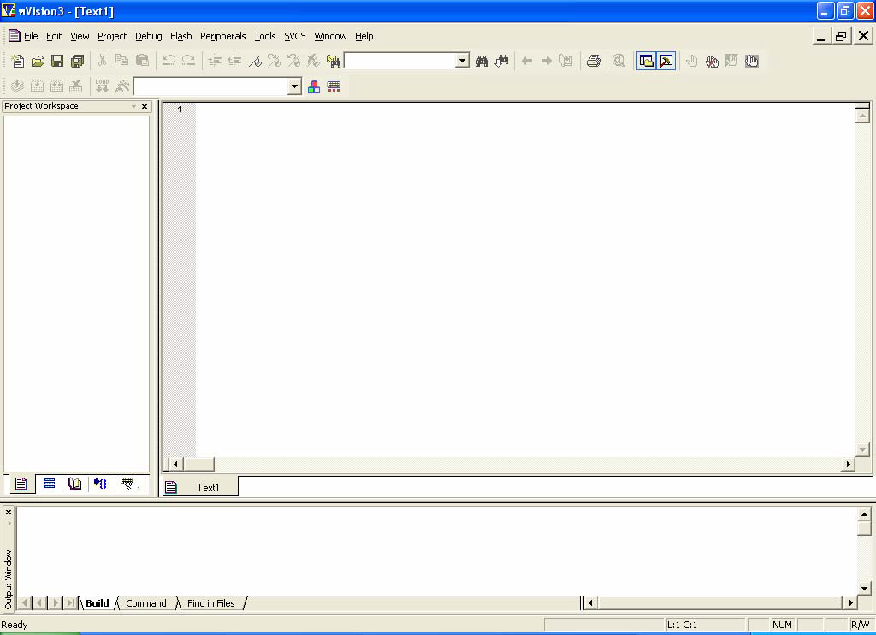
7. Start writing C Language Source Code, click command File → New

Slide 18
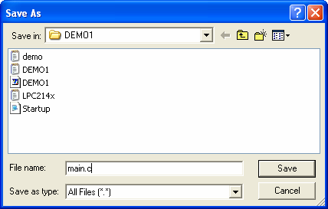
8. After writing the program save the file as File → Save As with .c extension for C programming or .asm for Assembly language

Slide 19
9. Add Files into Project File, click command Project → Components, Environment, Books…, select Tab Project Components and then select desired Add File to add into Project File.

Slide 20
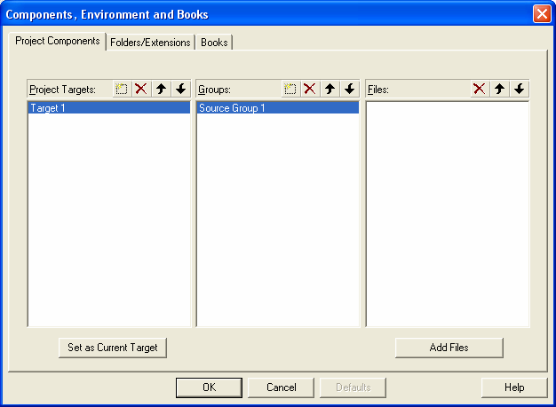

Slide 21
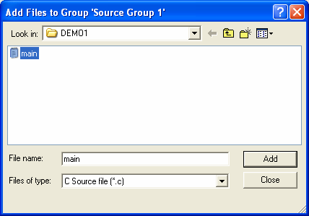
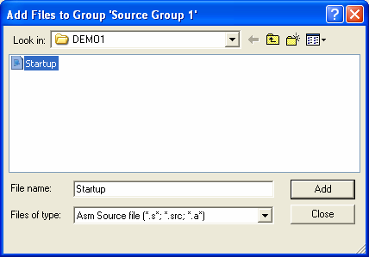

Slide 22
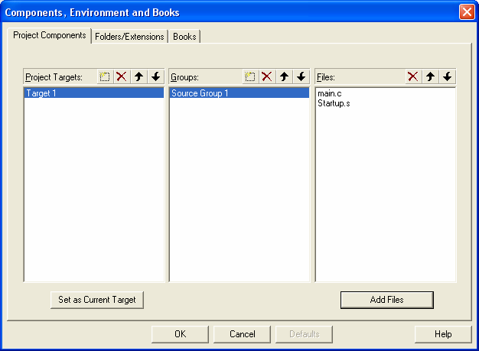

Slide 23
10. Command to interpret the written program, click commandProjects → Rebuild all target files.
11. HEX file will be obtained at the source folder location.

Slide 24
Project Development Cycle
Create source file in C or Assembly
Compile or Assemble source files
Correct errors in source files
Link object files from compiler & assembler
Test linked application.

Slide 25
GENERATE HEX FILE

Slide 26
EMBEDDED C PROGRMMING USING KEIL

