Slide 1
C I Engine Combustion chambers

Slide 2
Two types
Direct-injection diesels inject into the combustion chamber formed in the top of the piston.
For indirect injection, the combustion chamber is a separate chamber formed in the head.

Slide 3
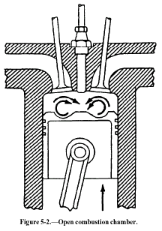
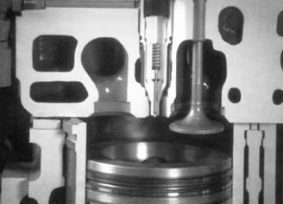
Direct Injection (open combustion chamber)
cylinder heads with a flat face
The combustion chamber is formed in the top of the piston
S.A/Volume ratio low – to reduce heat loss
No heater plugs
Rough running.
Shallow depth, hemispherical, cylindrical ,toroidal
requires a higher injection pressure and a greater degree of fuel atomization
very susceptible to ignition lag
low speed engines

Slide 4
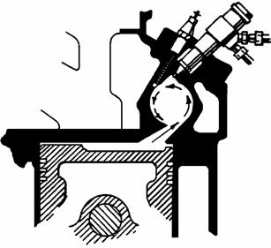
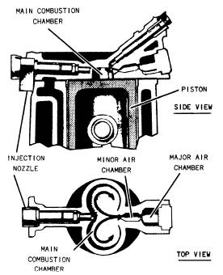
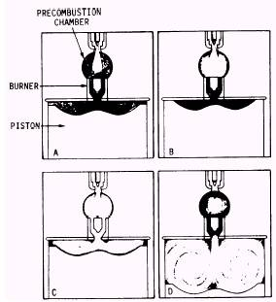
Indirect injection Combustion chambers
SWIRL CHAMBER TYPE
AIR – CELL (ENERGY CELL )TYPE
PRE-COMBUSTION CHAMBER TYPE

Slide 5
Indirect injection Combustion chambers
Two or more independent chambers connected by restricted passages.
the piston is fairly flat, or has a shallow cavity
The main combustion chamber is between the cylinder head and the top of the piston
a smaller, separate chamber is in the cylinder head
Fuel is injected into this smaller chamber
Pre chamber - Air cell chamber
During the compression stroke of the engine, air is forced into the pre-combustion chamber
combustion begins in the pre-combustion chamber
The entering mixture hits the hollowed-out piston top- creats turbulence in the chamber to ensure complete mixing of the fuel charge with the air-mixing ensures even and complete combustion
is not very susceptible to ignition lag
suitable for high-speed operations
low fuel injection pressures

